Slide 1


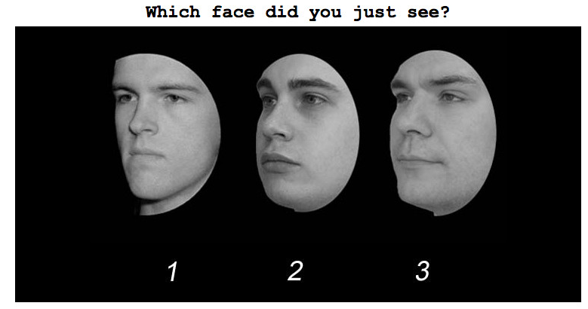

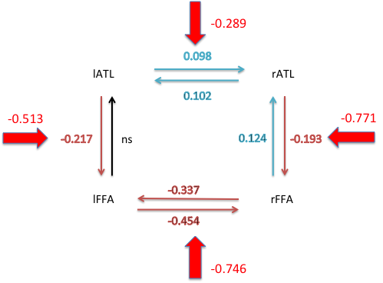

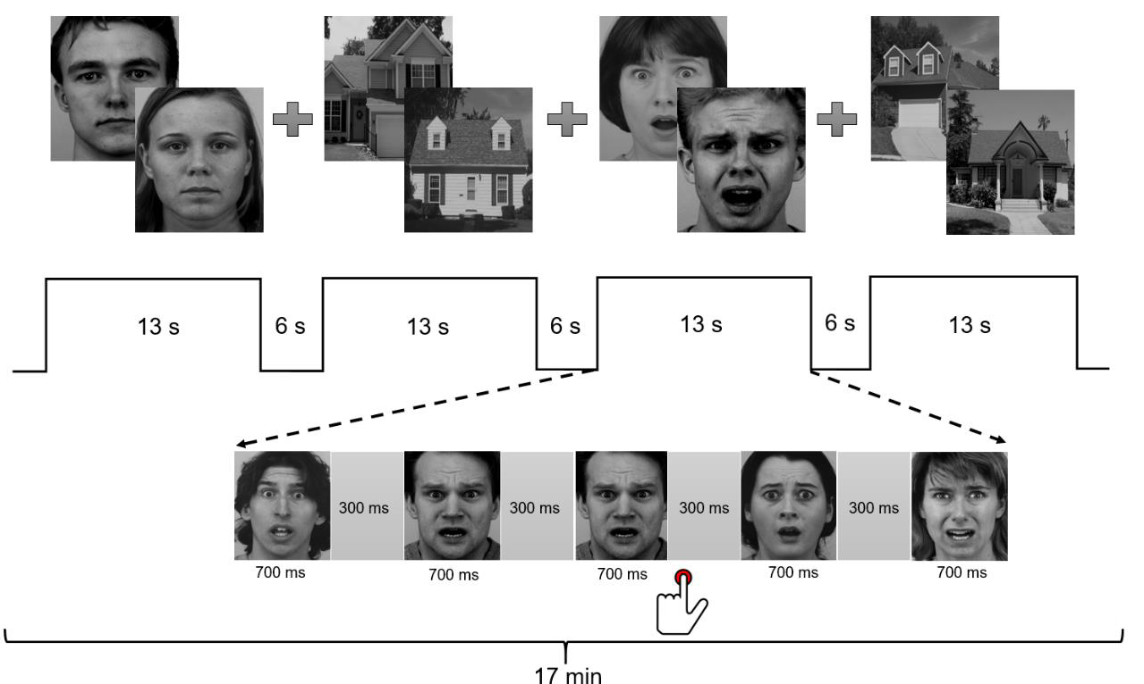


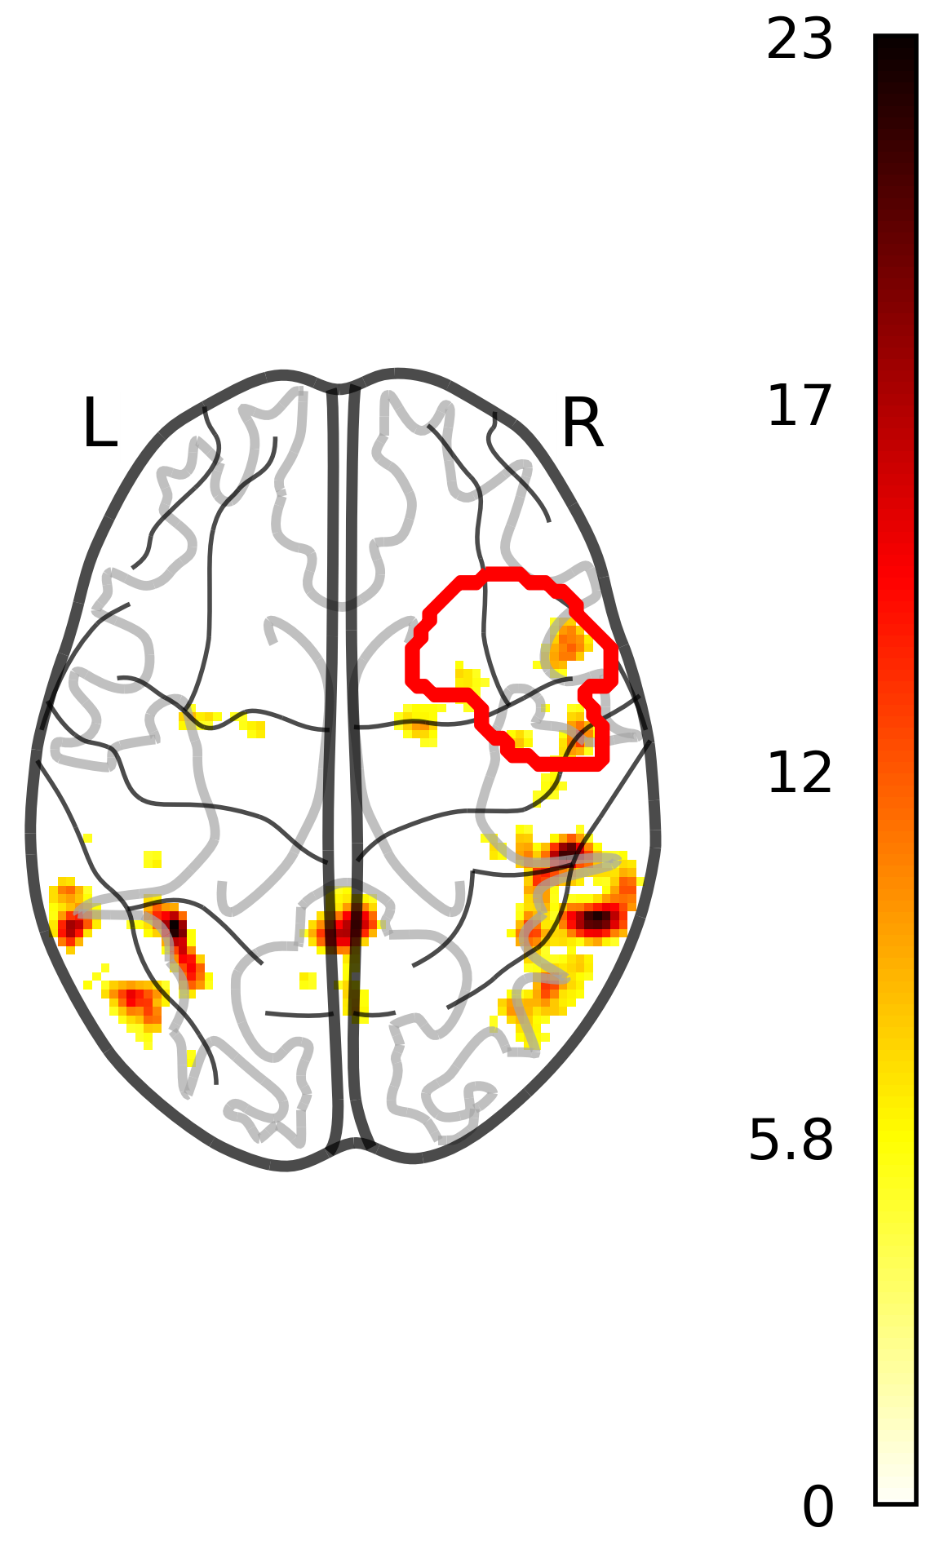
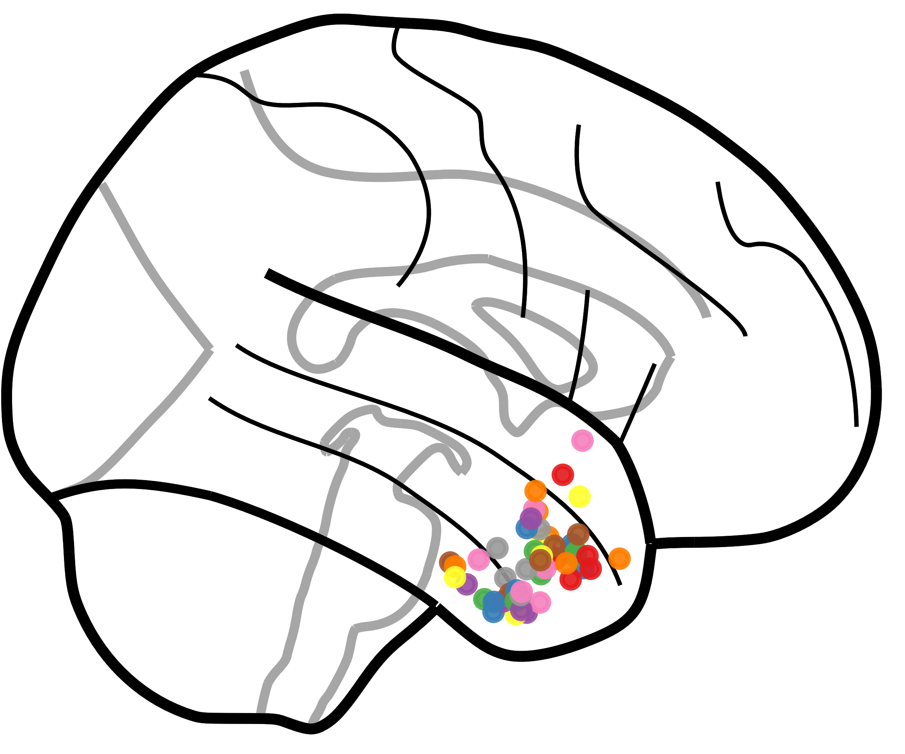
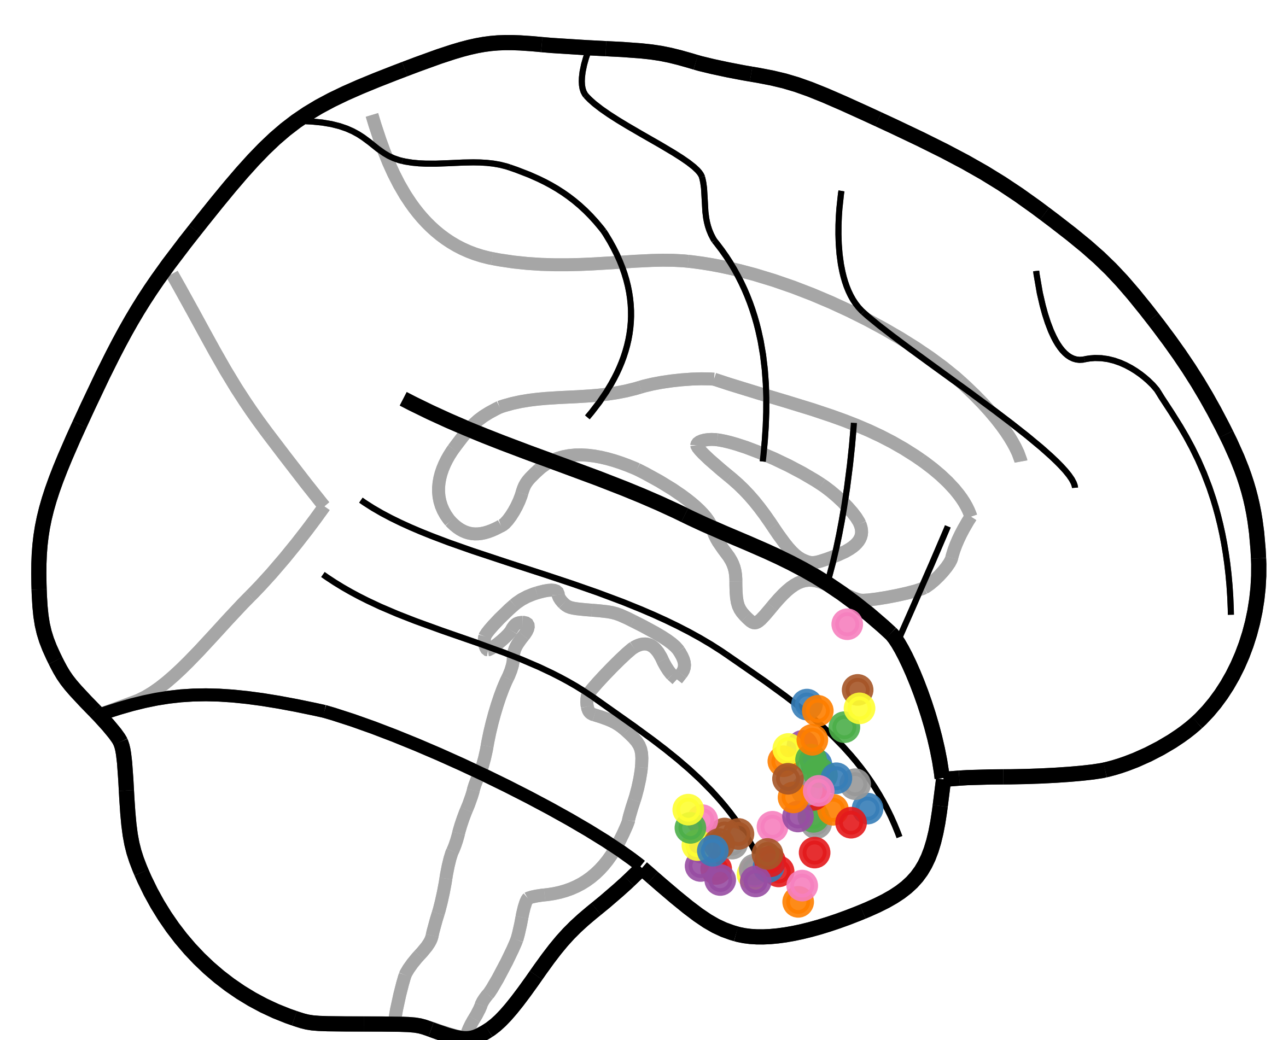
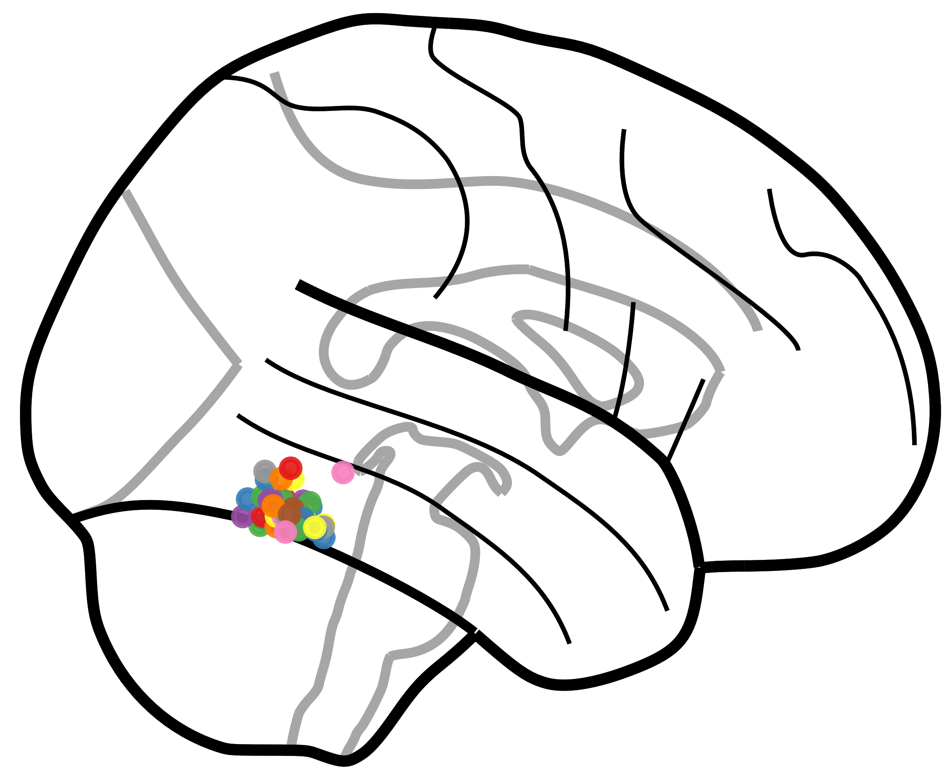
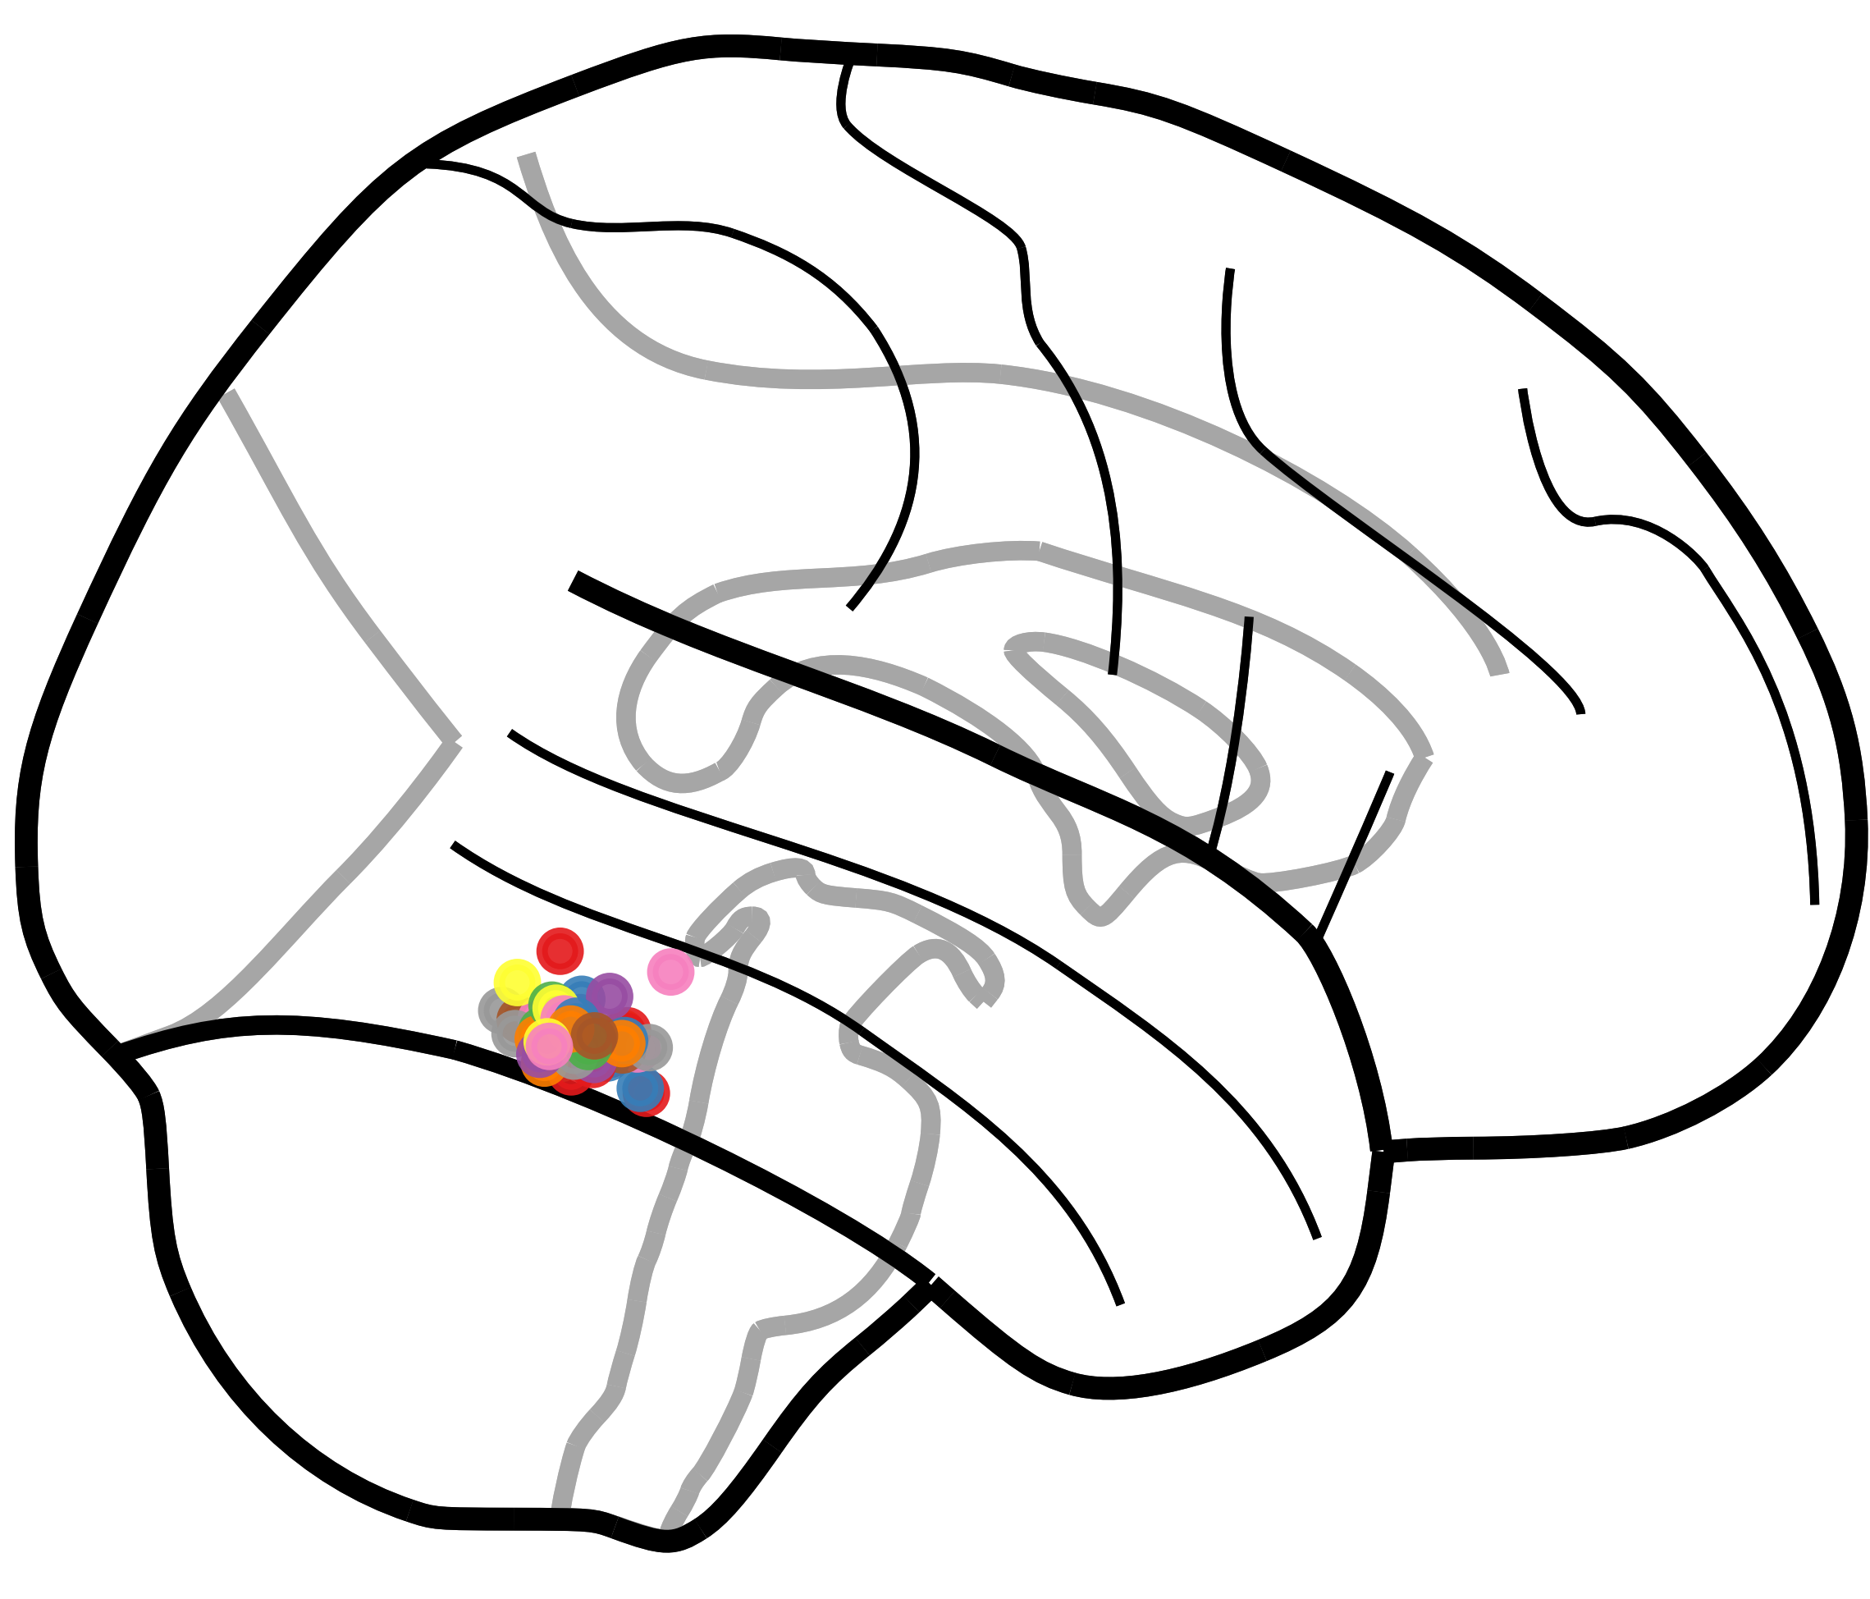





a bilateral model of congenital prosopagnosia – connectivity between FFA & ATL
*Kessler R ^{1,2}, *Albert i Gracenea P ^{1,2}, *Zimmermann KM ^{1,2}, Schmidt K¹ & Jansen A ^{1,2,3}
1 Laboratory for Multimodal Neuroimaging, Department of Psychiatry and Psychotherapy, University of Marburg, Marburg, Germany
2 CMBB Center for Mind, Brain, and Behavior, University of Marburg & University of Giessen, Germany
3 Core-Unit Brainimaging, Department for Psychiatry, University of Marburg, Marburg, Germany
* equal contribution
What is prosopagnosia?
Face perception is an important human ability that uses large parts of cortical resources.
Prosopagnosia is a condition, in which face perception is affected (“face blindness”).
We differentiate between:
Acquired prosopagnosia,
an acquired cerebral damage in regions related to face perception or recognition of identities
Congenital/developmental prosopagnosia,
heterogeneous disabilities of (mainly) identity recognitions with no macroscopic changes in cerebral structure
The nature of Congenital prosopagnosia
Pathological view
congenital prosopagnostics form an own sub-population with a pathologic development of face perception
Normative view
congenital prosopagnostics are “just extremely bad” in face recognition, therefore on the lower extreme of a normal distribution
We work with the normative view of congenital prosopagnosia. Our aim is to assess bilateral connectivity in two nodes of the face perception network – the Fusiform Face Area (FFA) and the Anterior Temporal Face Area (ATL). Previous studies have shown reduced ATL activation in congenital prosopagnostics. We assume it comes from disrupted forward-connectivity from FFA. To test this hypothesis, we examined a group of healthy subjects.
Hypothesis:
congenital prosopagnosia is associated
with ffa/atl dysconnectivity
Dynamic Causal Modeling (DCM)
& Parametric Empirical Bayes (PEB)
Friston et al. (2004), Friston et al., (2013)
Connectivity model with bihemispheric FFA and ATL
input „faces“ into bilateral FFA
reciprocal connections between FFA and ATL, modulated by „faces“
interhemispheric connections, modulated by „faces“
We use a PEB model to evaluate the effects of „faces“ and covariates such as „prosopagnosia“ (100 - CFMT), age and sex.
A model of FFA/ATL effective connectivity
intrinsic (A-Matrix) connectivity and driving input (C-matrix)
„effect of faces“ (B-matrix) on connectivity
Only ‚significant‘ effects displayed (posterior probability > 0.95)
positive , symmetrical input of faces into the system (C-Matrix)
faces strengthen the backwards inhibitory influence from ATL to FFA (bilateral)
faces increase interhemispheric inhibition on level of FFA
congenital prosopagnosia (= bad face recognition) slightly weakens left ATL to FFA inhibition of face processing (weak effect)
but: sex has a very strong effect on the very same connection on the right side (factor 500 times stronger)
Because of its weak effect size (compared to the effect of sex), we do not conclude an effect of congenital prosopagnosia on FFA/ATL effective connectivity !
Cambridge face memory test
Carrow, Dalrymple & Barton (2016), Duchaine & Nakayama (2006)
To determine the individual face recognition ability.
Method:
encoding of 6 individuals
retrieval in a series of new faces
repeat encoding and retrieval with
variying illuminations of faces
repeat encoding and retrieval with
noisy images
threshold : <58% accuracy
→ congenital prosopagnosia
Result:
8 prosopagnostics
41 non-prosopagnostics
effect of
congenital
prosopagnosia
(B-matrix)
1.183
effect of
sex
(B-matrix)
Neural face localizer
Zimmermann, Schmidt et al.(2018)
presenting faces & houses in block conditions
1-back task
faces > houses t-contrast →face perception areas
FFA: core area for holistic face perception
ATL: face identity recognition
define mask for all regions, and find maximally activated voxel inside each mask (i.e. rATL, lATL, rFFA, lFFA) in each subject
extract time series of areas for connectivity analyses
but: high inter-individual difference in localization of ATL
as compared to FFA
example subject
with rATL mask
References
Avidan, Galia, Behrmann (2014). Impairment of face processing network in congenital prosopagnosia.
Duchaine, Nakayama (2006). The Cambridge Face Memory Test
Carrow, Dalrymple, Barton (2016). Prosopagnosia: current perspectives.
Friston, Harrison, Penny (2003). Dynamic Causal Modelling.
Friston, Zeidman, Litvak (2015). Empirical Bayes for DCM. A Group Inversion Scheme.
lATL
rATL
lFFA
rFFA
Correspondence:
Roman Kessler
Laboratory for Multimodal Neuroimaging
kessler5@staff.uni-marburg.de
DGBP/AGNP, March 2020, Berlin

