Slide 1
Sugar Rush!
Play
Feed your hobbit.
Track his sugar.
….
*hobbit image 1*
*hobbit image 2*

Slide 2

Welcome to Hobbit Village
1
🔒
🔒
🔒
🔒
🔒
?

Slide 3
<Village Text>
How to play
Select a hobbit home to meet a new hobbit
Help the hobbit pick out meals to eat throughout the day
Try to select meals that are low in sugar to avoid a sugar crash!
When you have successfully helped your hobbit, try to help some of their neighbors!
<House>
<House>
<House>
<House>
🔒
Close
?

Slide 4



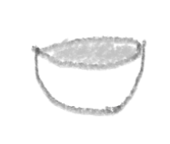
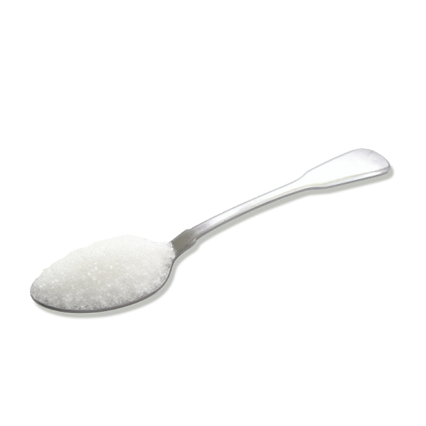
First meal of the day!
Breakfast
Apple
Croissant
Cocoa Pops
Current Sugar Level:
Quit
?

Slide 5

Not bad, halfling!
First meal of the day!
Breakfast
Apple
Croissant
Cocoa Pops
Current Sugar Level:
Quit
?

Slide 6
Fool of a Took!
First meal of the day!
Breakfast
Apple
Croissant
Cocoa Pops
Current Sugar Level:
Quit
?

Slide 7
Fool of a Took!
First meal of the day!
Breakfast
Apple
Croissant
Cocoa Pops
Current Sugar Level:
Quit
?

Slide 8
<Help Text>
Help
First meal of the day!
<Breakfast Title>
Choose the meal which you think has the lowest sugar level!
<Food Image 1>
<Food Image 2>
<Food Image 3>
<Food Title 1>
<Food Title 2>
<Food Title 3>
Close
<Sugar Cube Images>
Quit
?

Slide 9
Game Over!
Your Score:
Game Summary
Meal Summary
Home
Share Results
?

Slide 10



<Hobbit Image>
<Game End Title>
Breakfast
Second Breakfast
Elevenses
Luncheon
<Score Text>
Afternoon Tea
Dinner
Supper
<Nutritional Information>
<Nutritional Information>
<Nutritional Information>
<Game Summary Text>
<Nutritional Information>
<Nutritional Information>
<Nutritional Information>
<Nutritional Information>
<Meal Summary Button>
<Home Button>
<Share Results Button>
?
Close

Slide 11



<Hobbit Image>
Share
<Game End Title>
Share your results with family and friends!
<Score Text>
<Game Summary Text>
<Meal Summary Button>
Cancel
<Home Button>
<Share Results Button>

Slide 12
<Help Text>
<Hobbit Image>
Help
<Game End Title>
Share your results with friends and family, or return home and unlock another hobbit!
<Score Text>
<Game Summary Text>
<Meal Summary Button>
<Home Button>
<Share Results Button>
Close

