Slide 1
Extravascular dose
Absorption
Blood
Excretion
Turnover
Unbound
Bound
Metabolism
Distribution
Tissue
Unbound
Bound
Pharmacokinetics
Pharmacodynamics
Efficacy
Toxicity
Adapted from Gabrielsson & Weiner, 2006. Pharmacokinetic & Pharmacodynamic Data Analysis: Concepts and Applications (4th). Swedish Pharmaceutical Press, Stockholm, Sweden, p. 11.
Utility

Slide 2
Pulmonary administration
Lung
Heart
Intravenous (artery)
Muscle / subcutaneous
Intravenous (peripheral vein)
Other tissues
Arterial blood
Venous blood
Kidney
Renal excretion
Gut wall
Liver
Oral administration
Gut lumen
Fecal excretion and decomposition
Metabolism

Slide 3
Intravascular dosing
Extravascular dosing
Depot compartment
Dose
ka
Central compartment (V1)
Central compartment (V2)
Dose
Concentration = A1 / V1
k = CL / V1
Concentration = A2 / V2
k = CL / V2
A1 = amount of drug in the central compartment.
A2 = amount of drug in the central compartment.

Slide 4
Intravascular dosing
Extravascular dosing
Depot compartment
Dose
ka
Central compartment (V1)
Central compartment (V2)
Dose
Concentration = A1 / V1
k = CL / V1
Concentration = A2 / V2
k = CL / V2
k₁₂ = Q / V1
k₂₁ = Q / V2
k₂₃ = Q / V2
k₃₂ = Q / V3
Peripheral compartment (V2)
Peripheral compartment (V3)
A1 = amount of drug in the central compartment.
A2 = amount of drug in the central compartment.

Slide 5
Intravascular dosing
Extravascular dosing
Depot compartment
Dose
k₁₃ = Q2 / V1
Dose
k₁₃ = Q2 / V1
k₃₁ = Q2 / V3
k₃₁ = Q2 / V3
ka
Second peripheral compartment (V3)
Central compartment (V1)
Second peripheral compartment (V3)
Central compartment (V2)
Concentration = A1 / V1
k = CL / V1
Concentration = A2 / V2
k = CL / V2
k₁₂ = Q1 / V1
k₂₁ = Q1 / V2
k₂₃ = Q / V2
k₃₂ = Q / V3
First peripheral compartment (V2)
Peripheral compartment (V3)
A1 = amount of drug in the central compartment.
A2 = amount of drug in the central compartment.

Slide 6
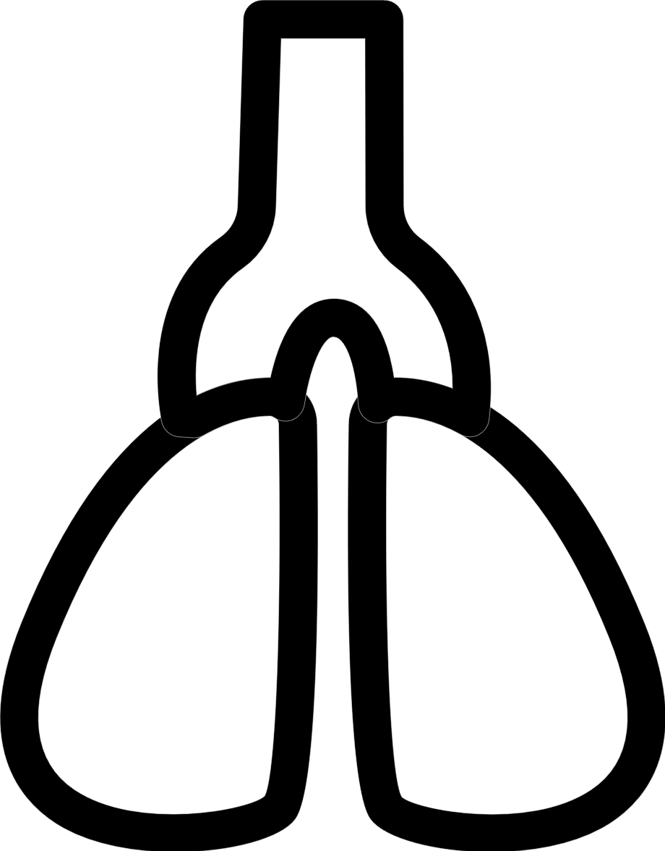

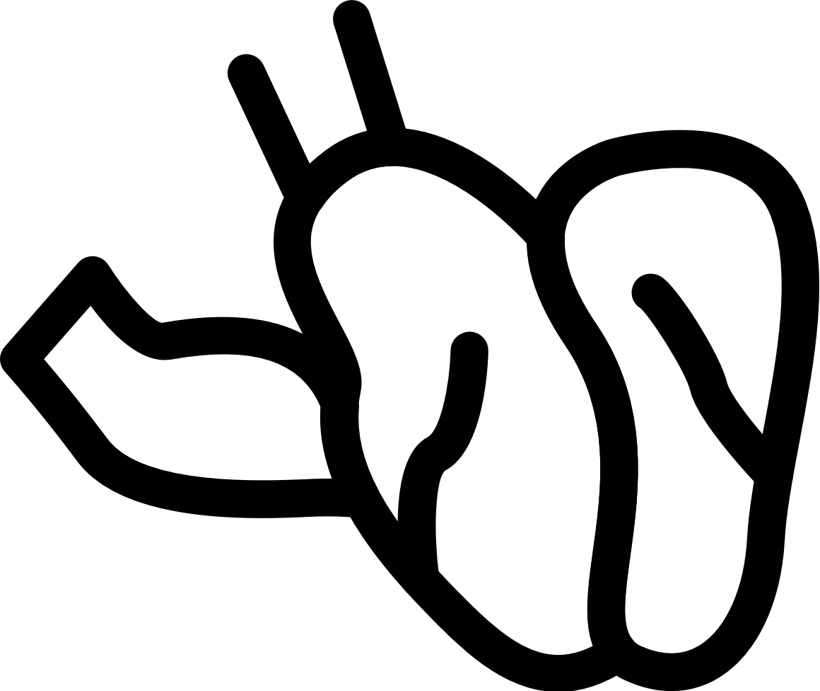

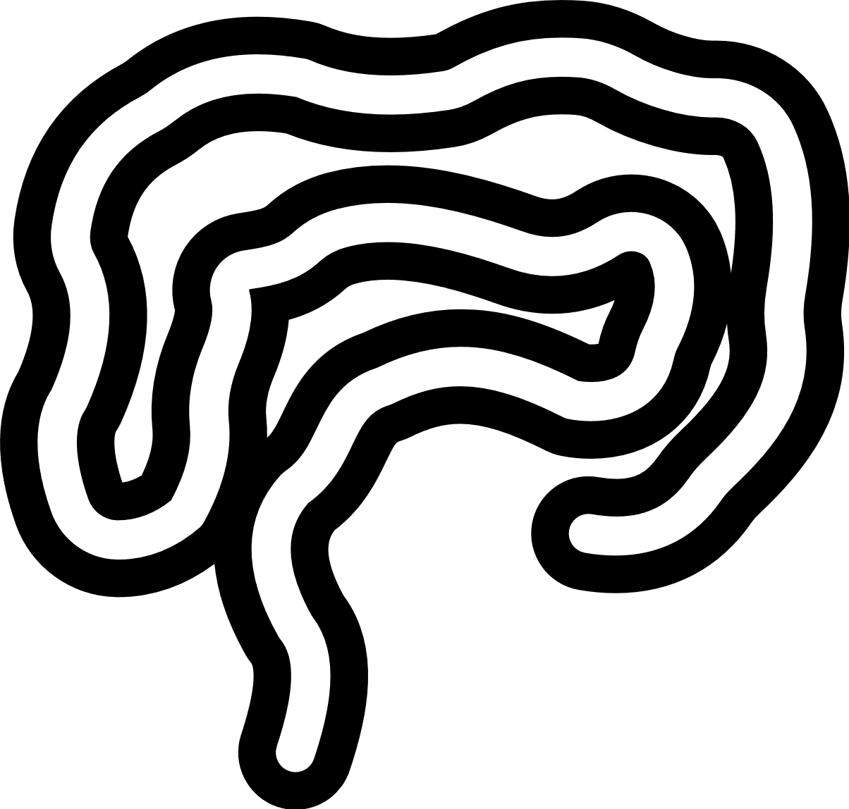
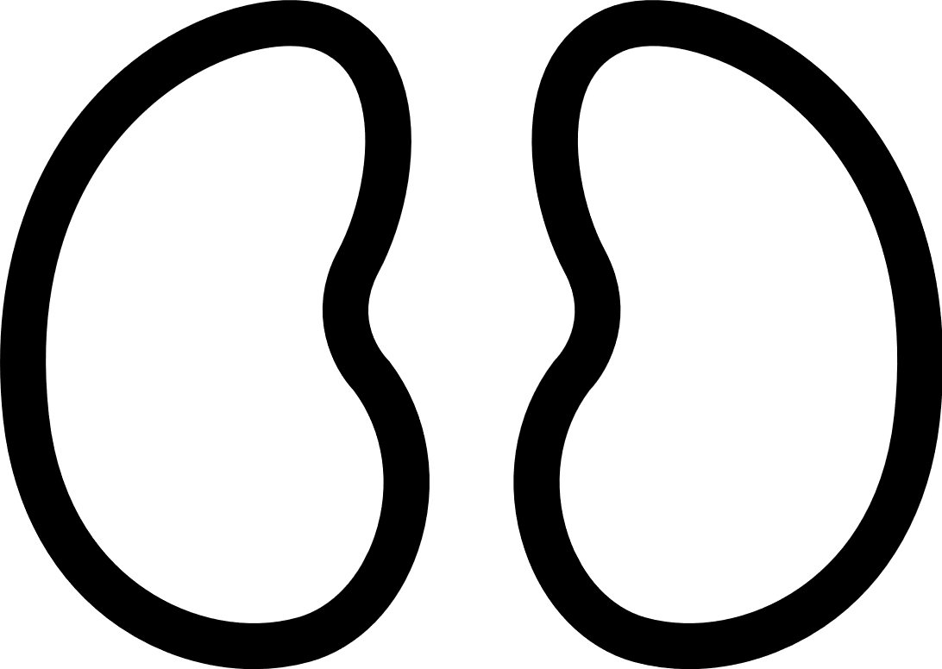


Q_{lung}
Q_{lung}
Vascular space
Lung
k_{b,T}
Tissue
Q_{brain}
Q_{brain}
Brain
Q_{heart}
Q_{heart}
Heart
Dose
Q_{liver}
Q_{gut}
Q_{gut}
CL_{int}
Liver
Gut
Venous blood
Arterial blood
Q_{kidney}
Q_{kidney}
CL_{renal}
Kidney
Q_{bone}
Q_{bone}
Bone
Q_{muscle}
Q_{muscle}
Muscle
Q_{adipose}
Adipose tissue
Q_{adipose}
Q_{other}
Other
organs
Q_{other}

Slide 7

Central compartment (V1)
Dose
C = A1 / V1
k = CL / V1
$$E=\frac{E_{max}∙C}{{EC}_{50}+C}$$

Slide 8




I. Inhibition (k_{in})
III. Stimulation (k_{in})
k_{in}
Response (R)
k_{out}
k_{in}
Response (R)
k_{out}
IC₅₀
EC₅₀
$$\frac{dR}{dt}=k_{in}∙\left(1−\frac{C}{{IC}_{50}+C}\right)−k_{out}$$
$$\frac{dR}{dt}=k_{in}∙\left(1+\frac{E_{max}∙C}{{EC}_{50}+C}\right)−k_{out}$$
II. Inhibition (k_{out})
IV. Stimulation (k_{out})
k_{in}
Response (R)
k_{out}
k_{in}
Response (R)
k_{out}
IC₅₀
EC₅₀
$$\frac{dR}{dt}=k_{in}−k_{out}∙\left(1−\frac{C}{{IC}_{50}+C}\right)$$
$$\frac{dR}{dt}=k_{in}−k_{out}∙\left(1+\frac{E_{max}∙C}{{EC}_{50}+C}\right)$$

