Slide 1
Unit I
Embedded Processor and Applications
T E Electronics and Computer Engineering
ARM7, ARM9, ARM11 processors
Department of Electronics and Computer Engineering
Pravara Rural Engineering College, Loni
Dr. S. S. Lavhate

Slide 2
Contents
Introduction to ARM processors and its versions,,
ARM7, ARM9 & ARM11 features and applications
advantages & suitability of ARM processors for embedded application,
ARM7 TDMI architecture / Core diagram, registers, CPSR, SPSR, Barrel shifter,
ARM7 data flow model, programmers model, modes of operations
Addressing mode and instruction set.
<number>/70

Slide 3
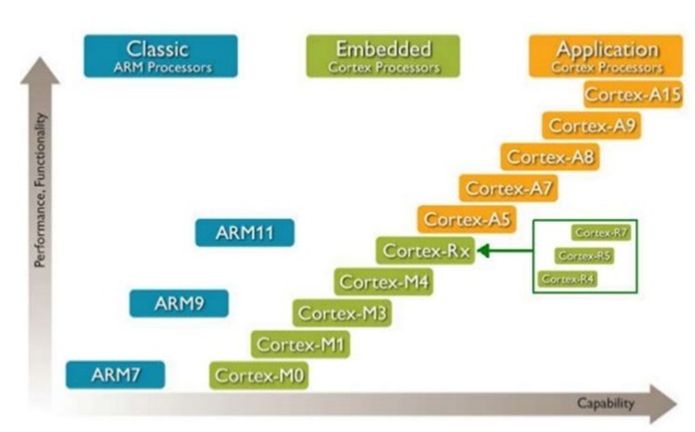
ARM Processor Cores
<number>/70

Slide 4
ARM Nomenclature
A R M {x}{ y}{ z} T D M I E J F S (Example: ARM7-TDMI-S)
x | Series
y | MMU
z | Cache
T | Thumb
D | Debugger
M | Multiplier
I | Embedded In-Circuit Emulator (ICE) macrocell
E | Enhanced Instructions for DSP
J | JAVA acceleration by Jazelle
F | Floating-point
S | Synthesizable version
<number>/70

Slide 5
ARM - Introduction
Advances RISC Machines (now known as ARM) was established as a joint venture between Acorn, Apple and VLSI between Acorn, Apple and VLSI in November 1990
ARM is the industry's leading provider of 16/32-bit embedded RISC microprocessor solutions
The company licenses its high-performance, low-cost, power-efficient RISC processors, peripherals, and system-chip designs to leading international electronics companies
ARM provides comprehensive support required in developing a complete system
<number>/50

Slide 6
RISC Properties/ Features of ARM
Single cycle execution of all (80 %) instructions
Single word standard length of all instructions
Small number of instructions (<= 128)
Small number of instruction format (<= 4)
Small number of addressing modes (<= 4)
Simple LOAD/STORE instructions for memory access
It must have hard wired control unit
It must have relatively large general purpose register
HLL support
Pipelined instruction cycle (typically uniform delay
pipelines)
<number>/70

Slide 7
RISC Properties/ Features of ARM Cont....
Pipelining
Delayed branch approach:- Waste of time in branching is solved by using the delayed branch approach
Dual split Cache: separate Cache for code & data
Instruction level Parallelism
VLSI realization of RISC machine
Higher computing speed
Low design cost
Higher reliability
<number>/70

Slide 8
ATM 7 TDMI
ARM & TDMI
T = Thumb instruction set
D = Debug extension
M = Multiplier
I = In Circuit Emulator (ICE)
ARM 7 EJ-S
E = Enhanced instruction
J = Java code support
S = Synthesizable
<number>/70

Slide 9
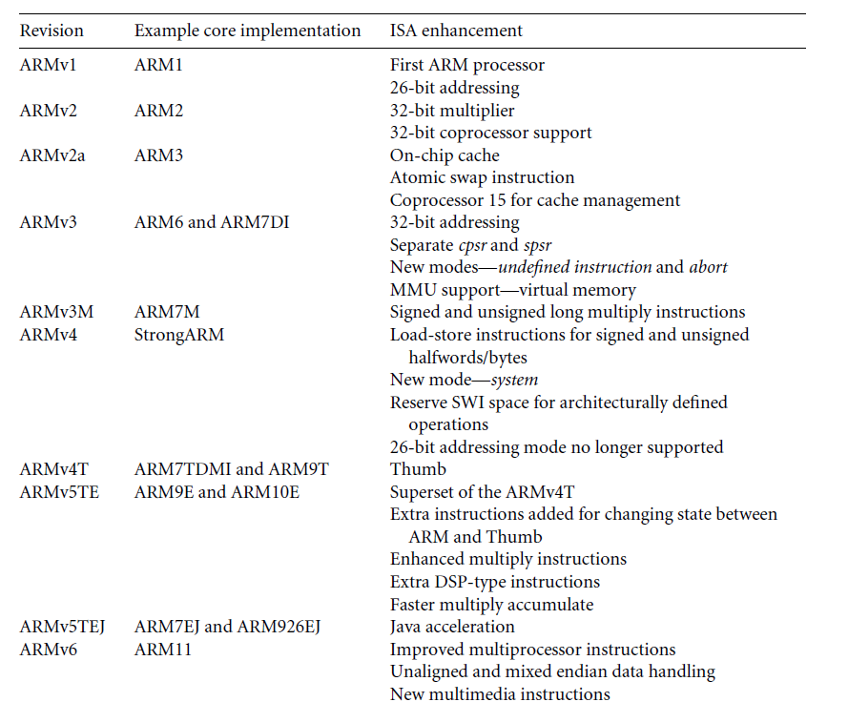
ARM Processor Versions
<number>/70
<number>/50

Slide 10

Development of the ARM Architecture
v4
v5
v6
v7
Halfword and signed halfword / byte support
System mode
Thumb instruction set (v4T)
Improved interworking
CLZ
Saturated arithmetic
DSP MAC instructions
Extensions:
Jazelle (5TEJ)
SIMD Instructions
Multi-processing
v6 Memory architecture
Unaligned data support
Extensions:
(6T2) Thumb-2
(6Z) TrustZone®
(6K) Multicore
(6-M) Thumb only
Thumb-2
Architecture Profiles
7-A - Applications
7-R - Real-time
7-M - Microcontroller
Note that implementations of the same architecture can be different
  Cortex-A8 - architecture v7-A, with a 13-stage pipeline
  Cortex-A9 - architecture v7-A, with an 8-stage pipeline
<number>/50

Slide 11
ARM - Introduction
Arm 7
  The ARM7 cell is functionally identical to the ARM6 cell in capabilities but may be clocked faster than the ARM6
  A variant of the ARM7 cell offers an improved hardware multiply, suitable for DSP work
Arm 8
  Includes a five stage pipeline, a speculative instruction fetcher and internal tweaks to the processor to allow a higher clock speed
Strong ARM
  This is the high speed variant of the ARM chip family
  Architecturally it is similar to the ARM8 core, sharing the five stage pipeline with that processor
  A further difference is change from a unified data and instruction cache to a split, Harvard architecture, instruction and data cache
<number>/50

Slide 12
ARM - Introduction
ARM9
  An incremental improvement over the ARM8 this chip features the same five stage pipeline but is now a Harvard Architecture chip, like the StrongARM
ARM 10
  300 MHz
  400 MIPS
  600 mWatts
<number>/50

Slide 13
RISC Design Philosophy
Instruction
Pipeline
Registers
Load and store
<number>/70

Slide 14
ARM Design Philosophy
Advantages /Suitability towards Embedded System
Hardware Aspect (Technology Perspective)
Low Power
High code density
Reduced die area
Adoption of standard bus architecture
Hardware debug technology
<number>/70

Slide 15
ARM Design Philosophy
Advantages /Suitability towards Embedded System
Software Aspect (Developers’ Perspective)
Variable cycle executions for certain Instructions
Inline barrel shifter
Thumb Instruction
Conditional Execution
Enhanced Instructions
<number>/70

Slide 16
ARM7 - Features
32-bit processor (32-bit data & address bus)
It is RISC processor
It supports ARM as well as Thumb instuction set
Big and Little Endian operating modes
High performance RISC (17 MIPS sustained @ 25 MHz (25 MIPS peak) @ 3V)
Low power consumption (0.6mA/MHz @ 3V fabricated in .8µm CMOS)
Fully static operation (ideal for power-sensitive applications)
Fast interrupt response (for real-time applications)
Virtual Memory System Support
Excellent high-level language support
Simple but powerful instruction set
<number>/50

Slide 17
ARM7 – Features Cont…
Later versions of ARM 7 have DSP & Jazzel instruction set
In system programming (ISP)/In application programming (IAP)
Two 32 bit Timers/Counters
Power saving mode options:- Idle & Power down mode
Single power supply with Power on Reset (POR) & Brown out detegt (BOR)
Operating voltage 3.0 V to 3.6 V
Three stage pipelining
It has AHB (Advanced High Performance Bus)
<number>/70

Slide 18
ARM7 - Applications
The ARM7 is ideally suited to those applications requiring RISC performance from a compact, power-efficient processor
  Telecomms - GSM terminal controller
  Datacomms - Protocol conversion
  Portable Computing - Palmtop computer
  Portable Instrument - Hendheld data acquisition unit
  Automotive - Engine management unit
  Information systems - Smart cards
  Imaging - JPEG controller
<number>/50

Slide 19
ARM9 - Features
It is 32 bit
Operating frequency: 150 MHz
Power Consumption: 0.19 mW/MHz
MIPS/MHz: 1.1
Architecture used: Harvard
MMU/MPU: Present
Cache Memory: Present (separate 16k/8k)
ARM/ Thumb Instruction: Support both
ISA (Instruction Set Architecture): V5T(ARM926EJ-S)
31 (32-Bit size) Registers
32-bit ALU & Barrel Shifter
Enhanced 32- bit MAC block
Memory Controller
<number>/50

Slide 20
ARM9 - Features
Memory operations are controlled by MMU or MPU
1. MMU:
▪ Provides Virtual Memory Support
▪ Fast Context Switching Extensions
2. MPU:
▪ Enables memory protection & bounding
▪ Sand – boxing of applications
Flexible Cache Design (sizes can be 4KB to 128KB)
Flexible Core Design
DSP Enhancements: (very important)
Single cycle 32x16 multiplier Implementation
Speed up all the multiply instructions
New 32x16 & 16x16 multiply instructions
Allows independent access to 16 bit halves of registers
ARM ISA supports 32x32 multiply instruction
Saturating Arithmetic (QADD, QSUB)
Count leading zero for factor Division
<number>/70

Slide 21
ARM9 - Applications
Product Type | Application
Consumer | Smartphones, PDA, Set top box, PMP, Electronic toys, Digital still cameras, Digital video cameras etc
Networking | Wireless LAN, 802.11, Bluetooth, Firewire, SCSI, 2.5G/3G Baseband etc
Automotive | Power train, ABS, Body systems, Navigation, Infotainment etc
Embedded | USB controllers, bluetooth controllers, medical scanners etc
Storage | HDD controllers, solid state drives etc
<number>/50

Slide 22
Applications of ARM9
1.Consumer type: Smart phones, PDA, Set-Top box, Electronics Toys, Digital Cameras, etc.
2.Networking type: Wireless LAN, 802.11, Bluetooth, etc.
3.Automatic: Power Train, ABS, Navigation, etc.
4.Embedded USB controllers, Bluetooth controllers, Medical scanners, etc.
5.Storage: HDD controllers, solid state drivers etc.
<number>/70

Slide 23
ARM11 - Features
Powerful ARMv6 instruction set architecture ARM Thumb® instruction set reduces memory bandwidth and size requirements by up to 35% ARM Jazelle® technology for efficient embedded Java execution ARM DSP extensions SIMD (Single Instruction Multiple Data) media processing extensions deliver up to 2x performance for video processing ARM TrustZone® technology for on-chip security foundation (ARM1176JZ-S and ARM1176JZF-S processors) Thumb-2 technology (ARM1156(F)-S only) for enhanced performance, energy efficiency and code density Low power consumption: 0.21 mW/MHz (65G) including cache controllers
Energy saving power-down modes address static leakage currents in advanced processes
High performance integer processor 8-stage integer pipeline delivers high clock frequency (9 stages for ARM1156T2(F)-S)
Separate load-store and arithmetic pipelines
Branch Prediction and Return Stack
<number>/50

Slide 24
ARM 11 – Features Cont…
1. Pipeline Depth: 8stage
2. Operating frequency: 335MHz.
3. Power Consumption: 0.4mW/MHz.
4. MIPS/MHz: 1.2
5. Architecture used: Harvard
6. MMU/MPU: Present
7. Multiplier unit: 16x32 (16 bits of 32-bit size register)
8. Cache Memory: present (4-64k size)
9. ISA (Instruction Set Architecture): V6
10. Enhanced multiply instruction & saturation
11. Powerful ARMV6 instruction set architecture
<number>/70

Slide 25
ARM 11 – Features Cont…
Supports the thumb instruction set-memory BW & Size requirements reduces
by up to 35%
13. Supports Jazelle Technology for efficient embedded JAVA execution
14. Supports the DSP extensions
SIMD media processing extensions deliver up to 2x performance for video
processing
16. ARM Trust-Zone Technology for on chip security
Thumb-2 Technology for enhanced performance energy efficiency & code
density
18. Low power consumption
19. High performance integer processor
Vectored interrupt interface & low-interrupt latency mode speeds up interrupt
response & real time performance
Optional vector floating point co-processor for automotive/ industrial controls
& 3D graphics acceleration
<number>/70

Slide 26
ARM11 - Applications
Consumer:- Smart Phone, Home Video Security
Wireless:-
Automotive :-Electronic Control unit of automobiles
<number>/50

Slide 27
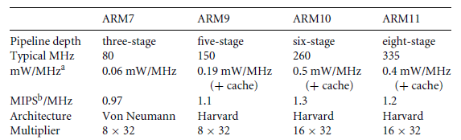
Comparisons of ARM Processor
<number>/50

Slide 28
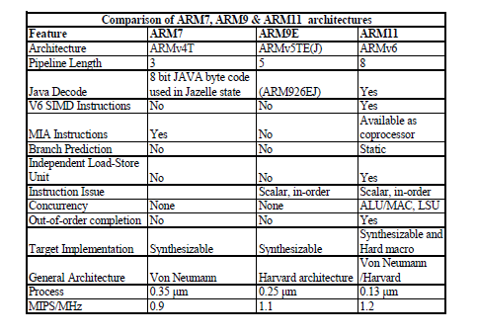
Comparison of ARM 7, ARM 9, ARM 11
<number>/70

Slide 29



ARM Powered Products
Consumer Entertainment
Automotive
Digital Imaging
<number>/50

Slide 30
Pipeline changes for ARM9TDMI
ARM7TDMI
Instruction
Fetch
ARM decode
Reg
Read
Reg
Write
Thumb→ARM
decompress
Shift
ALU
Reg Select
FETCH
DECODE
EXECUTE
ARM9TDMI
ARM or Thumb
Inst Decode
Instruction
Fetch
Shift + ALU
Memory
Access
Reg
Write
Reg
Decode
Reg
Read
FETCH
DECODE
EXECUTE
MEMORY
WRITE
Notes:
Pipeline Comparison
The point of this foil is to show that with the ARM7TDMI a lot of work was carried out in the execute stage of the pipeline. Now with ARM9TDMI the execute stage has been split out into three stages to allow greater throughput.
This then means the CPI is about 1.5 compared against 1.9 for ARM7TDMI, and the operating frequency is approximately double for ARM9TDMI over ARM7TDMI on the same fabrication process. Therefore, at least double the processing power is available.
It is possible for the pipeline to interlock. Forwarding paths have been provided to minimise this as much as possible, but they can still occur. By using a bit of consideration when writing code they can almost be eliminated.

Slide 31
ARM10 vs. ARM11 Pipelines
ARM10
Branch
Prediction
ARM or
Thumb
Instruction
Decode
Reg Read
Shift + ALU
Memory
Access
Reg
Write
Instruction
Fetch
Multiply
Multiply Add
FETCH
ISSUE
DECODE
EXECUTE
MEMORY
WRITE
ARM11
Shift
ALU
Saturate
Write
back
Fetch
1
Fetch
2
Decode
Issue
MAC
1
MAC
2
MAC
3
Address
Data
Cache
1
Data
Cache
2
Notes:
ARM10 - It just illustrates that another stage was added to the ARM9’s pipeline to provide additional time to handle coprocessor instruction decode and handle branch prediction. The Multiplier is now broken up over two stages, execute and memory, since the multiplier is also pipelined.
Note that the ARM9E multiplier is also pipeline (like ARM10) so the upper diagram strictly only applies to the ARM9TDMI.
ARM11 - The processor is a single issue processor, meaning that only one instruction per cycle can be issued from the issue stage to one of the 3 backend pipeline stages.
While the instructions are issued in order they may complete out of order. This will be depend on availability of data, length of execution and memory access times.

Slide 32
Pipeline Organization (2)
3-stage pipeline: Fetch – Decode - Execute
Three-cycle latency,
one instruction per cycle throughput
instruction
i
Fetch
Decode
Execute
i+1
Fetch
Decode
Execute
i+2
Fetch
Decode
Execute
cycle
t
t+1
t+2
t+3
t+4

Slide 33
Pipeline Organization (3)
5-stage pipeline:
  Reduces work per cycle =>
  allows higher clock frequency
  Separates data and
  instruction memory =>
  reduction of CPI
  (average number
  of clock Cycles Per Instruction)
Stages:
Fetch
Decode
Execute
Buffer/data
Write-back

Slide 34
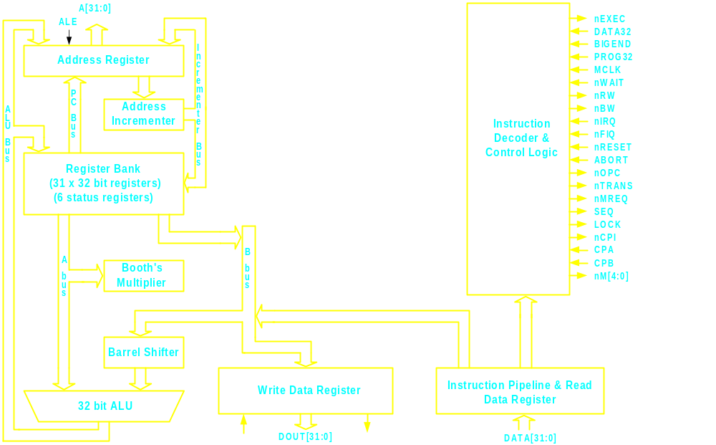
ARM7 - Block Diagram
<number>/50

Slide 35
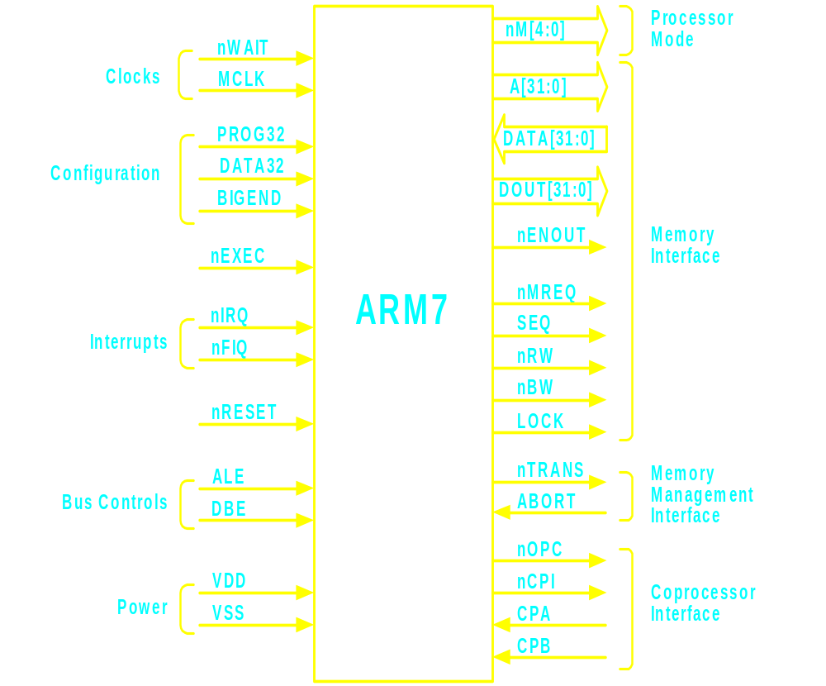
ARM7 - Functional Diagram
<number>/50

Slide 36
ARM7 - Signal Description
Clocks
  MCLK Memory Clock Input
  nWAIT Not wait
Configuration
  PROG32 32 bit program configuration
  DATA32 32 bit data configuration
  BIGEND Big Endian configuration
Interrupts
  nIRQ Not interrupt request
  nFIQ Not fast interrupt request
Bus Controls
  ALE Address latch enable
  DBE Data bus enable
Power
  VDD Power supply
  VSS Ground
Processor Mode
  nM[4:0] Not processor mode
<number>/50

Slide 37
ARM7 - Signal Description
Memory Interface
  A[31:0] Addresses
  DATA[31:0] Data bus in
  DOUT[31:0] Data bus out
  nENOUT Not enable data outputs
  nMREQ Not memory request
  SEQ Sequential address
  nRW Not read/write
  nBW Not byte/word
  LOCK Locked operation
Memory Management Interface
  nTRANS Not memory translate
  ABORT Memory abort
Coprocessor Interface
  nOPC Not op-code fetch
  nCPI Not coprocessor instruction
  CPA Coprocessor absent
  CPB Coprocessor busy
Other
  nEXEC ******************
  nRESET Not reset
<number>/50

Slide 38
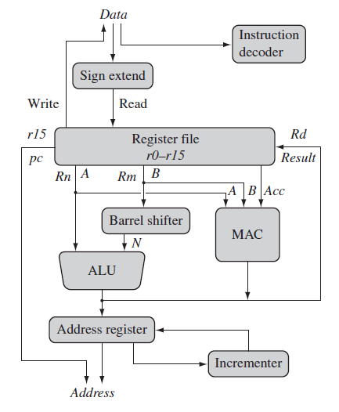
ARM Core data flow model
<number>/50

Slide 39
ARM Core data flow Contd..
Von-Neumann implementation – data items and instructions share the same bus.
● Instruction decoder translates instructions before they are
executed.
● Load instruction: copy data from memory to register
● Store instruction: copy data from register to memory
● There are no data processing instructions that directly
manipulate data in memory.
● Data items are placed in the register file – a storage bank made
up of 32-bit registers.
● ARM instructions typically have two source registers Rn and
Rm and one destination register Rd.
<number>/50

Slide 40
ARM Core data flow Contd..
● ALU and MAC (Multiply-accumulate) unit takes the register values Rn and Rm from A and B buses and computes a result.
● Load and store instructions use the ALU to generate an address to be held in the address
register and broadcast on the Address bus.
● The register Rm can be alternatively pre-processed in the barrel shifter before it enters the ALU.
● For load and store instructions the incrementer updates the address register before the core reads or writes the next register value from or to the next sequential memory location.
<number>/50

Slide 41
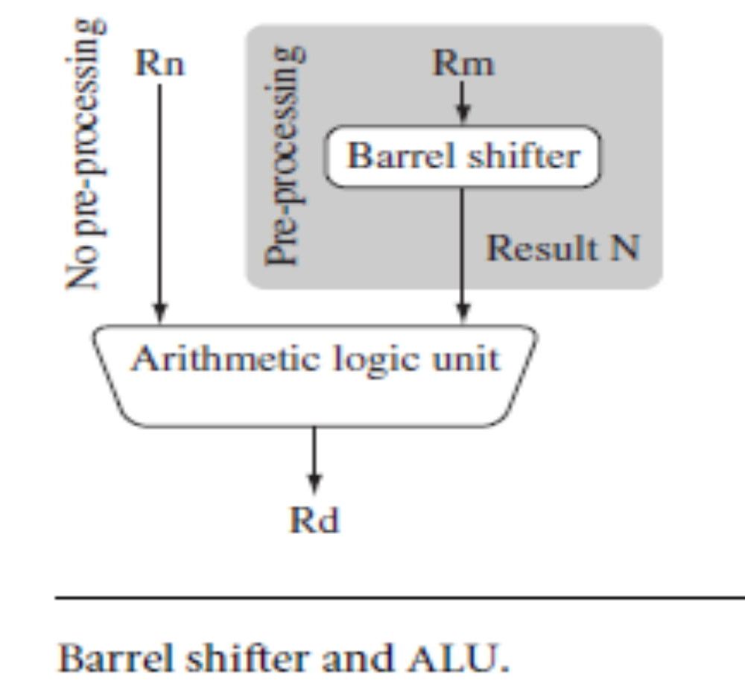
ARM Core data flow Contd..
Barrel Shifter
<number>/50

Slide 42
ARM Core data flow Contd..
Barrel Shifter
  One important feature of the is that register Rm alternatively can be pre processed in barrel in barrel shifter before it enters the ALU [left shift , right shift , rotated etc.].
  Depending on the instruction Barrel Shifter may be used or it could be short circuit.
  Barrel shifter & ALU can calculate together a wide range of expression & address in the same cycle.
  A unique and powerful feature of the ARM processor is the ability to shift the 32-bit binary pattern in one of the source registers left or right by a specific number of positions before it enters the ALU. This shift increases the power and flexibility of many data processing operations.
  There are data processing instructions that do not use the barrel shift, for example, the MUL (multiply), CLZ (count leading zeros), and QADD (signed saturated 32-bit add) instructions.
  Pre-processing or shift occurs within the cycle time of the instruction. This is particularly useful for loading constants into a register and achieving fast multiplies or division by a power of 2.
<number>/50

Slide 43
Data Sizes and Instruction Sets
ARM is a 32-bit load / store RISC architecture
  The only memory accesses allowed are loads and stores
  Most internal registers are 32 bits wide
  Most instructions execute in a single cycle
When used in relation to ARM cores
  Half word means 16 bits (two bytes)
  Word means 32 bits (four bytes)
  Double word means 64 bits (eight bytes)
ARM cores implement two basic instruction sets
  ARM instruction set – instructions are all 32 bits long
  Thumb instruction set – instructions are a mix of 16 and 32 bits
    Thumb-2 technology added many extra 32- and 16-bit instructions to the original 16-bit Thumb instruction set
Depending on the core, may also implement other instruction sets
  VFP instruction set – 32 bit (vector) floating point instructions
  NEON instruction set – 32 bit SIMD instructions
  Jazelle-DBX - provides acceleration for Java VMs (with additional software support)
  Jazelle-RCT - provides support for interpreted languages
<number>/50

Slide 44
ARM7 - Registers
37 registers
  31 general 32 bit registers
  6 status registers
16 general registers and one or two status registers are visible at any time
The visible registers depend on the processor mode
The other registers (the banked registers) are switched in to support IRQ, FIQ, Supervisor, Abort and Undefined mode processing
<number>/50

Slide 45
ARM7 - Registers
R0 to R15 are directly accessible
  R0 to R14 are general purpose
  R15 holds the Program Counter (PC)
CPSR - Current Program Status Register contains condition code flags and the current mode bits
5 SPSRs (Saved Program Status Registers) which are loaded with CPSR when an exceptions occurs
<number>/50

Slide 46
Register Model of ARM 7 / (Banked Rgister)
Programmers Model of ARM 7
User mode
IRQ
FIQ
Undef
Abort
SVC
r0
r1
ARM has 37 registers, all 32-bits long
A subset of these registers is accessible in each mode
Note: System mode uses the User mode register set.
r2
r3
r4
r5
r6
r7
r8
r8
r9
r9
r10
r10
r11
r11
r12
r12
r13 (sp)
r13 (sp)
r13 (sp)
r13 (sp)
r13 (sp)
r13 (sp)
r14 (lr)
r14 (lr)
r14 (lr)
r14 (lr)
r14 (lr)
r14 (lr)
r15 (pc)
cpsr
spsr
spsr
spsr
spsr
spsr
<number>/50
Current mode
Banked out registers

Slide 47
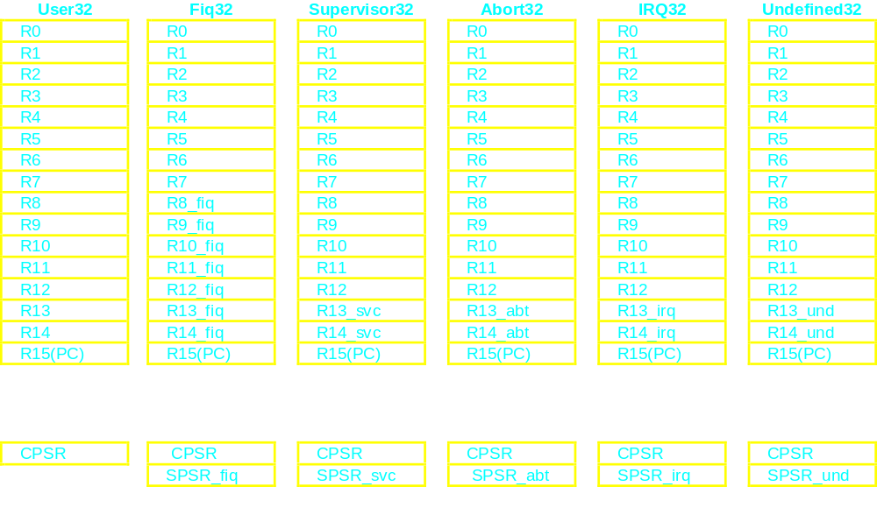
ARM7 - Registers
General Registers and Program Counter Modes
Program Status Registers
<number>/50

Slide 48
ARM7 - Registers
R14 is used as the subroutine link register and receives a copy of R15 when a Branch and Link instruction is executed. Link register is used to store the return address of main program
R14_svc, R14_irq, R14_fiq, R14_abt and R14_und are used to
  hold the return values of R15 when interrupts and exceptions arise,
  when Branch and Link instructions are executed within interrupt or exception routines
FIQ mode has seven banked registers mapped to R8-14 (R8_fiq-R14_fiq)
User mode, IRQ mode, Supervisor mode, Abort mode and Undefined mode each have two banked registers mapped to R13 and R14
The two banked registers allow these modes to each have a private stack pointer and link register
<number>/50

Slide 49
The Registers
ARM has 37 registers all of which are 32-bits long.
  1 dedicated program counter
  1 dedicated current program status register
  5 dedicated saved program status registers
  30 general purpose registers
The current processor mode governs which of several banks is accessible. Each mode can access
  a particular set of r0-r12 registers
  a particular r13 (the stack pointer, sp) and r14 (the link register, lr)
  the program counter, r15 (pc)
  the current program status register, cpsr
Privileged modes (except System) can also access
  a particular spsr (saved program status register)
<number>/70

Slide 50
The Registers
  Program counter, r15 (pc):- It is a register which points the address of instruction from where the next instruction is fetched. Hence PC points the sequence of execution of program
<number>/70

Slide 51
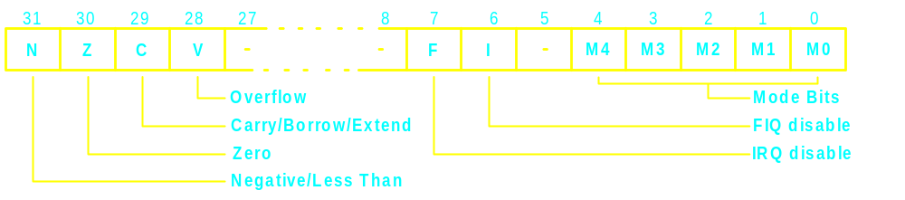
Current Program Status Register (CPSR) (Program Status Register)
The N, Z, C and V are condition code flags
  may be changed as a result of arithmetic and logical operations in the processor
  may be tested by all instructions to determine if the instruction is to be executed
The I and F bits are the interrupt disable bits
The M0, M1, M2, M3 and M4 bits are the mode bits
<number>/50

Slide 52
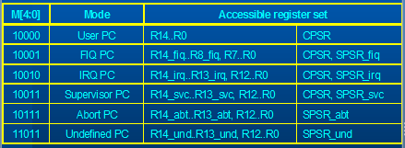
ARM7 - Registers
The Mode Bits
<number>/50

Slide 53
Interrupt and Exception
Exception:
An exception is an event that disrupts the normal flow of instruction execution, causing the processor to temporarily halt the current program and execute a specific exception handler routine to address the event.
Feature | Interrupt | Exception
Source | External hardware events | Internal processor events or software instructions
Timing | Asynchronous (can occur at any time) | Synchronous (usually tied to the current instruction)
Handling | Prioritized based on urgency | Handled in a fixed sequence
Handling Mode | Usually handled in a separate interrupt service routine (ISR) | Handled within the exception handler routine
Vector Table | Separate interrupt vector table | Combined exception vector table (may include interrupts)
Return Behavior | May return to the interrupted instruction or the next instruction | Typically returns to the instruction that caused the exception
Examples | Timer interrupts, I/O device signals, external events | Memory access violations, undefined instructions, division by zero, system calls
<number>/50

Slide 54
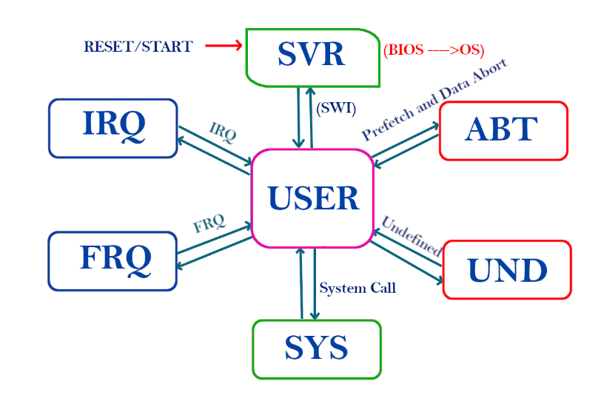
ARM 7 Processor Operating Modes
<number>/50

Slide 55
ARM 7 Processor Operating Modes
User Mode (USR)
Normal program execution mode.
Used for application programs.
Limited privileges (cannot access protected resources).
System Mode (SYS)
Privileged mode.
Uses same registers as User mode.
Used for operating system tasks.
Supervisor Mode (SVC)
Entered after reset or software interrupt (SWI).
Used for operating system and system-level functions.
IRQ Mode (Interrupt Request)
Entered when a normal interrupt occurs.
Has its own banked registers (R13, R14).
Lower priority than FIQ.
FIQ Mode (Fast Interrupt Request)
Entered when high-priority interrupt occurs.
Has more banked registers (R8–R14).
Faster interrupt handling than IRQ.
Abort Mode (ABT)
Entered when memory access fails.
Used for memory protection and error handling.
Undefined Mode (UND)
Entered when an undefined instruction is executed.
Used for software emulation or error handling.
<number>/70

Slide 56
ARM 7 Processor Operating Modes
The ARM processor supports seven operating modes. The processor mode decides availability of the registers to the programmer and also access rights to the CPSR.
The processor modes are classified as:
1. Privileged mode
2. Non-privileged mode.
Privileged Mode:
A mode of operation in the ARM7 processor that grants full access to the processor's resources and the ability to execute sensitive operations.
Used for tasks that require high levels of control and security, such as operating system kernels, interrupt handlers, and system software.
Includes five specific modes: Supervisor mode (SVC), Fast interrupt mode (FIQ), Interrupt mode (IRQ), Abort mode (ABT), and Undefined instruction mode (UND).
Non-Privileged Mode (User Mode):
A mode of operation in the ARM7 processor that has limited access to resources and cannot execute sensitive operations.
Used for running user applications to protect the system and other programs from potential harm.
Provides a restricted environment to ensure application stability and security.
<number>/50

Slide 57
ARM 7 Processor Operating Modes
Privileged mode supports full read and write access to the CPSR.
Non-privileged mode allows only read access to the control field in the CPSR. However, it allows read-write access to the condition flags.
All modes other than User are privileged modes. These are used to service hardware interrupts, exceptions, and software interrupts. Each privileged mode has an associated Saved Program Status Register (SPSR). This register is use to save the state of the Current Program Status Register (CPSR) of the task immediately before the exception occurs.
In these privileged modes, mode-specific banked registers are available. These are automatically restored to their original values on return to the previous mode and the saved CPSR restored from the SPSR.
System mode does not have any banked registers. It uses the User mode registers. System mode runs tasks that require a privileged processor mode and allows them to invoke all classes of exception.
<number>/50

Slide 58

ARM 7 Processor Operating Modes
ARM has seven basic operating modes
  Each mode has access to its own stack space and a different subset of registers
  Some operations can only be carried out in a privileged mode
Mode | Description
Supervisor (SVC) | Entered on reset and when a Supervisor call instruction (SVC) is executed | Privileged modes
FIQ | Entered when a high priority (fast) interrupt is raised
IRQ | Entered when a normal priority interrupt is raised
Abort | Used to handle memory access violations
Undef | Used to handle undefined instructions
System | Privileged mode using the same registers as User mode
User | Mode under which most Applications / OS tasks run | Unprivileged mode
Exception modes
<number>/50

Slide 59
ARM 7 Processor Operating Modes
SVR Operating Mode in ARM 7
Supervisor Mode ARM7 enters this mode on reset. It is used to execute the BIOS program (Booting program). This mode can also be invoked by the programmer by SWI (Software Interrupt).
User Operating Mode in ARM 7
This is the normal mode in which all user programs are executed. It is the only non-privileged mode.
It has limited access to memory, I/O components, and flags. All the other modes can be entered through different kinds of exceptions (interrupts).
After the supervisor mode, the micro-controller goes into the user-mode till the time you switch off it.
Remember When you start this is not going directly to the user mode. First, it handles by supervisor mode then the supervisor mode makes a switch to user mode. and more than 95% time of its lifetime the ARM processor spends time in user mode. In this mode, you can go to all other modes.
<number>/50

Slide 60
ARM 7 Processor Operating Modes
System Operating Mode in ARM 7
System Mode This is a Privileged version of the User Mode. The User program can invoke this mode to gain full control over CPSR and Memory.
Needless to say, this mode should be used very discretely by the programmer, else the entire protection mechanism may be compromised.
When you make a system call then you are going to the system mode.
IRQ Operating Mode in ARM 7
Interrupt Request Mode This is a normal Interrupt Mode get invoked when a low priority interrupts occurs on the nIRO pin.
Here Interrupt latency is the mode and nested interrupts are allowed.
FIQ Operating Mode in ARM 7
Fast Interrupt Request Mode This mode is entered when a high priority interrupts occurs through nFIQ pin.
As this mode is used for high priority interrupts, the ISR should be executed with minimum latency (delay).
<number>/50

Slide 61
ARM 7 Processor Operating Modes
Abort Operating Mode in ARM 7
Abort Mode This mode is entered when an unsuccessful attempt is made to access a memory location. Due to the protection mechanism, some locations are not accessible in some of the modes. When an attempt is made to access such a location, the processor enters Abort mode and the program that tried to access this location is aborted.
Undefined Operating Mode in ARM 7
This mode is used to enter undefined instructions. This generally occurs when a co-processor instruction is encountered but a co-processor is not present in the system. The processor then enters Undefined mode and the program attempting that instruction is terminated.
<number>/50

Slide 62
ARM 7 Processor Operating Modes
User mode (usr): the normal program execution state
FIQ mode (fiq): designed to support a data transfer or channel process
IRQ mode (irq): used for general purpose interrupt handling
Supervisor mode (svc): a protected mode for the operating system
Abort mode (abt): entered after a data or instruction prefetch abort
Undefined mode (und): entered when an undefined instruction is executed
<number>/50

Slide 63
ARM7 - Exceptions
Exceptions arise whenever there is a need for the normal flow of program execution to be broken, so that the processor can be diverted to handle an interrupt from a peripheral
Many exceptions may arise at the same time
When multiple exceptions arise simultaneously, a fixed priority determines the order in which they are handled
ARM7 handles exceptions by making use of the banked registers to save state
<number>/50

Slide 64
ARM7 - Exceptions
Types of Exceptions
FIQ (Fast Interrupt reQuest)
  The FIQ exception is externally generated by taking the nFIQ input LOW.
  This input can accept asynchronous transitions, and is delayed by one clock cycle for synchronisation before it can affect the processor execution flow
IRQ (Interrupt ReQuest)
  The IRQ exception is a normal interrupt caused by a LOW level on the nIRQ input
ABORT
  An ABORT can be signalled by the external ABORT input
  ABORT indicates that the current memory access cannot be completed
<number>/50

Slide 65
ARM7 - Exceptions
Types of Exceptions
Software interrupt
  The software interrupt instruction (SWI) is used for getting into Supervisor mode, usually to request a particular supervisor function
Undefined instruction trap
  When the ARM7 comes across an instruction which it cannot handle it offers it to any coprocessors which may be present
  If a coprocessor can perform this instruction but is busy at that time, ARM7 will wait until the coprocessor is ready or until an interrupt occurs
  If no coprocessor can handle the instruction then ARM7 will take the undefined instruction trap
<number>/50

Slide 66
ARM7 - Exceptions
Exception Priorities
(1) Reset (highest priority)
(2) Data abort
(3) FIQ
(4) IRQ
(5) Prefetch abort
(6) Undefined Instruction, Software interrupt (lowest priority)
<number>/50

Slide 67
Exception Handling in ARM
When an exception occurs, the ARM:
  Copies CPSR into SPSR_<mode>
  Sets appropriate CPSR bits
    Change to ARM state
    Change to exception mode
    Disable interrupts (if appropriate)
  Stores the return address in LR_<mode>
  Sets PC to vector address
To return, exception handler needs to:
  Restore CPSR from SPSR_<mode>
  Restore PC from LR_<mode>
This can only be done in ARM state.
0x1C
FIQ
0x18
IRQ
0x14
(Reserved)
0x10
Data Abort
0x0C
Prefetch Abort
0x08
Software Interrupt
0x04
Undefined Instruction
0x00
Reset
Vector Table
Vector table can be at
0xFFFF0000 on ARM720T
and on ARM9/10 family devices
<number>/70

Slide 68
ARM7 - Reset
When the RESET signal goes LOW, ARM7 abandons the executing instruction and then continues to fetch instructions from incrementing word addresses
<number>/50

Slide 69
Addressing mode of ARM 7
What is an addressing mode ?“. Addressing mode is a way to address an operand. The technique or the way by which an operand (data) is specified in the instructions is called as addressing mode
<number>/70

Slide 70
Addressing Modes of ARM 7
Addressing modes of ARM 7:- The way/technique by which and operand is specified in the instructions
Different Types of addressing modes:
A) Addressing modes for data processing operands
i) Unmodified Type
ii) Modified Type
B) Addressing modes for memory access operands
i) Register indirect addressing mode
ii) Relative register indirect addressing mode
iii) Based indexed indirect addressing mode
iv) Base with scaled register addressing mode
<number>/50

Slide 71
Addressing Modes of ARM 7
A) Addressing modes for data processing operands
i) Unmodified Type: In this addressing mode the register or value is given in unmodified i.e. without any shift or rotation.
Example:-
1) MOV R0 , #1234H
2) MOV R0, R1
ii) Modified Type: In this addressing mode the given register content or value is in shifted or rotated.
Example:-
1) MOV R0 , R1, LSL #2
2) MOV R0, R1, LSL R2
3) MOV R0, R1, ASR #2
<number>/70

Slide 72
Addressing Modes of ARM 7
B) Addressing modes for memory access operands
i) Register indirect addressing mode: In this addressing mode a register is used to specify the address of the memory location to be accessed.
Example:
1) LDR R0, [R1]
ii) Relative register indirect addressing mode: In this addressing mode the memory address is generated by immediate value added to the register. Pre- index and Post-icex are supported in this addressing mode
Example:
Pre-index addressing
LDR R0, [R1, #4]
Post-index addressing
LDR R0, [R1] ,#4
<number>/70

Slide 73
Addressing Modes of ARM 7
iii) Based indexed indirect addressing mode:- In this addressing mode the
memory address is generated by adding the values of two register. Pre-index and
Post-icex are supported in this addressing mode
Example:
Pre-index addressing
LDR R0, [R1, R2]
Post-index addressing
LDR R0, [R1] , R2
iv) Base with scaled register addressing mode: In this addressing mode the memory
address is generated by adding the value of register to another register value
which is left shifted. Pre-index and Post-icex are supported in this addressing mode
Example:
Pre-index addressing
LDR R0, [R1, R2, LSL #4]
Post-index addressing
LDR R0, [R1] , R2, LSL #4
<number>/70

Slide 74
Thank You
?
<number>/50

