Slide 1
UNIT III: ARM7 Based Microcontrollers LPC 2148
Contents
ARM7 Based Microcontroller LPC2148:
Features, Architecture its Description
System Control Block ( PLL and VPB divider),
GPIO, Pin Connect Block,
timer,
interfacing with LED, LCD, Relay, Buzzer, Motion sensor, soil moisture sensor.

Slide 2
Features of LPC2148:-
 PACKAGE: 6/32-bit ARM7TDMI-S microcontroller in a tiny LQFP64 package.
MEMORY:
32 kB of on-chip static RAM
512 kB of on-chip flash program memory.
SPEED: 128 bit wide interface/accelerator enables high speed 60 MHz
In-System / In-Application Programming (ISP/IAP) via on-chip boot-loader software.
Single flash sector or full chip erase in 400 ms and programming of 256 bytes in 1ms.
USB 2.0 Full Speed compliant Device Controller with 2kB of endpoint RAM.
In addition, the LPC2146/8 provides 8kB of on-chip RAM accessible to USB by DMA.
ADC: Two 10-bit A/D converters(AD0 and AD1) provide a total of 14 analog inputs
Conversion times as low as 2.44μs per channel.
DAC: Single 10-bit D/A converter provides variable analog output
TIMERS:
Two 32-bit timers/external event counters
Each timer with four capture and four compare channels
PWM unit (six outputs)
Watchdog timer

Slide 3
Features of LPC2148 Cont…
RTC:
Low power real-time clock with independent power and dedicated 32 kHz clock input.
SERIAL INTERFACES:
I2C-bus:
Two Fast I2C-bus with 400 kbit/s
Serial communication: Two UARTs (16C550)
SPI (Serial Peripheral Interface) and SSP(Synchronous Serial Port) with buffering and variable data length capabilities
FAST GPIO: Up to 45 of 5 V tolerant fast general purpose I/O pins in a tiny LQFP64
INTERRUPTS:
Vectored interrupt controller with 16 configurable priorities and vector addresses.
9 edge or level sensitive external interrupt pins available.
60 MHz maximum CPU clock available from programmable on-chip PLL with settling time of 100 μs.
OSCILLATOR:
On-chip integrated oscillator operates with an external crystal in range from 1 MHz to 30 MHz and with an external oscillator up to 50 MHz
POWER SAVING MODES:
Idle mode
Power-down mode
CPU operating voltage range of 3.0 V to 3.6 V (3.3 V ± 10 %) with 5 V tolerant I/O pads.

Slide 4
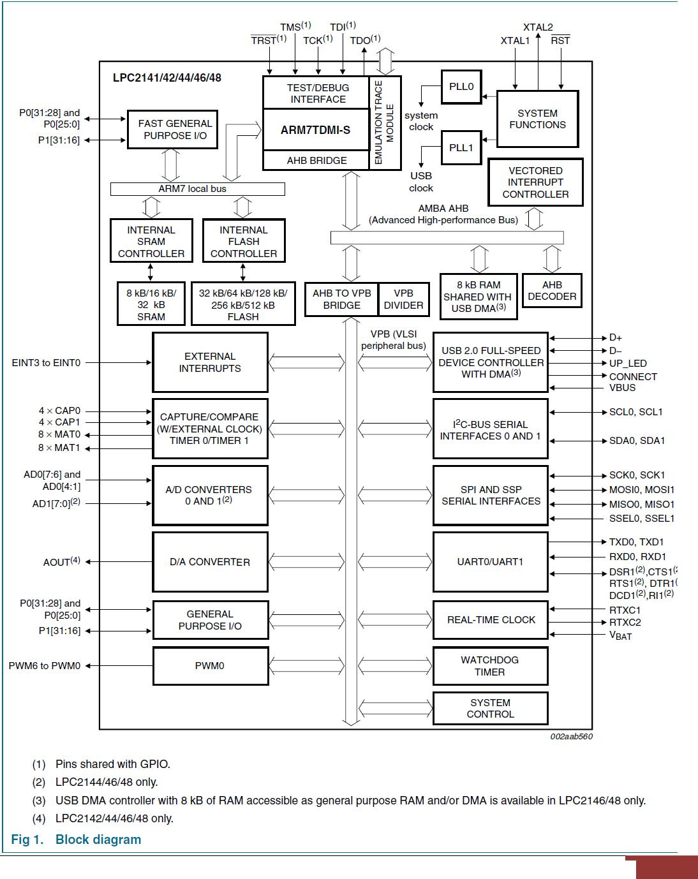
Architecture of LPC2148 (Block Diagram and Its Description):

Slide 5
Architecture of LPC2148 Cont…..
The LPC2148 is a general purpose 32bit microprocessor which offers high performance and very low power consumption.
The architecture is based on Reduced Instruction Set Computer (RISC) principles, and the instruction set and related decode mechanism are much simpler than those of micro programmed Complex Instruction Set Computers (CISC).This simplicity results in a high instruction throughput and impressive real time interrupt response from a small and cost-effective processor core.
Pipeline techniques are employed so that all parts of the processing and memory systems can operate continuously.
The key idea behind Thumb is that of a super reduced instruction set. Essentially, the LPC2148 processor has two instruction sets: The standard 32bit ARM set
16bit Thumb set:
The Thumb set‟s 16-bit instruction length allows it to approach twice the density of standard ARM code while retaining most of the ARM‟s performance advantage over a traditional 16-bit processor using 16-bit registers.
This is possible because Thumb code operates on the same 32-bit register set as ARM code.
Thumb code is able to provide up to 65 % of the code size of ARM, and 160 % of the performance of an equivalent ARM processor connected to a 16-bit memory system

Slide 6
Architecture of LPC2148 Cont…..
On-Chip Flash Memory
The LPC2148 incorporate a 512 kB flash memory system.
This memory may be used for both code and data storage
Interrupt Controller
The Vectored Interrupt Controller (VIC) accepts all of the interrupt request inputs and categorizes them as:
Fast Interrupt Request (FIQ): have the highest priority
Vectored Interrupt Request (IRQ): have the middle priority
Non vectored IRQ: have the lowest priority
Fast General Purpose Parallel I/O(GPIO)
Device pins that are not connected to a specific peripheral function are controlled by the GPIO registers.
Pins may be dynamically configured as inputs or outputs
All GPIO registers are byte addressable.
Entire port value can be written in one instruction
10 bit ADC
The LPC2148 contains two analog to digital converters.
These converters are single 10bit successive approximation analog to digital converters.
While ADC0 has six channels, ADC1 has eight channels. Therefore, total number of available ADC inputs for LPC2148 is 14.

Slide 7
Architecture of LPC2148 Cont…..
10 bit DAC
The DAC enables the LPC2148 to generate a variable analog output.
The maximum DAC output voltage is the VREF voltage
UARTs (Universal Asynchronous Receiver and Transmitter)
The LPC2148 contains two UARTs, UART0 and UART1
16 byte Receive and Transmit FIFOs (First In First Out)
Built-in fractional baud rate generator covering wide range of baud rates without a need for external crystals of particular values
I2CBus serial I/O Controller
The LPC2148 contains two I2Cbus controllers.
The I2Cbus is bidirectional
For inter IC control using only two wires: A serial clock line (SCL), A serial data line (SDL)
SPI (Serial Peripheral Interface) I/O Controller
The LPC2148 contains one SPI controller.
The SPI is a full duplex serial interface, designed to handle multiple masters and slaves connected to a given bus.
Only a single master and a single slave can communicate on the interface during a given data transfer

Slide 8
Architecture of LPC2148 Cont…..
Crystal Oscillator
On chip integrated oscillator operates with external crystal in range of 1 MHz to 25 MHz.
Watchdog timer
The purpose of the watchdog is to reset the microcontroller within a reasonable amount of time if it enters an erroneous state.
Real-time clock
Measures the passage of time to maintain a calendar and clock.
Ultra-low power design to support battery powered systems.
Provides Seconds, Minutes, Hours, Day of Month, Month, Year, Day of Week, and Day of Year

Slide 9
System Control block (PLL & VPB Divider)
The System Control Block includes several system features and control registers for a number of functions that are not related to specific peripheral devices. These include:
Crystal Oscillator: On-chip integrated oscillator operates with external crystal in range of 1 MHz to 25 MHz
External Interrupt Inputs:
The LPC2148 includes four External Interrupt Inputs as selectable pin functions.
The External Interrupt Inputs can optionally be used to wake up the processor from Power-down mode.
Memory Mapping Control:
The Memory Mapping Control alters the mapping of the interrupt vectors that appear beginning at address 0x0000 0000.
This allows code running in different memory spaces to have control of the interrupts.
Power Control:
The LPC2141/2/4/6/8 supports two reduced power modes: Idle mode and Power-down mode
The Power Control function contains two registers PCON (Power Control Register), PCONP (Power Control for Peripherals Register)
Reset:
PLL
VPB Divider

Slide 10
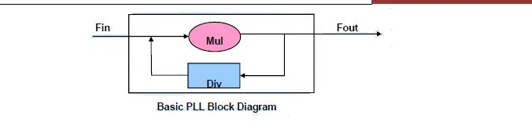
PLL (Phased Lock Loop):
PLL is a closed loop control system to generate high frequency by multiplying with given factor to the input frequency.
There are two PLL modules in the LPC2141/2/4/6/8 microcontroller. The PLL0 is used to generate the CCLK clock (system clock) while the PLL1 has to supply the clock for the USB at the fixed rate of 48 MHz
The PLL0 and PLL1 accept an input clock frequency in the range of 10MHz to 25 MHz only. The input frequency is multiplied up the range of 10 MHz to 60 MHz for the CCLK and 48 MHz for the USB clock using a Current Controlled Oscillators (CCO).
The multiplier can be an integer value from 1 to 6 due to the upper frequency limit of the CPU.
The output divider may be set to divide by 2, 4, 8, or 16 to produce the output clock.
Since the minimum output divider value is 2, it is insured that the PLL output has a 50% duty cycle

Slide 11
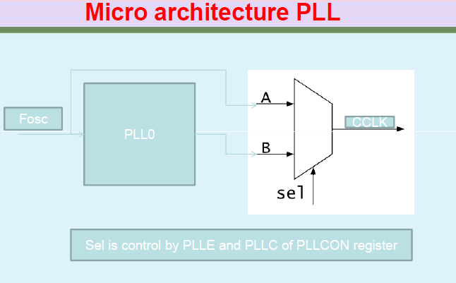
PLL Architecture

Slide 12
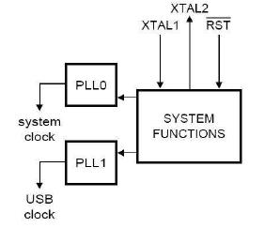
PLL (Phased Lock Loop): Cont…
 | Element |  |  | Description
 | FOSC |  |  | The frequency from the crystal oscillator/external oscillator
FCCO |  |  |  | The frequency of the PLL current controlled oscillator
 | CCLK |  |  | The PLL output frequency (also the processor clock frequency)
M |  |  |  | PLL Multiplier value from the MSEL bits in the PLLCFG register
 | P |  |  | PLL Divider value from the PSEL bits in the PLLCFG register
 |  |  |  | Table : Elements determining PLL’s frequency
 |  |  |  |  |  | 8

Slide 13
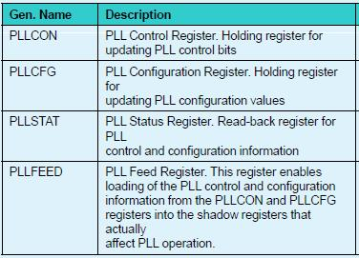
PLL Registers
PLL activation is controlled via the PLLCON register.
The PLL multiplier and divider values are controlled by the PLLCFG register.
These two registers are protected in order to prevent accidental alteration of PLL parameters or deactivation of the PLL.
Since all chip operations, including the Watchdog Timer, are dependent on the PLL0 when it is providing the chip clock, The same concern is present with the PLL1 and the USB

Slide 14
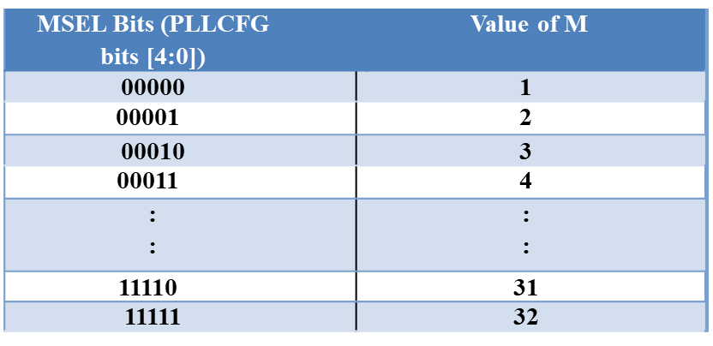
PLL Programming:
Steps for PLL programming
Select the desired operating frequency for your system (Processor operating frequency) CCLK.
Check the oscillator connected to the controller on board. (FOSC)
Calculate the value of PLL multiplier “M”. CCLK = M × FOSC
Find the value of PLL Divider “P” in such a way that is in the range of 156 MHz to 320 MHz.
156 < FCCO < 320 = CCLK x 2 x P
Write the values PLLCON and PLLCFG.
Write the PLLFEED Values 0xAA and 0x55.
Wait for PLL to lock.
Connect the PLL.
 |  | PSEL Bits (PLLCFG bits |  |  |  |  | Value of P
 |  | [6:5])
 |  | 00 |  |  |  |  | 1
 | 01 |  |  |  |  | 2
 |  | 10 |  |  |  |  | 4
 | 11 |  |  |  |  | 8
Table 1: PLL Divider values
Table 2 : PLL Multiplier values

Slide 15
PLL0 and PLL1 configuring examples:
Example 1: an application not using the USB - configuring the PLL0 System design asks for FOSC= 10 MHz and requires CCLK = 60 MHz. Based on these specifications,
M = CCLK / Fosc = 60 MHz / 10 MHz = 6.
Consequently,
M - 1 = 5 will be written as PLLCFG[4:0]
Value for P can be derived from P = FCCO/ (CCLK x 2), using condition that FCCO must be in range of 156 MHz to 320 MHz.
Assuming the lowest allowed frequency for FCCO = 156 MHz, P = 156 MHz / (2 x 60 MHz) = 1.3.
The highest FCCO frequency criteria produces P = 2.67.
The only solution for P that satisfies both of these requirements and is listed in Table1 is P = 2.
Therefore, PLLCFG[6:5] = 1 will be used.

Slide 16
Example 2: an application using the USB - configuring the PLL1
System design asks for FOSC= 12 MHz and requires the USB clock of 48 MHz. Based on these specifications,
M = 48 MHz / Fosc = 48 MHz / 12 MHz = 4.
Consequently,
M - 1 = 3 will be written as PLLCFG[4:0]
Value for P can be derived from P = FCCO / (48 MHz x 2), using condition that FCCO must be in range of 156 MHz to 320 MHz.
Assuming the lowest allowed frequency for FCCO = 156 MHz, P = 156 MHz / (2 x 48 MHz) = 1.625.
The highest FCCO frequency criteria produces P = 3.33.
Solution for P that satisfy both of these requirements and are listed in Table 1 are P = 2 and P = 3.
Therefore, either of these two values can be used to program PLLCFG[6:5] in the PLL1.

Slide 17
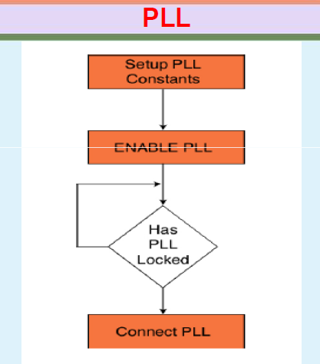
PLL Programming flow chart
No
Yes

Slide 18
VPB Divider:
The VPB divider determines the relationship between the processor clock (CCLK) and the clock used by peripheral devices (PCLK).
The VPB divider serves two purposes.
The first is to provide peripherals with the desired PCLK via VPB bus so that they can operate at the speed chosen for the ARM processor.
In order to achieve this, the VPB bus may be slowed down to 1⁄2 to 1⁄4 of the processor clock rate. Because the VPB bus must work properly at power-up (and its timing cannot be altered if it does not work since the VPB divider control registers reside on the VPB bus), the default condition at reset is for the VPB bus to run at 1⁄4 of the processor clock rate.
The second purpose of the VPB divider is to allow power savings when an application does not require any peripherals to run at the full processor rate. Because the VPB divider is connected to the PLL output, the PLL remains active (if it was running) during Idle mode .

Slide 19
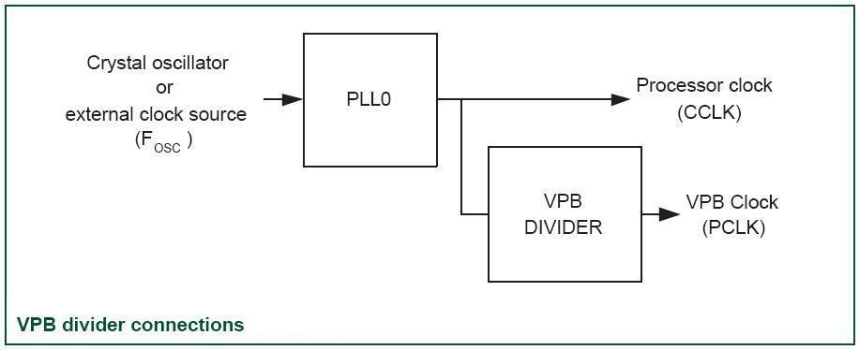
VPB Divider:
VPBDIV registers least 2 significant bits can be changed for desired PCLK
Peripherals on LPC2000 series can run at the full 60 MHz clock.

Slide 20
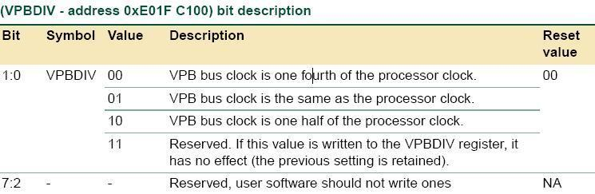
VPB Divider

Slide 21
Memory map
The basic concept on the LPC2148 is that each memory area has a "natural" location in the memory map.
This is the address range for which code residing in that area is written.
The bulk of each memory space remains permanently fixed in the same location, eliminating the need to have portions of the code designed to run in different address ranges.
LPC2148 memory map 0x00000000 ~ 0xFFFFFFFF space that 4G mapping space
In general, 0x00000000 started sequentially stored FLASH ,
SRAM - 0x40000000,
the APB (low-speed peripherals address, such as GPIO, UART) - at 0xE0000000
AHB (high-speed peripherals: vector interrupt controller external memory controller) - from 0XF0000000

Slide 22
Memory map
On-chip flash memory system:
The LPC21418 incorporate a 512 kB Flash memory system.
This memory may be used for both code and data storage.
Programming of the Flash memory may be accomplished in several ways: 1)JTAG 2) ISP and 3)UART0 or by means of (IAP) capabilities.
The application program, using the IAP functions, may also erase and/or program the Flash while the application is running.
When the LPC2148 on-chip boot loader is used, 500 kB of Flash memory is available for user code (12 KB is used by boot loader).
On-chip Static RAM (SRAM):
On-chip Static RAM (SRAM) may be used for code and/or data storage.
The LPC2148 provide 32 kB of static RAM.
The LPC2148 SRAM is designed to be accessed as a byte addressed memory.
The SRAM controller incorporates a write-back buffer in order to prevent CPU stalls during back-to-back writes. The write-back buffer always holds the last data sent by software to the SRAM.
8 KB RAM shared with USB DMA.
To access any peripheral we need its address. The entire address space can be divided in to several sections.

Slide 23
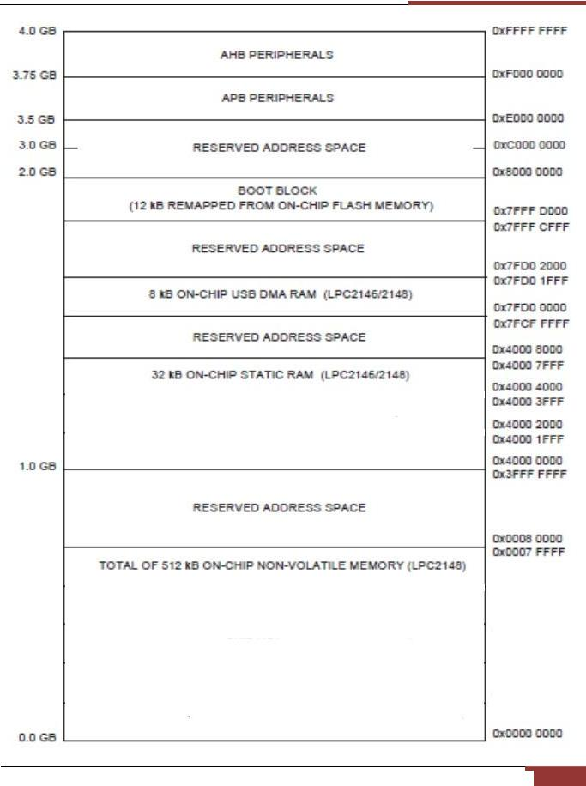
Memory map

Slide 24
Memory map
Because of the location of the interrupt vectors on the ARM7 processor (at addresses 0x0000 0000 through 0x0000 001C,) a small portion of the Boot Block and SRAM spaces need to be re-mapped in order to allow alternative uses of interrupts in the different operating modes Re-mapping of the interrupts is accomplished via the Memory Mapping Control feature
Peripheral memory Map (AHB, APB):
Figures 3 show different views of the peripheral address space.
Both the AHB and APB peripheral areas are 2 megabyte spaces which are divided up into 128 peripherals. Each peripheral space is 16 kilobytes in size.
This allows simplifying the address decoding for each peripheral.
All peripheral register addresses are word aligned (to 32-bit boundaries) regardless of their size.

Slide 25
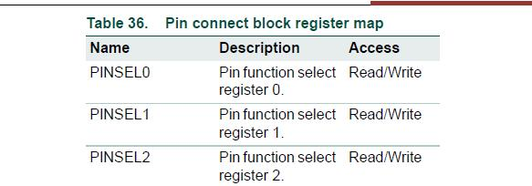
Pin Connect Block:
It is a 32 bit processor, consists of two ports (P0, P1) each of 32 pins. i.e total number of pins =64.
Out of above two ports, P0 is fully available to user to access any data or take data.
For P1, lower half (LSB-16 bit) is used by processor itself & not available for user whereas upper half (MSB-16 bit)is available for user
The pin connect block allows selected pins of the microcontroller to have more than one function. Configuration registers control the multiplexers to allow connection between the pin and the on chip peripherals.
Peripherals should be connected to the appropriate pins prior to being activated, and prior to any related interrupt(s) being enabled.
Activity of any enabled peripheral function that is not mapped to a related pin should be considered undefined.
Selection of a single function on a port pin completely excludes all other functions otherwise available on the same pin.
To enable pin functions three 32 bit PINSEL registers: PINSEL0, PINSEL1 and PINSEL2 are used

Slide 26
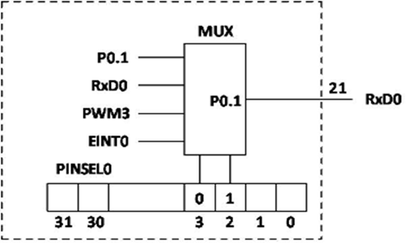
PINSEL0:
contains GPIO pins P0.0 to P0.15
This is of 32 bit register
Group of two bits starting from LSB decides the function of each pin of respective port

Slide 27
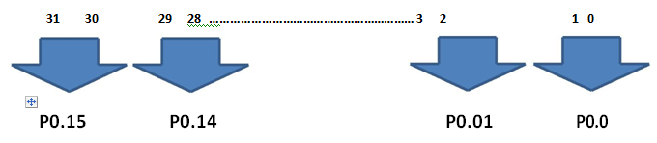
 |  | Bit |  |  | Value |  |  | function
 |  |  |  |  | 00 |  |  | GPIO Port 0.0
 |  | P0.0 |  | 01 |  |  |  | TXD (UART0)
 |  |  |  |  | 10 |  |  | PWM1
 |  |  |  | 11 |  |  |  | Reserved
 |  | P0.1
 |  | :
 |  | :
 |  | P0.15
If we want to choose P0.0 as TXD then we have
to write PINSEL0=0x00000001
If we want to choose P0.0 as PWM1 then write
PINSEL0=ox00000002

Slide 28
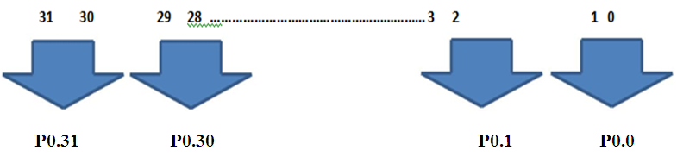
PINSEL1:
contains GPIO pins P0.16 to P0.31
Pin Select register controls the function of the pins as per the setting done in the register by user/ programmer
 |  | Bit |  |  | Value |  |  | function
 |  |  |  |  | 00 |  |  | GPIO Port 0.16
 |  | P0.16 |  |  | 01 |  |  | EINT0
 |  |  |  |  | 10 |  |  | Match 0.2 (Timer 0)
 |  |  |  |  | 11 |  |  | Capture 0.2 (Timer 1)
 |  | P0.17
 |  | :
 |  | :
 |  | P0.31

Slide 29
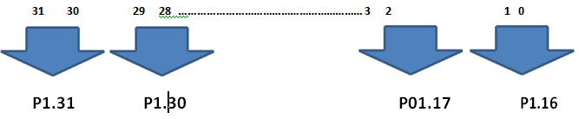
PINSEL2
PINSEL 2 is a special case, and is used to control whether pins P1.16..31 are used as GPIO pins, or as a Debug port in combination with a hardware JTAG debugger

Slide 30
GPIO (General Purpose Input Output) :
GPIO:
Device pins that are not connected to a specific peripheral function are controlled by the GPIO registers.
Pins may be dynamically configured as inputs or outputs.
Separate registers allow setting or clearing any number of outputs simultaneous
The value of the output register may be read back, as well as the current state of the port pins.
LPC2141/42/44/46/48 introduce accelerated GPIO functions over prior LPC2000 devices
Accelerated GPIO functions:
GPIO registers are relocated to the ARM local bus so that the fastest possible I/O timing can be achieved
Mask registers allow treating sets of port bits as a group, leaving other bits unchanged
All registers are byte and half-word addressable
Entire port value can be written in one instruction
GPIO Pin Description:
 | Pin |  |  | Type |  |  | Description
 | P0.0-P.31 |  |  | Input/ |  |  | General purpose input/output. The
 |  |  |  | Output |  |  | number of GPIOs actually available
 | P1.16-P1.31
 |  |  |  |  |  |  | depends on the

Slide 31
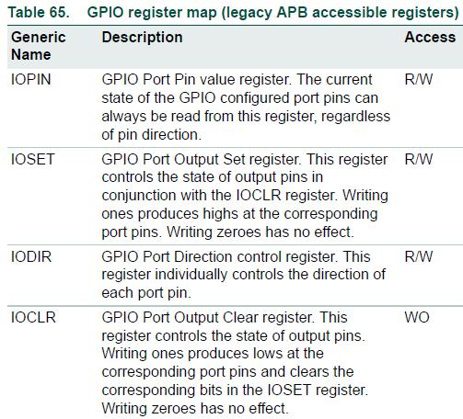
Register description:

Slide 32

IODIR
IODIR 0:
Each register is of 32 bit & each bit corresponds to each pins of respective port (port 0)
31 30 29 ……… 3 2 1 0
P0.31 P0.30 P0.29 …….. P0.03 P0.02 P0.01 P0.0
If IODIR0 = 1 i.e 00000001H
IODIR 0 ⁼ 1 then Output (P 0.0)
If IODIR 0 = 0 i.e 00000000H
IODIR 0 = 0 then Input (P 0.0)

Slide 33
IODIR Cont….
IODIR 1:
As, P1.0 to P1.15 pins is not available for programmers use. Setting or clearing of these bits will not affect the execution of program.
31 30 29 …… 3 2 1 0
P1.31 P1.30 P1.29 ……… P1.03 P1.02 P1.01 P1.0
IODIR 1 = 1 Output
IODIR 1 = 0 Input

Slide 34

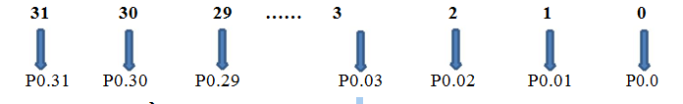
IOSET 0 / IOSET 1:
In order to SET the particular bit of port 0 & 1 IOSET Register are used
IOCLR 0 /IOCLR 1:
In order to CLR the particular bit of port 0 & 1 IOCLR Register are used
IOCLR 0.0 = 1 Will be cleared (0V)
IOCLR 0.0 = 0 P0.0 No Change in previous logic

Slide 35
Timer
Features of Timers
A 32-bit Timer/Counter with a programmable 32-bit Prescaler.
Counter or Timer operation
Up to four 32-bit capture channels per timer, that can take a snapshot of the timer value when an input signal transitions. A capture event may also optionally generate an interrupt.
Four 32-bit match registers that allow:
Continuous operation with optional interrupt generation on match.
Stop timer on match with optional interrupt generation.
Reset timer on match with optional interrupt generation.
Up to four external outputs corresponding to match registers, with the following capabilities:
Set low on match.
Set high on match.
Toggle on match.
Do nothing on match
Applications of Timers:
Interval Timer for counting internal events.
Pulse Width Demodulator via Capture inputs.
Free running timer.

Slide 36
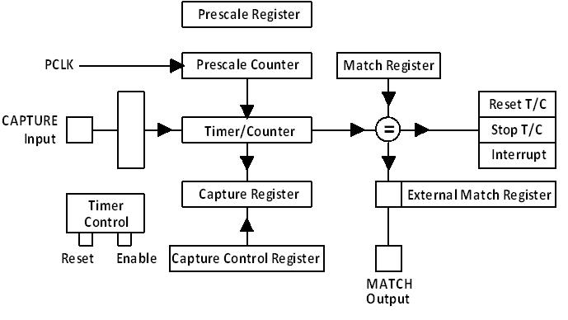
Block diagram of timer

Slide 37
Timer Cont….
Timer Basic:
LPC2148 comes loaded with two 32-bit-Timer blocks.
Each Timer block can be used as a „Timer‟ (like for e.g. triggering an interrupt every „t‟ microseconds) or as a „Counter‟ and can be also used to demodulate PWM signals given as input.
A timer has a Timer Counter(TC) and Prescale Register(PR) associated with it. When Timer is Reset and Enabled TC is set to 0 and incremented by 1 every
„PR+1′ clock cycles. When it reaches its maximum value it gets reset to 0 and hence restarts counting.
Prescale Register is used to define the resolution of the timer.
If PR=0 then TC is incremented every 1 clock cycle of the peripheral clock.
If PR=1 then TC is incremented every 2 clock cycles of peripheral clock and so on.
Each Timer has four 32-bit Match Registers and four 32-bit Capture Registers

Slide 38
Timer Cont….
Match Register (T0MR0/T1MR)
A Match Register is a Register which contains a specific value set by the user. When the Timer starts – every time after TC is incremented the value in TC is compared with match register. If it matches then it can Reset the Timer or can generate an interrupt as defined by the user. We are only concerned with match registers in this tutorial.
Match Registers can be used to:
Stop Timer on Match(i.e when the value in count register is same as than in Match register) and trigger an optional interrupt.
Reset Timer on Match and trigger an optional interrupt.
To count continuously and trigger an interrupt on match.
Capture Registers:
As the name suggests it is used to Capture Input signal. When a transition event occurs on a Capture pin , it can be used to copy the value of TC into any of the 4 Capture Register or to generate an Interrupt. Hence these can be also used to demodulated PWM signals.
Timer Match Control Register: The Match control register is used to specify the operation whenever a match occurs between the value stored in T0MR0 and T0TC register.

Slide 39
Timer Cont….
Timer Registers:
PR : Prescale Register (T0PR/T1PR)(32 bit) – Stores the maximum value of Prescale counter after which it is reset.
PC : Prescale Counter Register (T0PC/T1PC)(32 bit) –The 32-bit Prescale Counter controls division of PCLK by some constant value before it is applied to the Timer Counter. This register increments on every PCLK(Peripheral clock). When it reaches the value stored in the Prescale Register, the Timer Counter is incremented and the Prescale Counter is reset on the next PCLK. If PR=0 then Timer Counter Increments on every 1 PCLK. If PR=9 then Timer Counter Increments on every 10th cycle of PCLK.
TC : Timer Counter Register (32 bit) (T0TC/T1TC) – This is the main counting register. Timer Counter increments when PC reaches its maximum value as specified by PR. If timer is not reset explicitly(directly) or by using an interrupt then it will act as a free running counter which resets back to zero when it reaches its maximum value which is 0xFFFFFFFF.
TCR : Timer Control Register(T0TCR/T1TCR) – This register is used to enable , disable and reset TC. When bit0 is 1 timer is enabled and when 0 it is disabled. When bit1 is set to 1 TC and PC are set to zero together in sync on the next positive edge of PCLK. Rest of the bits of TCR are reserved.

Slide 40
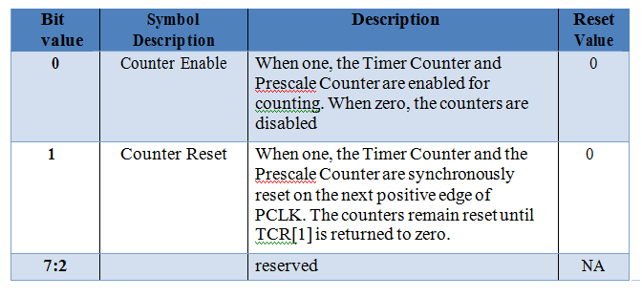
Timer Cont….

Slide 41
Timer Cont….
CTCR : Count Control register – Used to select Timer/Counter Mode. When the value of the CTCR is set to 0×0 Timer Mode is selected.
MCR : Match Control register – This register is used to control which all operations can be done when the value in MR matches the value in TC. Bits 0,1,2 are for MR0 , Bits 3,4,5 for MR1 and so on..
For MR0:
Bit 0 : Interrupt on MR0 i.e trigger an interrupt when MR0 matches TC. Interrupts are enabled when set to 1 and disabled when set to 0.
Bit 1 : Reset on MR0. When set to 1 , TC will be reset when it matched MR0. Disabled when set to 0.
Bit 2 : Stop on MR0. When set to 1 , TC & PC will stop when MR0 matches TC. Similarly bits 3-5 , 6-8 , 9-11 are for MR1 , MR2 , MR3 respectively.
IR : Interrupt Register – It contains the interrupt flags for 4 match and 4 capture interrupts. Bit0 to bit3 are for MR0 to MR3 interrupts respectively. And similarly the next 4 for CR0-3 interrupts. when an interrupt is raised the corresponding bit in IR will be set to 1 and 0 otherwise. Writing a 1 to the corresponding bit location will reset the interrupt – which is used to acknowledge the completion of the corresponding ISR execution.

Slide 42
Timer Cont….
Steps for configuring timers:
Set appropriate value in TxCTCR
Define the Prescale value in TxPR
Set Value(s) in Match Register(s) if required
Set appropriate value in TxMCR if using Match registers / Interrupts
Reset Timer –Which resets PR and TC
Set TxTCR to 0×01 to Enable the Timer when required
Wait till the interrupt and then clear the flag by writing T0IR register
Reset TxTCR to 0×00 to Disable the Timer when required

Slide 43
Prescale Register Value Calculation
The delay or time required for 1 clock cycle at PCLK=‘X’ MHz is given by :
Delay = 1/(X*1000000) Seconds
ASSUME PCLK = 60 MHz
Hence in our case when PR=0 i.e TC increments at every PCLK the delay required for TC to increment by 1 is:
Delay = (0+1)/(60*1000000) Seconds
Similarly when we set PR = 59999 the delay in this case will be:
Delay = (59999+1)/(60*1000000) Seconds
Delay = 1mS
which boils down to 1/1000 = 0.001 Seconds which is nothing but 1 Milli-Second i.e mS. Hence the delay required for TC to increment by 1 will be 1mS.
For 1 microsecond PR= 59
For 1 second PR= 59999999

Slide 44
Timer Programming Example 1 Microsecond delay using timer
void DelayUS(unsigned int microseconds)
{
T0IR = 0;
T0TCR = 0;
T0PR = 59; //for = 1mS
T0PC = 0;
T0TC = 0;
T0TCR = 0x01; //enable timer
//wait until timer counter reaches the desired delay
while(T0TC < 1 ms);
T0TCR = 0x00; //disable timer
}

Slide 45
1 Millisecond delay using timer
void DelayMS(unsigned int milliseconds)
{
T0IR = 0;
T0TCR = 0;
T0PR = 5999 For 1 mS delay
T0PC = 0;
T0TC = 0;
T0TCR = 0x01; //enable timer
//wait until timer counter reaches the desired delay
while(T0TC < milliseconds);
T0TCR = 0x00; //disable timer
}

Slide 46
1 Second delay using timer
void DelayS(unsigned int seconds)
{
T0IR = 0;
T0TCR = 0;
T0PR = 59999999 ; for = 1 Second delay
T0PC = 0;
T0TC = 0;
T0TCR = 0x01; //enable timer
//wait until timer counter reaches the desired delay
while(T0TC < seconds);
T0TCR = 0x00; //disable timer
}

Slide 47
Interfacing LEDs to ARM 7 Controller- (LPC2148 ):
Light Emitting Diodes (LEDs) are popularly used display components used to indicate the ON and OFF state of a system. These are also used to realize various counters like binary counters experimentally. These LEDs can be easily interfaced with the Port pins of any Microcontroller by using current limiting resistors of the order of 220 Ohms.
The diagram below shows the interfacing of LED array to the Port1 pins of LPC2148 ARM 7 microcontroller

Slide 48
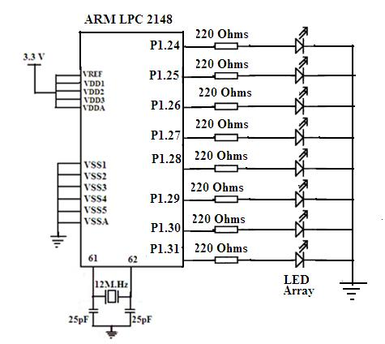
Interfacing LEDs to ARM 7 Controller (LPC2148)

Slide 49
Program to Blink LED
This program blinks the LEDs continuously with a small delay. The LEDs are connected to the Port1 pins P1.24 to P1.31 and the these pins are configured as General Purpose output pins.
Algorithm
1) Start
2) Make PINSEL2= 0X00000000
3) IO1DIR = 0XFF000000 to make each pin of port as output
4) IO1SET=0XFF000000 Pins P1.24 to P1.31 goes to high state
5) IO1CLR=0XFF000000; Pins P1.24 to P1.31 goes to low state
6) Repeat the steps 5 and 6

Slide 50
Program to Blink LED
#include<lpc2148.H> //LPC2148 Header
void main()
{
PINSEL2 = 0X00000000; // Set P1.24 TO P1.31 as GPIO
IO1DIR = 0XFF000000; //Port pins P1.24 to P 1.31 Configured as Output port.
while(1) //Infinite loop
{
IO1SET=0XFF000000; // Pins P1.24 to P1.31 goes to high state
delay();
IO1CLR=0XFF000000; // Pins P1.24 to P1.31 goes to low state
delay() ;
}
}

Slide 51
Program to Blink LED Cont..
void delay()
{
Int i, int j;
for( i=0x00;i<=0xff;i++)
for(j=0x00;j<=0xFf;j++) ; // Delay program
}

Slide 52
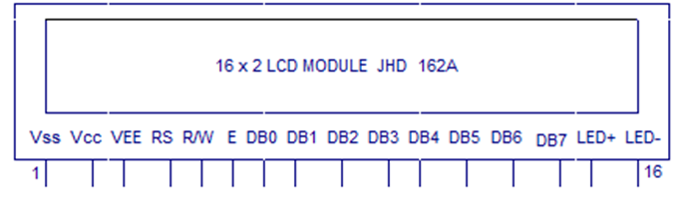
Liquid Crystal Display(LCD):
Liquid Crystal Display(LCD):
Liquid Crystal Display(LCDs) provide a cost effective way to put a text output unit for a microcontroller.
Most of the 16x2 LCDs use a Hitachi HD44780 or a compatible controller.

Slide 53
Interfacing LCD to ARM 7 Controller (LPC2148)
Sr. No. | Signal (LPC21xx) | Description
1 | Pin 16 (P1.16) | Data 0
2 | Pin 12 (P1.17) | Data 1
3 | Pin 8 (P1.18) | Data 2
4 | Pin 4 (P1.19) | Data 3
5 | Pin 48 (P1.20) | Data 4
6 | Pin 44 (P1.21) | Data 5
7 | Pin 40 (P1.22) | Data 6
8 | Pin 36 (P1.23) | Data 7
9 | Pin 13 (P0.28) | EN
10 | Pin 14 (P0.29) | RS
11 | GND | WR

Slide 54
LCD pin configuration

Slide 55
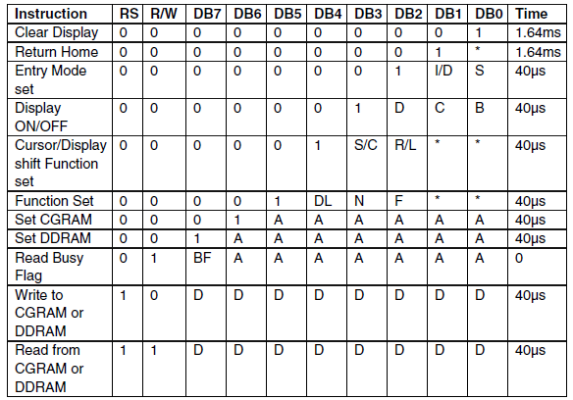
LCD Command

Slide 56
LCD command codes

Slide 57
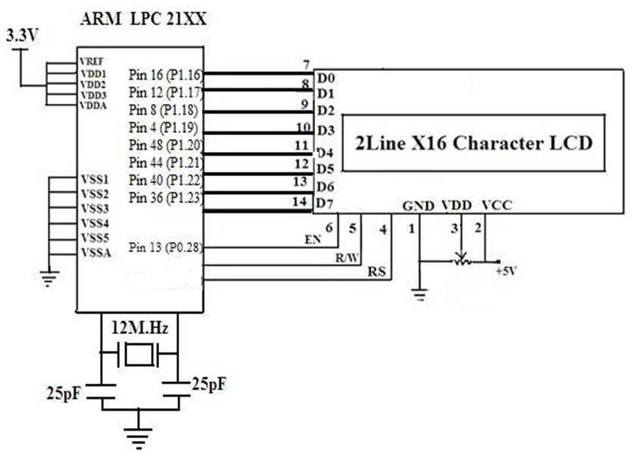
Interfacing Diagram of LCD With LPC2148
P0.29
P0.30

Slide 58
Algorithm to display message on LCD :
Start
Declare Functions & variables
Select the pins as per the schematic diagram with IODIR1and IODIR0 register.
Send the command with lcdcmd subroutine .Here, in lcdcmd subroutine command is sent through IOSET1 register and select the RS pin =0.
Give delay and clear the register with IOCLR1 register.
Send the data with lcddata subroutine .Here, in lcddata subroutine data is sent through IOSET1 register and select the pin RS=1
Give delay and clear the register with IOCLR1 register.

Slide 59
Program to display message on LCD
#include <LPC21xx.H>
#include<board.h>
void lcdcmd(unsigned int);
void lcddata(unsigned int);
void delay_lcd(void);
int main(void)
{
IODIR1=0X00FF0000;
IODIR0=0x70000000;
lcdcmd(0x38);
delay_lcd ();
lcdcmd(0x0e);
lcdcmd(0x01);
delay_lcd ();
lcdcmd(0x06);
delay_lcd ();
lcdcmd(0x84);
delay_lcd ();
lcddata (‘S’);
delay_lcd ();
lcddata (‘P’);
delay_lcd ();
lcddata (‘P’);
delay_lcd ();
lcddata (‘U’);
delay_lcd ();
while(1);
}

Slide 60
Program to display message on LCD Cont..
LCD Command Routine
LCD Data Routine
void lcdcmd(unsigned int cmddata)
{
IOCLR0=0X40000000;
IOCLR0=0x20000000;
cmddata = cmddata << 16;
IOSET1=cmddata;
IOCLR0=0x10000000;
delay_lcd();
IOSET0=0x10000000;
delay_lcd();
}
void lcddata(unsigned int outdata)
{
IOSET0=0x40000000;
IOCLR0=0x20000000;
outdata = outdata << 16;
IOSET1=outdata;
IOSET0=0x10000000;
delay_lcd();
IOCLR0=0x10000000;
delay_lcd();
}

Slide 61
Program to display message on LCD Cont..
dely_lcd Routine
void delay_lcd(void)
{
int j;
for (j=0;j<500;j++);
}

Slide 62
Working of Relay

Slide 63
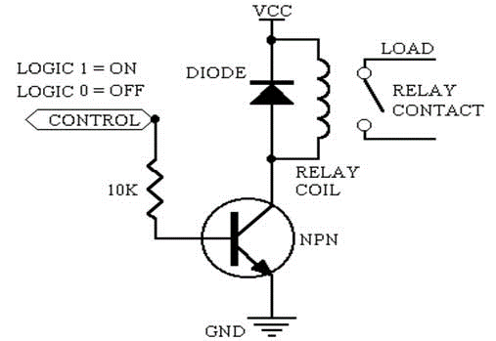
Interfacing of Relay with LPC 2148
LPC 2148
P 0.0

Slide 64
Program to turn Relay ON and Off
#include<lpc214x.h>
int main()
{
IO0DIR0=0xff;
while(1)
{
IO0SET= 0x01; //Relay ON
delay();
IO0CLR= 0x00; //Relay OFF
delay();
}
}
Void delay()
unsigned int i,j;
{
for(i=0;i<60000;i++)
for(j=0;j<80000;j++)
}

Slide 65
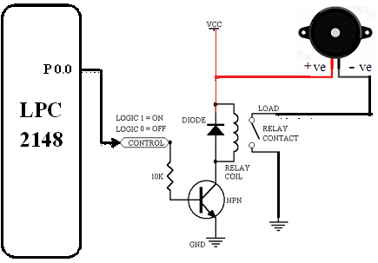
Interfacing of Buzzer using Relay with LPC 2148

Slide 66
Program to turn Buzzer ON and Off
#include<lpc214x.h>
int main()
{
IO0DIR0=0xff;
while(1)
{
IO0SET0= 0x01; //Relay ON, Buzzer On
delay();
IO0CLR= 0x00; //Relay OFF, Buzzer Off
delay();
}
}
Void delay()
unsigned int i,j;
{
for(i=0;i<60000;i++)
for(j=0;j<80000;j++)
}

Slide 67
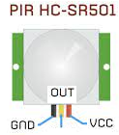

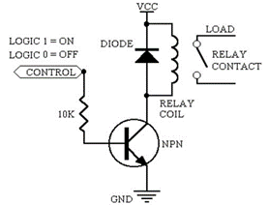
Interfacing Motion Sensor and Buzzer with LPC 2148
LPC 2148
Motion
Sensor
P0.05
P3.2
Buzzer
P0.1

Slide 68
Program to turn on buzzer in the presence of human
#include<lpc214x.h>
int main()
{
IO0DIR0=0x01;
While (1)
{
If IOPIN0== 0x01
{
IOSET0= 0x02;
delay();
IOCLR0= 0x02;
delay();
}
}
Void delay()
unsigned int i, j;
{
for(i=0;i<60000;i++)
for(j=0;j<80000;j++)
}

Slide 69
Interfacing of soil moisture sensor with LPC 2148
What is soil moisture sensor module
Soil moisture sensor consists of two conducting plates which function as a probe and acting as a variable resistor together. They are used to measure the volumetric content of water.
The two probes allow the current to pass through the soil, which gives the resistance value to measure the moisture value.
When the sensor is inserted into the water, the resistance will decrease and get better conductivity between plates.
Dry soil conducts electricity poorly, so when there is less water, then the soil will conduct less electricity, which means that there will be more resistance.

Slide 70
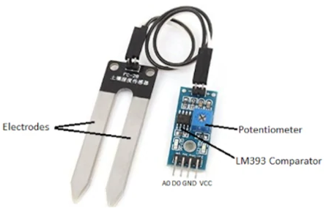
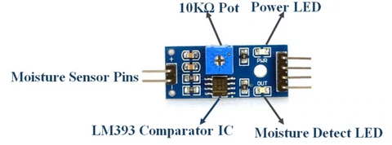
Interfacing of soil moisture sensor with LPC 2148
Soil moisture sensor pin out configuration
Pin Name | Description
VCC | The VCC pin powers the module, typically with +5V
GND | Power Supply Ground
DO | Digital Out Pin for Digital Output
AO | Analog out Pin for Analog Output

Slide 71
Interfacing of soil moisture sensor with LPC 2148

Slide 72
Program Using Digital output D0
#include<lpc214x.h> int main() {
PINSEL0=0X00000002;
while(1)
{
if (P0.0 == 1)
IO0SET- 0x0000002;
else
IO0SET- 0x0000000;
}
}

Slide 73
Program Using analog output A0
#include<lpc214x.h> void delay(void); int main() { int adcdata; float moisture; PINSEL0=0X00000000; PINSEL1=0X01000000; //Select P0.28 pin function as Analog i/p AD0CR=0x00210402; ///CHANNEL1 OF ADC0, ad freq=3MHz, while(1) { if(AD0DR1 & 0x80000000) ////EOC bit monitoring { adcdata=(AD0DR1 & 0x0000FFC0); adcdata=adcdata>>6; delay();
moisture = (100 - ( (adcdata/1024.00) * 100 ) ); } } }
void delay(void) { int i,j; for(i=0;i<1000;i++) for(j=0;j<10000;j++); }

Slide 74
Thank You
?

