Slide 1
Parkinson’s Disease Classification using Machine Learning Techniques
12-05

Slide 2
Approach Towards Project
01
02
03
04
What is Parkinson’s disease
About dataset and Data splitting
Selecting Features
Random Forest and decision Trees
05
06
07
08
Training Our Model
Outputs after training and Accuracy
Confusion Matrix and Classification Info
Discussion and Outro

Slide 3
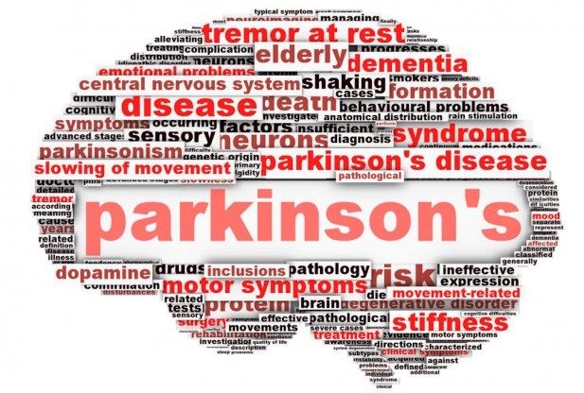
01
What’s Parkinson’s
12-05
Brain disease that causes unintended and uncontrollable movements

Slide 4
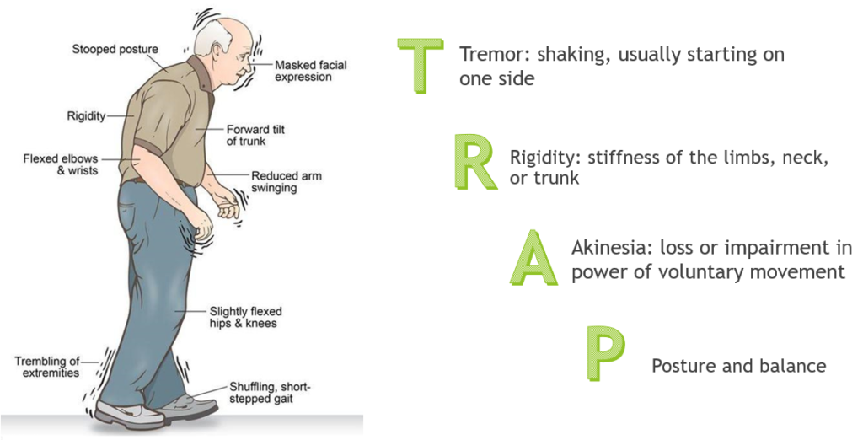
Symptoms Of Parkinson’s Disease
DYSARTHIA
Voice tremor and motor disabilities
GAIT DISTURBANCES
To investigate presence of correlations , which reflect underlying neural control mechanisms

Slide 5
02
Dataset and Splitting data
12-05

Slide 6
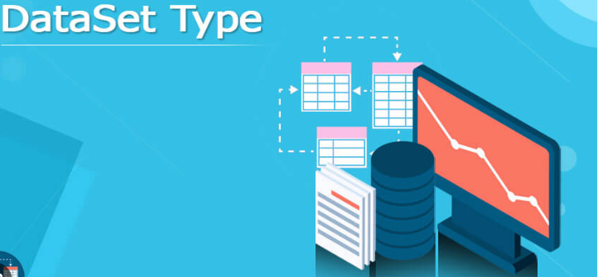
DATASET
How the dataset helps us ??
COLUMNS ->speech features
ROWS->Clients response to features in data set
Our Data set contains 756 rows and 755 columns.
*

Slide 7
Some Dataset features
PPE
NumPulses
Voice Intensity
Pitch Period Entropy reflects the irregularity or randomness of the pitch contour of speech.
NumPulses feature is a measure of distinct pulses in voice signal.
Parkinson’s disease can cause change in speech, including reduced loudness, monotone and hoarseness.
MFCC
DFA
Gender
Mel-Frequency Cepstyral Coefficients are a feature extraction technique commonly used in speech recognition tasks.
Detrended Fluctuation Analysis-used to quantify the presence of long range correlations in time series.
Parkinson’s disease is also dependent on the gender of the human being.

Slide 8
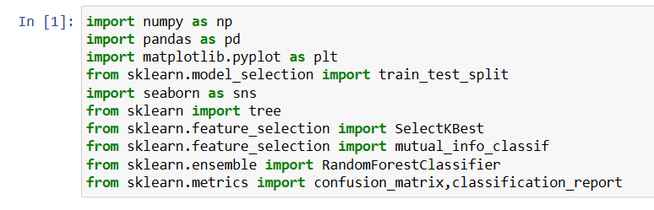
Importing required Libraries and Methods

Slide 9

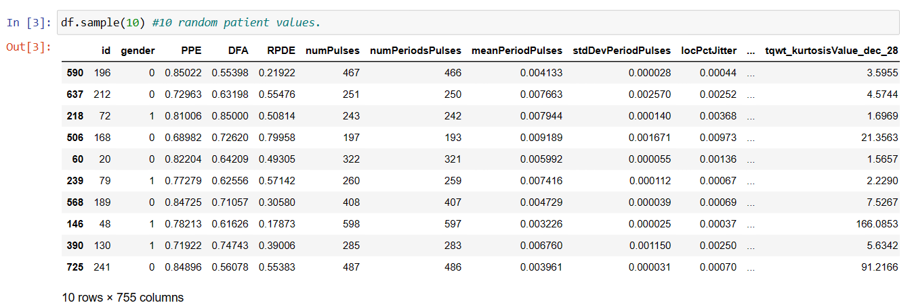
Data of 10 Random Patients

Slide 10
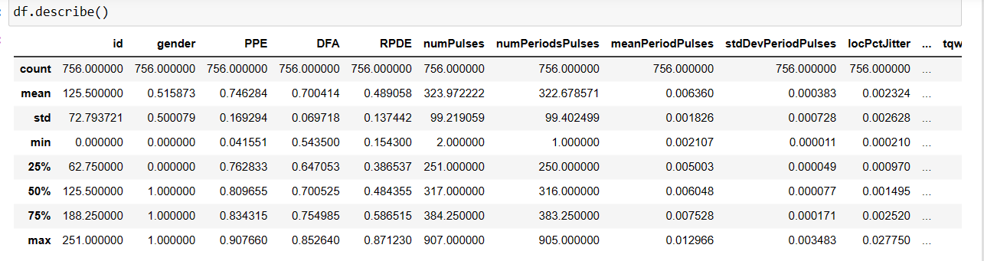
A Small Description about dataset
The describe() method is used for calculating some statistical data like percentile, mean and std of the numerical values of the Series or Data Frame

Slide 11
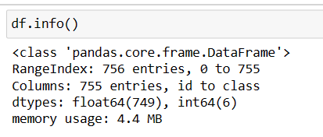
Gives information about dataset

Slide 12
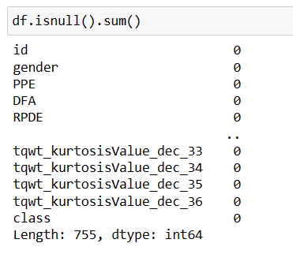
Null Value Checking
1.Checking whether there are null values or not for every feature
2.If null values are encountered, then its value gets replaced by the mean value of the remaining non null values

Slide 13
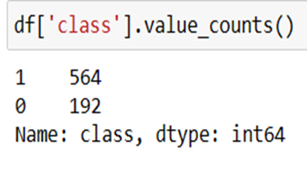
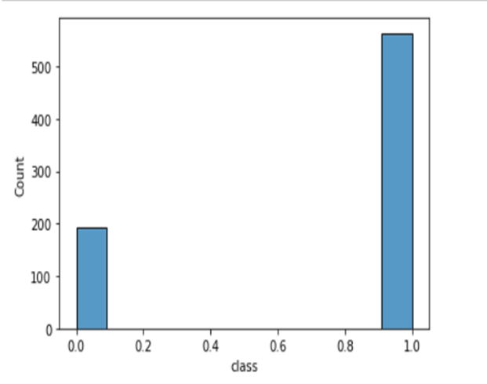
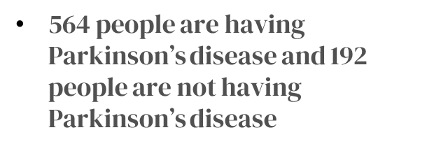

Slide 14
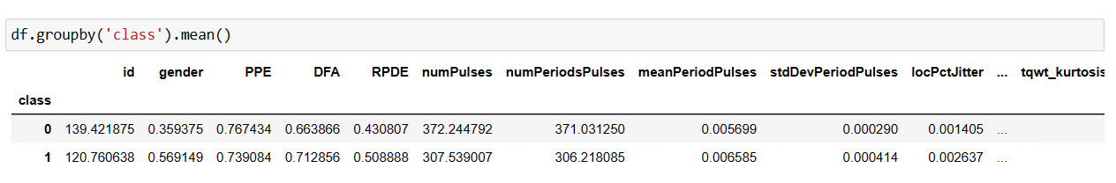
We group our data according to the target variable. So that we can make some small observations. For example, here we can see that numPulses and numPeriodPulses of healthy person are more than for a person with Parkinson’s.

Slide 15

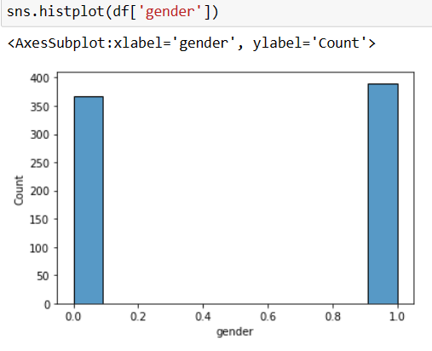
Here by this code, we got that our dataset contains 390 male patient records and 366 female patient records.

Slide 16

Splitting of Dataset into Dependent and Target Variables
In dependent variables we have every feature except ‘id’ and ‘class’. Class is output variable stored in variable “y”. We remove ‘id’ because the occurrence of disease doesn’t depend on Person’s id.

Slide 17
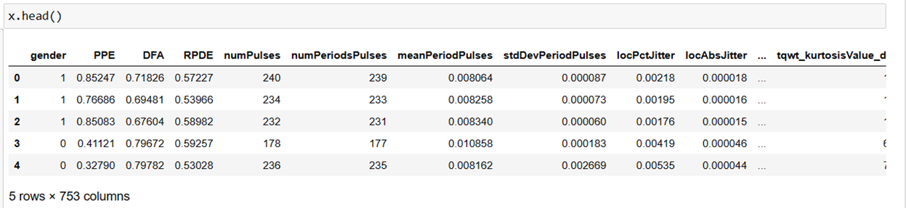
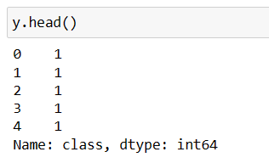

Slide 18
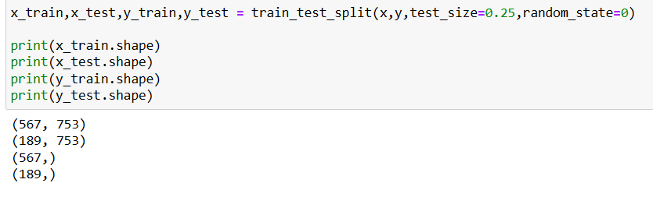
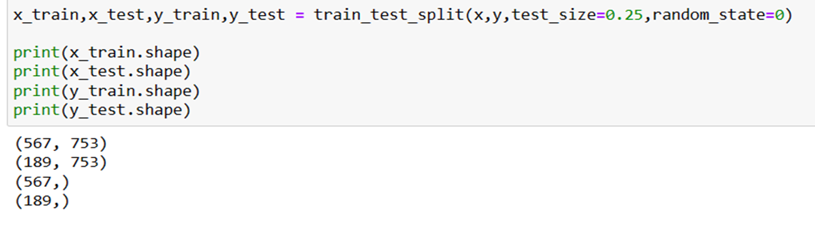
Splitting of dependent and target variables into Training and Test data
We split the data into train data and test data using train_test_split() method included in sklearn library. We mention test_size as 0.25, which means 25% of our data is test data and remaining is train data.

Slide 19
03
Selecting Features
12-05

Slide 20
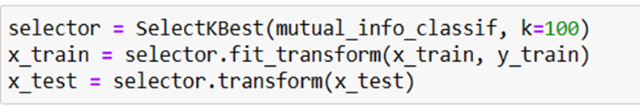
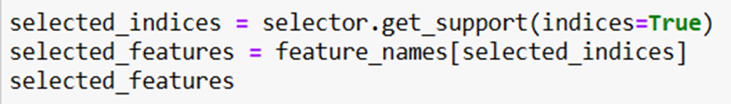
How we select best features
We select best features using “SelectKBest” method and we pass mutual_info_classif as argument which selects top K features according to mutual information of features
We store the selected features from above in a variable

Slide 21
Top 100 Features In Our Case
array(['gender', 'PPE', 'DFA', 'RPDE', 'numPulses', 'numPeriodsPulses', 'meanPeriodPulses', 'stdDevPeriodPulses', 'locPctJitter', 'locAbsJitter', 'rapJitter', 'ppq5Jitter', 'ddpJitter', 'locShimmer', 'locDbShimmer', 'apq3Shimmer', 'apq5Shimmer', 'apq11Shimmer', 'ddaShimmer', 'meanAutoCorrHarmonicity', 'meanNoiseToHarmHarmonicity', 'meanHarmToNoiseHarmonicity', 'minIntensity', 'maxIntensity', 'meanIntensity', 'f1', 'f2', 'f3', 'f4', 'b1', 'b2', 'b3', 'b4', 'GQ_prc5_95', 'GQ_std_cycle_open', 'GQ_std_cycle_closed', 'GNE_mean', 'GNE_std', 'GNE_SNR_TKEO', 'GNE_SNR_SEO', 'GNE_NSR_TKEO', 'GNE_NSR_SEO', 'VFER_mean', 'VFER_std', 'VFER_entropy', 'VFER_SNR_TKEO', 'VFER_SNR_SEO', 'VFER_NSR_TKEO', 'VFER_NSR_SEO', 'IMF_SNR_SEO', 'IMF_SNR_TKEO', 'IMF_SNR_entropy', 'IMF_NSR_SEO', 'IMF_NSR_TKEO', 'IMF_NSR_entropy', 'mean_Log_energy', 'mean_MFCC_0th_coef', 'mean_MFCC_1st_coef', 'mean_MFCC_2nd_coef', 'mean_MFCC_3rd_coef', 'mean_MFCC_4th_coef', 'mean_MFCC_5th_coef', 'mean_MFCC_6th_coef', 'mean_MFCC_7th_coef', 'mean_MFCC_8th_coef', 'mean_MFCC_9th_coef', 'mean_MFCC_10th_coef', 'mean_MFCC_11th_coef', 'mean_MFCC_12th_coef', 'mean_delta_log_energy', 'mean_0th_delta', 'mean_1st_delta', 'mean_2nd_delta', 'mean_3rd_delta', 'mean_4th_delta', 'mean_5th_delta', 'mean_6th_delta', 'mean_7th_delta', 'mean_8th_delta', 'mean_9th_delta', 'mean_10th_delta', 'mean_11th_delta', 'mean_12th_delta', 'mean_delta_delta_log_energy', 'mean_delta_delta_0th', 'mean_1st_delta_delta', 'mean_2nd_delta_delta', 'mean_3rd_delta_delta', 'mean_4th_delta_delta', 'mean_5th_delta_delta', 'mean_6th_delta_delta', 'mean_7th_delta_delta', 'mean_8th_delta_delta', 'mean_9th_delta_delta', 'mean_10th_delta_delta', 'mean_11th_delta_delta', 'mean_12th_delta_delta', 'std_Log_energy', 'std_MFCC_0th_coef'], dtype=object)

Slide 22
04
Random Forest And Decision Trees
12-05

Slide 23
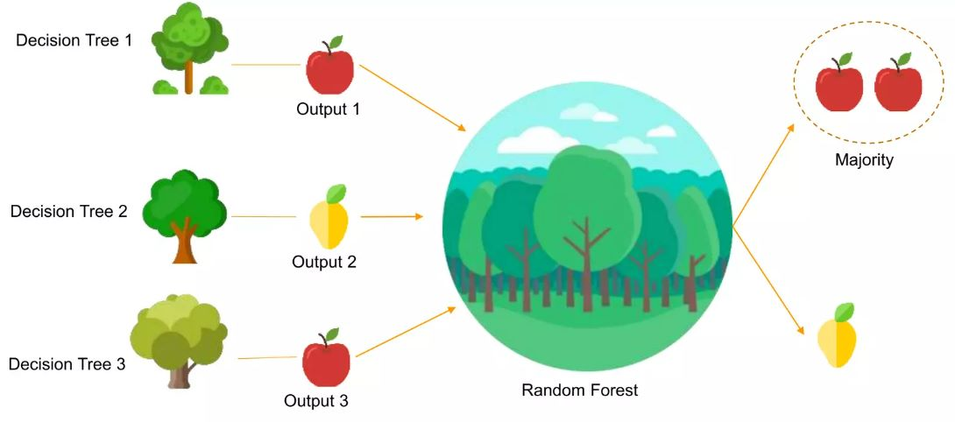
Random Forest

Slide 24
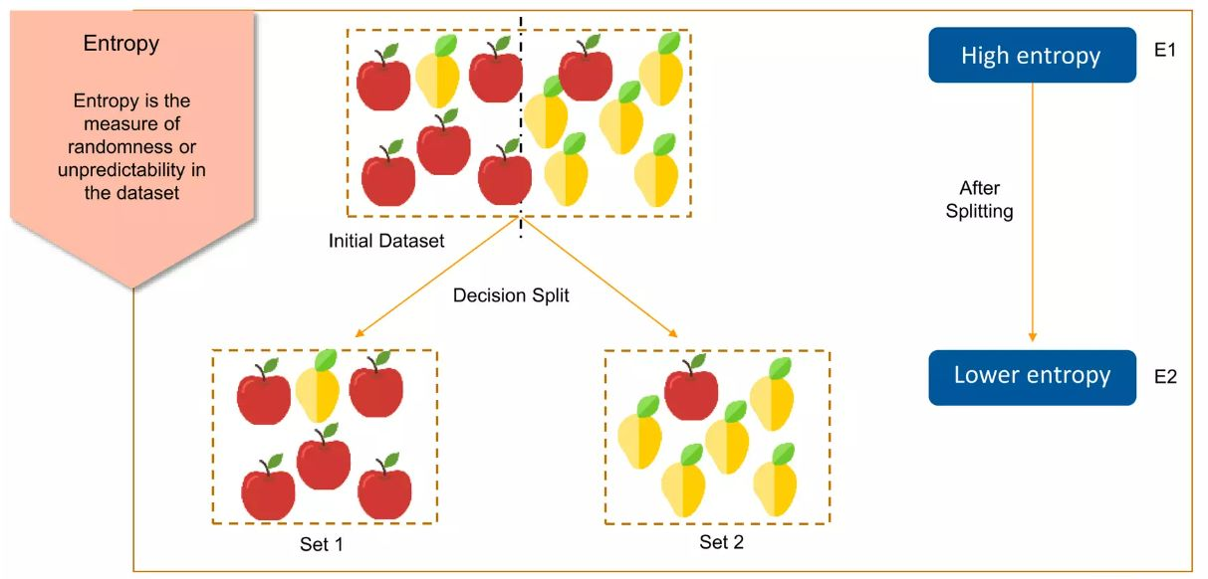
Decision Tree

Slide 25
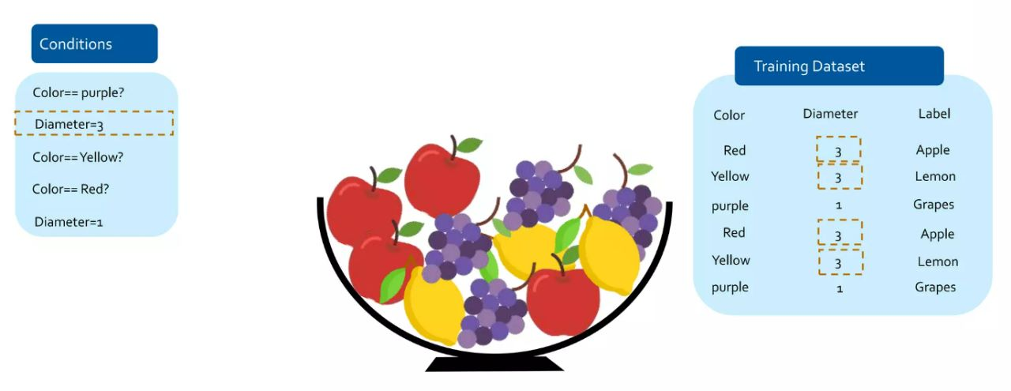
How Decision Tree Works??

Slide 26
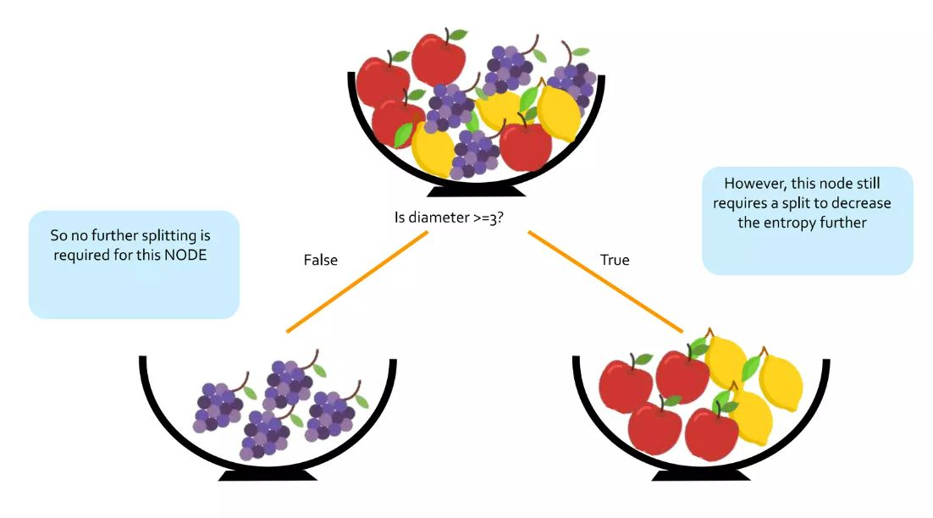

Slide 27
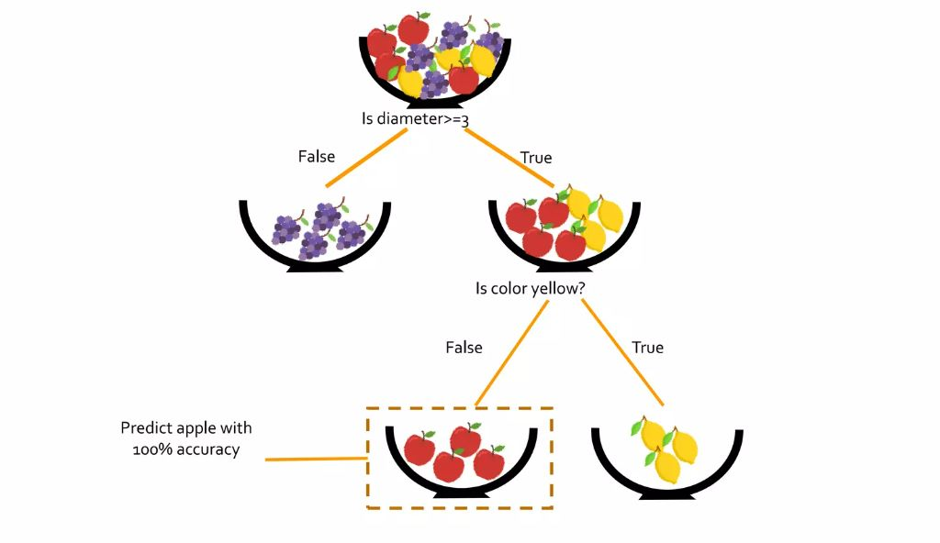

Slide 28
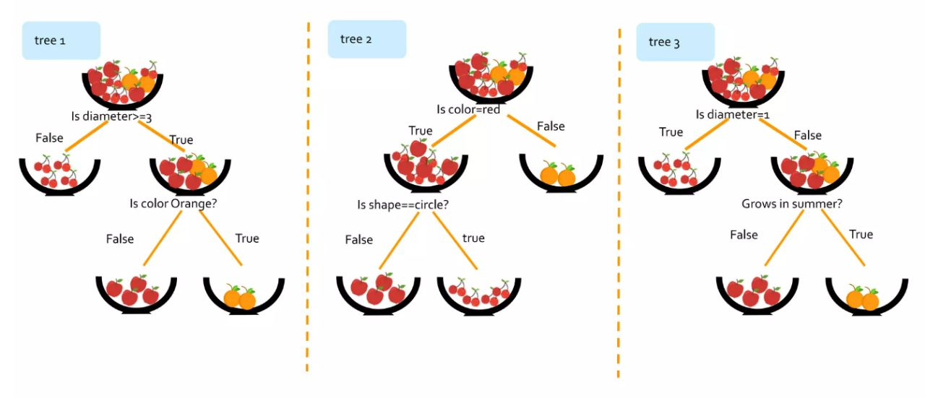
How Random Forest Uses Decision Trees for Prediction

Slide 29
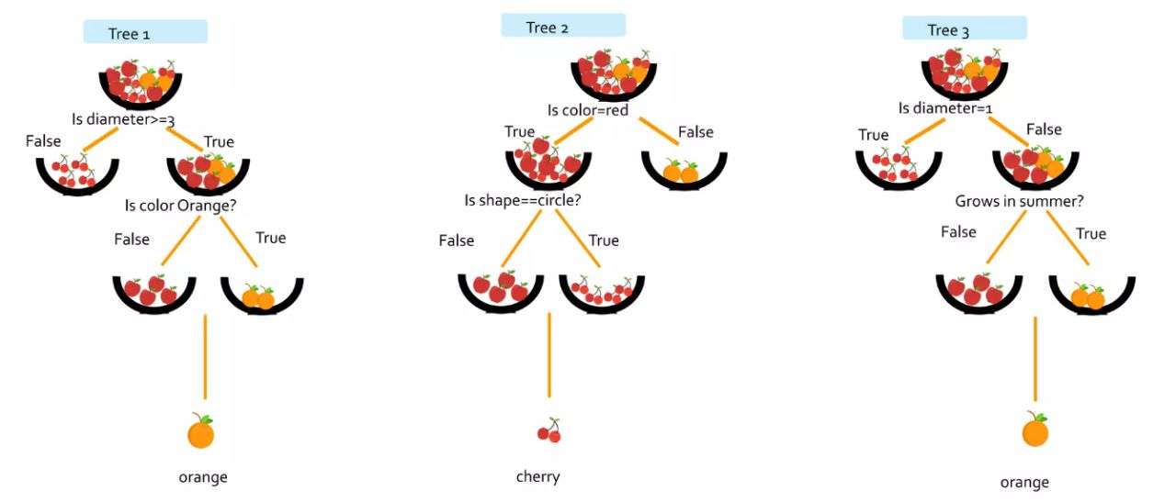

Slide 30
05
Training our Model
12-05

Slide 31
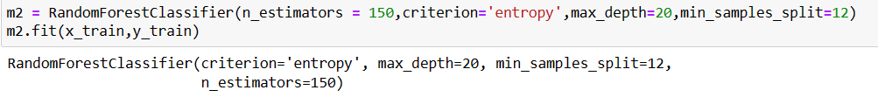
We create a random Forest classifier using n_estimators as 150 which means we used 150 Decision trees in our model and we use criterion as entropy for splitting in Decision trees and maximum depth of each Decision tree is 20. The minimum samples required for a split are 12.

Slide 32
06
Outputs after Training and Accuracy
12-05

Slide 33
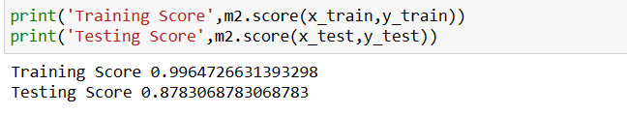
Accuracy scores
We get the training accuracy score and testing accuracy score from the model using score method.

Slide 34
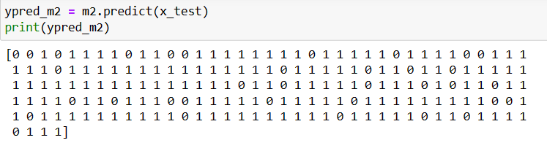
We predict the target variable of test data using predict method.

Slide 35
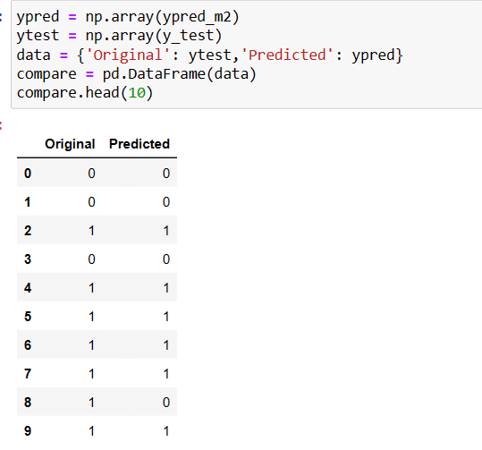
We stored the actual value of output and predicted value of output in a dataframe just for the sake of comparison.

Slide 36
07
Confusion Matrix And Classification Report
12-05

Slide 37
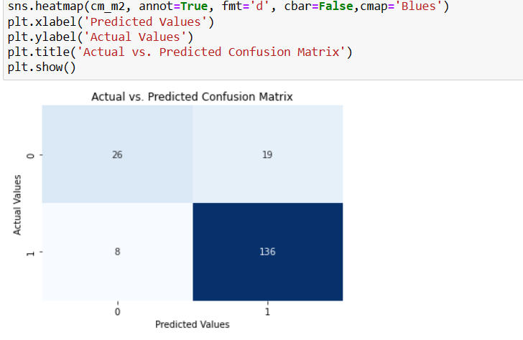
Confusion Matrix

Slide 38
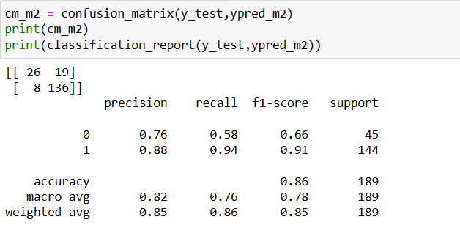
We derive the confusion matrix and classification report

Slide 39
Plotting A Decision Tree
Here, we are plotting decision tree number two out of the total 150 decision trees

Slide 40
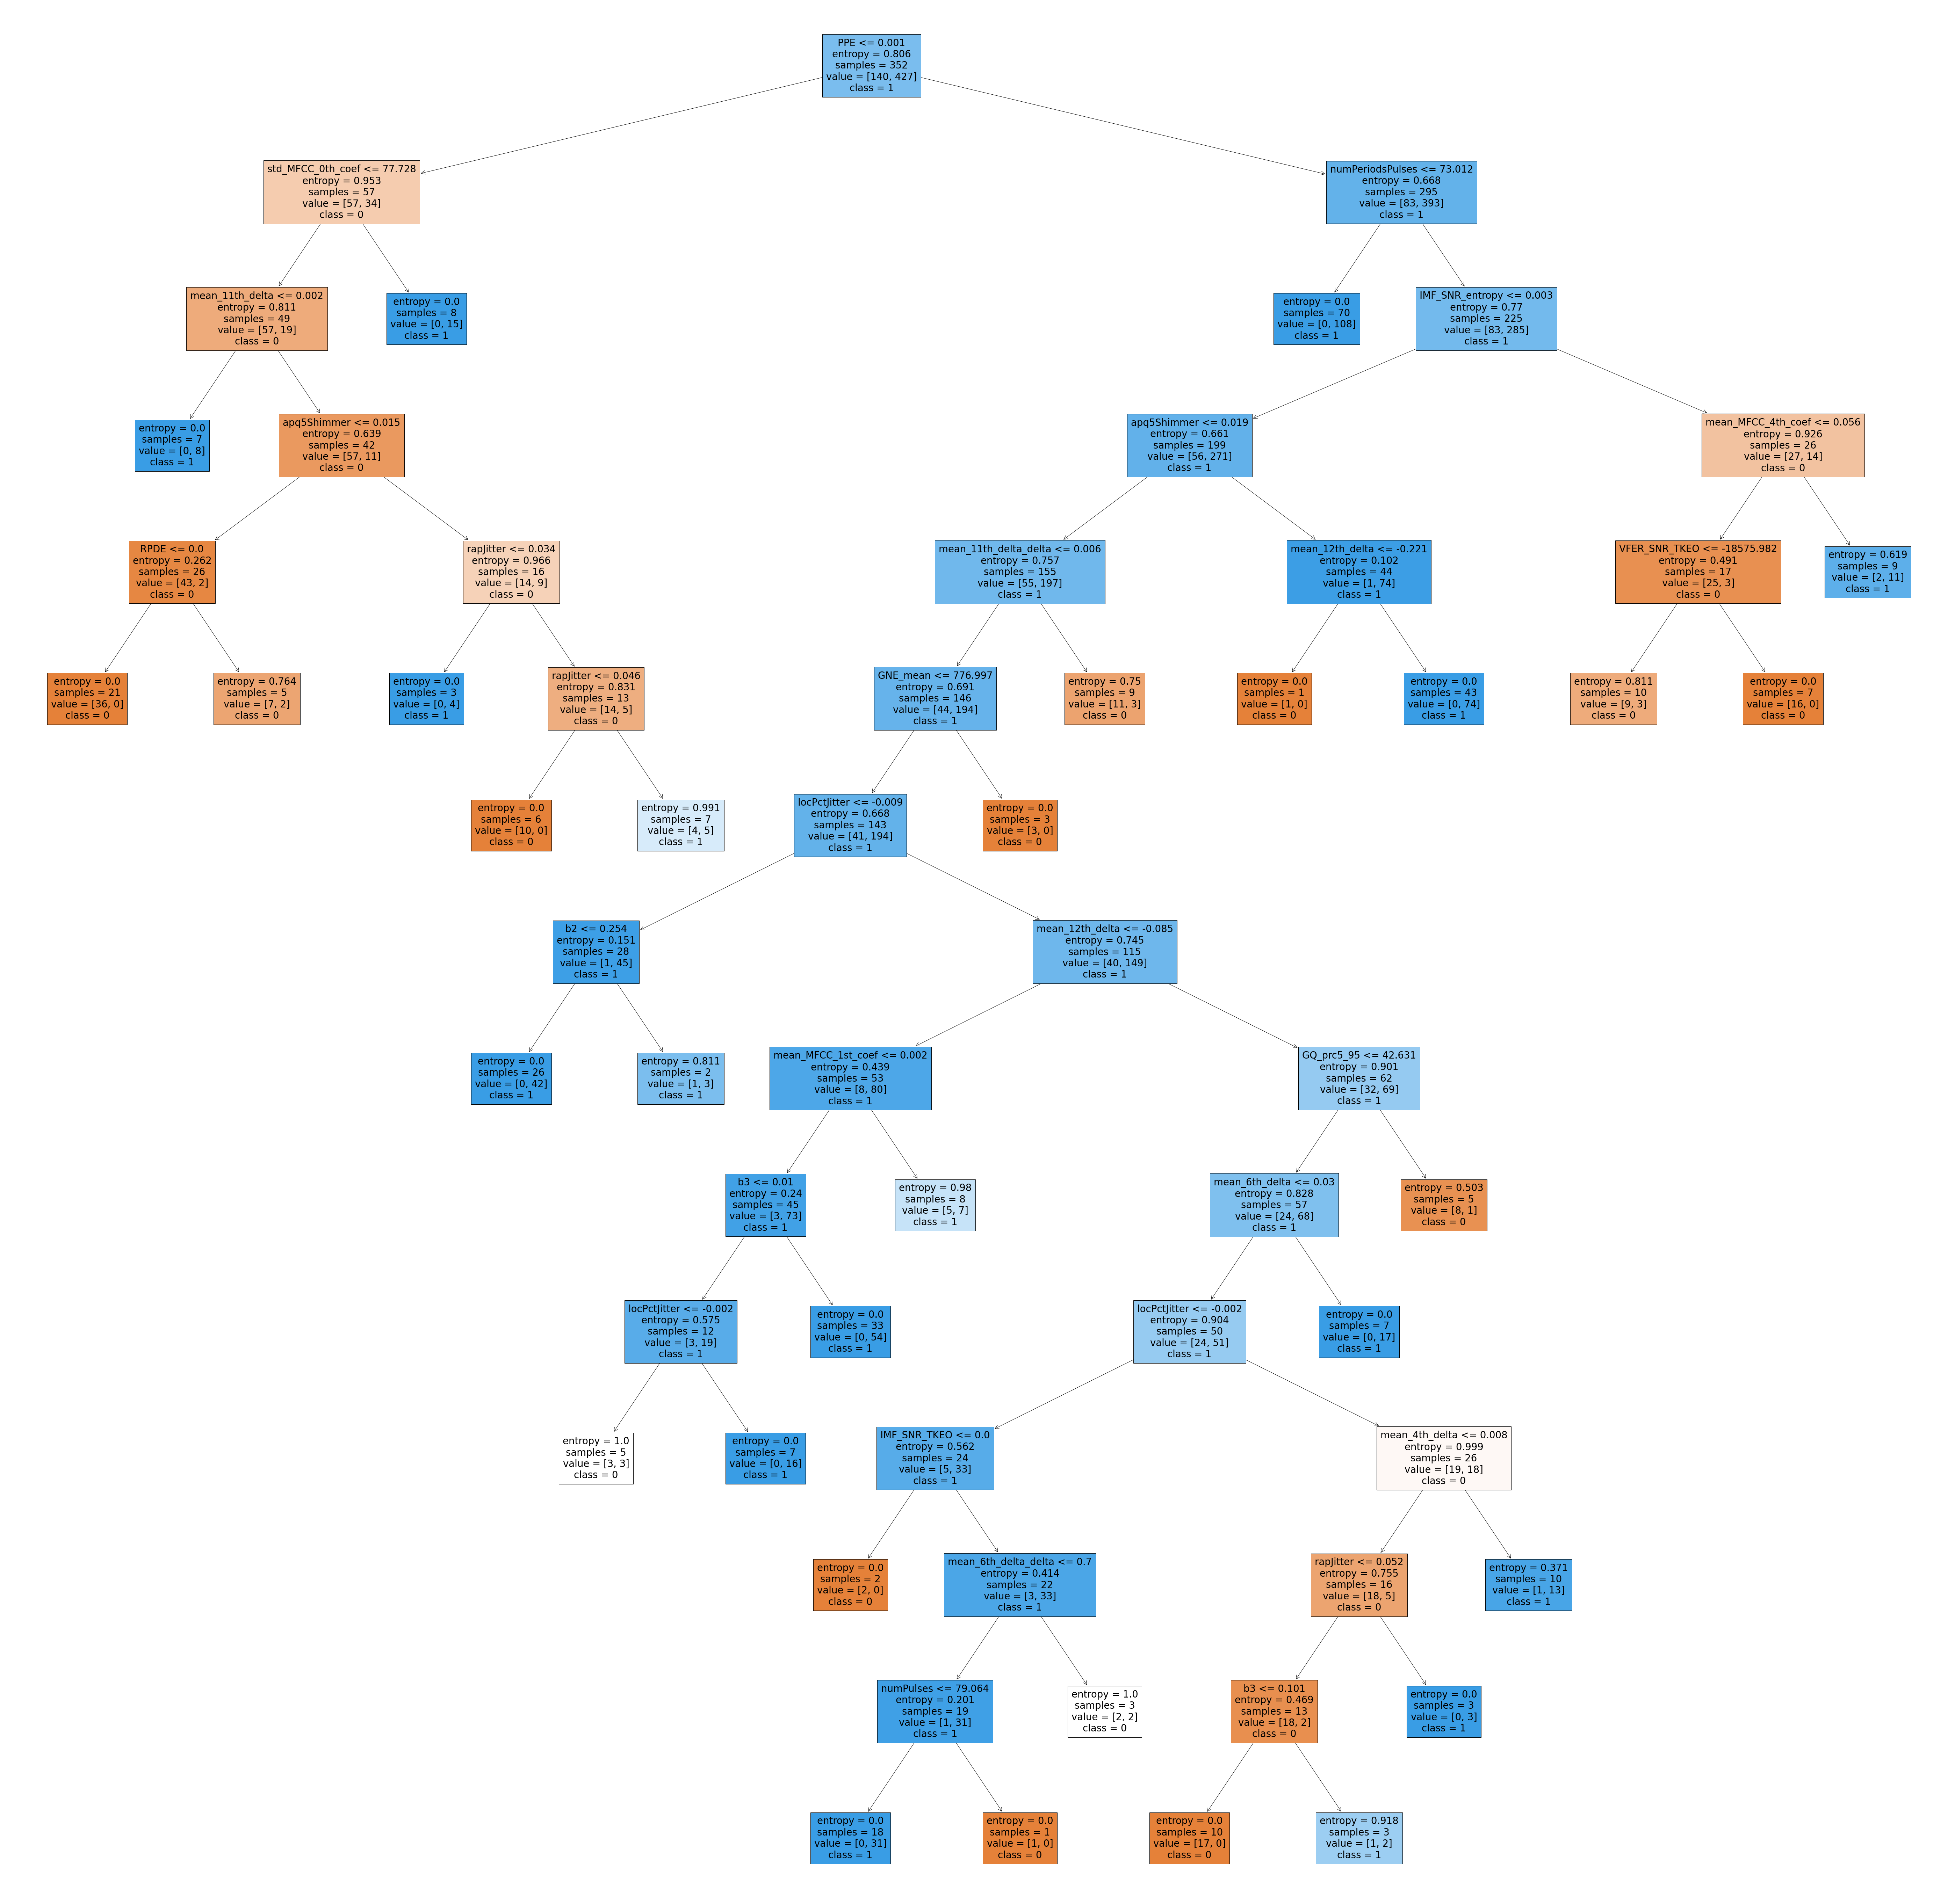

Slide 41
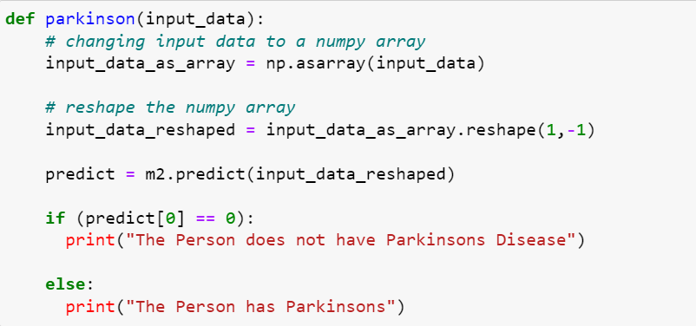
Code To Predict The Output

Slide 42
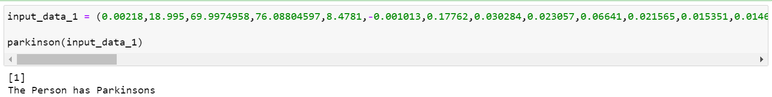
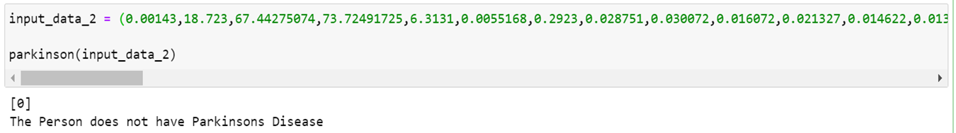
Outputs of Test Data

Slide 43
08
Discussion and Outro
12-05

Slide 44
Discussion
Introduction:
Given for us is a dataset for patients where some have Parkinson’s disease and some don’t.
We use Machine learning techniques like Random Forest,Decision Trees for classification.
Main discussion:
First, we divide our data into dependent and target variables and further we divided this data into train and test data.
Due to high dimensionality of dataset, we try to reduce it by reducing the number of features.
We create a Random Forest model and train it with train data.
We predict the output for test data and we derive accuracy scores and plot one of decision tree from our model.
Conclusions:
We efficiently predict the output by giving model one of the patients data.

Slide 45
Thank you!
.
.

Slide 46
Resources
Dataset:
https://www.kaggle.com/datasets/utkarshx27/parkinsons-disease-classification-data-set
Information Sources:
Parkinsonism Reduces Coordination of Fingers, Wrist, and Arm in Fine Motor Control – ScienceDirect
https://www.ninds.nih.gov/healthinformation/disorders/parkinsons-disease
Image Sources:
Google, https://www.istockphoto.com/photos/parkinsons-disease, https://www.shutterstock.com/search/random-forest

