Slide 1
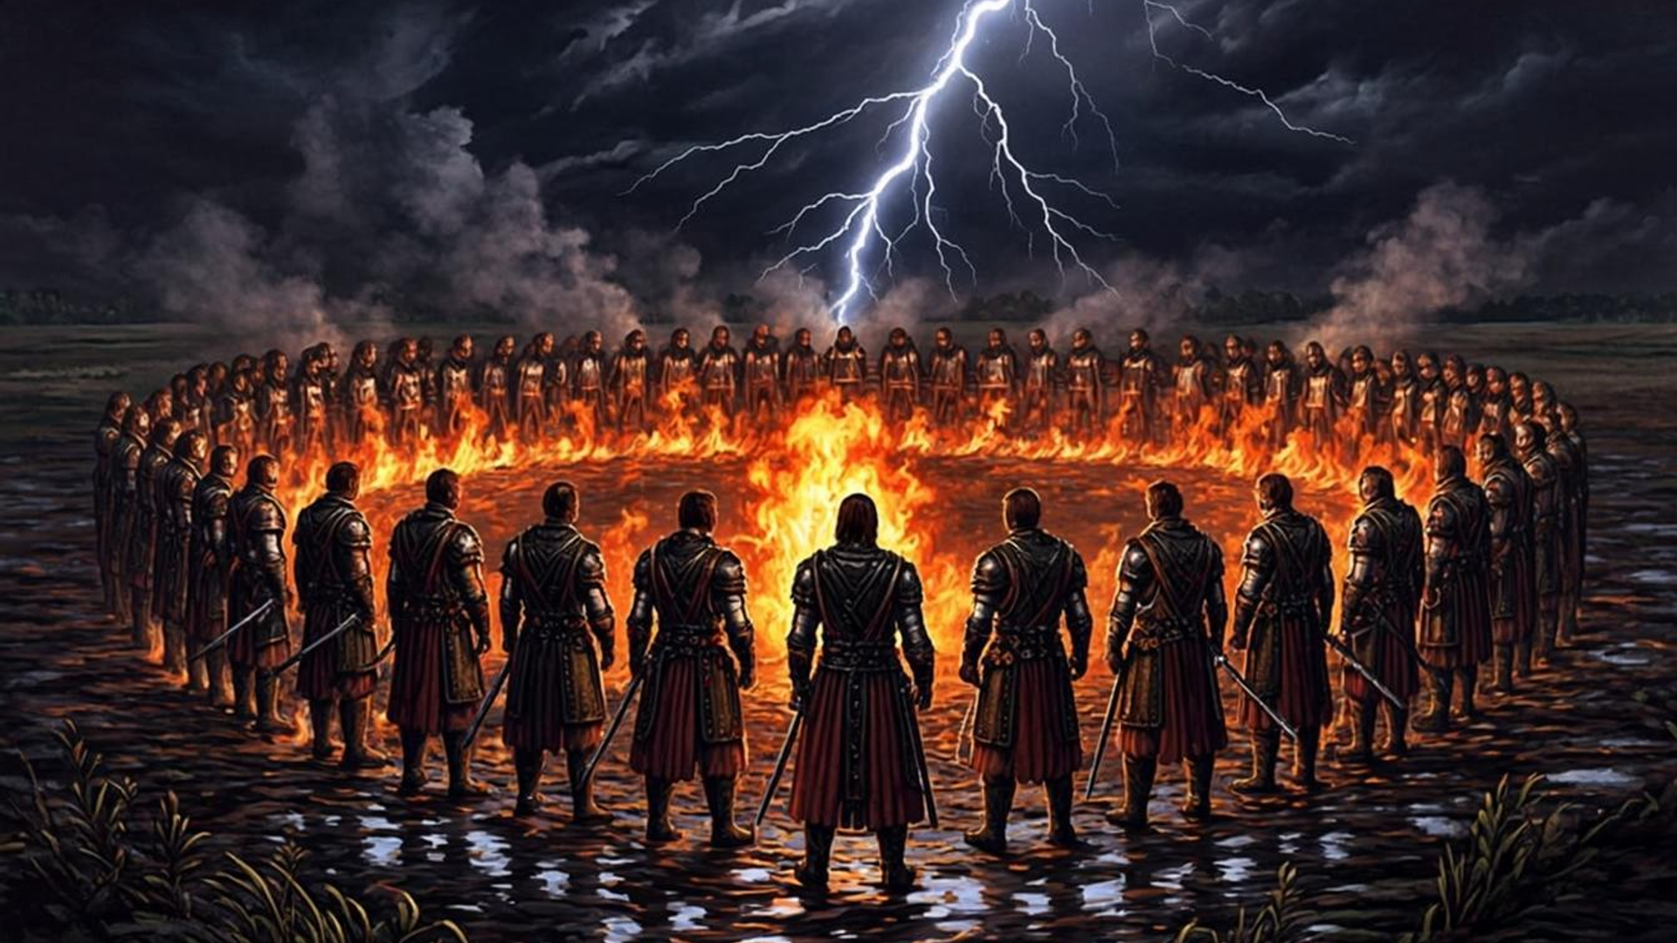


PUBLISHER PITCH · 2026
ZARNITSA
“The oath binds the vataga. The vataga holds the world. Betray the oath — and the world falls first.”
Narrative action-RPG · Single-player + co-op 2–4 · PC / next-gen consoles / cloud · Release 2031
Vataga Games

Slide 2
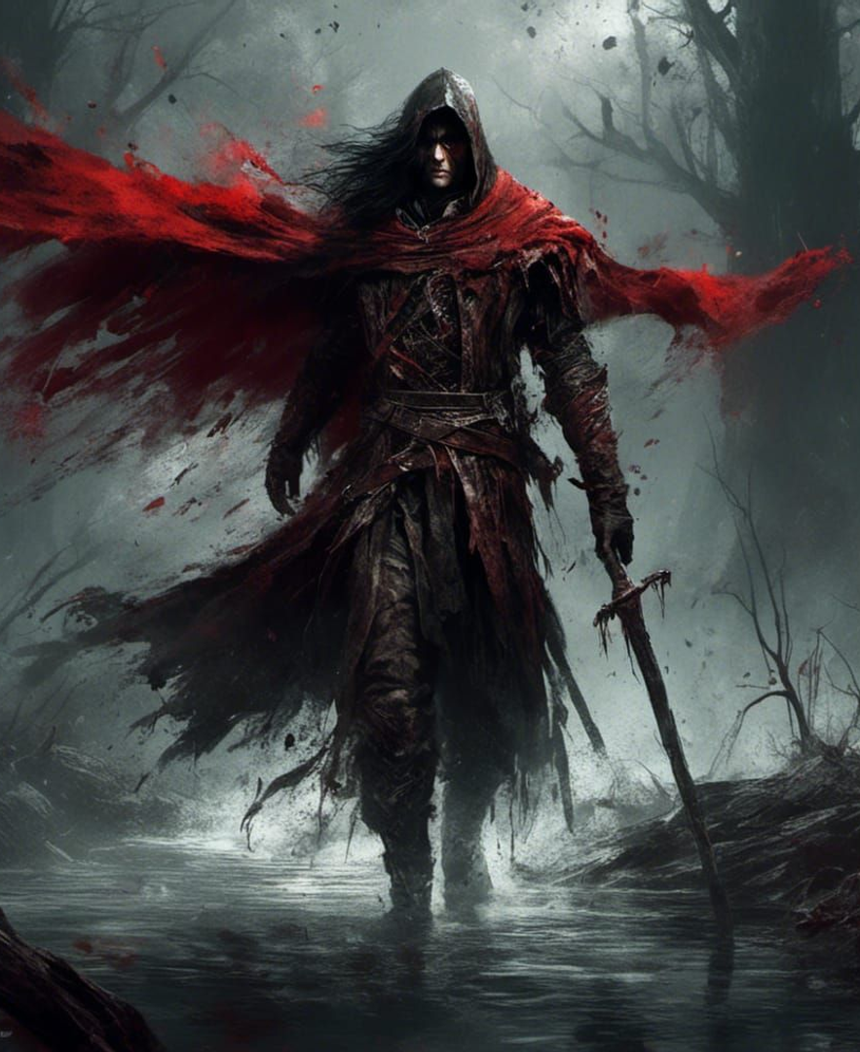

LOGLINE
The god is dead. Night is coming. The Vataga remembers.
Thirty years ago, people killed the last god — Zlatoglav. Since then the Mgla rises from the earth each night, and the country grows rich digging gold out of his body. Every ingot unearthed brings the eternal night closer. The player is the Oathbound Ataman, leading a vataga of sworn brothers: six companions with their own memory, hidden agendas and a very real capacity for betrayal.
Memory of the brotherhood
A world worth preparing for
choices stay in every companion's memory
victory is earned before the battle: scouting, oils, the hour you march
Morality without a judge
The night as an element
no good-and-evil meter, only consequences that ripen
trade and politics by day, survival by night
100+
6
5
4
hours of content
companions with memory
regions of Okovye
global endings

Slide 3
SECTION 01 / 03
01
THE GAME
The world of Okovye, the vataga, and the Betrayal Engine
ZARNITSA · publisher pitch

Slide 4
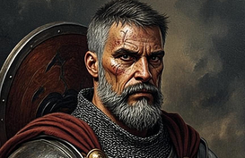
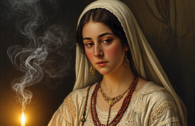


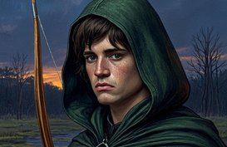
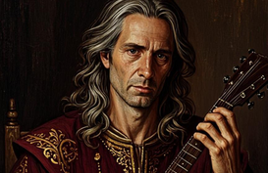
UNIQUE SELLING POINT
Companions who remember everything
In existing RPGs, companions are either eternal, or their attitude shifts by a single number, or they betray on script. In Zarnitsa, betrayal is a simulation: every companion carries a memory journal, a personal rupture threshold and a goal pursued even off-screen. The game continuously checks three conditions, and when they converge, the companion acts against the ataman — from sabotaging gear to a Night of Knives.
Memory journal
Personal threshold
Circumstance node
four kinds of tags: honor · blood · gold · faith
five irreversible stages: from first doubt to the Night of Knives
accumulated grudge, opportunity and incentive must converge at once
The Witcher 3 — set-dressing companions
Baldur’s Gate 3 — no life outside the party
Dragon Age — one approval number
ZARNITSA — betrayal as a simulation
6 companions × 5 stages × 4 endings — a matrix you cannot see in a single playthrough

Slide 5


SETTING
Okovye: a country living on the body of a god
Dark Slavic fantasy with no orcs and no elves: the nav, the Oathbound, rumor-mongering taverns and the Gilded Decree. By day Okovye trades, litigates and weaves politics; by night the world belongs to the Mgla. The player chooses the hour of leaving camp — and pays for the choice.
✦
5 regions — from the Polesie marshes to the drowned Still Sea
✦
The Mgla — the world’s tension meter: gold dug from the god’s body brings the eternal night closer
SIX FACTIONS
Oathbound Vatagas
Gilded Decree
Seer Circles
Courts of Nav
Princes’ Council
Children of Dawn
BESTIARY OF THE NAV
Mglenik
Uporen
Kostyanitsa
Zarnik
Mgla-Vedun

Slide 6
GAMEPLAY LOOP
Contract → Camp → Night
1
2
3
CONTRACT
CAMP
NIGHT
→
→
A job board with bargaining: price, deadlines, currency, witnesses. Terms shift in dialogue — witnesses remember the deal, and a stingy haggle comes back through a companion’s memory journal.
One conversation before nightfall: the raid party — up to three brothers; gear: oils, traps, strings. Gifts and oaths stay in the vataga’s memory.
A real-time raid into the Mgla under the Oath Pause. After the fight — the Right of Speech: a brother may step out of the shadow with a grievance, and the ataman answers.
Between nights the world lives without the player: factions make their moves, rumors spread through taverns, the Mgla gathers strength.

Slide 7
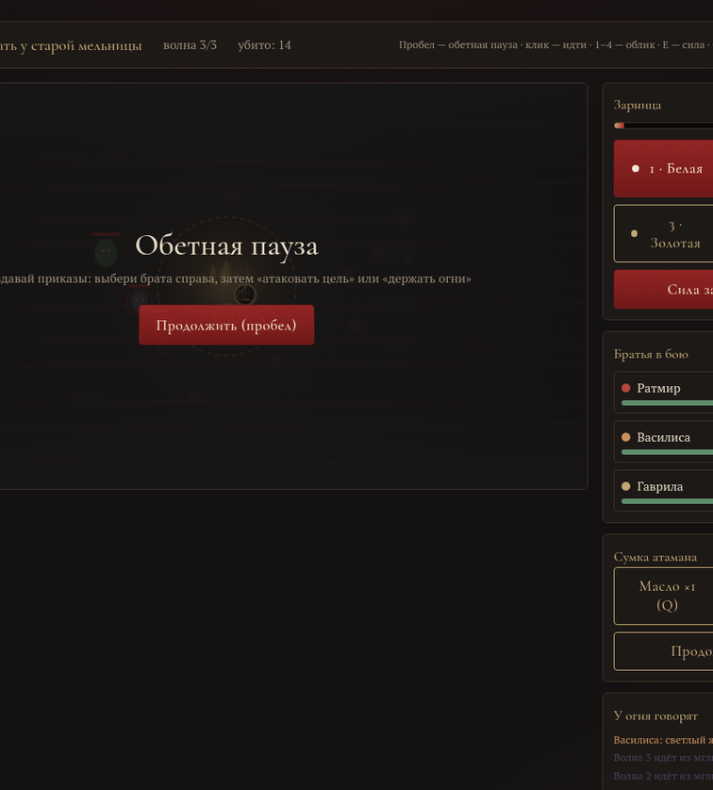
COMBAT SYSTEM
Real time under the Oath Pause
The spacebar freezes time at any moment: the ataman issues orders to the brothers, picks a Zaritsa form and resumes the fight. Reflex matters less than half an hour of preparation — “run in and swing” tactics are punished naturally.
1 · White
— five empowered strikes in a row
2 · Blue
— a slowing field around the point of the throw
3 · Gold
— shield and healing for the whole vataga
4 · Red
— detonates the accumulated Mgla across the causeway
Heat and overload: every form heats the power — in overload, strikes burn your own. Oathfire holds the line: the nav skirt the flame in a wide arc.
Prototype: the Oath Pause, orders to the brothers and four Zaritsa forms

Slide 8
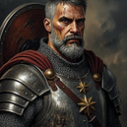



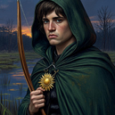
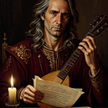
THE VATAGA
The six who can betray
Ratmir
Vasilisa
Gavrila
WARDEN · FRONTLINE DEFENSE
SEERESS · HEAT SUPPORT
MARKSMAN · LOGISTICS
“Leads the brothers away if the vataga is sacrificed for profit”
“Defects to the Seer Circles if the vault is razed”
“Sells the ataman’s plans for gold”
Khodata
Odinets
Miluta
PACTMAKER · CONTROL
ARCHER · SCOUTING
CHANTER · CHRONICLER
“Joins the Courts of Nav after a massacre of the nav”
“An engineered heresy: a separate story branch”
“A slanderous chronicle against the ataman”
Each memory holds four kinds of tags: honor · blood · gold · faith. Tags move a companion up the rupture ladder — from doubt to the Night of Knives.

Slide 9


CO-OP
Raids for 2–4 that stay in the chronicle
A hybrid without compromise: the single-player campaign carries the narrative, while co-op raids are assembled from day contracts and play out in the night layer. Cross-play across all platforms from day one. A raid is preserved as a “line” in both players’ chronicles — co-op doesn’t discard the story, it writes into it.
×8
how many times better a typical co-op game sells than a non-co-op on Steam: about 40,000 copies versus 5,000 (VGI · Sensor Tower)
Launch goal: at least 18% of players complete at least one raid.

Slide 10
SECTION 02 / 03
02
MARKET
Audience, competitors and the sales model
ZARNITSA · publisher pitch

Slide 11
AUDIENCE & DEMAND
A proven market, an open niche
The core is players aged 20–40 who grew up on The Witcher 3 and Baldur’s Gate 3: story, choices, long campaigns. The secondary segment is streamers: every vataga has its own betrayal, and every Night of Knives is a ready-made broadcast.
50+ million
20+ million
30 million
100K
The Witcher 3: the benchmark of story-driven RPGs
Baldur’s Gate 3 as of December 2025 (Bloomberg)
It Takes Two: the co-op phenomenon; Hazelight’s catalog tops 50 million (A Way Out 13M, Split Fiction 7M)
in 3 weeks — Black Book: demand for a Slavic setting (Morteshka, 2021)
The “adult dark fantasy with companions” niche is open now that Dragon Age has moved on to multiplayer experiments.

Slide 12
COMPETITIVE POSITIONING
We take the combination, and keep the niche
Game | Strength | What’s missing | Our answer
The Witcher 3 | Dense quests, adult moral dilemmas | Companions are set dressing, betrayal is scripted | Companions are the core of the simulation
Baldur’s Gate 3 | Freedom of choice, reputation | The world doesn’t live outside the party; no autonomous goals | Companion goals execute off-screen
Dragon Age | Character ensemble, banter | A single approval number; ruptures are cosmetic | Five irreversible stages of rupture
Kingdom Come 2 | Simulation of preparation and daily life | No party mechanics, no story-driven vataga | Preparation + ensemble in one loop
World scale — CD Projekt RED. Simulation density — Larian. Ensemble drama — BioWare. The memory and betrayal of comrades — ours alone.

Slide 13
SALES MODEL
Premium pricing, long life cycle
$69.99
PC · consoles · cloud
Cross-play
base game price
release platforms
one pool from day one
LIFE CYCLE
MONTH 4
MONTH 10
MONTH 20
“Winter Oaths”
DLC “Children of Dawn”
DLC “The Still Deep”
free patch campaign
the next chapter of the vataga’s arc
the sunken layer of the Still Sea
9M copies
20M
5.2M
year-one plan
life-cycle plan
break-even point (net price $42)
Completion ≥ 38% · Sessions 75+ minutes · Reach rupture stage IV ≥ 55% · Co-op players ≥ 18% · Press 85+

Slide 14
SECTION 03 / 03
03
THE DEAL
Prototype, production plan, budget and terms
ZARNITSA · PUBLISHER PITCH

Slide 15
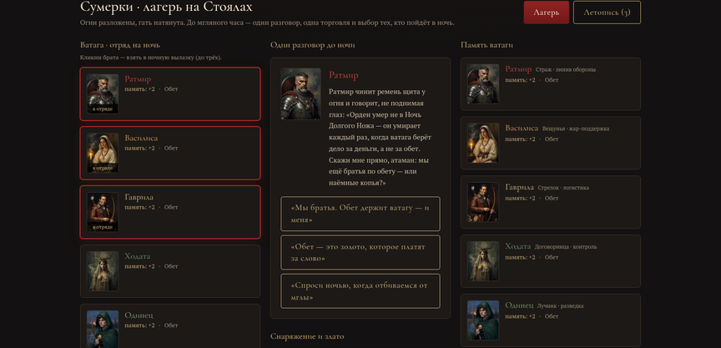
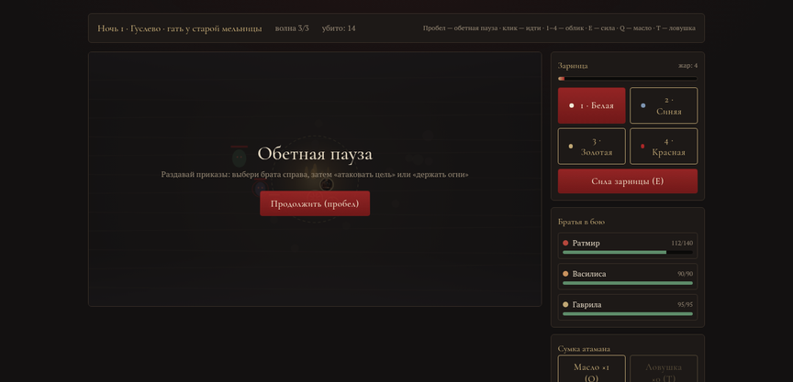
READINESS
The vertical slice is already playable
ZARNITSA · Three Nights is a working prototype of the core: three days and three nights, all four systems in one build. Real time with the Oath Pause and four Zaritsa forms; the companions’ rupture ladder from doubt to the Night of Knives; the Right of Speech after battle; factions, gold and the Mgla as world-scale resources.
✦
Full golden path verified: title → contracts → three nights → finale
Camp: the vataga’s memory, conversation and raid lineup
✦
Three finales across three lines of ataman behavior
✦
Six companions with memory, tags and the Right of Speech
Build link and the full GDD (30 pages) — available on request.
Night: the Oath Pause, orders and four Zaritsa forms

Slide 16
PRODUCTION PLAN
Five years, five phases — $210M
2027
2028
2029
2030
2031
PRE-PRODUCTION
PRODUCTION I
PRODUCTION II
ALPHA & BETA
RELEASE
vertical slice: Polesie, combat, vataga memory
two regions, full bestiary, Betrayal Engine v1
all five regions, voiced story skeleton, co-op alpha
content lock, balancing, co-op beta, localization
optimization, certification, marketing campaign
90–120 staff
240–300 staff
360–420 staff
420–450 staff
400 → 150 staff
BUDGET: $210M
Content
$97M (46%)
Marketing
$44M (21%)
Engine & co-op tech
$25M (12%)
Live support & first DLC
$19M (9%)
Audio & 6 voice-over languages
$17M (8%)
Contingency
$8M (4%)
A dedicated team of 14 has been building the Betrayal Engine since day one — the project’s riskiest and most valuable system.

Slide 17
THE ASK
What we are asking for
Financing of full production — $210 million, staged across the 2027–2031 phases. The publisher leads marketing, distribution and certification; the studio owns narrative and the Betrayal Engine.
Vataga Games studio
Next steps
220
full-time specialists
by mid-production
1 ·
Prototype demo and GDD walkthrough — 60 minutes
28
46
60
70
16
2 ·
Access to the full financial model and the betrayal matrix
narrative
design
programming
art
QA & localization
3 ·
Term sheet by the end of Q1 2027 — pre-production starts in summer
Outsourcing — up to 230 seats at peak.
Vataga Games · hello@vataga.games · pitch 2026

