Slide 1
NSE-BSE Arbitrage System
Group 5: Rasika Pande Vaishnavi Kolhe Ketaki Kshirsagar Diksha Sharma Sejal Chaudhari

Slide 2
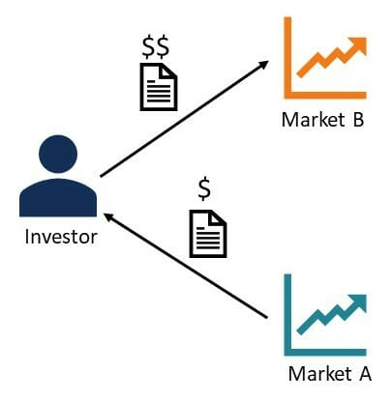
Introduction
Arbitrage : process of simultaneous buying and selling of an asset
Quantity Same
Strategy : price differences in different markets for the same asset.
Arbitrage is a widely used trading strategy, and probably one of the oldest trading strategies to exist.
Arbitrageurs : Traders who engage in the strategy .

Slide 3
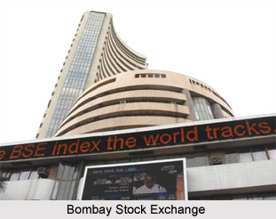

NSE & BSE
Bombay Stock Exchange :BSE is the first stock exchange of Asia, and it offers varied services such as market data services, risk management etc.
National Stock Exchange: NSE is India’s leading stock exchange market. NSE introduced Nifty 50 in 1996 as the identifying base for top 50 stock index, and it is extensively utilized by Indian investors.
While NSE’s index, Nifty 50, gives top 50 stock index, BSE’s index, SENSEX, gives top 30 stock index.
The number of listed companies is 1696 for NSE and 5749 for BSE.

Slide 4
API
Financial data APIs (application programming interfaces) are pieces of software that interact with financial applications to facilitate information access, transactions, and payments.
Yahoo Finance API: The Yahoo Finance API offers access to a wide range of data, including stock quotes, historical prices, company information, and more.
This makes it the perfect choice for businesses and developers who need to incorporate financial data into their applications or websites.

Slide 5



Tech Stack
Java
Angular
MySql

Slide 6
Functional Flow
LOGIN
DASHBOARD
SAVED
STOCKS

Slide 7
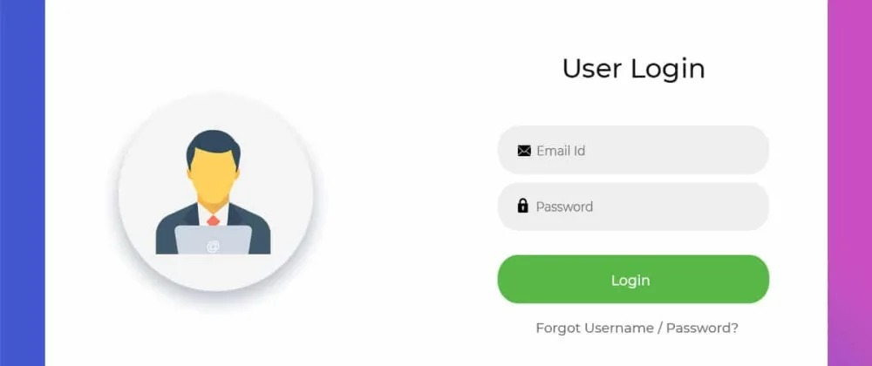

Slide 8
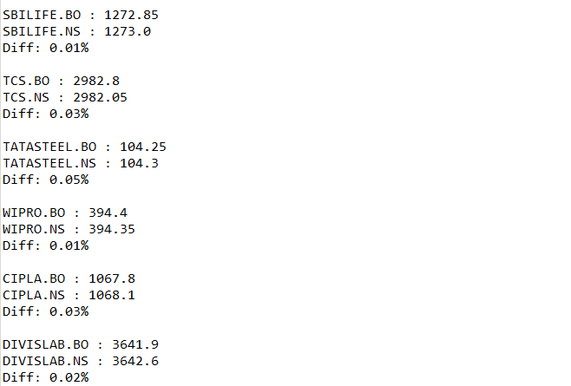
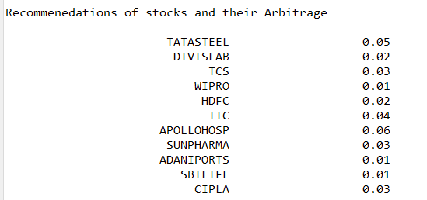

Slide 9
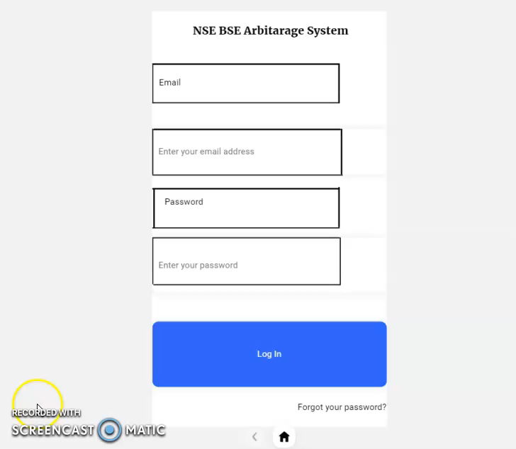

Slide 10
Deliverables
Trade recommendation System based on Arbitrage opportunity between BSE and NSE
User can select to save any of the recommended arbitrage trades and current market price.
User can also see the saved stocks.

Slide 11
Learnings
Tech Skills
Java
Angular
Wireframing
MySQL
Using functions of the Yahoo Finance API
Soft Skills
Team Work
Time Management
Corporate Experience
Effective Communication
Dealing with constructive criticism properly

Slide 12
Thank You !

