Slide 1
MyTasks.com Manage your Projects and Tasks

Slide 2
Purpose of MyTasks.com ..??
The main purpose of application is to understand the use of AngularJs, Java script design patterns, HTML5 integration in a project implementation.

Slide 3
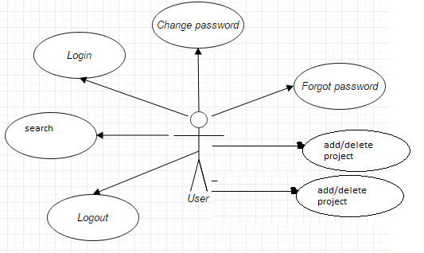
Functions of MyTasks.com

Slide 4
MyTasks.com controllers
User Controller
Project Controller
Task Controller

Slide 5
MyTasks.com Services
Custom Services-
MyTasks.com have implemented custom services for performing CRUD operations on the entity.
Factory method and Revealing Module pattern

Slide 6
MyTask Services
Services Provided by AngularJS :
$rootScope
$scope
$location
$localStorage

Slide 7
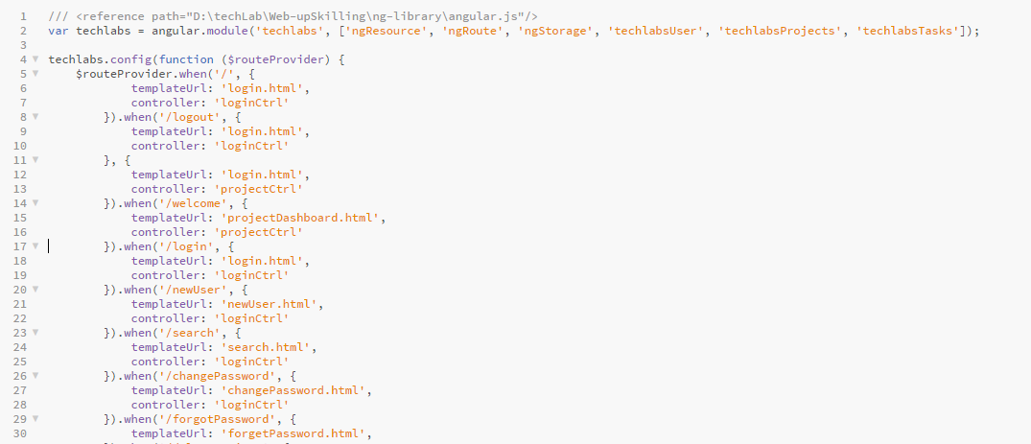
Single Page Application
Angular framework provides best practices to design SPA.
SPA allows to load different controllers on single page based on request.
The angular config() method defined in ngRoute module allows routing of pages.
<ng-view> tag displays the requested page on current page.

Slide 8
AngularJs Practices
Filters
Directives

Slide 9
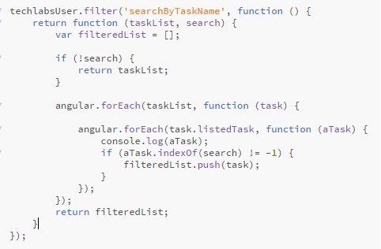
Filters
A filter formats the value of an expression for display to the user. They can be used in view templates, controllers or services and it is easy to define your own filter. You can make your own filters by register a new filter factory function with your module:
Example:
<input type=text" name="search" >
<div ng-repeat="item in taskList ' | searchByTaskName: search">

Slide 10
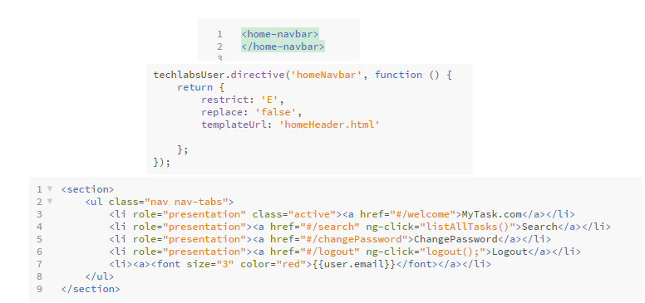
Custom Directive
In addition to all the built-in AngularJS directives, you can create your own directives. New directives are created by using the .directive function.To invoke the new directive, make an HTML element with the same tag name as the new directive.

Slide 11
THANK YOU

