Slide 1
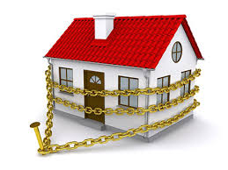
Home security: smart door system The University of Texas at Arlington
Group 4:
Shreemay panhalkar
Ketaki Chinchorkar
Rachana badekar
Akshat Vaidya
Guided By – Prof. Yonghe Liu

Slide 2
INdex
Motivation
Problem Description
Modules
Components
Challenges
Future Work
Conclusion

Slide 3

Motivation
Home security has been a critical issue
Ways of securing of our homes:
Smart door locks
Alarm systems
CCTV systems
The main door should be secured at all times

Slide 4
Problem description
IOT Based home security system which allows remote access of the main door using Raspberry Pi
Remote access of the main door can be used in many ways by the owner:
Allowing a trusted party to enter
Monitoring the front door by the camera
Securing the main door from intruders

Slide 5
Modules
Smart door bell notification system:
Notifies the owner via G-mail
Sends the photo of the visitor along with the email
Smart door locking/unlocking system:
Can be accessed by the owner’s cell phone
Allows the owner to control the door from anywhere in the world with the help of
Blynk App

Slide 6
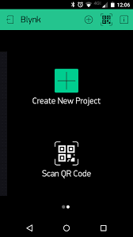
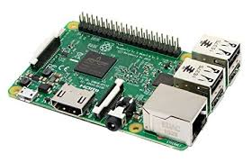
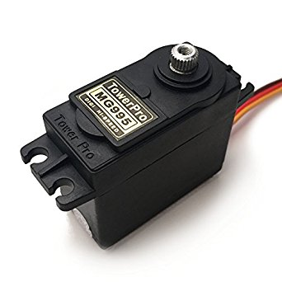
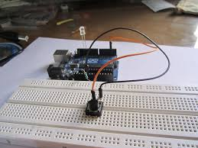
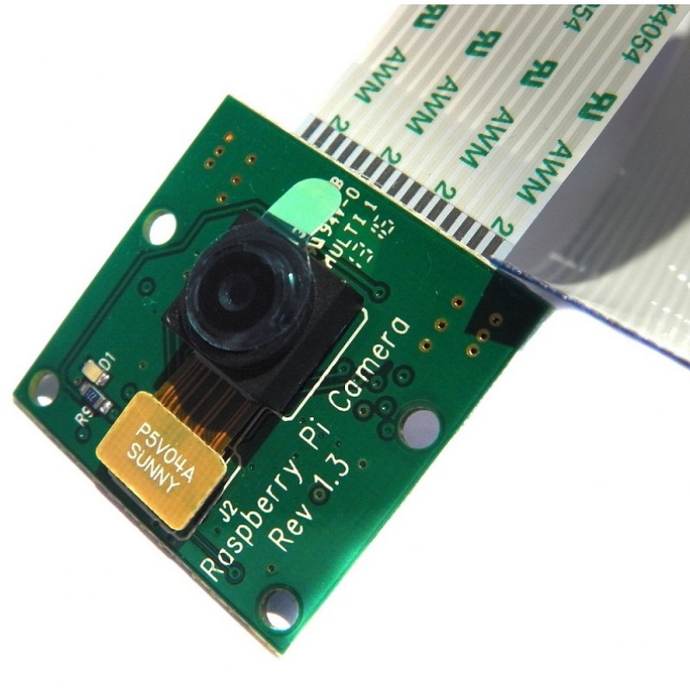
components
H/W components:
Raspberry Pi 3 B
TowerPro MG995R
Push Button, Jumper wires, Breadboard
Raspberry pi Camera Module
S/W requirements:
Python support
Blynk app configuration (working internet connection)

Slide 7
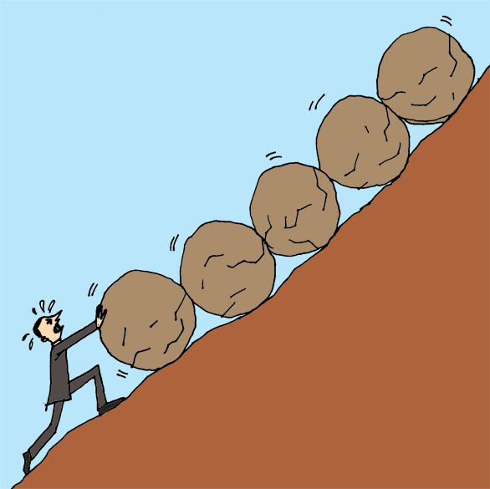
challenges
Blynk’s native NodeJs library was not working properly
Faulty hardware components

Slide 8

Future work
Audio / Video support at the door
Complete home automation
Facial recognition for the front door camera

Slide 9
conclusion
Door safety plays a key role in preventing intrusion and having a better safety system. We have developed a door automation system which allows the owner to remotely access it. Our approach allows the owner to be in control of the main door and provide access to trusted visitors.

Slide 10
references
http://www.instructables.com/id/Servo-Motor-Control-With-Raspberry-Pi/
https://github.com/vshymanskyy/blynk-library-python
https://www.blynk.cc/
https://picamera.readthedocs.io/en/release-1.13/

Slide 11


