Slide 1
Web Development Using Python Framework - 2
Team Details:
Ketan (2410993217)
Mayank Jindal(2410993228)
Vineet Sharma(2410993244)
Faculty Coordinator:
Ratan Lal Gupta
:
Chitkara University Institute of Engineering and Technology,
Chitkara University, Punjab

Slide 2

Table of Contents
Introduction
Problem Statement
Technical Details
Key Features
Project Highlights
Conclusion
References/Links used

Slide 3
Introduction
Welcome to the Second phase of our blood bank management system project! Our team of three, led by Ketan, has used HTML and CSS and Django.
Project Overview:
Our goal is to create a user-friendly and engaging platform for people of all ages.
Team Members:
-KETAN.
-MAYANK JINDAL
-VINEET
Highlights:
- HTML Structure: Robust and semantic for accessibility and navigation.
CSS Styling: Clean and responsive design.
Django: High level and Secure and Scalable Framework
We look forward to sharing more updates as we progress through the next phases. Stay tuned for more features and improvements!

Slide 4

Problem Statement
Poor Inventory Management: Blood banks face difficulties in tracking blood inventory levels, expiration dates, and the types of blood available, resulting in wastage or shortages.
Lack of Real-Time Data: There is a lack of real-time data on blood availability, donor status, and upcoming donation drives, making it hard for hospitals and clinics to plan effectively.
Inadequate Communication: Communication between blood donors, blood banks, and hospitals is often inefficient, leading to delays in blood availability and donor engagement.

Slide 5
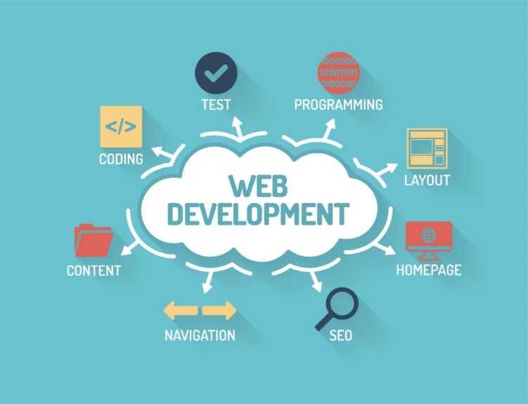
Technical Details
HTML Structure:
Semantic HTML elements for better accessibility.
Organized layout with header, footer, main content, and navigation sections.
CSS Styling:
Basic CSS for styling and layout.
Responsive design principles to ensure compatibility across different devices.
Use of CSS Flexbox/Grid for layout management.
Django:
High-level Python web framework that helps you build web applications quickly and efficiently
Development Tools:
Code editor: VS Code.

Slide 6
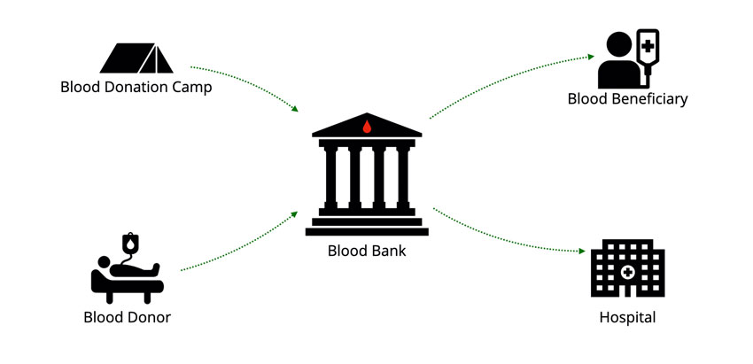
Key Features (To Be Included In Later Phases)
Donor Registration
Admin Login
Profile Management
Donation History
Real-Time Inventory Tracking
Search for Donors
Responsive Design

Slide 7
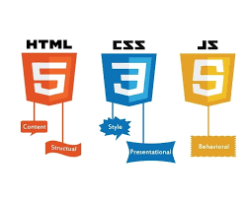

Project Highlights
Blood Donation Management System
We are thrilled to unveil the first phase of our blood donation management system.
Key Achievements in Phase 2:
Responsive Design: Optimized for various devices for a seamless experience.
Team Collaboration: Our team has worked diligently to complete this initial phase. We look forward to enhancing the platform with advanced features in the upcoming phases. Stay tuned for more updates!

Slide 8
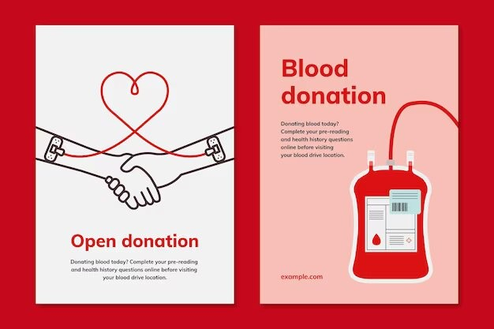
Conclusion
As a result, this project contributes significantly to addressing the ongoing challenges of blood shortages and promotes a healthier society. Future enhancements could include mobile application integration and advanced analytics for demand forecasting.

Slide 9
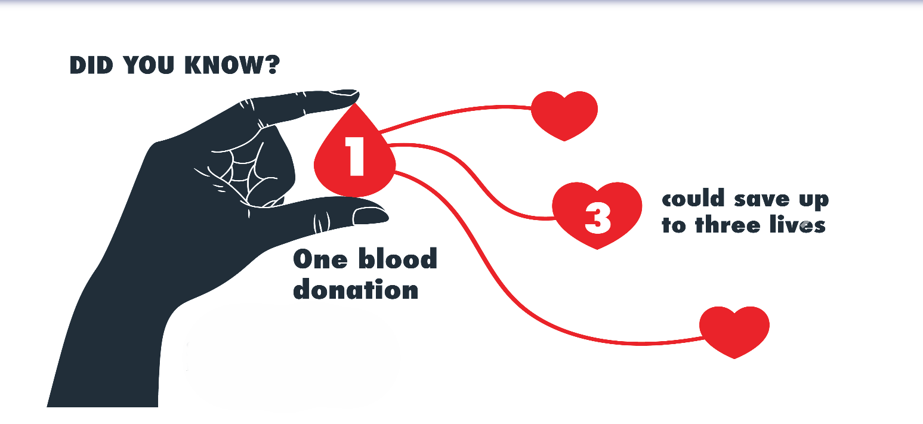

Slide 10



References/Links used
Inspiration Sources:
https://www.redcrossblood.org
Open AI
Youtube
Additional Resources:
W3Schools
Stack Overflow
Tools and Technologies:
VS Code: Primary code editor

Slide 11


