Slide 1
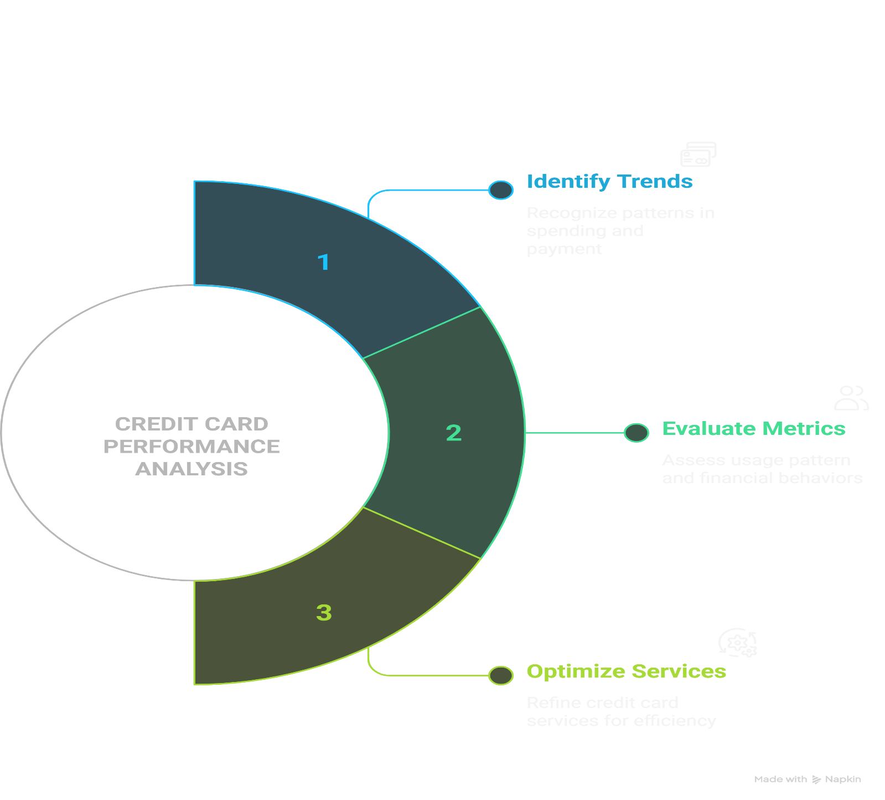
CREDIT CARD PERFORMANCE ANALYSIS

Slide 2
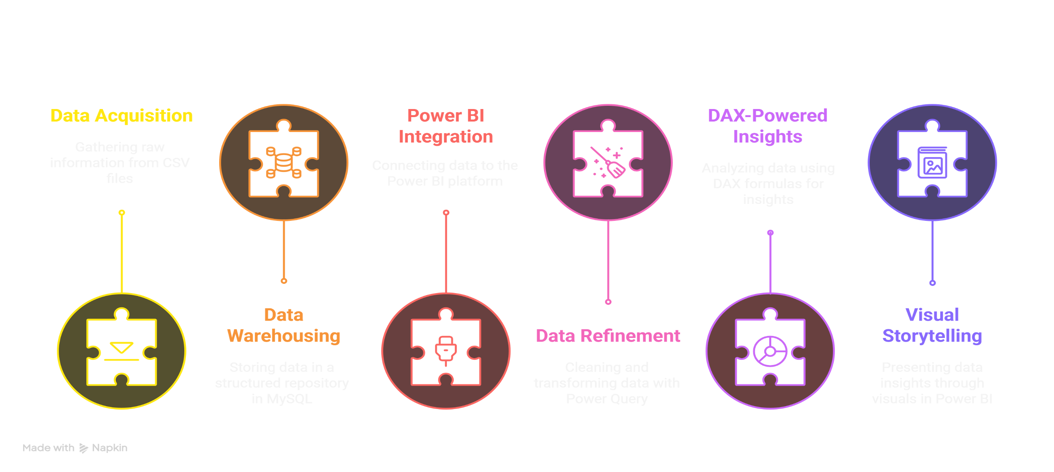
PROCESS OVERVIEW

Slide 3
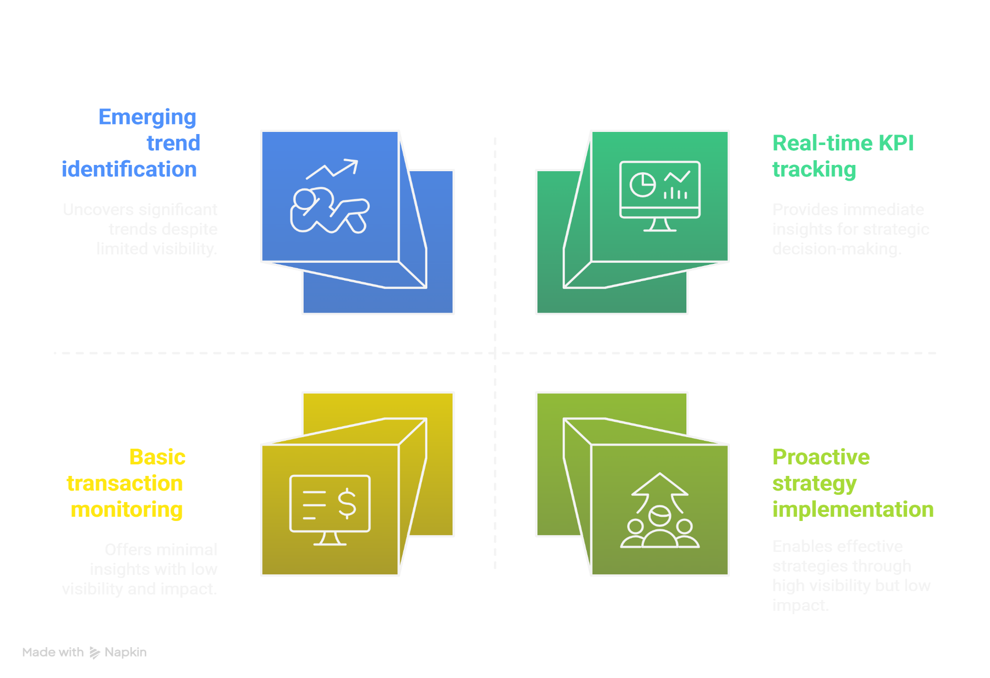
PROJECT OBJECTIVE

Slide 4
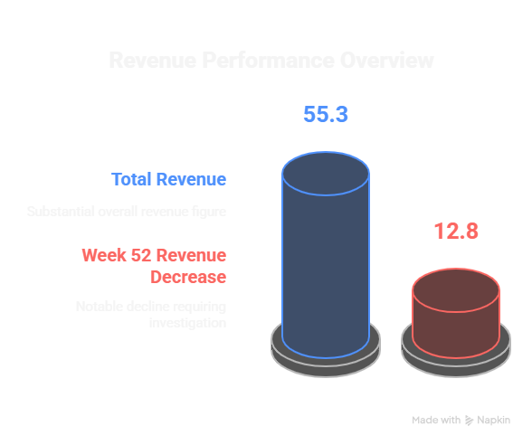
INSIGHTS
Key Finding:
The dashboard reveals a substantial total revenue of $55.3M.
Analysis:
While the overall revenue is significant, the insight that Week 52 revenue decreased by 12.8% warrants further investigation.
This decline could be attributed to various factors such as seasonal trends, changes in spending behavior, or specific marketing campaign impacts.
Analyzing the contributing factors to this decrease is crucial for future strategy adjustments.

Slide 5
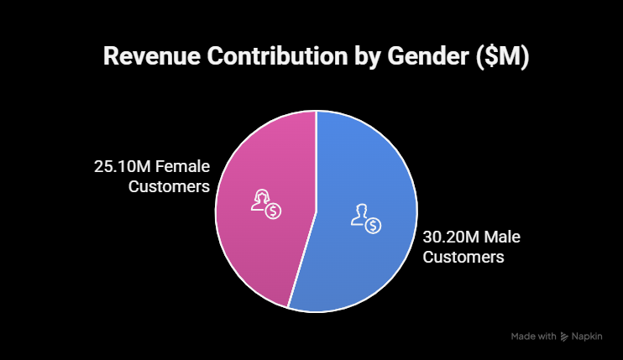
INSIGHTS
Key Finding:
Male customers contribute a larger share of the revenue at $30.2M compared to female customers at $25.1M.
Analysis:
This difference in revenue contribution by gender could inform targeted marketing campaigns or product offerings tailored to each demographic.
Further analysis into the spending patterns and average transaction value of each group could provide deeper insights.

Slide 6
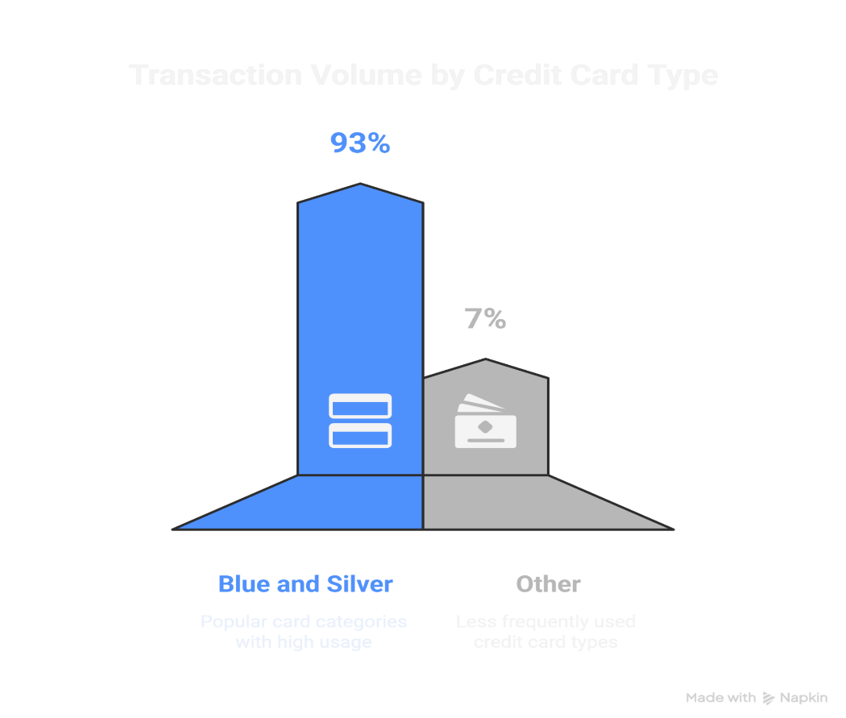
INSIGHTS
Key Finding:
Blue and Silver credit cards account for approximately 93% of the Total Transaction Volume.
Analysis:
This highlights the popularity and widespread use of these card categories & further understanding the features and demographics associated with Blue and Silver cardholders can be valuable for customer segmentation and loyalty programs.

Slide 7
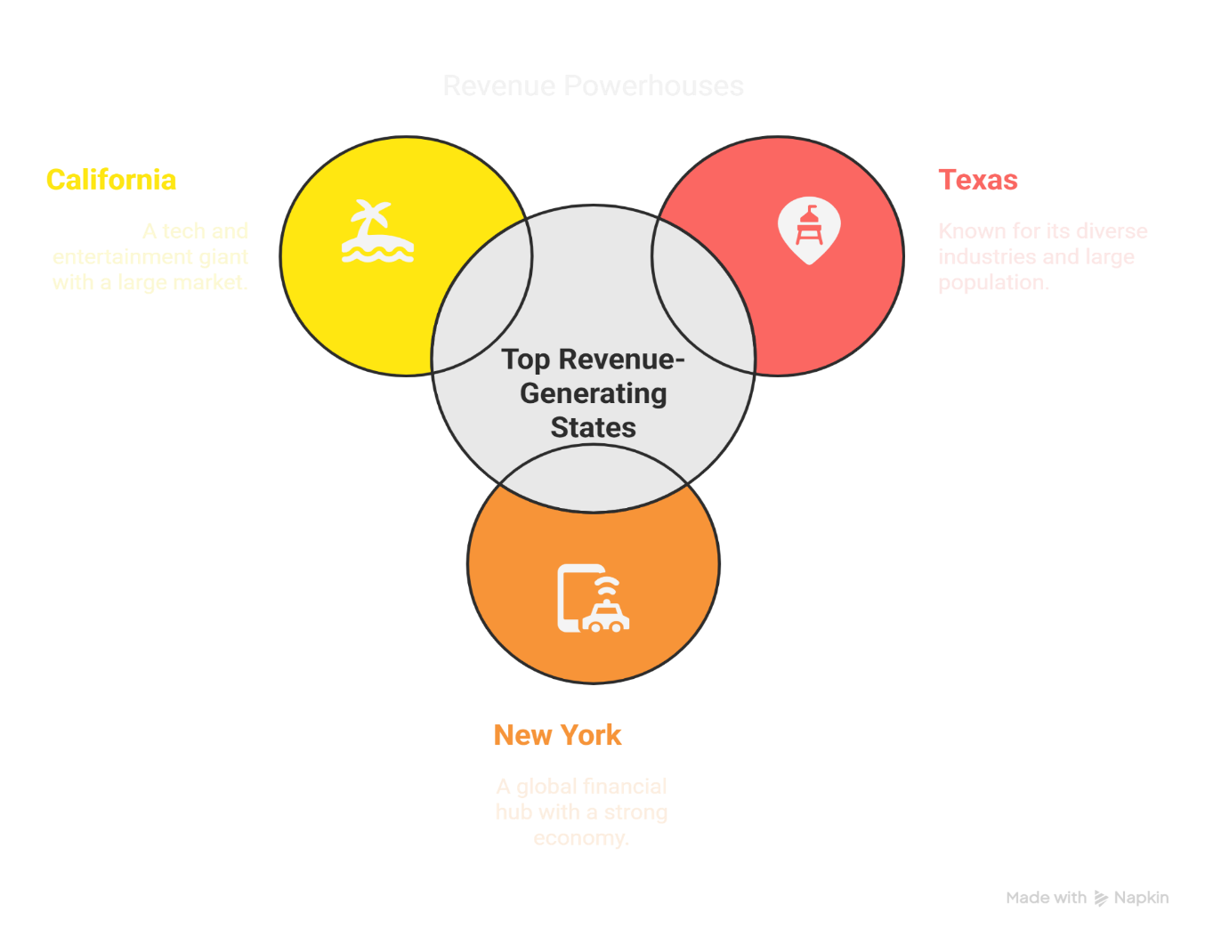
INSIGHTS
Key Finding:
Texas (TX), New York (NY), and California (CA) are the top three revenue-generating states.
Analysis:
This geographical concentration of revenue suggests that marketing efforts and business strategies should be particularly focused on these key regions.
Investigating the economic factors and customer demographics within these states could further optimize resource allocation and targeted campaigns.

Slide 8
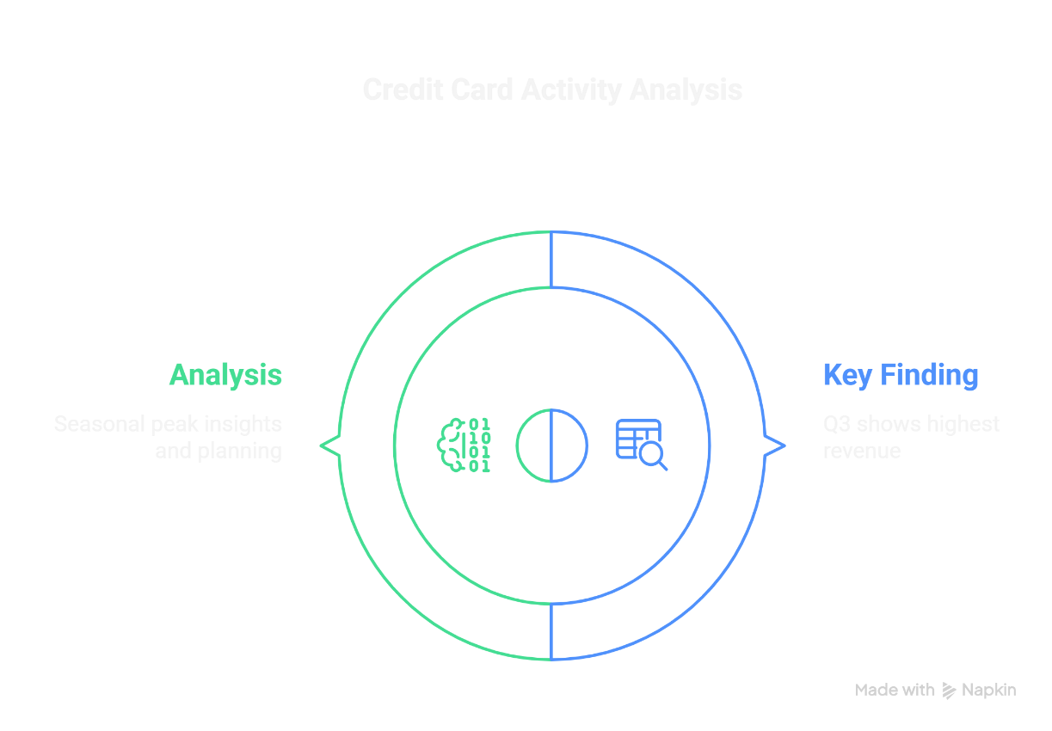
INSIGHTS
Key Finding:
Quarter 3 (Q3) exhibits the highest Revenue and Transaction Count.
Analysis:
This indicates a seasonal peak in credit card activity during this period. Understanding the drivers behind this surge (e.g., holiday spending, specific promotions) can help in planning inventory, staffing, and marketing initiatives for future Q3 periods.
Comparing the types of transactions and spending categories in Q3 versus other quarters could provide valuable insights into consumer behavior.

