Slide 1

CCART – Climate Change Analysis and Risk Tool
Ketan Pednekar – 20 April 2026

Slide 2
CCART - Open, Reproducible Climate‑Hazard Infrastructure
Multi‑hazard engine (Cyclone, Flood, Heat)
Built for TCFD physical risk workflows
Uses CHIRPS, CMIP6, IndoFloods, HydroBASINS
Transparent, modular, reproducible pipelines
Hazard only where empirical susceptibility exists
Future: CCART‑UK + Cyclone‑Induced Flood module

Slide 3
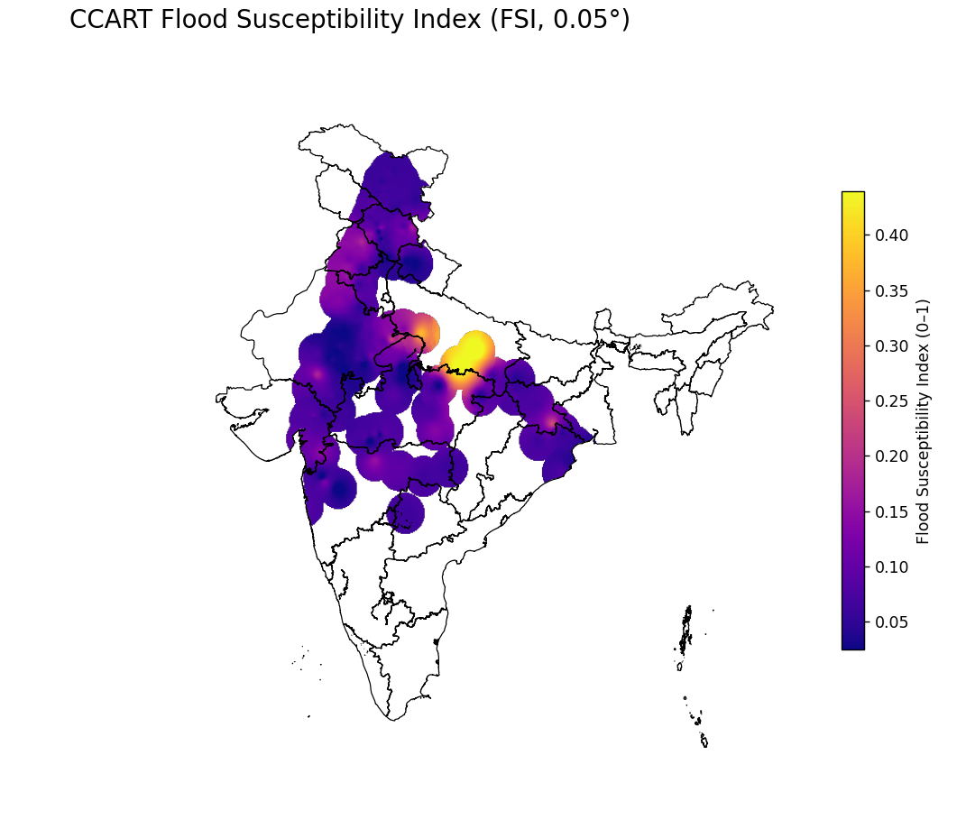

Slide 4
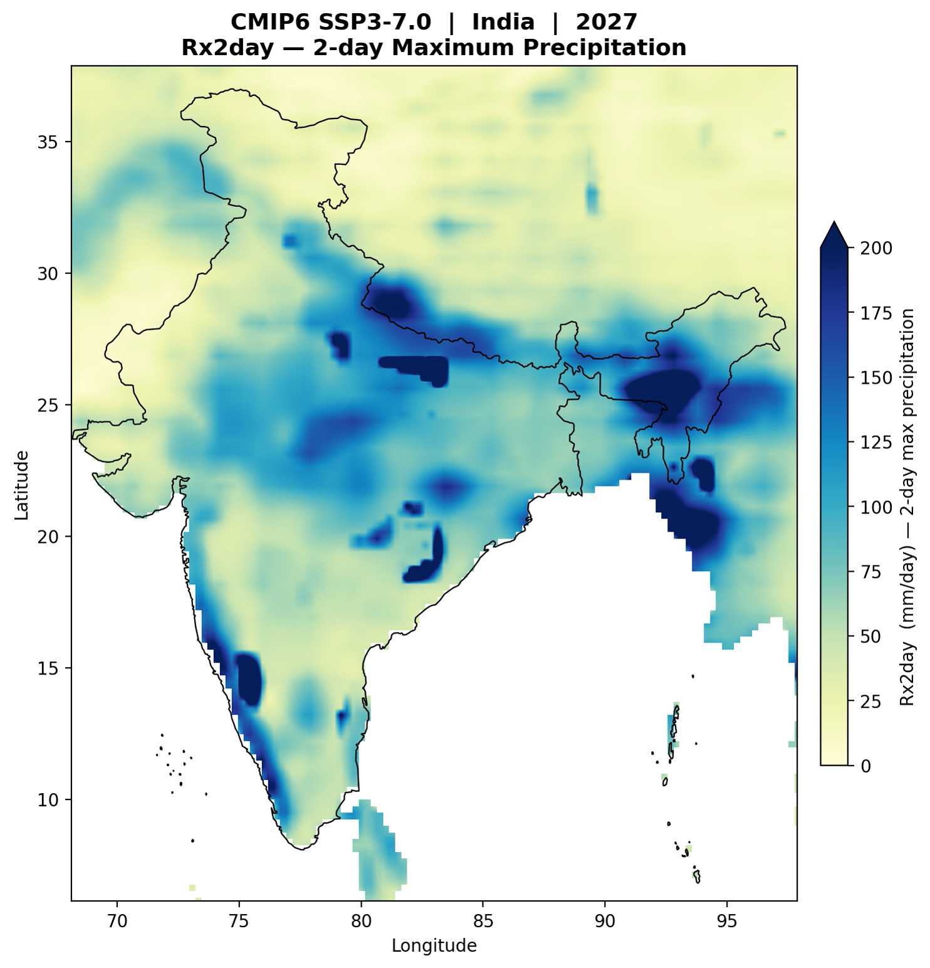

Slide 5
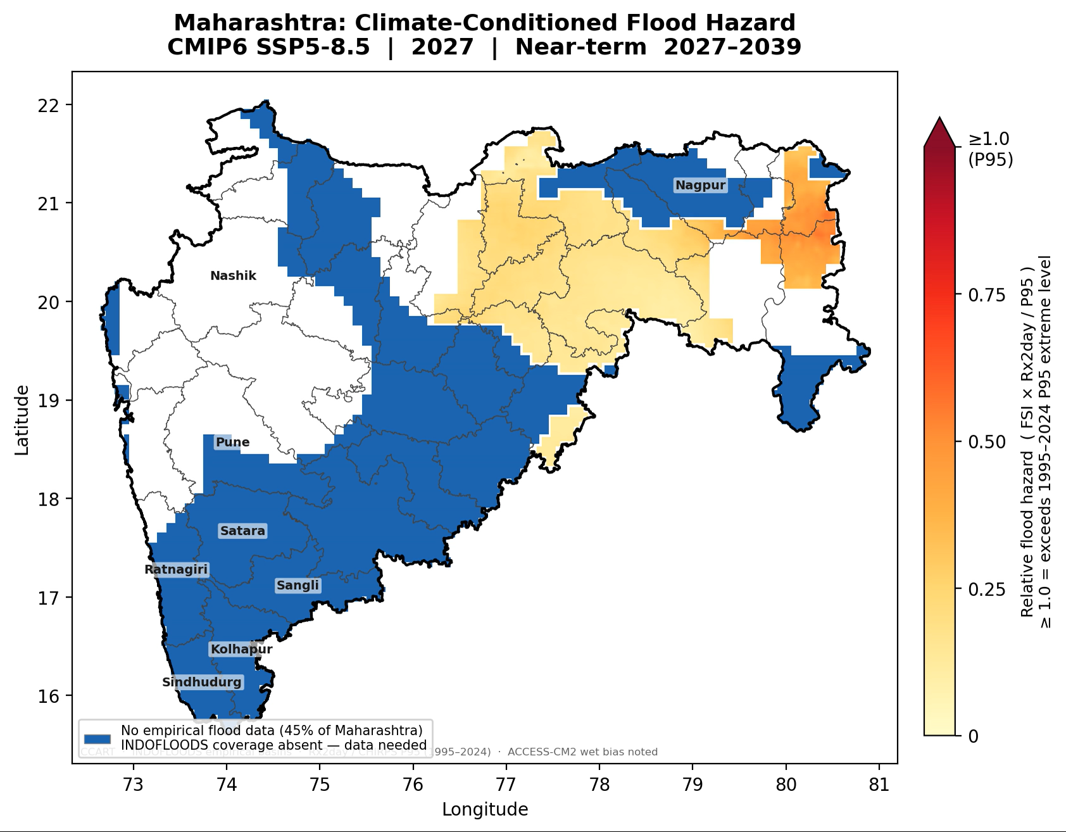

Slide 6
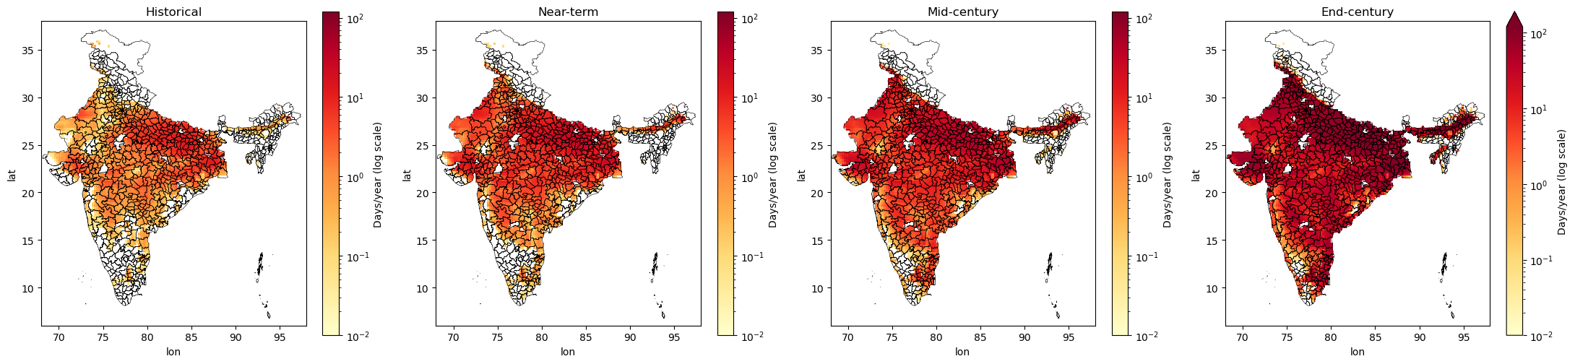
Number of Days WBT > 35ºC (SSP3-7.0)
1995-2014
2027-2039
2040-2069
2081-2100
Max days/year: 20.25
Max days/year: 67.62
Max days/year: 109.57
Max days/year: 173.50

Slide 7
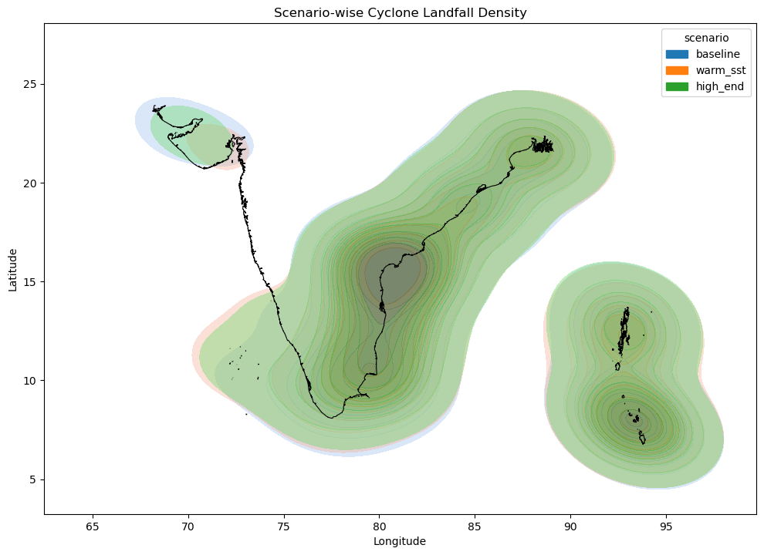

Slide 8
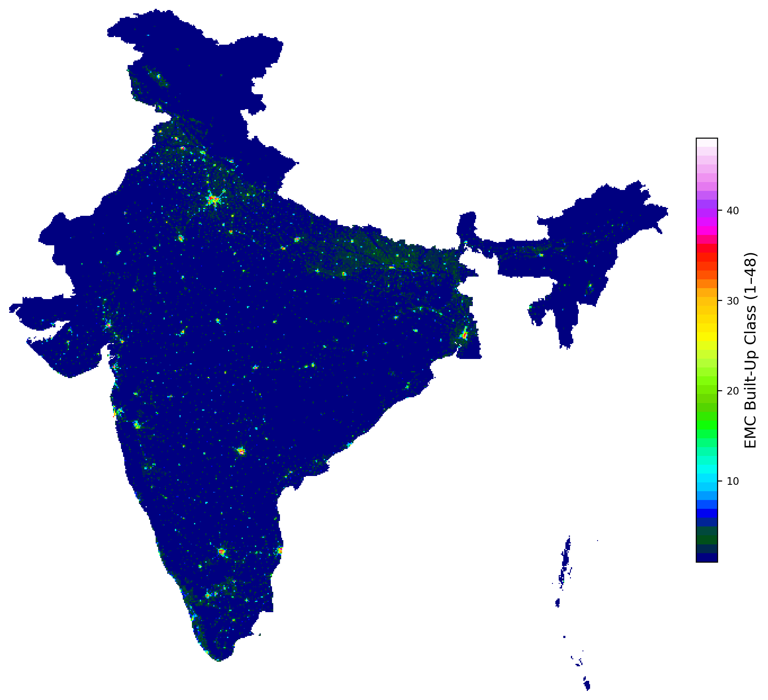

Slide 9
Thank You!
Ketan Pednekar
support@ccartghg.com
www.ccartghg.com
GitHub: https://github.com/ketan-pednekar/ccart-india
Phone: +91 8898336029

