Slide 1
How the Human Body Digests Dietary Protein
Nutrition and Physiology for Informed Lay Readers

Slide 2
Why Digestion Matters
Proteins are amino acid polymers linked by peptide bonds
Must be broken into absorbable units before entering blood
About 90-95% of dietary protein is absorbed in the small intestine
Digestion speed differs by protein source

Slide 3
Stomach: Acid and Pepsin
HCl lowers gastric pH to about 1.5-2.0
Pepsinogen converts to pepsin
Pepsin cleaves bonds near aromatic amino acids
Forms chyme: polypeptides ready for the duodenum
Contributes roughly 10-20% of total proteolysis

Slide 4
Pancreas: The Protease Cascade
Pancreatic juice neutralizes acid with bicarbonate
Zymogens: trypsinogen, chymotrypsinogen, proelastase
Enterokinase activates trypsinogen to trypsin
Trypsin activates other zymogens in a cascade
Endopeptidases plus carboxypeptidases yield oligopeptides and free amino acids

Slide 5
Brush Border and Absorption
Aminopeptidases and DPP-IV on the microvillus membrane
Free amino acids: multiple sodium-dependent transporters
Dipeptides and tripeptides: PEPT1 transporter
Primary absorption site: jejunum
Portal vein carries amino acids to the liver

Slide 6
Whey vs Casein Digestion Speed
Whey: soluble, fast gastric emptying
Peak aminoacidemia in 1-2 hours
High leucine and BCAA content
Ideal for rapid post-exercise recovery
Casein: forms gastric curd
Slow emptying, sustained release
Elevated amino acids for 7-8 hours
Useful overnight or between meals

Slide 7
Plant Protein Digestion
Generally slower and more variable than dairy
Food matrix, fiber, and antinutrients slow hydrolysis
Soy trypsin inhibitors can reduce pancreatic activity
Processing and blending improve digestibility
Well-formulated blends can match whey when EAAs are equated

Slide 8
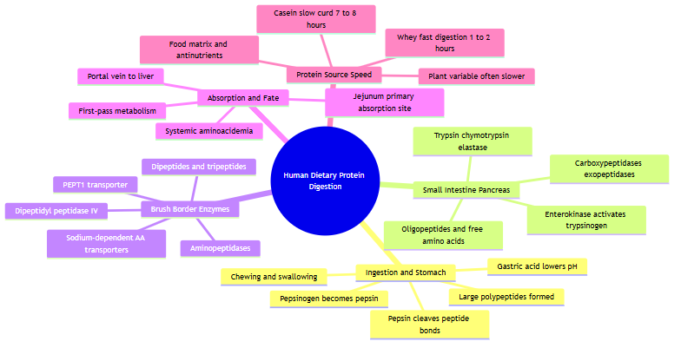
Digestion Pathway Mind Map
Overview of the protein digestion pathway from ingestion to absorption

Slide 9
Key Takeaways
Digestion is a three-compartment process: stomach, pancreas, brush border
Absorption kinetics differ: whey fast, casein slow, plant variable
Total daily protein and essential amino acids matter most
Educational content only — not personal medical advice

