Slide 1
How the Human Body Digests Dietary Protein
From ingestion to amino acid absorption

Slide 2
Overview
Proteins are amino acid chains linked by peptide bonds
Must be broken into absorbable units in the GI tract
About 90-95% absorbed in the small intestine
Enzymes in stomach, pancreas, and brush border cooperate

Slide 3
Stomach Phase
HCl lowers pH to about 1.5-2.0
Pepsinogen converts to active pepsin
Pepsin cleaves bonds near aromatic amino acids
Produces polypeptides and chyme
Roughly 10-20% of total proteolysis occurs here

Slide 4
Pancreatic Phase
Bicarbonate neutralizes gastric acid in duodenum
Pancreatic zymogens activated by enterokinase
Trypsin activates chymotrypsin and elastase
Carboxypeptidases trim C-terminal amino acids
Majority of luminal protein breakdown occurs here

Slide 5
Brush Border and Absorption
Brush-border peptidases finalize hydrolysis
Free amino acids use multiple transporters
Dipeptides and tripeptides use PEPT1
Jejunum is the primary absorption site
Amino acids reach liver via portal vein

Slide 6
Whey vs Casein
Whey: soluble, fast gastric emptying
Peak aminoacidemia in 1-2 hours
High leucine and BCAA content
Casein: forms gastric curd
Slow release over 7-8 hours
Sustained amino acid availability

Slide 7
Plant Protein Digestion
Often slower and more variable than dairy
Fiber and food matrix reduce enzyme access
Antinutrients such as trypsin inhibitors in soy
Processing and blending improve digestibility

Slide 8
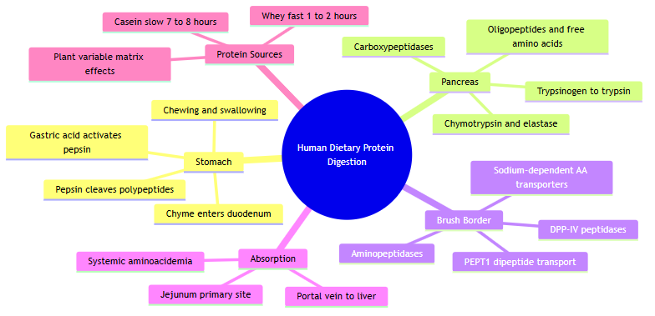
Digestion Pathway Mind Map
Staged pathway from stomach through absorption

Slide 9
Key Takeaways
Three-stage cascade: stomach, pancreas, brush border
Whey fast, casein slow, plant variable
Total essential amino acid intake remains primary
Educational content only — not personal medical advice

