Slide 1
DATA MINING / ALGORITHM BENCHMARK
Apriori vs DHP
Hash-based pruning and transaction trimming for frequent itemset mining
Implementation • Synthetic benchmark • Performance trade-offs
Updated to match the supplied Python dataset and experiment code
APRIORI / DHP • TECHNICAL COMPARISON
01

Slide 2
01 / ORIENTATION
What this comparison asks
Baseline: Apriori
Modification: DHP
Additional variant
Generate candidate itemsets level by level; prune candidates whose subsets are not frequent.
Use pair-hash bucket counts to safely prune some 2-itemset candidates before exact counting.
Apply a simplified transaction-trimming step to reduce later-pass data work.
Evaluation dimensions
Runtime
Memory
Correctness
Elapsed time by dataset size and support
Peak traced allocation after data is loaded
Same frequent itemsets/counts across variants
APRIORI / DHP • TECHNICAL COMPARISON
02

Slide 3
02 / CORE CONCEPTS
Association-rule mining in one slide
Transaction
Frequent itemset
Association rule
A basket or event containing a set of items, e.g. {bread, milk, eggs}.
An item combination whose support reaches the chosen minimum threshold.
A directional implication X → Y evaluated with support and confidence.
Key measures
Where it is used
Retail basket analysis and cross-selling
Web clickstream and content recommendations
Diagnosis/event co-occurrence and inventory planning
Support(X) = transactions containing X / all transactions
Confidence(X → Y) = support(X ∪ Y) / support(X)
Scope note: this implementation benchmarks frequent itemset mining; rule generation/confidence reporting is described conceptually, not implemented in the benchmark script.
APRIORI / DHP • TECHNICAL COMPARISON
03

Slide 4
03 / BASELINE
Apriori: the downward-closure principle
Candidate generation = join + prune
If an itemset is frequent…
Join frequent (k−1)-itemsets with a shared prefix.
Prune a k-itemset if any required (k−1)-subset is absent.
Count support only for the remaining candidates.
{A,B,C}
{A,B}
{A,C}
{B,C}
Main cost: candidate explosion + repeated database scans
APRIORI / DHP • TECHNICAL COMPARISON
04

Slide 5
03 / BASELINE
Apriori workflow
1
2
3
4
5
Count singletons
Keep frequent L₁
Join + prune to C₂
Scan & count support
Repeat until no candidates
Output: all frequent itemsets and their exact support counts
Apriori remains the reference implementation used to compare output equality.
APRIORI / DHP • TECHNICAL COMPARISON
05

Slide 6
04 / MODIFICATION
DHP: use hash buckets to prune pairs early
Pass 1
Safe pruning rule
Exact verification
Count each item and hash every observed pair into a bucket table.
If a bucket count is below min support, every pair mapped there is infrequent.
A bucket above threshold is only a possibility; candidate pairs still need exact support counting.
Hash used in the supplied code
bucket(a,b) = (a × 1009 + b) mod B • default B = 20,011
Hash collisions can keep extra candidates, but they cannot make a truly frequent pair disappear.
APRIORI / DHP • TECHNICAL COMPARISON
06

Slide 7
04 / IMPLEMENTATION
Three implementations compared
Apriori
DHP — hash only
DHP — hash + trim
Shared candidate join/prune and exact support counting. No hash pruning or transaction trimming.
Adds first-pass pair-bucket counts; uses the same candidate generator and exact support counter.
Adds a simplified transaction-trimming step after passes to reduce later-pass records.
Important implementation detail: this is a clear educational Python version, not a reproduction of every optimization in the original DHP paper.
The code asserts output equality against Apriori for the completed configurations and runs a brute-force self-test at startup.
APRIORI / DHP • TECHNICAL COMPARISON
07

Slide 8
05 / EXPERIMENT
Dataset and benchmark design
Item universe
200 item IDs
Observed distinct items
190 / 194 / 198 across 2k / 5k / 10k
Average transaction length
≈ 11.3 items
Dataset origin
Synthetic Quest-style generator; fixed seed 2026
Size sweep
2,000 • 5,000 • 10,000 transactions
Support sweep
5,000 transactions; 2% and 1% support
Bucket sweep
5,000 transactions; B = 997, 4,999, 20,011
Timing shown in this deck is a single completed run per configuration; treat small differences as indicative, not statistically conclusive.
APRIORI / DHP • TECHNICAL COMPARISON
08

Slide 9
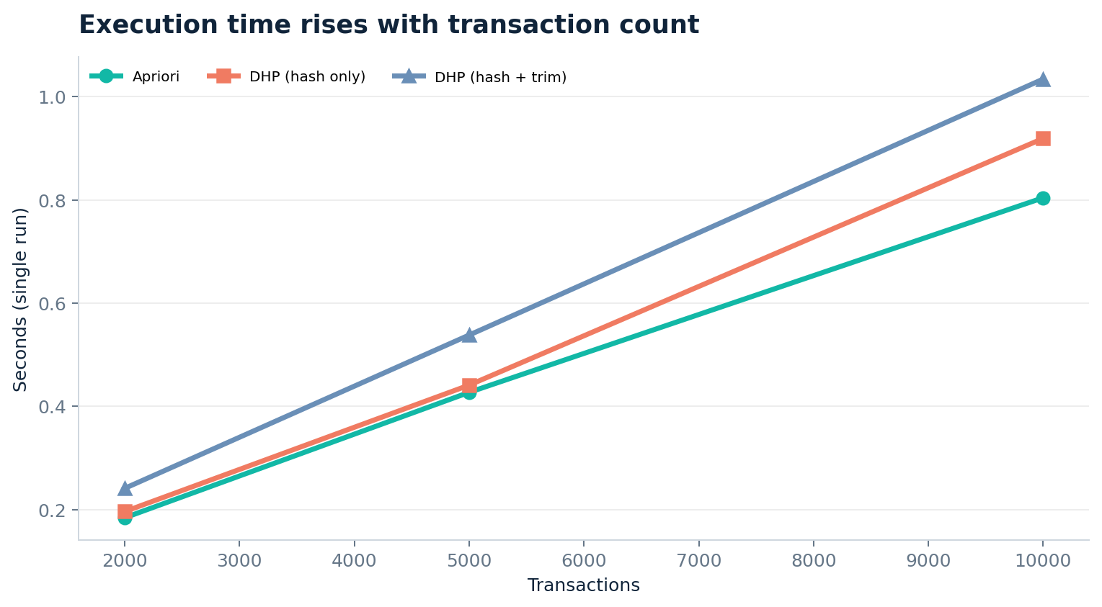
06 / RESULTS
Result 1 — runtime grows with dataset size
10k transactions
Apriori: 0.804 s
DHP hash only: 0.919 s
DHP + trim: 1.034 s
Interpretation
On this synthetic workload, hash overhead and trimming cost outweigh pruning savings in elapsed time.
All three returned 4,370 frequent itemsets at 10k / 1% support.
APRIORI / DHP • TECHNICAL COMPARISON
09

Slide 10
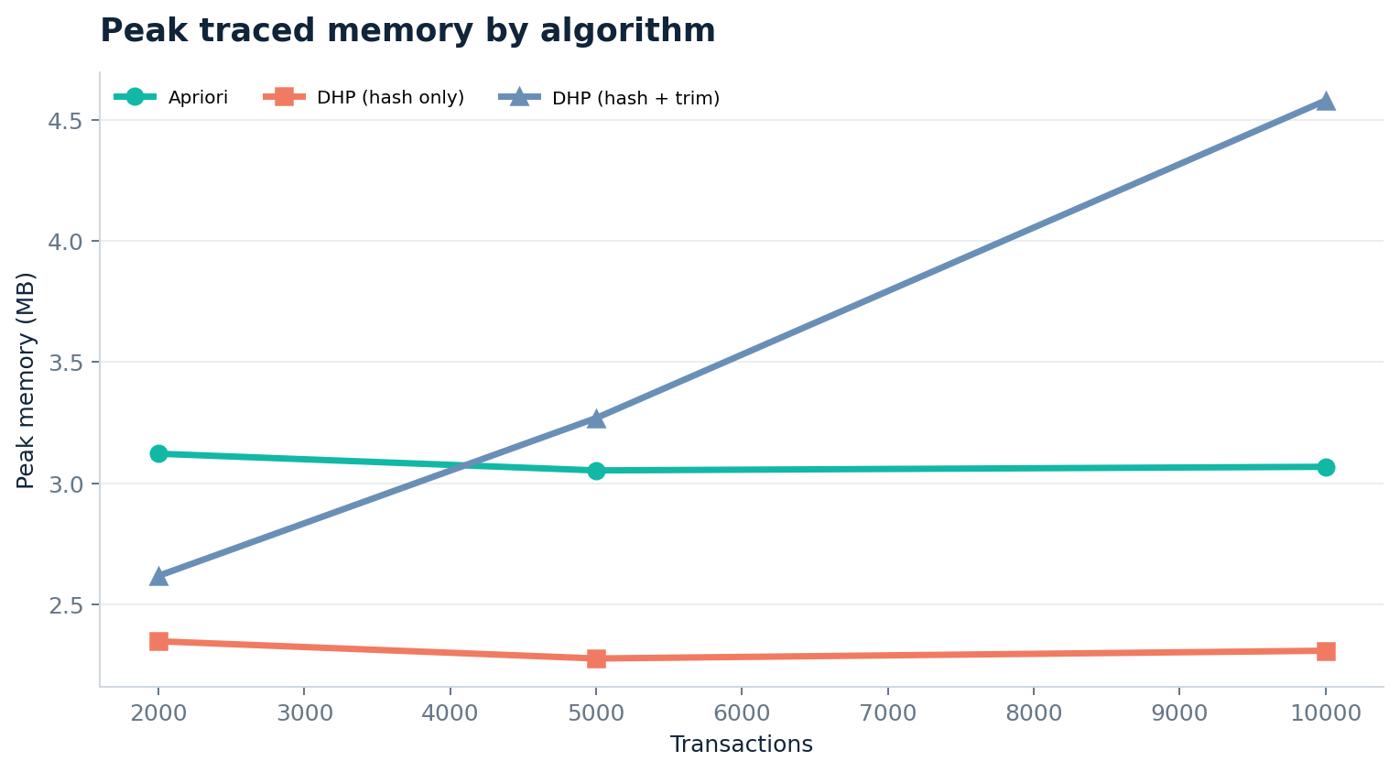
06 / RESULTS
Result 2 — memory trade-off
Hash only
Lower peak traced memory than Apriori in these measured cases.
Hash + trim
Memory is higher here; the extra bucket table and trimmed transaction structures have a cost.
Memory uses tracemalloc peak after input loading—not total process RSS.
APRIORI / DHP • TECHNICAL COMPARISON
10

Slide 11
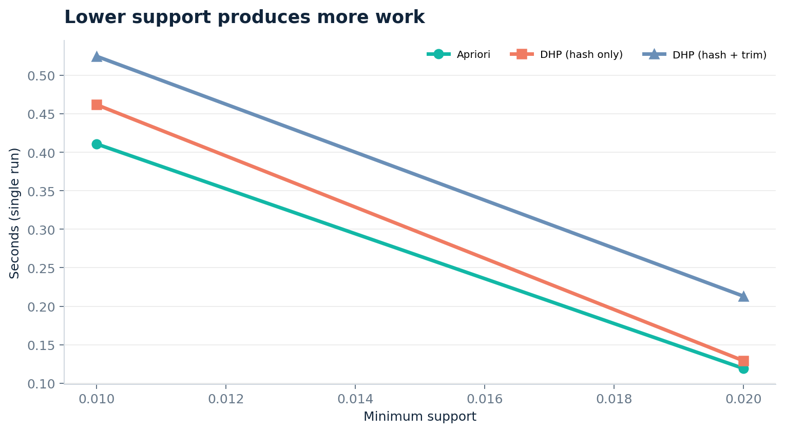
06 / RESULTS
Result 3 — lower support means more work
At 2% support
1,188 frequent itemsets; fewer candidates and lower runtime.
At 1% support
4,369 frequent itemsets; more combinations survive pruning.
Expected pattern: lowering minimum support increases search space.
APRIORI / DHP • TECHNICAL COMPARISON
11

Slide 12
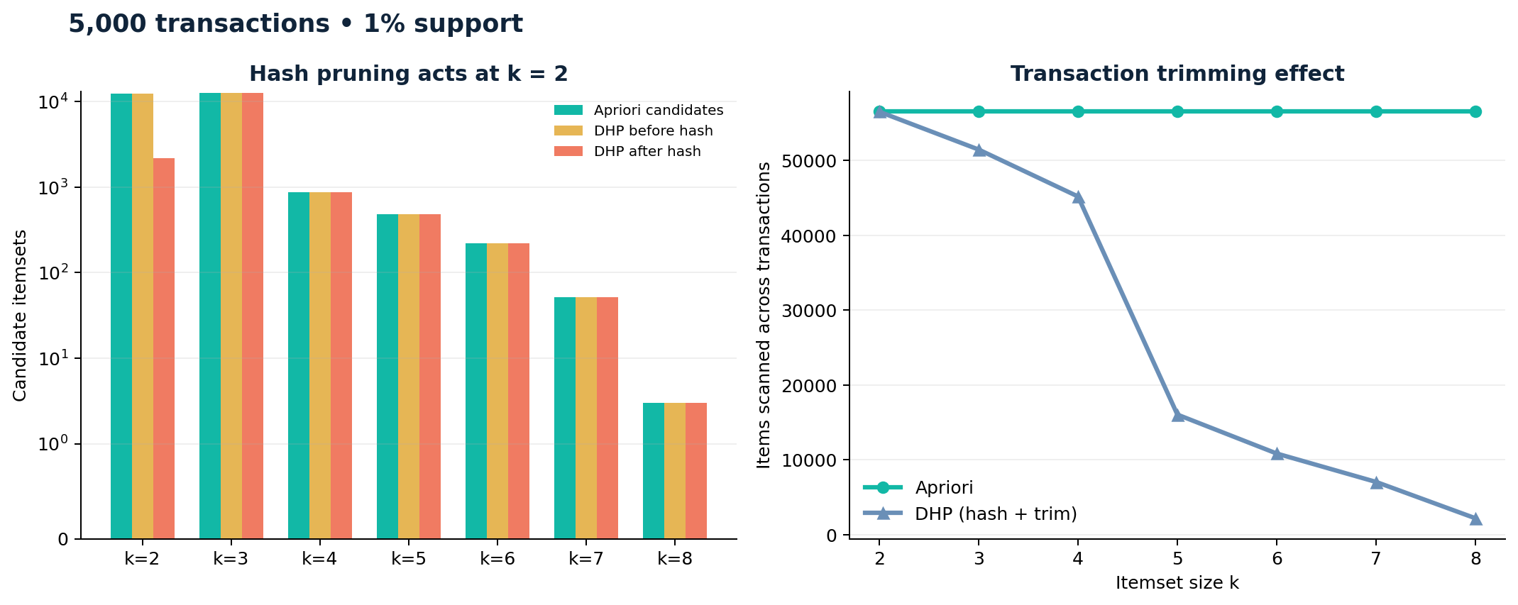
06 / RESULTS
Result 4 — candidate pruning vs transaction trimming
Hash pruning
Targets C₂ directly. Collisions limit pruning power.
Transaction trimming
May reduce items scanned later, but adds per-pass bookkeeping.
The trimming rule here is simplified for teaching.
APRIORI / DHP • TECHNICAL COMPARISON
12

Slide 13
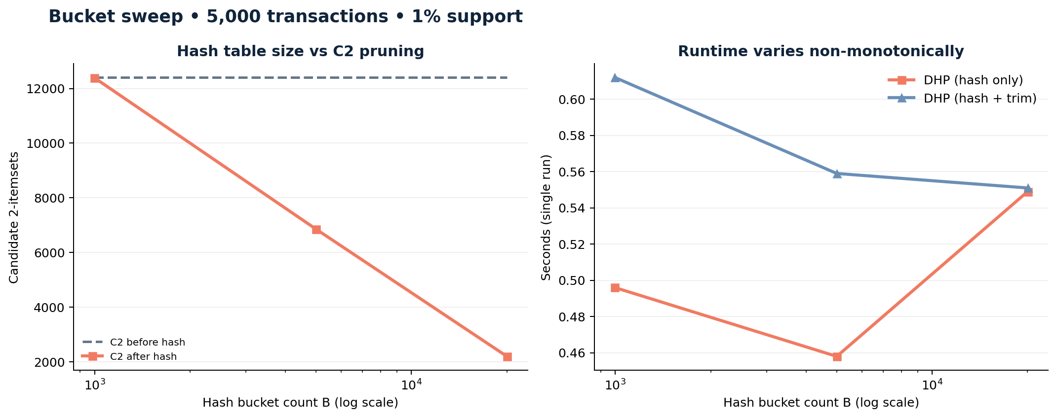
06 / RESULTS
Result 5 — bucket count changes the trade-off
Smaller B
More collisions can retain more candidate pairs.
Larger B
Finer buckets may prune more, but use more table memory.
Runtime is not monotonic: hashing and memory overhead matter too.
APRIORI / DHP • TECHNICAL COMPARISON
13

Slide 14
07 / CONCLUSION
Takeaways and limitations
What the run shows
What DHP contributes
Why trim did not win
On this synthetic workload, Apriori is competitive and often faster; DHP hash-only reduces traced memory in the tested settings.
A principled early filter for C₂, with potential gains when pair candidates are the bottleneck.
The simplified trim logic and extra processing may cost more than the work saved at this scale.
Limitations to disclose
Synthetic data only; results may not generalize to real transaction distributions.
Only a curated subset completed: 2k/5k/10k size, 2 support thresholds, 3 bucket sizes. The provided 20k file is included, but its full benchmark was not completed.
Single-run timings are exploratory. Full study should use more repeats and verify every bucket-sweep output against Apriori.
Benchmark measures frequent itemsets; confidence-based rule generation is not part of the supplied experiment code.
APRIORI / DHP • TECHNICAL COMPARISON
14

Slide 15
08 / REFERENCES
Research references
1
Agrawal, R. & Srikant, R. (1994). “Fast Algorithms for Mining Association Rules in Large Databases.” VLDB, 487–499.
https://www.vldb.org/conf/1994/P487.PDF
2
Park, J. S., Chen, M.-S., & Yu, P. S. (1995). “An Effective Hash-Based Algorithm for Mining Association Rules.” SIGMOD ’95, 175–186. DOI: 10.1145/223784.223813.
https://doi.org/10.1145/223784.223813
3
Han, J., Pei, J., & Yin, Y. (2000). “Mining Frequent Patterns without Candidate Generation.” SIGMOD 2000, 1–12. DOI: 10.1145/342009.335372.
https://doi.org/10.1145/342009.335372
References cover the foundational Apriori and DHP papers plus a widely cited alternative frequent-pattern approach.
APRIORI / DHP • TECHNICAL COMPARISON
15

