Slide 1
TWITTER SENTIMENT ANALYSIS
Team 11
Ketan Bedarkar
Jay Patel
Jacob Shea

Slide 2
Agenda
Introduction​
Primary goals
​Dataset Description
Preprocessing
Design and Training
Analysis of trends
Targeted Users

Slide 3
Introduction
Twitter - the most comprehensive dataset about people's opinions
Can’t read every tweet
Analysing twitter can help understand
Brand perception
Sentiments about an electoral candidate
Understand well-liked players/actors to TV ratings

Slide 4
Primary Goals
Understand sentiments of twitter users on general topics
Analyze the trending topics on twitter
Use the results to understand brand perception, opinion about a certain player or the citizen sentiments about an event such as an ongoing election

Slide 5
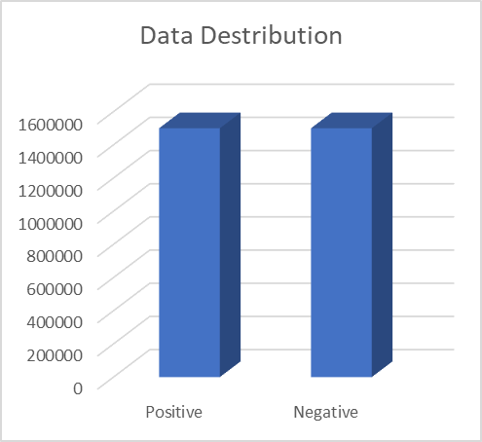
Dataset
Combined 3-4 smaller datasets to generate a large dataset of size ~1.2GB.
3 million records - ~400 bytes per record on average
Evenly Distributed

Slide 6
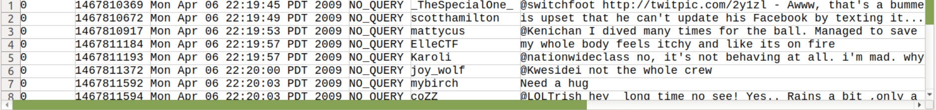
Data Description
Sentiment - Positive/Negative
Id - unique identifier
Date
User Name
Tweet Text

Slide 7
Data Cleanup
Multiple Datasets -> different columns per dataset
Removing extra columns
Standardize Sentiment column
Sentiment140 Dataset -> 0 = Negative, 4 = Positive
Bitcoin Sentiment Analysis Dataset -> 0 = Negative, 1 = Positive

Slide 8
Conceptual Flowchart
Start
Get Twitter Dataset
Tokenization and GloVe embedding
Define Model Architecture
Preprocess data for training
Tune hyperparameters
Stemming
Padding
Save Best Model
Lemmatization
Remove stopwords and links
Analyse the trending twitter topics

Slide 9
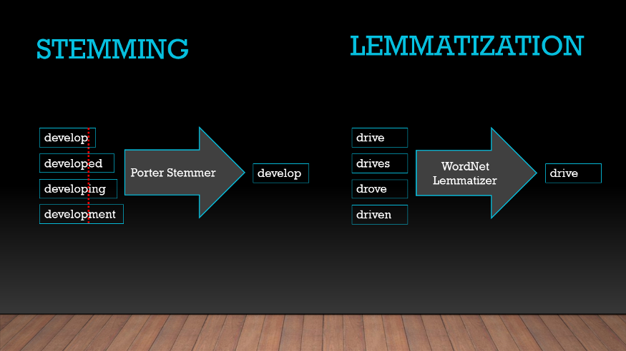

Data Preprocessing
Stemming
Lemmatization

Slide 10
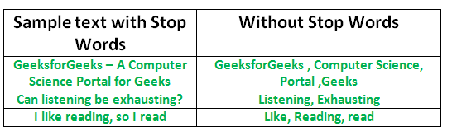
Data Preprocessing
Remove Stopwords
Remove Mentions
Remove Hyperlinks

Slide 11
Data Split
70% Training
10% Validation
20% Testing

Slide 12
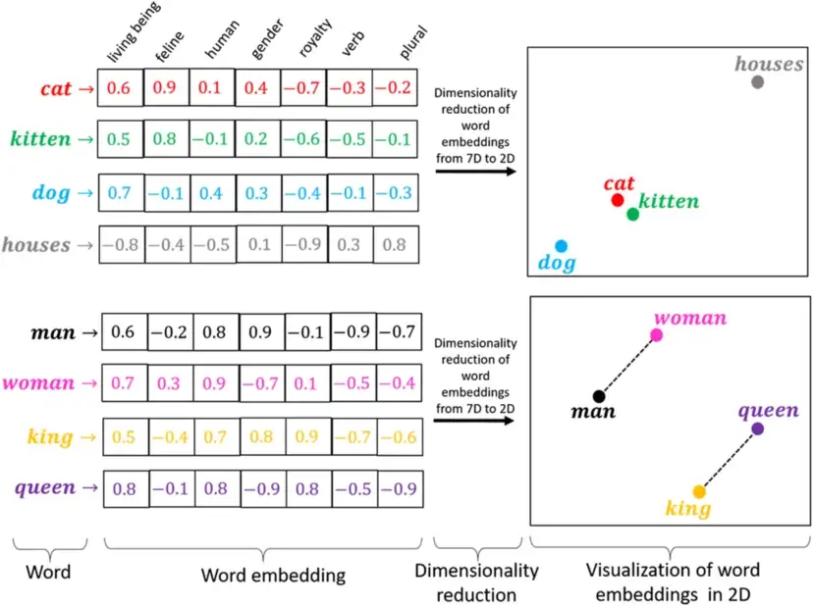
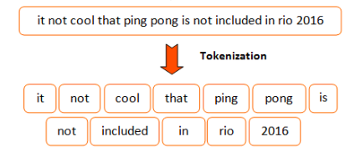
Tokenization, Padding and Word Embedding(GloVe)

Slide 13
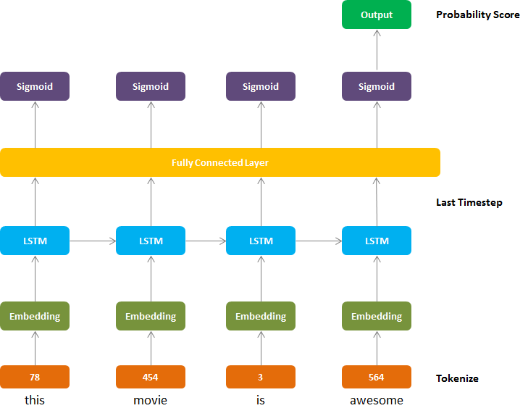
LSTM (sequence model)
Input Layer
Embedding layer
Dropout(0.2)
Bidirectional LSTM
64 neurons
Dropout = 0.2
Dense Layer
512 neurons
Activation function = ReLU
Dropout = 0.5
Dense Layer
512 neurons
Activation function = ReLU
Output Layer
1 neuron
Activation function = Sigmoid

Slide 14
LSTM Hyperparameters
Learning Rate = 0.001
Adam Optimizer
Batch Size = 1024
Epochs = 10
Loss Function = Binary Cross-Entropy

Slide 15
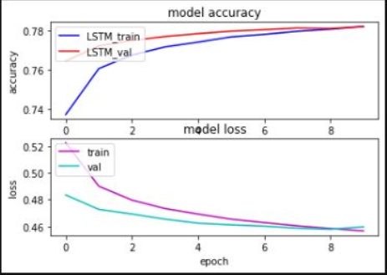
LSTM Benchmarks
Training
Accuracy: 78.20%
Loss: 45.66%
Validation
Accuracy: 78.10%
Loss: 45.96%

Slide 16
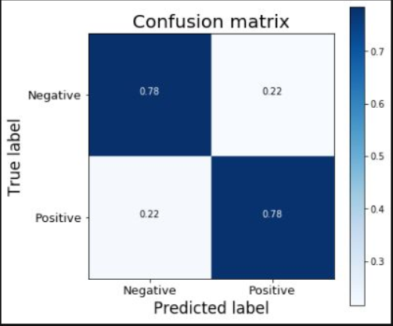
LSTM Results
Testing
Accuracy: 78%

Slide 17
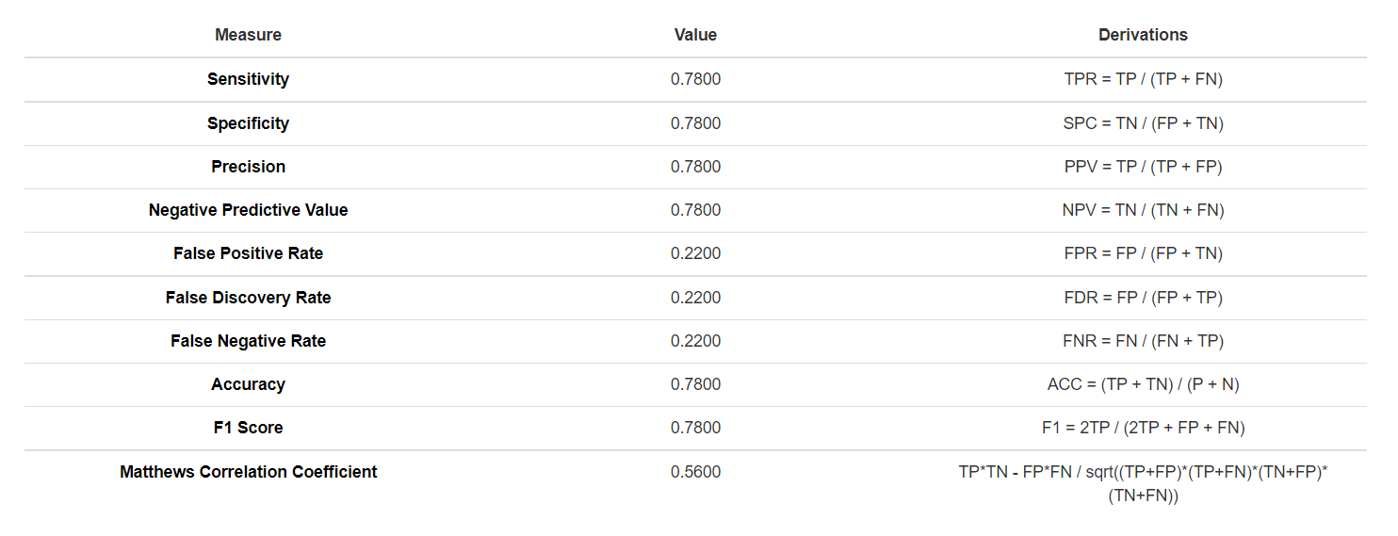
LSTM Analysis

Slide 18
Model Summary - CNN
Embedded layer - GLOVE Twitter, 200 dim vector
Conv1D: 512 neurons of size 5, activation is ReLU
Average Pooling: To reduce dimensionality with a window of size 5
Repeat convolution layers twice with an average pooling layer in the middle
Flatten layer to get one dimensional tensors
Add dropout layer of value=0.3 to prevent overfitting
Dense layers to condense into 2 classes i.e. positive or negative

Slide 19
CNN Hyperparameters
Learning Rate = 0.001
Adam Optimizer
Batch Size = 256
Epochs = 4
Loss Function = Categorical Cross-Entropy (even though binary classification was required, experimental results were better for categorical cross-entropy)

Slide 20
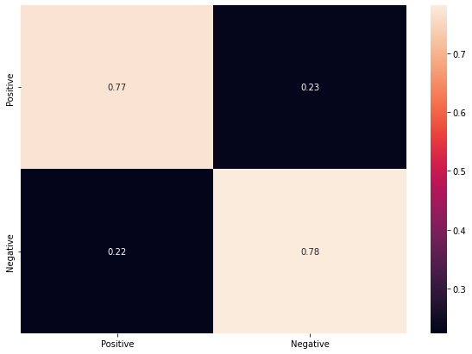
CNN Confusion Matrix
Testing
Accuracy: 77.5%

Slide 21
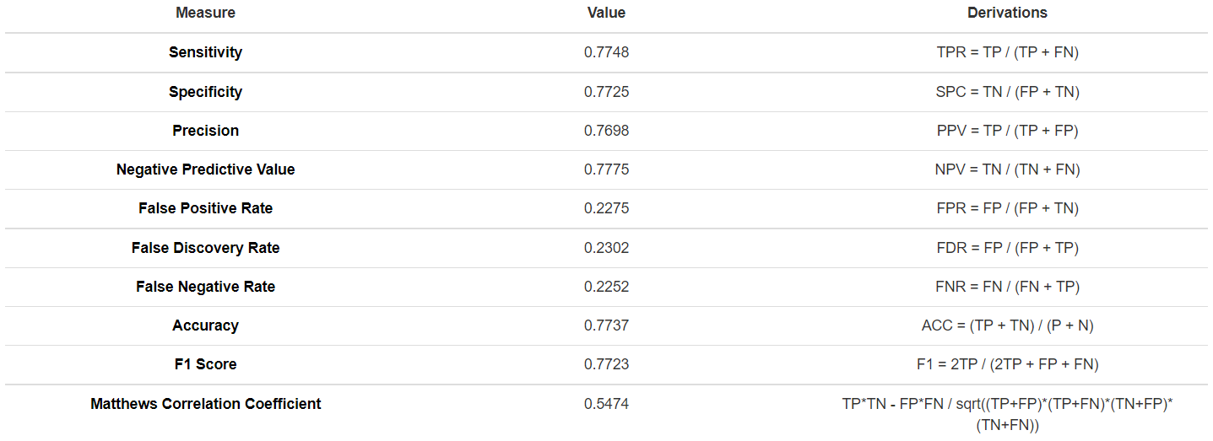
CNN Analysis

Slide 22
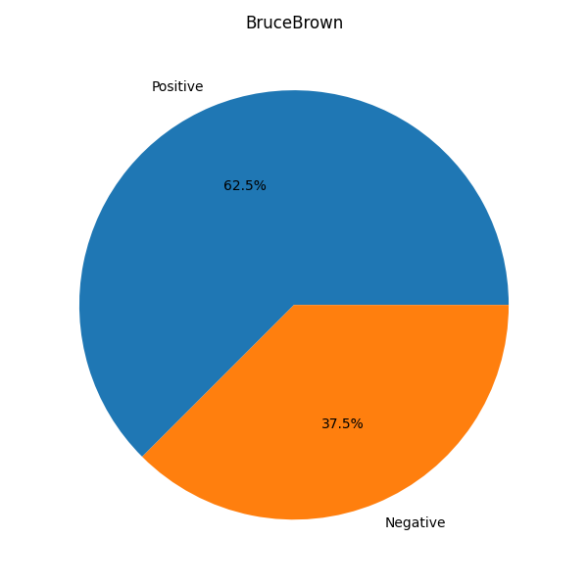

Analysis of trending topics - Bruce Brown
CNN
LSTM

Slide 23
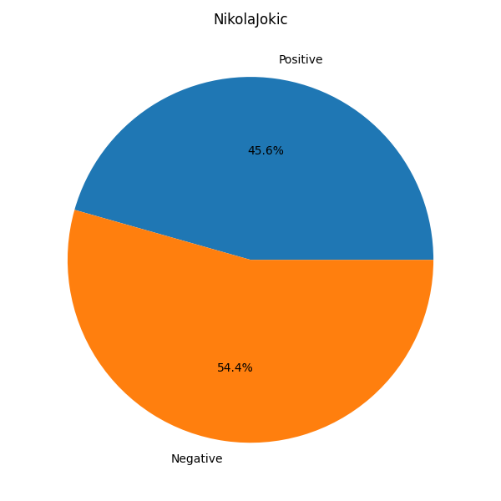

Analysis of trending topics - Nikola Jokic
CNN
LSTM

Slide 24
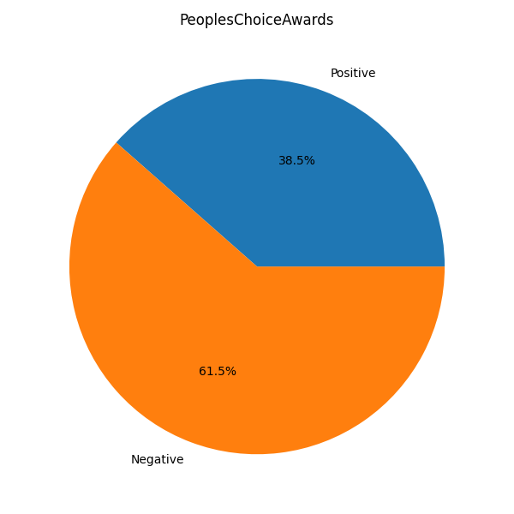

Analysis of trending topics - People’s Choice Awards
CNN
LSTM

Slide 25
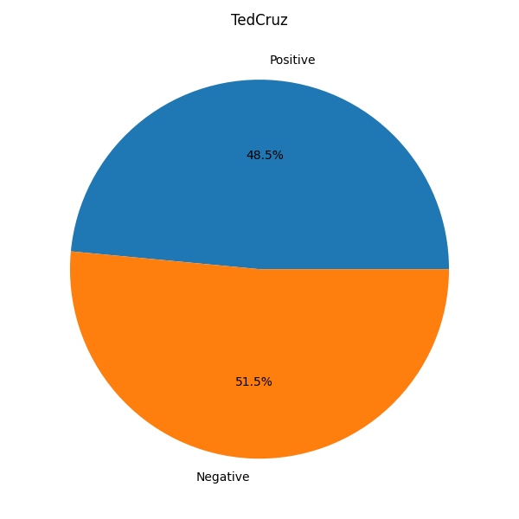

Analysis of trending topics - Ted Cruz
CNN
LSTM

Slide 26
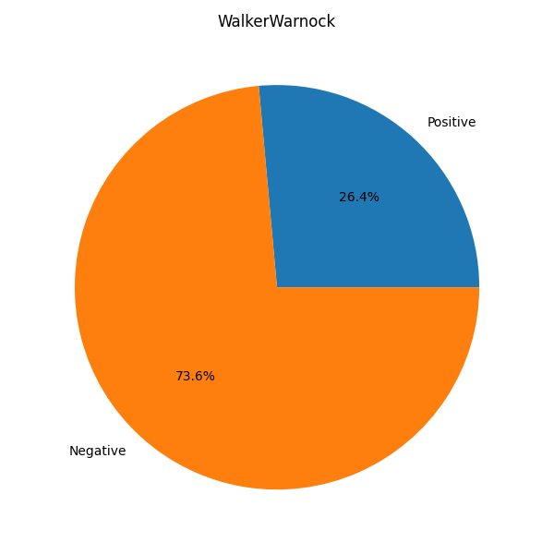

Analysis of trending topics - Walker v. Warnock
CNN
LSTM

Slide 27
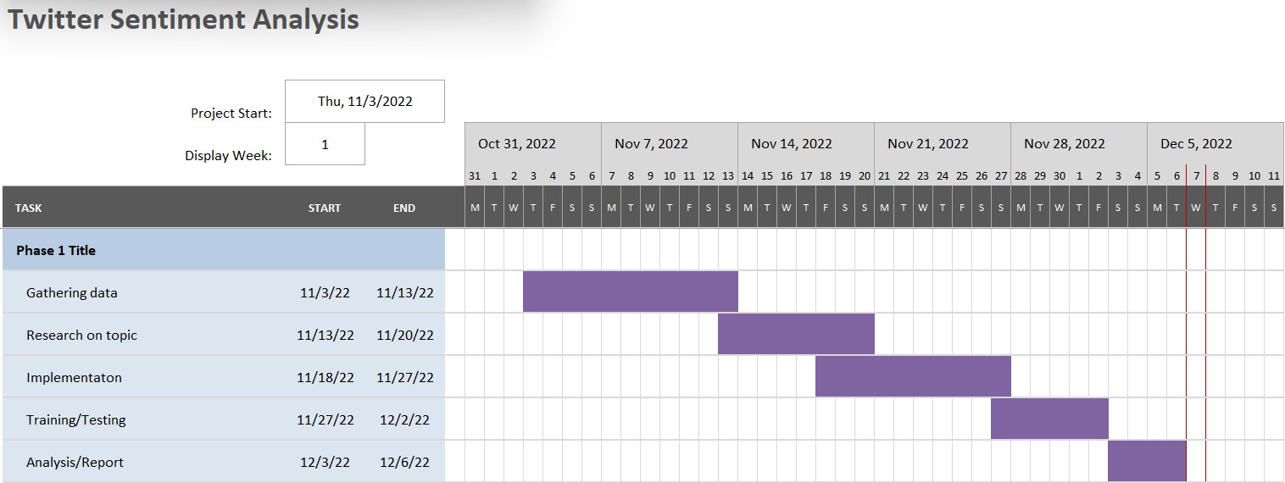
Gantt Chart

Slide 28

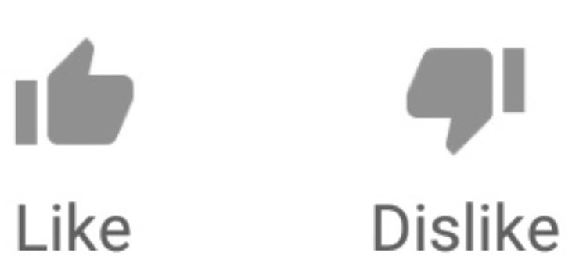
Who Can Use This Model
When someone is trending, they can use this model to see if the tweets about them are positive or negative.
A brand can see what the public perception for its products is
A political candidate can check the people’s views about him/her
A youtuber can see if comments they get are positive or negative
A seller on amazon can check the sentiments of their reviews.

Slide 29
References
Keras: https://www.tensorflow.org/guide/keras/rnn
Dataset: https://www.kaggle.com/datasets/kazanova/sentiment140, https://www.kaggle.com/datasets/gautamchettiar/bitcoin-sentiment-analysis-twitter-data
CNN-LSTM: https://aclanthology.org/P16-2037.pdf
GloVe: https://nlp.stanford.edu/projects/glove/
NLTK: https://www.nltk.org/

Slide 30
Thank You
Questions?

