Slide 1
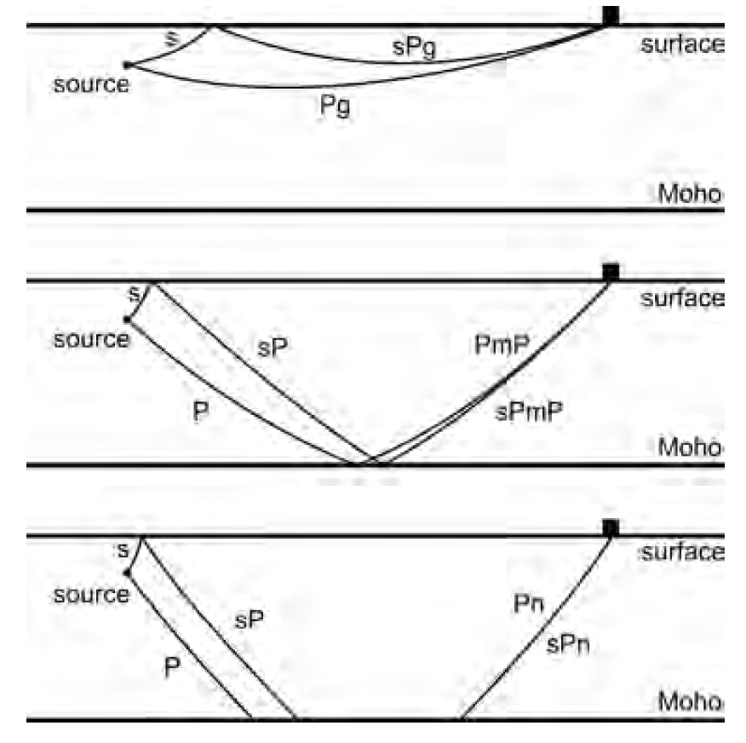
Regional depth phases (sPg, sPmP and sPn):
(1) sPg the S-wave travels upward to the surface, is converted to a P-wave at the critical angle, then the P-wave travels along or close
the surface to the station;
(2) sPmP the S-wave travels upward to the surface, is converted to a P-wave, then the P-wave travels downward to the Moho, is reflected there and travels upward to the station;
(3) sPn the S-wave travels upward to the surface, is converted to a P-wave, then the P-wave travels along the Pn path to the station.
Ma, 2012

Slide 2
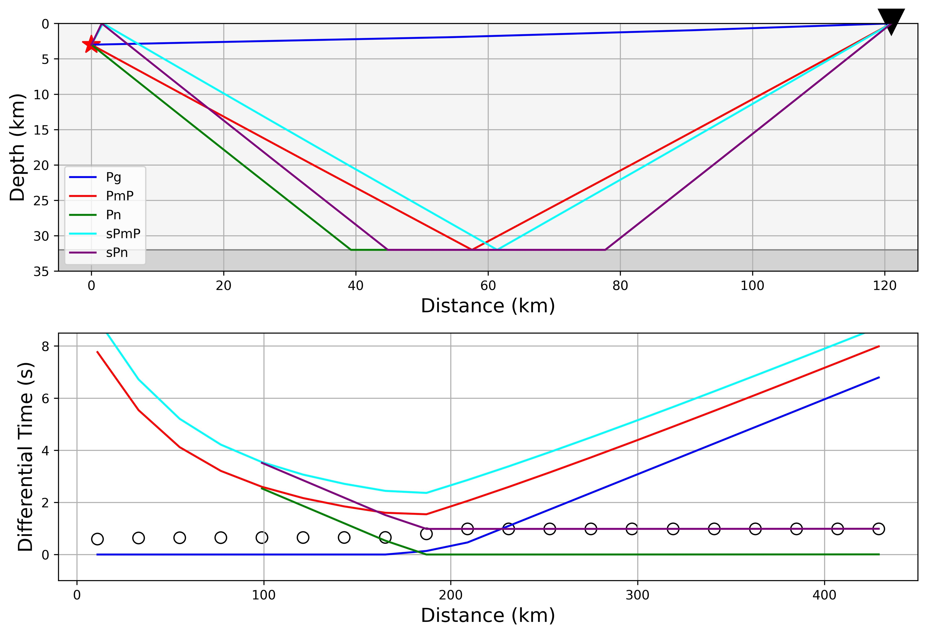
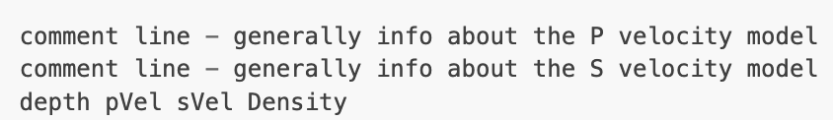
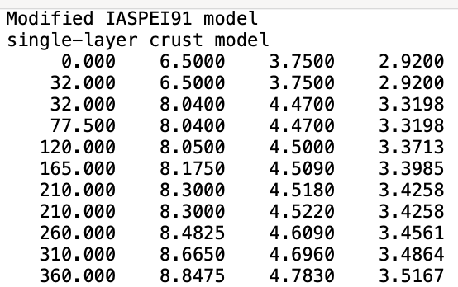

Phase list = [‘sP’] →
[‘sPvmP’] or [‘sPn’]
∘ First sP arrival time

Slide 3
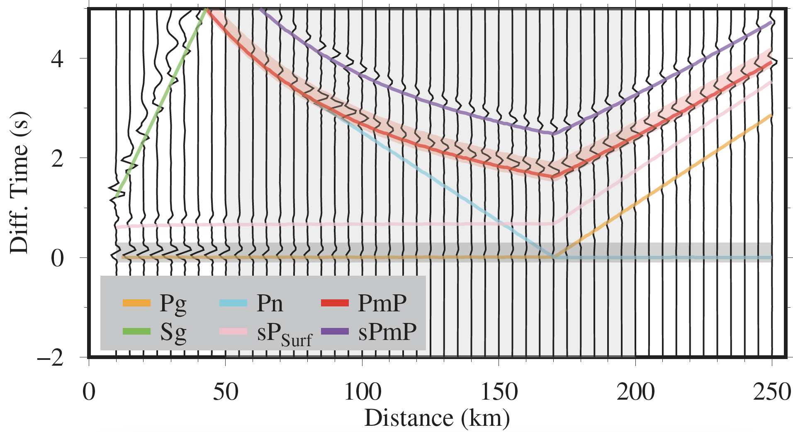
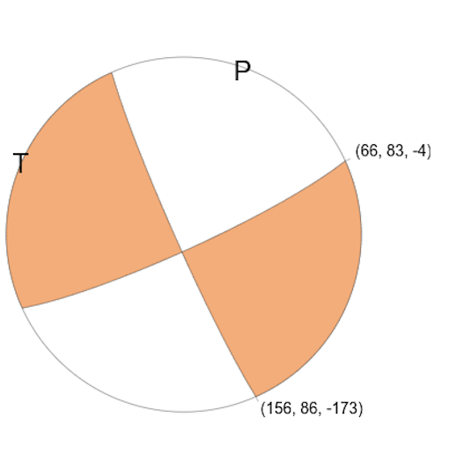
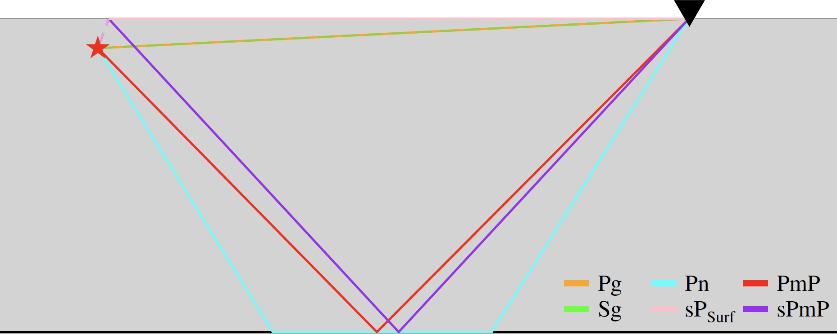
Synthetic Waveforms
$Double−coupleSource$

Slide 4

Summary I:
On regional waveform records, one or more phases are well developed between the first arrivals (Pg or Pn) and the S-wave train, and one or two of them are regional depth phases:
Within about 100 km, the sPg phase is well developed on some records of earthquakes as small as M~1.5.
In the distance window from about 200 to 300 km, the sPmP phase is well developed on some records of earthquakes as small as M~2.0;
Beyond 300 km, the sPn phase is developed on some records of moderate and sub-moderate earthquakes.
Ma, 2012

Slide 5
Umino et al., 1995
Summary II:
Many shallow earthquakes occur in and around the seismic network, and a remarkable later phase sP is often observed at small epicentral distances of about 150 km or so from those small events (M~3) with focal depths from about 40 km to 90 km. This phase appears between the P- and S-wave arrivals and characteristics of the phase are as follows.
The sP phase is predominantly observed on the vertical component of seismograms;
(2) The direction of wave approach is almost the same as that for the direct P phase;
(3) The apparent velocity of the sP phase is slower than that of the direct P phase and faster than that of the direct S phase;
(4) The predominant period of the sP phase is slightly longer than that of the direct P phase and is nearly the same as that of the direct S phase;
(5) The amplitude of sP phase varies from event to event, ranging from about 50 to 200 per cent of that of the direct P
phase;
(6) The sP phase is clearly observed not only at some particular stations but at many stations widely distributed in space.
Amplitude
polarization
Apparent velocity (dist/traveltime)
Wavelet duration / frequency spectrum
Amplitude
$Verificationfromqualitativesensetoquantitativesense$

