Slide 1
Project Presentation of Integrated Project (22CS038)
On
BuyBliss : A Fashion Marketplace
Kavya Sharma - 2210990500
Kashish - 2210991764
Keshav Bansal - 2210991781
Ketan - 2210991790
Supervised By
Dr. Kamal Saluja Sir
Department of Computer Science and Engineering,
Chitkara University, Punjab

Slide 2
Introduction
Shop Smart, Drop Hassles!
Welcome to BuyBliss, your go-to platform for a seamless shopping experience. Discover a variety of trendy clothing and accessories through a sleek, user-friendly interface featuring vibrant images and easy navigation.
Track your orders, personalize your account, and enjoy the thrill of our interactive Game Zone, where you can win exciting rewards. Whether upgrading your wardrobe or finding the perfect gift, Shop and Drop makes every purchase enjoyable and hassle-free.
2

Slide 3
Problem Statement and Objective
Problem Statement
In today's fast-paced world, convenience and time-saving solutions are more important than ever to customers. Traditional shopping often means spending hours browsing stores, leading to frustration and inefficiency. Our project aims to revolutionize this experience by offering a cutting-edge e-commerce platform that simplifies online shopping with a seamless, user-friendly interface. By eliminating unnecessary complexities and providing a streamlined process, we're redefining how people shop, making it faster, more efficient, and enjoyable.
Say goodbye to the hassle—welcome to the future of shopping with BuyBliss!
Objective
To create a next-generation e-commerce platform that offers customers the flexibility to shop online with seamless home delivery options. Our goal is to provide a fast, hassle-free shopping experience that prioritizes convenience and customer satisfaction, redefining the way people shop in today’s fast-paced world.
3

Slide 4
Software And Hardware Requirement
Software Requirements
Frontend Development: React framework, Node.js, and package management tools like NPM or Yarn.
Backend Development: Node.js with Express.js for server-side operations and MongoDB for database management.
Payment Integration: Secure payment gateways (e.g., PayPal, Stripe) with SSL certificates for safe transactions.
Hardware Requirements
Server Requirements: High-performance servers with 8GB+ RAM and multi-core processors to handle high traffic.
Client Machine: Minimum 4GB RAM and a 2 GHz processor for development and testing.
Storage: SSD storage for fast data retrieval and efficient handling of databases and application files.
Network: Stable, high-speed internet for real-time communication between frontend, backend, and databases.
Operating System: Compatible with Windows, macOS, or Linux.

Slide 5
Software And Hardware Requirement
Programming/Working Environment
IDE: Visual Studio Code, Sublime Text, or WebStorm for efficient development.
Development Environment: Node.js runtime for backend operations and MongoDB for database management.
Dependencies Management: NPM or Yarn for managing and installing third-party libraries.
Debugging Tools: Chrome Developer Tools for frontend debugging and Postman for API testing and debugging
Requirements to Run the Application
Web Browser: Compatible with Chrome, Firefox, Safari, or Edge, with JavaScript enabled.
Runtime: Node.js installed on the server to manage backend operations.
Database Access: A running MongoDB server connected to the application.
Internet: Stable, high-speed internet for accessing the web application and ensuring seamless communication with servers.
Security: SSL certificates for secure connections and data protection.

Slide 6
Challenges
Performance under High Traffic: The site may experience slowdowns during peak traffic times or sales events due to server limitations or insufficient load balancing.
Complex Payment Integration: Securely managing multiple payment gateways while staying updated with evolving security standards and fraud prevention methods.
Scalability Issues: Without proper database optimization, an increase in users, products, and orders may lead to performance degradation.
Inventory Synchronization: Real-time syncing between online inventory and physical stock may lead to discrepancies, affecting order fulfillment and customer satisfaction.
Mobile Optimization: Advanced features, like live search and interactive filters, may not perform smoothly on lower-end mobile devices or slower internet connections, impacting mobile user experience.

Slide 7
Key Features
Seamless User Experience: The website offers a responsive, user-friendly interface built with React, ensuring smooth navigation across all devices.
Efficient Backend Operations: Node.js and Express.js enable scalable, real-time processing of user requests, ensuring fast load times and efficient operations.
Secure and Scalable Database: MongoDB provides secure and scalable storage for product catalogs, user data, and transactions, supporting the growing demands of the platform.
Flexible Payment and Delivery Options: Integration with multiple payment gateways and delivery methods enhances customer convenience and satisfaction.
Robust Infrastructure: With modern software and hardware, the platform ensures reliability, security, and scalability, delivering a high-quality e-commerce solution for both customers and businesses.

Slide 8
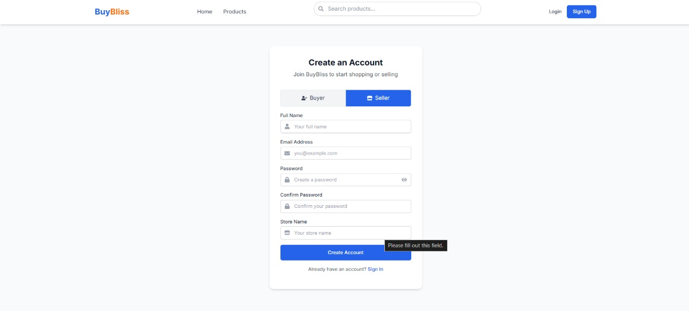
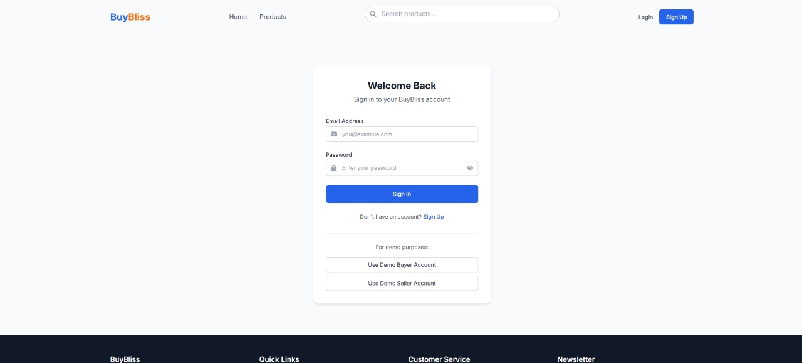

Slide 9
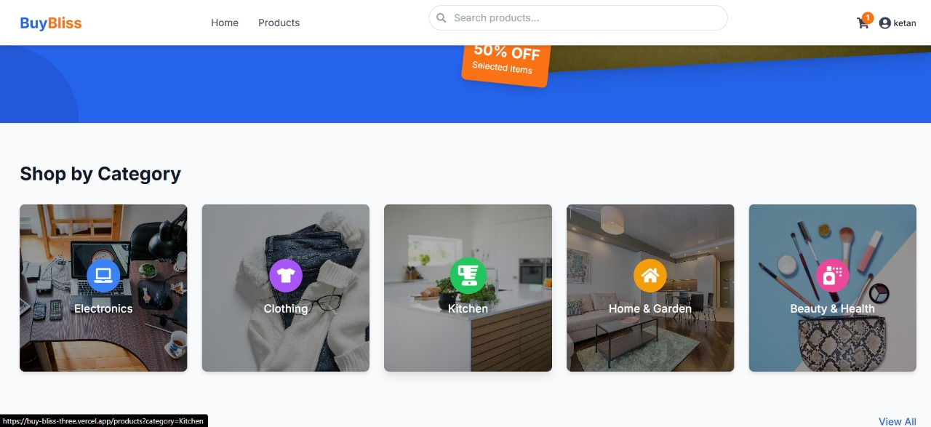
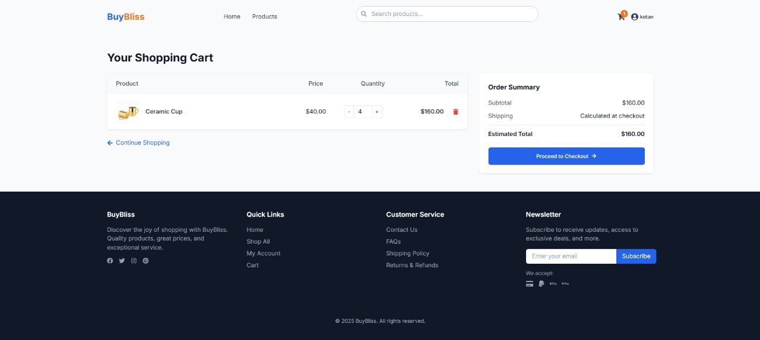
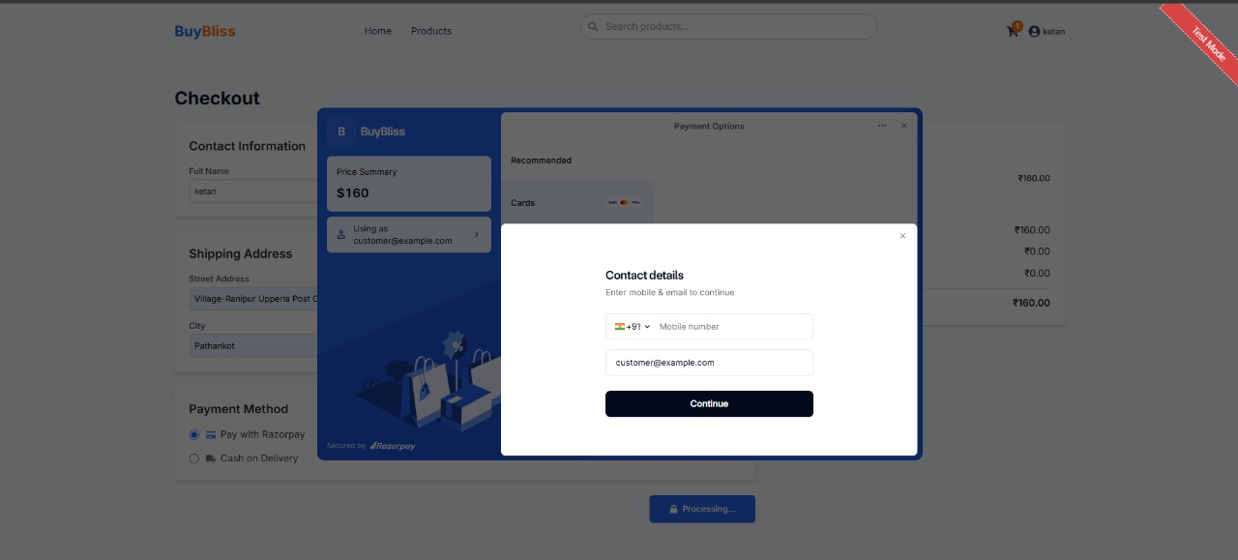

Slide 10
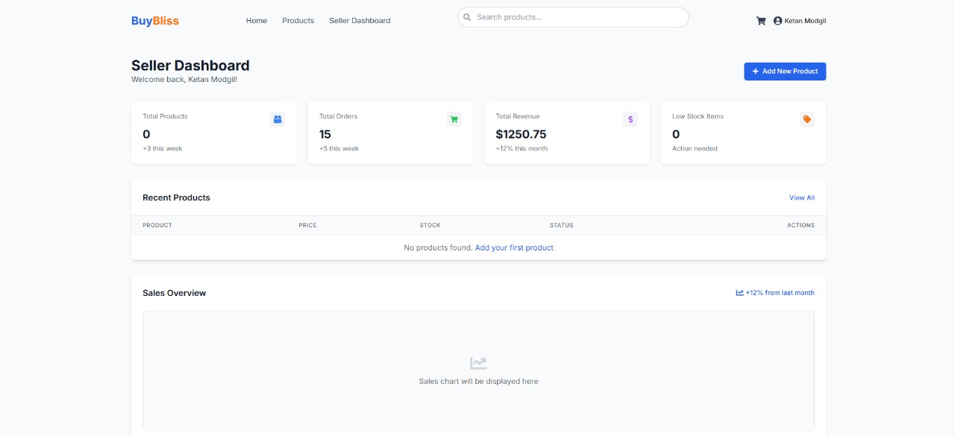
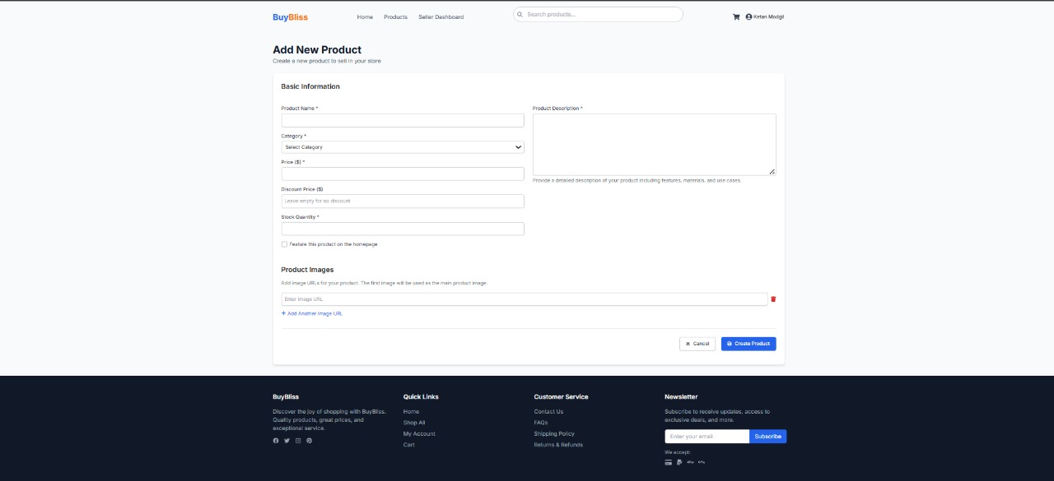

Slide 11
Future Enhancements
Enhanced Personalization: Using AI and machine learning for personalized shopping, product recommendations, and targeted marketing based on user preferences.
Expanded Payment Options: Adding cryptocurrencies and buy-now-pay-later services for broader customer convenience.
Advanced Analytics: Leveraging data analytics to gather insights on customer behavior, sales trends, and inventory management for better decision-making.
Multi-Channel Selling: Integrating with social media platforms, marketplaces, and mobile apps to reach a larger customer base.
In-Store Pickup Option: Offering a seamless in-store pickup option for quicker order fulfillment.
Improved Logistics: Streamlining order fulfillment, tracking, and inventory management to ensure timely deliveries and reduce costs.

Slide 12
Conclusion
Online shopping experience, offering a seamless and user-friendly interface powered by the MERN stack. With a focus on scalability, performance, and security, we provide customers with a wide range of customizable, high-quality furniture at competitive prices. Our efficient order processing, fast delivery, and excellent after-sales support ensure customer satisfaction and loyalty. By leveraging advanced technologies and prioritizing the needs of our diverse target audience, the platform is well-positioned for sustainable growth and long-term success in the competitive e-commerce market.

Slide 13
References
MDN Web Docs. "Introduction to React: Building Dynamic User Interfaces." Available at: MDN Web Docs - React
GeeksforGeeks. "Inventory Management in E-commerce Platforms." Available at: GeeksforGeeks - Inventory Management
StackOverflow. "Best Practices for Securing Multi-Gateway Payment Systems in E-commerce." Available at: StackOverflow - Payment Systems
Node.js Documentation. "Building Scalable and Efficient Backend with Node.js and Express.js." Available at: Node.js Documentation
W3Schools. "MongoDB: Introduction and Database Management." Available at: W3Schools - MongoDB
MDN Web Docs. "Introduction to Node.js: Building Server-Side Applications." Available at: MDN Web Docs - Node.js
GeeksforGeeks. "Building Responsive Frontend Interfaces with React." Available at: GeeksforGeeks - React

Slide 14
Thank You
14

