Slide 1
Back End Engineering-I Project
CABBIEZ
Team Details:
1.Aniket Singla 2310992100
2. Ankit Bansal 2310992106
3. Ketan Sharma 2310992120
4. Vihaan Chawla 2310991319
Faculty Coordinator: Dr. Kirandeep Singh
:
Chitkara University Institute of Engineering and Technology,
Chitkara University, Punjab

Slide 2
Table of Contents
Introduction
Problem Statement
Technical Details
Key Features
Project Highlights
Bonus Feature
Conclusion
References/Links used

Slide 3
Introduction
CABBIEZ
In today’s digital era, the need for fast and reliable transportation has driven the rise of online cab booking platforms. Traditional methods of hailing cabs are being replaced by digital solutions that offer real-time tracking, transparent pricing, and ease of use. Cabbiez is a modern web based cab booking platform designed to meet these expectations. It allows users to book rides, track cabs in real time, view available drivers, and get fare estimates through a simple, intuitive interface. Drivers can easily manage ride requests, navigate routes, and monitor earnings. Built with Node.js, Express.js, MongoDB, and EJS, Cabbiez offers a responsive, scalable, and maintainable solution tailored to today’s urban mobility needs

Slide 4
Problem Statement
Problem Statement:
Many commuters struggle to find reliable and timely cab services, while drivers face difficulties in finding consistent rides and fair commissions. Existing platforms are often expensive, lack transparency, or fail to provide a user-friendly experience. Our cab booking system addresses these challenges by offering a streamlined, affordable, and secure platform for both passengers and drivers
1. Limited Availability in Local Areas: Most cab platforms prioritize urban hotspots, leaving suburban and rural users with fewer or no options.

Slide 5
Problem Statement
2. High Commission Rates: Drivers are often charged excessive fees by existing platforms, reducing their earnings and affecting service quality.
3. Inefficient Ride Matching: Poor algorithmic matching results in delayed pickups and unsatisfied customers.
4. Complex Booking Interfaces: Overly complicated apps frustrate users, especially those unfamiliar with technology.
5. Lack of Customization: Users cannot set preferences for cab types, drivers, or routes, leading to dissatisfaction.
6. Security and Privacy Issues: Inadequate verification processes and data protection measures put users at risk.

Slide 6
Technical Details
Node.js – Server-side JavaScript runtime.
2. Express.js – Web framework for routing and middleware.
3. EJS – Templating engine for dynamic HTML generation.
4. MongoDB & MongoDB Compass – NoSQL database and its cloud service for storing users, drivers, and booking data.
5. Key npm packages:
Mongoose
Express
Node.js framework
NodeMailer
.

Slide 7
Key Features
. Seamless Cab Booking Interface
Users can easily enter their email, pick-up, and drop locations, and choose between available vehicle options (Cab GO, Auto, Moto).
. User Authentication System
Includes both Sign In and Sign Up pages.
Clean UI with fields for email, password, and optional details like phone number.
Interactive Home Page
Modern landing page with a friendly welcome message and clear CTAs: “Explore” and “Book Now”.

Slide 8
Project Highlights
1.Responsive Layout: Adapts to various screen sizes using CSS media queries.
2. Interactive Elements: Includes updates via mail and dynamic content.
3. Form Validation: Client-side validation complements server side checks.
4. Feedback Mechanisms: Clear notifications for successful operations and errors.

Slide 9
Bonus Feature
AI-Powered Ride Recommendations
We plan to integrate AI-based ride suggestions that analyze user behavior, past rides, preferred routes, and peak travel times to recommend the most relevant and cost-effective cab options—enhancing the booking experience with personalized travel insights.

Slide 10
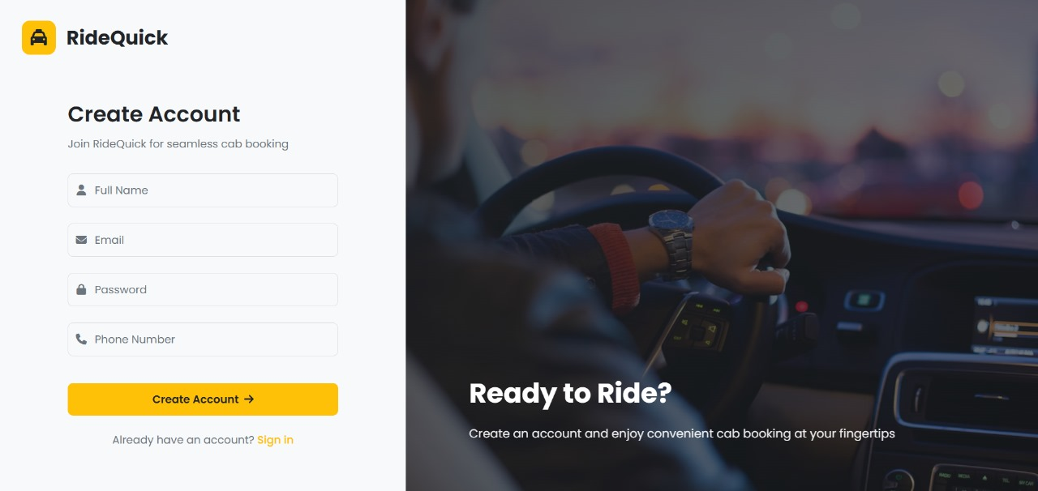
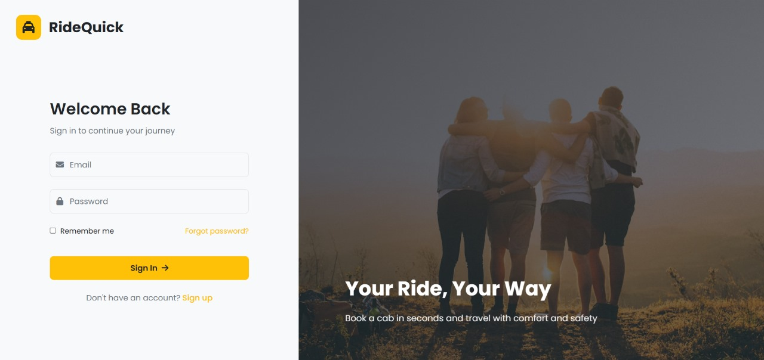
Sign-In Page
Sign Up Page

Slide 11
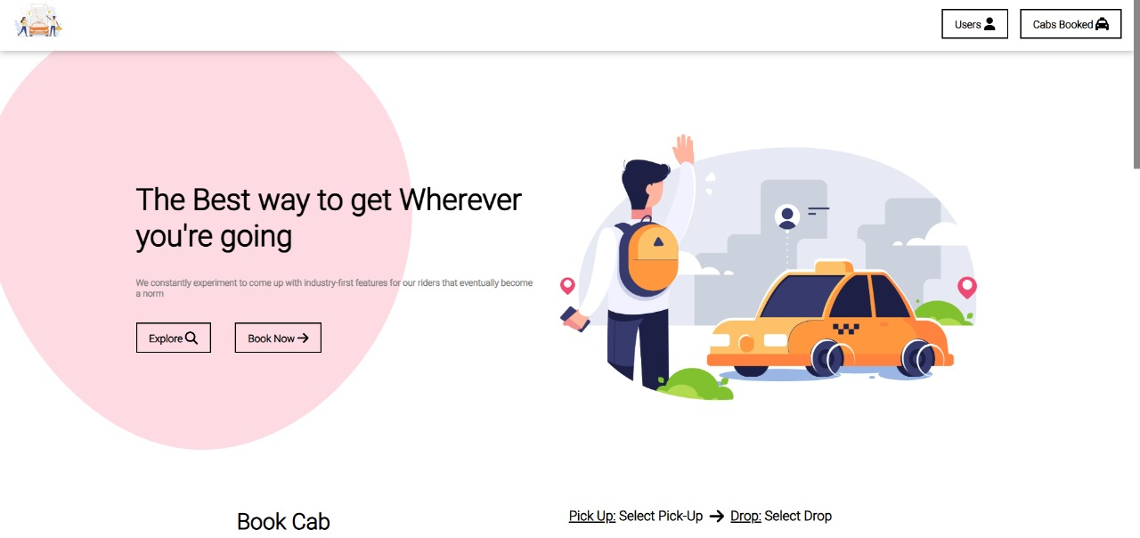
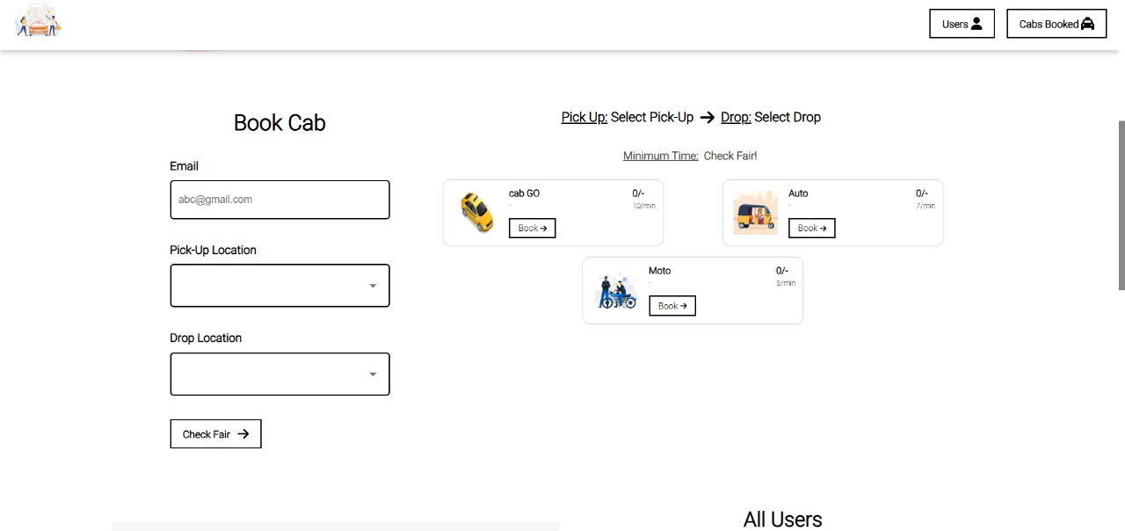
Cabbiez Home
Page
Book A Cab

Slide 12
Conclusion
KEY POINTS:
1. Robust Backend: Developed using Express.js, the backend ensures efficient routing, middleware use, and structured error handling for smooth server-side operations.
2. Responsive Frontend: EJS templates with modern CSS create an intuitive and adaptive user interface.
3. Data Persistence: Integration with MongoDB Compass ensures secure and scalable data storage for user profiles, cab details, and bookings
4. User Experience: Both riders and administrators are offered tailored features such as cab selection, real-time booking status, and ride history, improving usability and accessibility.
5. Scalable Architecture: Leveraging Node.js’s non-blocking I/O and modular code structure, the system is ready for scaling and future feature integration..

Slide 13
Conclusion
The Cabbiez web application showcases a fully functional full-stack solution built using Node.js, Express.js, EJS, and MongoDB. It addresses common challenges in online cab booking by offering a smooth, user-friendly platform for booking rides efficiently.
Future Enhancements:
• Real-time cab tracking using Web Sockets
• Driver-side dashboard with location and ride status
• Mobile app version for on-the-go booking
• Payment gateway integration for fare processing
• Admin analytics for trip monitoring and user insights
The Cabbiez project stands as a practical, scalable solution in the transportation sector, while also exemplifying modern web development techniques, including modular Express routing, EJS templating, and efficient use of MongoDB.

Slide 14
References/Links used
References Express.js Documentation. (2023). Express.js Guide. https://expressjs.com/en/guide/routing.html
MongoDB Documentation. (2023). MongoDB Manual. https://docs.mongodb.com/manual/
EJS Documentation. (2023). Embedded JavaScript templating. https://ejs.co/#docs
Node.js Documentation. (2023). Node.js v16 Documentation. https://nodejs.org/docs/latest-v16.x/api/
Brown, E. (2019). Web Development with Node and Express: Leveraging the JavaScript Stack. O'Reilly Media. Dayley, B. (2018). Node.js, MongoDB and Angular Web Development. Addison-Wesley Professional. Stack Overflow Community-driven solutions and troubleshooting tips for Node.js, Express, and MongoDB issues.
https://stackoverflow.com/
.

Slide 15


