Slide 1
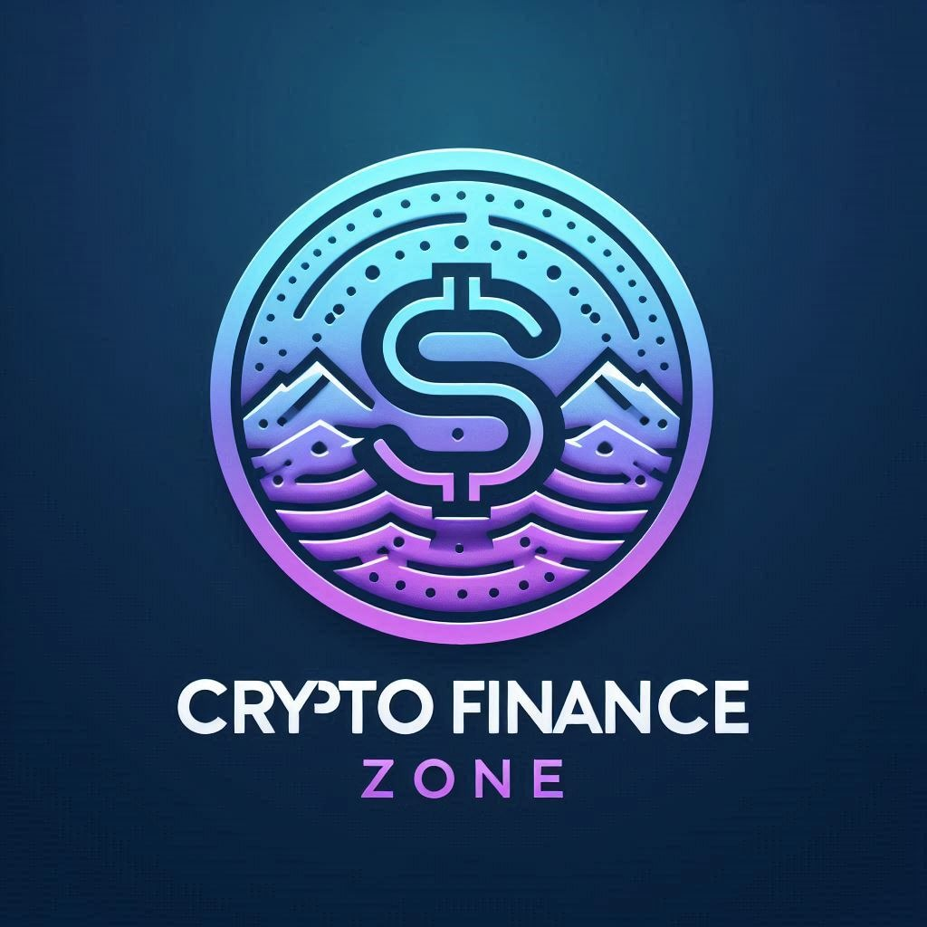
Crypto Payroll And Token Management Solutions

Slide 2
Problems To Be Solved
Complexity in Crypto Payroll: Managing payroll in cryptocurrencies can be challenging due to fluctuating values, regulatory concerns, and the need for secure, transparent transactions.
Token Management Challenges: Creating, minting, and vesting tokens require technical expertise, significant time, and resources, often leading to errors and inefficiencies.
Lack of Integrated Solutions: Many platforms offer fragmented services, forcing companies to use multiple tools for payroll, token creation, and vesting, which complicates the process and increases costs.
Lack of Workflow Automation: Lack of efficient workflow automation tools involving Smart Contracts

Slide 3
Problems to be solved (contd.)
Tax Implications: The tax treatment of cryptocurrency payments can be complex and varies by country. Companies need to ensure they are compliant with local tax laws, which can be a significant administrative burden.
Security Concerns: While blockchain technology is generally secure, the risk of hacking and fraud still exists. Companies need to implement robust security measures to protect their crypto assets

Slide 4
Existing Products Are Solving It, But...
They make user on-boarding a lengthy task
Have expensive solutions making it out of reach for most of the startups
Less transparent in terms of send and receive transactions between employers & employees
User interface not friendly enough to non technical users

Slide 5
Existing Products Are Solving It, But… (Contd.)
Lack ability to integrate with other useful tools
Not much capability to automate the complete workflow that include tasks both on chain and off chain

Slide 6
Our Solutions
Easy and quick on boarding
Secure and reliable by verifying employees using zk (zero knowledge) proof submission
Off chain solutions to scheduling salary and incentive SOL payments
Clear transaction history of transactions done via application
Easy integration with tools like Google Drive, Slack etc.
Ability to automate complete workflow starting from employee on boarding to the point they start receiving payments

Slide 7
Our Solutions (Contd.)
Quick and Easy Token Creation
Minting tokens, Token Vesting, Token Staking all at one place
Token Portfolio Monitor

Slide 8
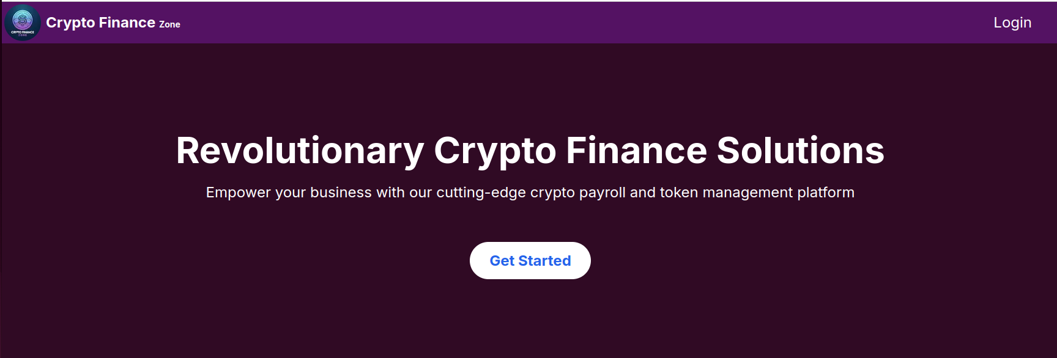
Introducing Crypto Finance Zone

