Slide 1
Hibernate
An Object-Relational mapping framework
U11CO025

Slide 2
What Hibernate Does
Object - Relational mapping
Transparent persistence & retrieval of objects
Persistence of associations and collections
Guaranteed uniqueness of an object (within a session)

Slide 3
Hibernate Features
O-R mapping using ordinary JavaBeans
Can set attributes using private fields or private setter methods
Lazy instantiation of collections (configurable)
Polymorphic queries, object-oriented query language
Cascading persist & retrieve for associations, including collections and many-to-many
Transaction management with rollback
Can integrate with other container-provided services

Slide 4
Why Use Hibernate?
Eliminate need for repetitive SQL
Work with classes and objects instead of queries and result sets
  More OO, less procedural
Mapping approach can resist changes in object/data model more easily
Strong support for caching

Slide 5
Why Use Hibernate?
Handles all create-read-update-delete (CRUD) operations using simple API; no SQL
Generates DDL scripts to create DB schema
(tables, constraints, sequences)
Flexibility to hand-tune SQL and call stored procedures to optimize performance
Supports over 20 RDBMS; change the database by tweaking configuration files

Slide 6
What Hibernate Does
User Interface
UI event
Application Logic
data request
Domain Objects
DAO
SessionFactory
Hibernate API
Hibernate
hibernate.cfg.xml
JDBC API
*.hbm.xml class mappings
Foundation Classes
JDBC

Slide 7
SessionFactory(org.hibernate.SessionFactory)
  A threadsafe (immutable) cache of compiled mappings for a single database.
  A factory for Session and a client of ConnectionProvider.
  Holds an optional (second-level) cache of data that is reusable between transactions, at a process level.
Session (org.hibernate.Session)
  A single-threaded, short-lived object representing a conversation between the application and the persistent store.
  Wraps a JDBC connection. Factory for Transaction. Holds a mandatory (first-level) cache of persistent objects, used when navigating the object graph or looking up objects by identifier.

Slide 8
Persistent objects and collections
  Short-lived, single threaded objects containing persistent state and business function.
  These might be ordinary JavaBeans/POJOs, the only special thing about them is that they are currently associated with (exactly one) Session. As soon as the Session is closed, they will be detached and free to use in any application layer.

Slide 9
Transaction (org.hibernate.Transaction)
  A single-threaded, short-lived object used by the application to specify atomic units of work.
  Abstracts application from underlying JDBC, JTA or CORBA transaction.
  A Session might span several Transactions.
ConnectionProvider (org.hibernate.connection.ConnectionProvider)
  A factory for (and pool of) JDBC connections. Abstracts application from underlying Datasource or DriverManager. Not exposed to application, but can be extended/implemented by the developer.

Slide 10
TransactionFactory (org.hibernate.TransactionFactory)(Optional)
  A factory for Transaction instances. Not exposed to the application, but can be extended/implemented by the developer.

Slide 11
What is the JPA?
Developed under JSR-220
  Initial goal was to simplify EJB CMP
JSR-220 segmented into two specifications:
  EJB 3.0
  Java Persistence API
    Complete, standalone ORM solution for both Java EE
and Java SE environments
Significant Community Involvement:
  Leverages best ideas from Hibernate, Toplink, and JDO

Slide 12
Why should I care?
Why not just use JDBC?
  Low level API
  Simple to use, but can be error prone
Why not just use [INSERT ORM HERE]?
  Standardized API leveraging best ideas from ORM community
  Better for developers - one API to learn and use
  Can choose between competing implementations
  Vendor independence

Slide 13
Goals
Provide complete ORM solution for Java SE and Java EE environments
Easy to use
  Standard POJOs - no framework interfaces or classes to implement or extend
  Facilitate test-driven development
Annotation driven, no XML mappings required.
Configuration By Exception
  Sensible defaults

Slide 14
JPA Features
Simple POJO Persistence
  No vendor-specific interfaces or classes
Supports rich domain models
  No more anemic domain models
  Multiple inheritance strategies
  Polymorphic Queries
  Lazy loading of associations
Rich Annotation Support
Pluggable persistence providers

Slide 15
POJO Requirements
Annotated with @Entity
Contains a persistent @Id field
No argument constructor (public or protected)
Not marked final
  Class, method, or persistent field level
Top level class
  Can’t be inner class, interface, or enum
Must implement Serializable to be remotely passed by value as a detached instance

Slide 16
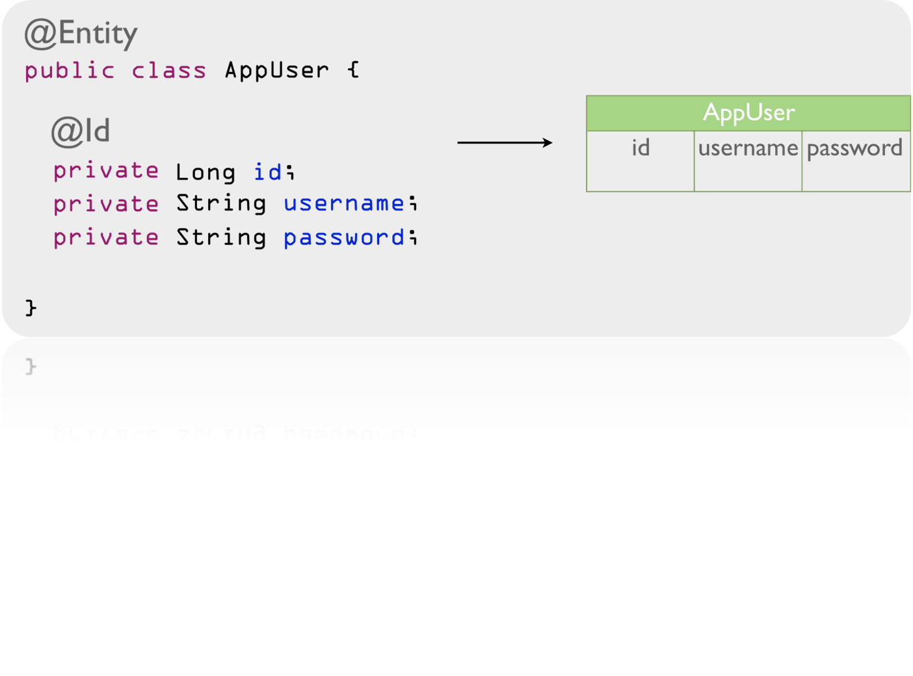
Persistent Entity Example

Slide 17
JPA Annotations
JPA annotations are defined in the javax.persistence package:
  http://java.sun.com/javaee/5/docs/api/javax/persistence/packagesummary.html
Annotations can be placed on fields or properties
  Field level access is preferred to prevent executing logic
  Property-level annotations are applied to "getter" method
Can’t mix style in inheritance hierarchy
  Must decide on field OR property

Slide 18
Persistent Identifiers
Entities must define an id field/fields corresponding the the database primary key
The id can either be simple or composite value
Strategies:
  @Id: single valued type - most common
  @IdClass: map multiple fields to table PK
  @EmbeddedId map PK class to table PK
Composite PK classes must:
  implement Serializable
  override equals() and hashCode()

Slide 19
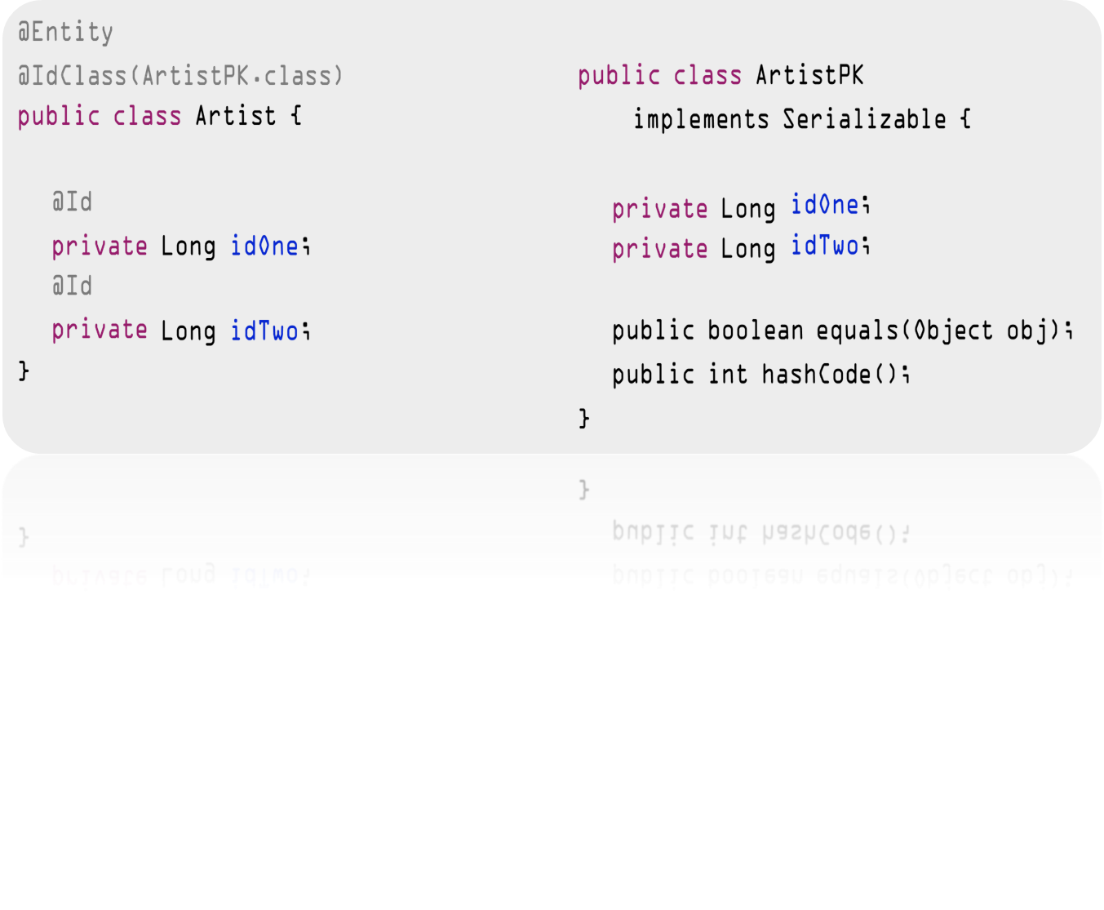
@IdClass
Maps multiple fields of persistent entity to PK class

Slide 20
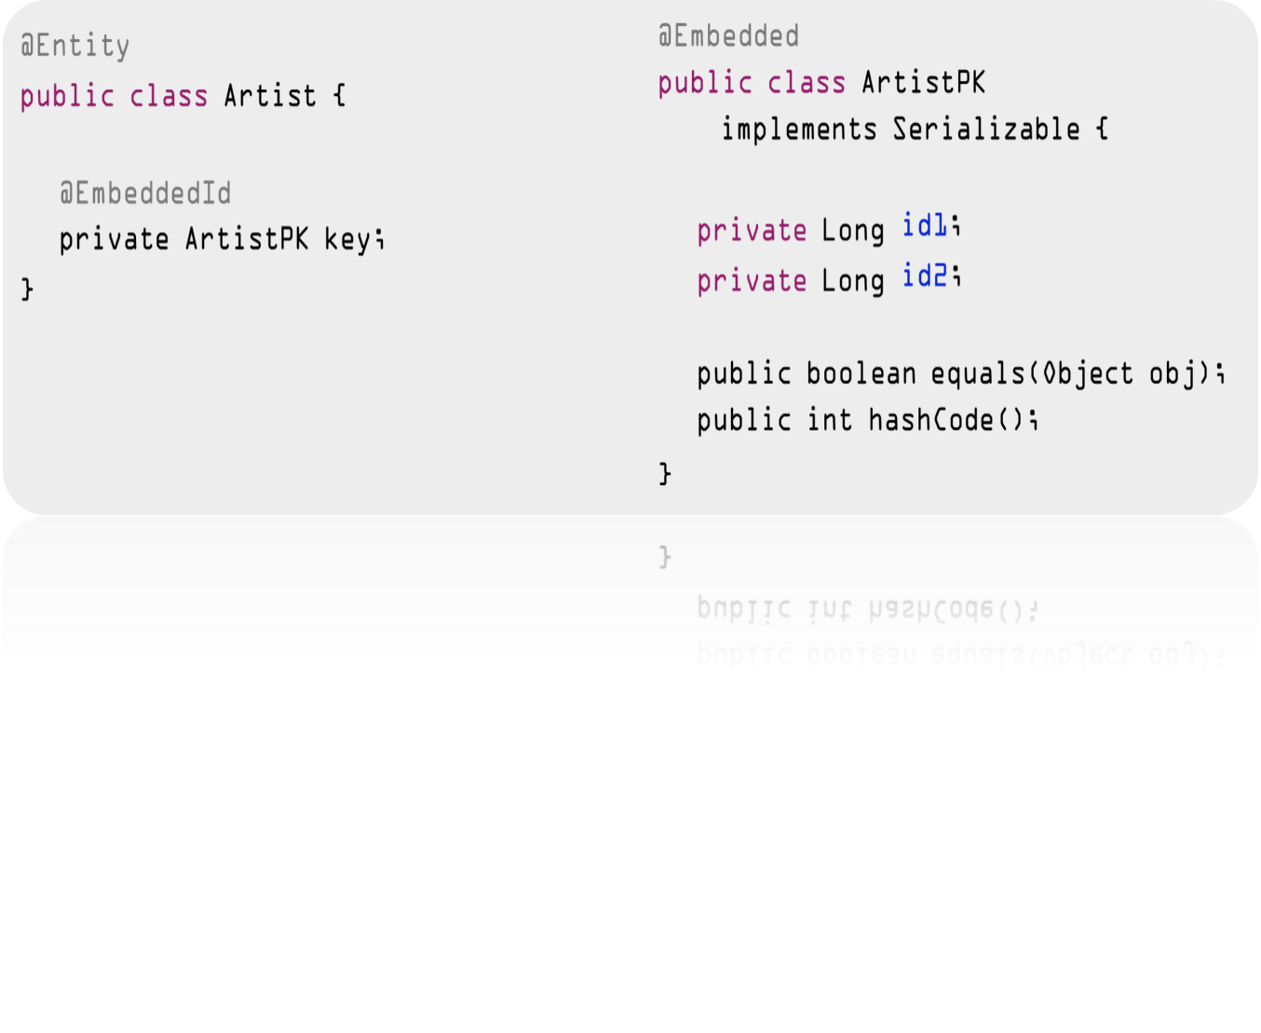
@EmbeddedId
Primary key is formal member of persistent entity

Slide 21
@GeneratedValue
Supports auto-generated primary key values
Strategies defined by GenerationType enum:
  GenerationType.AUTO (preferred)
  GenerationType.IDENTITY
  GenerationType.SEQUENCE
  GenerationType.TABLE

Slide 22
@Table and @Column
Used to define name mappings between Java object and database table/columns
@Table applied at the persistent class level
@Column applied at the persistent field/property level

Slide 23
Relationships
JPA supports all standard relationships
  One-To-One
  One-To-Many
  Many-To-One
  Many-To-Many
Supports unidirectional and bidirectional relationships
Supports both composite and aggregate relationships

Slide 24
Cascading Operations
JPA supports multiple cascade styles
Defined by the CascadeType enum:
  CascadeType.PERSIST
  CascadeType.MERGE
  CascadeType.REMOVE
  CascadeType.REFRESH
  CascadeType.ALL

Slide 25
EntityManager
Provides interface to Persistence Context
Obtained from instance of EntityManagerFactory
  Manually created in Java SE environment
  Managed in Java EE or Spring and injects EntityManager instances where needed
Provides core persistence operations
Used to obtain Query interface instance
Provides access to transaction manager for use in Java SE environments

Slide 26
Persistence Context & Unit
A Persistence Context is a collection of persistent entities managed by the Entity Manager
Persistence Unit is defined in persistence.xml
  The only XML required by JPA!
  Must be defined loaded from META-INF directory
A persistence-unit defines:
  The persistence context name
  Data source settings
  Vendor specific properties and configurations

Slide 27
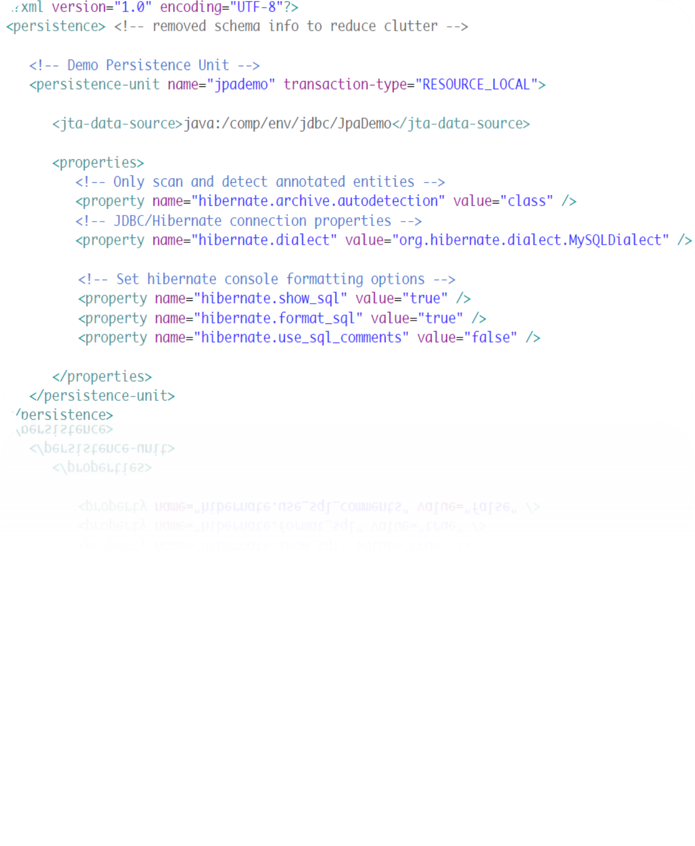
Example persistence.xml

Slide 28
Query Interface
Obtained from the EntityManager using:
  createQuery()
  createNamedQuery()
  createNativeQuery()
Supports bind parameters, both named and ordinal
Returns query result:
  getSingleResult()
  getResultList()
Pagination Support:
  setFirstResult()
  setMaxResults()

Slide 29
JPA Queries
Supports static & dynamic queries
Queries can be written using JPQL or SQL
Named and positional bind parameters
Supports both static and dynamic queries
  Static queries are written as annotations of the entity
Supports eager fetching using the fetch keyword

Slide 30
JPQL Features
Java Persistence Query Language (JPQL)
  Extension of EJB QL language
SQL like syntax
  Reference objects/properties instead of tables/columns
Supports common SQL features:
  Projections
  Inner & Outer Joins - Eager fetching supported
  Subqueries
  Bulk operations (update and delete)

