Slide 1
Probing performance limits on Perlmutter
GNU Parallel is ideal for quickly emulating the most extreme throughput workflows
Question: What is the largest rate can processes be launched on a Perlmutter CPU node?
Why is it important? This figure sets a lower bound on the size of individual tasks in a throughput workflow.
No, that isn’t a particularly HPC way to work, but NERSC has ~10,000 users so someone is going to run in this manner and we should be prepared to support (or dissuade) them.

Slide 2
Driver to measure process launch rate
#!/bin/bash
#SBATCH -N 1
#SBATCH -C cpu
#SBATCH -t 02:00:00
#SBATCH -q regular
module load parallel
for i in {500..30000..500}
do
#files with $i lines of input have been generated in the working directory
/usr/bin/time -f "%e" parallel "echo {}" :::: input_${i}.txt >> /tmp/output_0.txt
done
A single GNU Parallel instance can launch ~470 processes per second
With 256 CPU threads, the node can be fully utilized so long as tasks are sized to run for at least 545 milliseconds

Slide 3
Multiple GNU Parallel instances can do even more
#!/bin/bash
#SBATCH -N 1
#SBATCH -C cpu
#SBATCH -t 02:00:00
#SBATCH -q regular
# $1 is number of parallel instances
# $2 is number of jobs allowed to each parallel instance
module load parallel
for i in {500..30000..500}
do
for (( j = 1; j < ${1}; j++ ))
do
parallel -j $2 "echo {}" :::: input_${i}.txt >> /tmp/output_${1}.txt &
done
/usr/bin/time -f "%e" parallel -j $2 "echo {}" :::: input_${i}.txt >> /tmp/output_0.txt
done

Slide 4
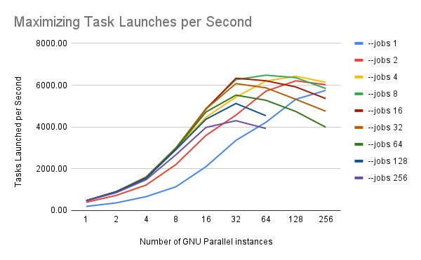
Process creation rates for multiple GNU parallel instances
Process launch rate upper bound ~6400 processes per second
Process duration could be as low as ~40 milliseconds and still maintain node utilization

Slide 5
Stress testing container services using Shifter on Perlmutter CPU
#!/bin/bash
#SBATCH -N 1
#SBATCH -C cpu
#SBATCH -t 02:00:00
#SBATCH -q regular
#SBATCH --image=docker:alpine:latest
# $1 is number of parallel instances
# $2 is number of jobs allowed to each parallel instance
module load parallel
for i in {500..30000..500}
do
for (( j = 1; j < ${1}; j++ ))
do
parallel -j $2 "shifter echo {}" :::: input_${i}.txt >> /tmp/output_${1}.txt &
done
/usr/bin/time -f "%e" parallel -j $2 "shifter echo {}" :::: input_${i}.txt >> /tmp/output_0.txt
done

Slide 6
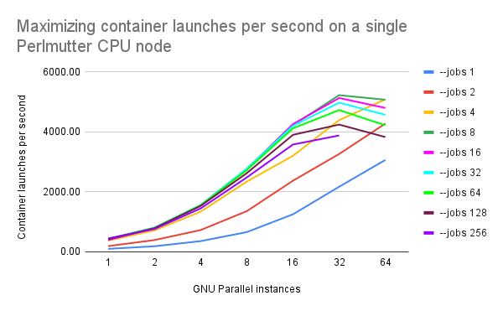
Container launch rates
The measured container launch rate upper bound is ~5200 processes per second
Shifter container startup overhead relative to “bare metal” is only ~19%

Slide 7
Stress testing Podman-HPC on Perlmutter CPU
#!/bin/bash
#SBATCH -N 1
#SBATCH -C cpu
#SBATCH -t 02:00:00
#SBATCH -q regular
# $1 is number of shards
# $2 is number of concurrent parallel tasks per shard
module load parallel
srun podman-hpc run -d --name sharedpod docker.io/library/alpine sleep 9999999999
for i in {500..30000..500}
do
for (( j = 1; j < ${1}; j++ ))
do
parallel -j $2 "podman-hpc exec sharedpod echo {}" :::: input_${i}.txt >> /tmp/output_${1}.txt &
done
/usr/bin/time -f "%e" parallel -j $2 "podman-hpc exec sharedpod echo {}" :::: input_${i}.txt >> /tmp/output_0.txt
done
Podman-HPC is a newer offering from NERSC; it’s interface is still a bit crude relative to Shifter
This driver script launches a single container, keeps it running using a sleep command, and then runs tasks inside that container using the exec function

Slide 8
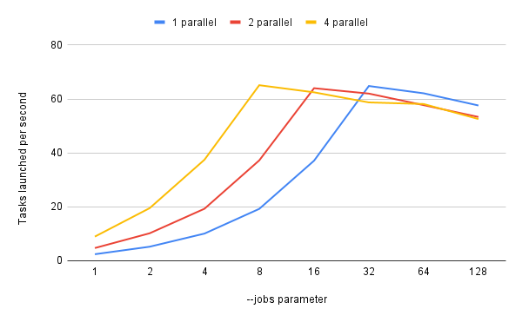
Podman-hpc launch rates
The measured podman-hpc launch rate upper bound is ~65 processes per second
Note that this is 2 orders of magnitude slower than Shifter performance; in its current form podman-hpc is not the best choice for throughput oriented workloads
Even worse, the result reliability decreases with more scale; errors include failure to set user namespace, database locking failures, setgid failures, and problems with the task /tmp directory

