Slide 1
Summit Data Collection - I
Ketan M
Sep 2020

Slide 2
Overview
Collect observational data: resource usage, perceived performance and scheduler on the five Summit login nodes
Status of the work
Why?
What is being collected?
How?
Other Considerations and Early results

Slide 3
This is a work in progress
The data collection started in Dec 2019
Settled on what to collect after early experiments
Consistent and unchanged since Jan 1, 2020
Plan is to collect data till Dec 31, 2020
Data is collected hourly
One of the motivation of this talk is to seek ideas
Insights about Summit usage for users and admins
Interesting patterns from data
... and more

Slide 4
Why? (Objectives)
Better understand system usage patterns
What are the most and least busy times and login nodes
Type of processes run by users
Look for any possible abuse/misuse of login nodes
Are the login nodes load balanced over time -- in terms of users and CPU load
State of the systems before outages
2020 happens to be an interesting year!
Publish the data (after anonymizing and due process)
Publish the data collection framework

Slide 5
What is being collected? - I
The following data is collected every hour:
overall system load, users logged in, from where (output of w command)
memory status from /proc/{vmstat,meminfo}
running process stats (output of ps command)
process stats (output of top command)
list of all jobs (output of bjobs -a -u all command)
aliased and unaliased ls time on $HOME
time to create a 1G random file on scratch
disk space usage (output of df command)
Data is compressed using gzip at the end of each month

Slide 6
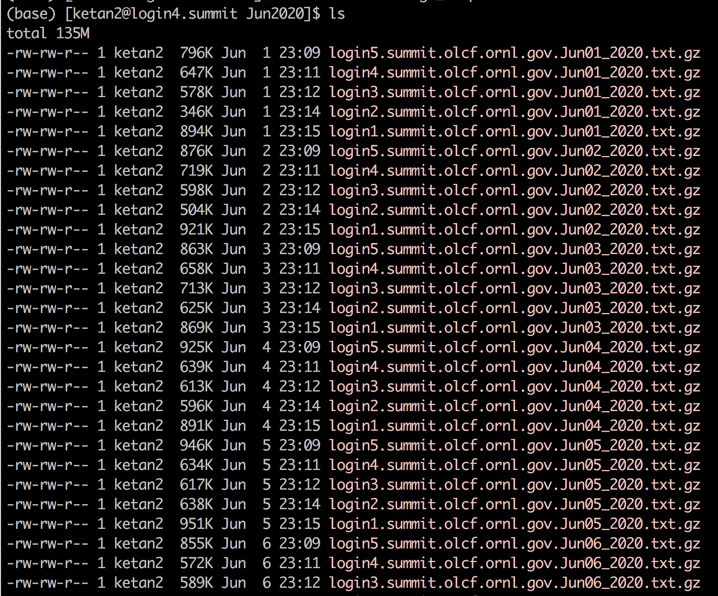
What is being collected? - II
Each hour is marked with an 'Hour nn' string
Within each hour 'sections' are marked to distinguish each section
Each filename has the name of the login node and date in the name
Resulting in per day generation of:
5 files -- one for each login node
Each file has 24 "hour sections"
Each file is between <2MB (gzipped)

Slide 7
How is the data being collected - I
A while loop inside a tmux session on each login node:
$ tmux new -s login1 while true do SECONDS=0 ./run.sh sleep $((3600-$SECONDS)) done
A cron job may be used -- not allowed on summit

Slide 8
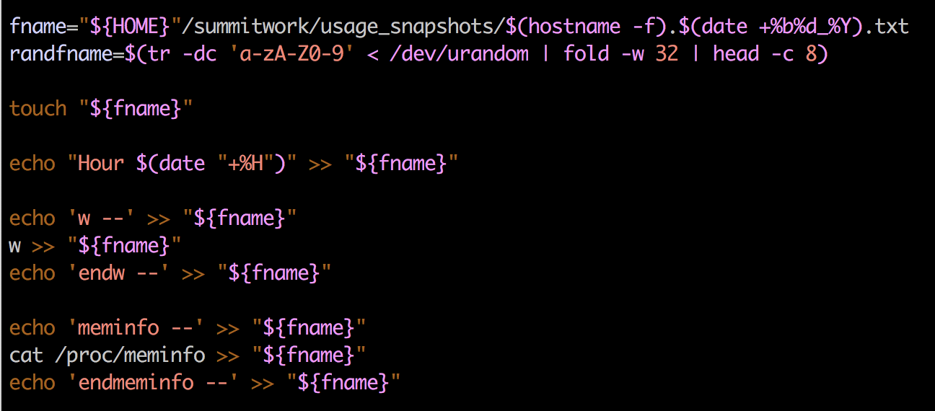
How is data being collected - II
A simple shell script runs the commands and redirects the standard output to a pre-created file
A snapshot:

Slide 9
Considerations: Anonymization
Although the data being collected is accessible to any Summit user without privileged access, it is still prudent to ensure the data is anonymized before being published
An anonymization script replaces usernames with a label (eg. u2104)
While the labels are consistent in a snapshot for a given day, they are reset and reassigned for each new day -- making it hard to derive any pattern for a particular user over time

Slide 10
Considerations: When Summit is Down
Data is not collected for those times when Summit is down
The collection routine needs to be restarted when Summit comes up
While data gets missing it gives
Potentially useful information about the state of machine before it went down
A historical account of downtimes

Slide 11
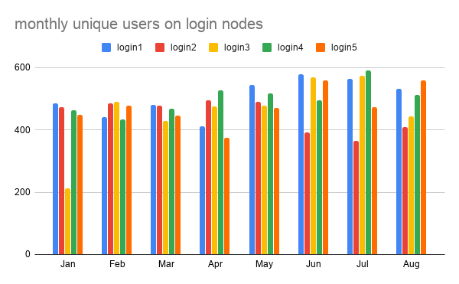
Example Early Result: monthly unique users

Slide 12
Summary and Future Work
Look for resource usage patterns on login nodes
Daily, Weekly, Monthly
Insights on the login node provisions for future systems
Scheduler stats over time
Can this data be used to predict patterns for Frontier?
Can this data be used to model login/gateways on other systems?

