Slide 1
An LLM-enabled Workflow for Understanding and Evolving HPC Scheduling Practices
Sep 8, 2025, WISDOM Workshop at ICPP
Anderson Borch (Colorado State Univ),
Ketan Maheshwari (ORNL), Justin Wozniak (ANL), Rafael Ferreira da Silva (ORNL)
Oak Ridge National Laboratory

Slide 2
Acknowledgements
The work presented here used resources of the Oak Ridge Leadership Computing Facility at the Oak Ridge National Laboratory, which is supported by the Office of Science of the U.S. Department of Energy under Contract No. DE-AC05-00OR22725
We thank the WISDOM workshop organizers and reviewers for useful reviews and opportunity to present.
Thanks to colleagues at Oak Ridge and many collaborators who have contributed and enriched the work presented.

Slide 3
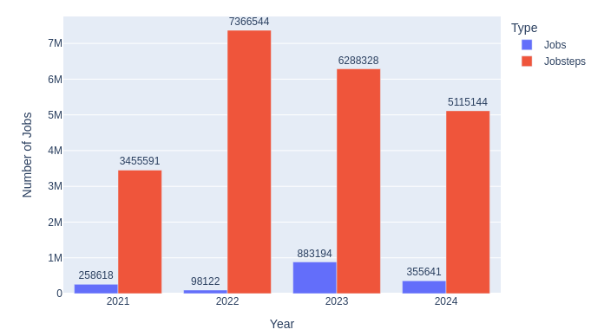
Overview
Context: Evolving job scheduling requirements due to proliferation of applications with diverse requirements
Objective: Analyze historical Slurm jobs data on Frontier to identify patterns that would be informative to the HPC community
Contribution: A ready-to-use portable and reusable workflow for an LLM enabled analysis of Slurm jobs at a large-scale HPC center
Jobs and job-steps executed on the Frontier from 2021 to 2024.

Slide 4
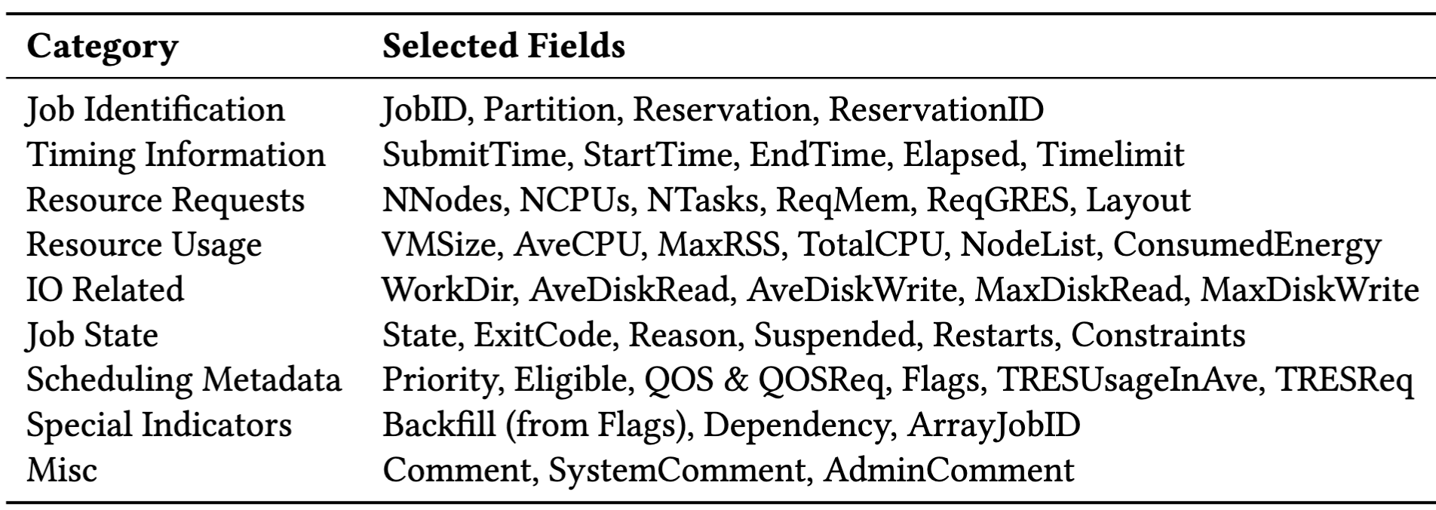
Data Collection and Curation
Slurm data collected via its sacct utility
Approx 50 fields selected out of 118
Preprocess to uniform units and format to CSV
Remove a fraction (~0.002%) of malformed data pertaining to hardware errors
Automated as part of the workflow

Slide 5
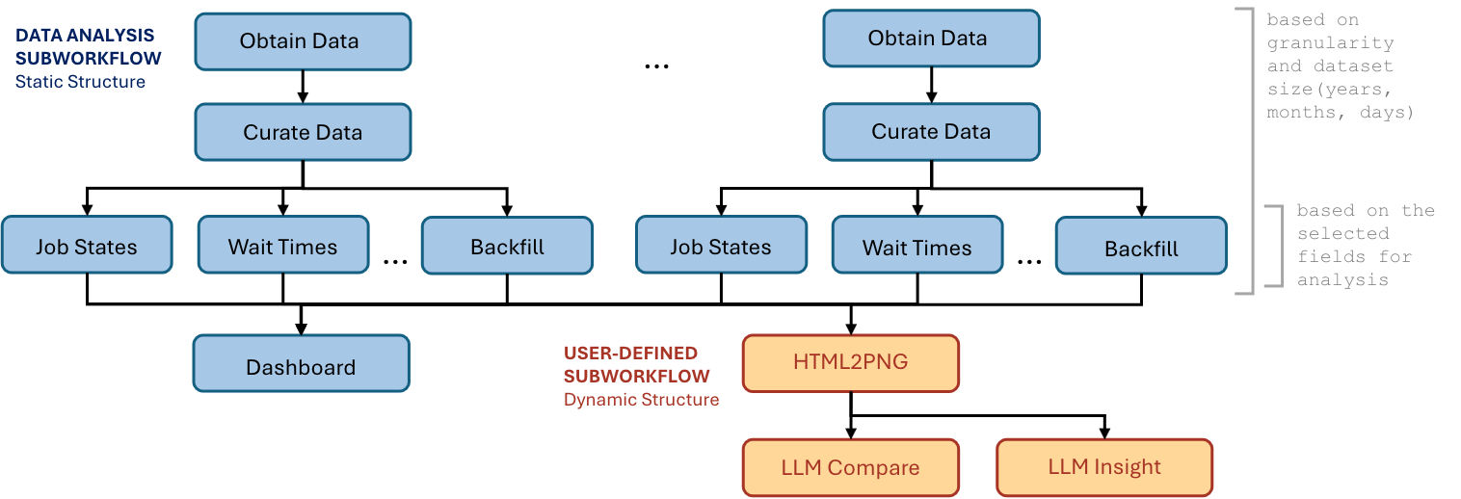
Workflow Design and Development

Slide 6
Workflow Implementation
Parallel Execution
Implemented in Swift/T
Seamlessly portable across local as well as HPC systems
Flexible invocation
Fault tolerant
swift-t -m local|slurm|pbs -n N workflow.swift date_spec date1 date2 cache data_loc

Slide 7
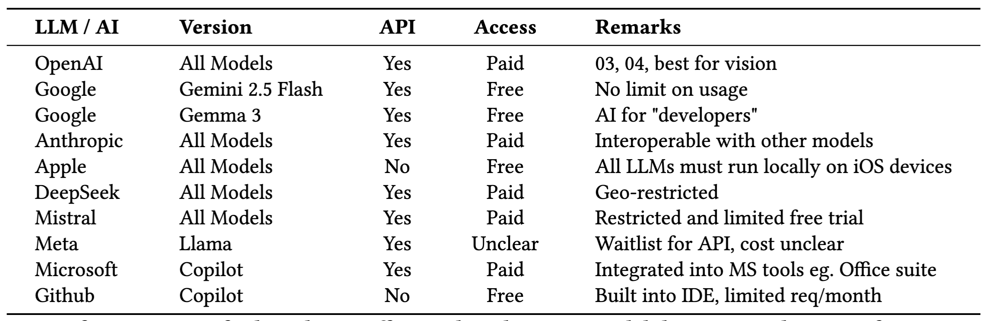
LLM Survey: Search for a “non-interactive” LLM API that accepts images (and is free for evaluation)

Slide 8
A Glimpse of results - Google Gemma 3 LLM API
Prompt1:
“Act as a data scientist to compare and contrast the two provided charts. Provide a quantitative analysis of the key trends, relationships, and statistics, highlighting similarities and differences. Be specific and mention any notable patterns or outliers. Calculate meaningful statistics from the plots."
Prompt2:
“Act as a data scientist to summarize the chart and provide a quantitative analysis of the key trends, relationships, and statistics of the provided chart. Be specific and mention any notable patterns or outliers. Calculate meaningful statistics from the plot.”
LLM Response1:
“The majority of jobs that completed successfully have shorter wait times in June compared to March, suggesting either a decrease in queue load or more efficient scheduling policies being implemented. Notably, March has a higher density of jobs with extended wait times exceeding 100,000 seconds, which could indicate batch congestion or policy thresholds being hit more frequently.”
LLM Response2:
“There is a consistent trend of users significantly overestimating their walltime requests. This creates a systemic gap that reduces scheduling efficiency. The presence of tightly clustered short-actual, long-requested jobs suggests a potential for implementing automated time prediction or adaptive rescheduling mechanisms.”

Slide 9
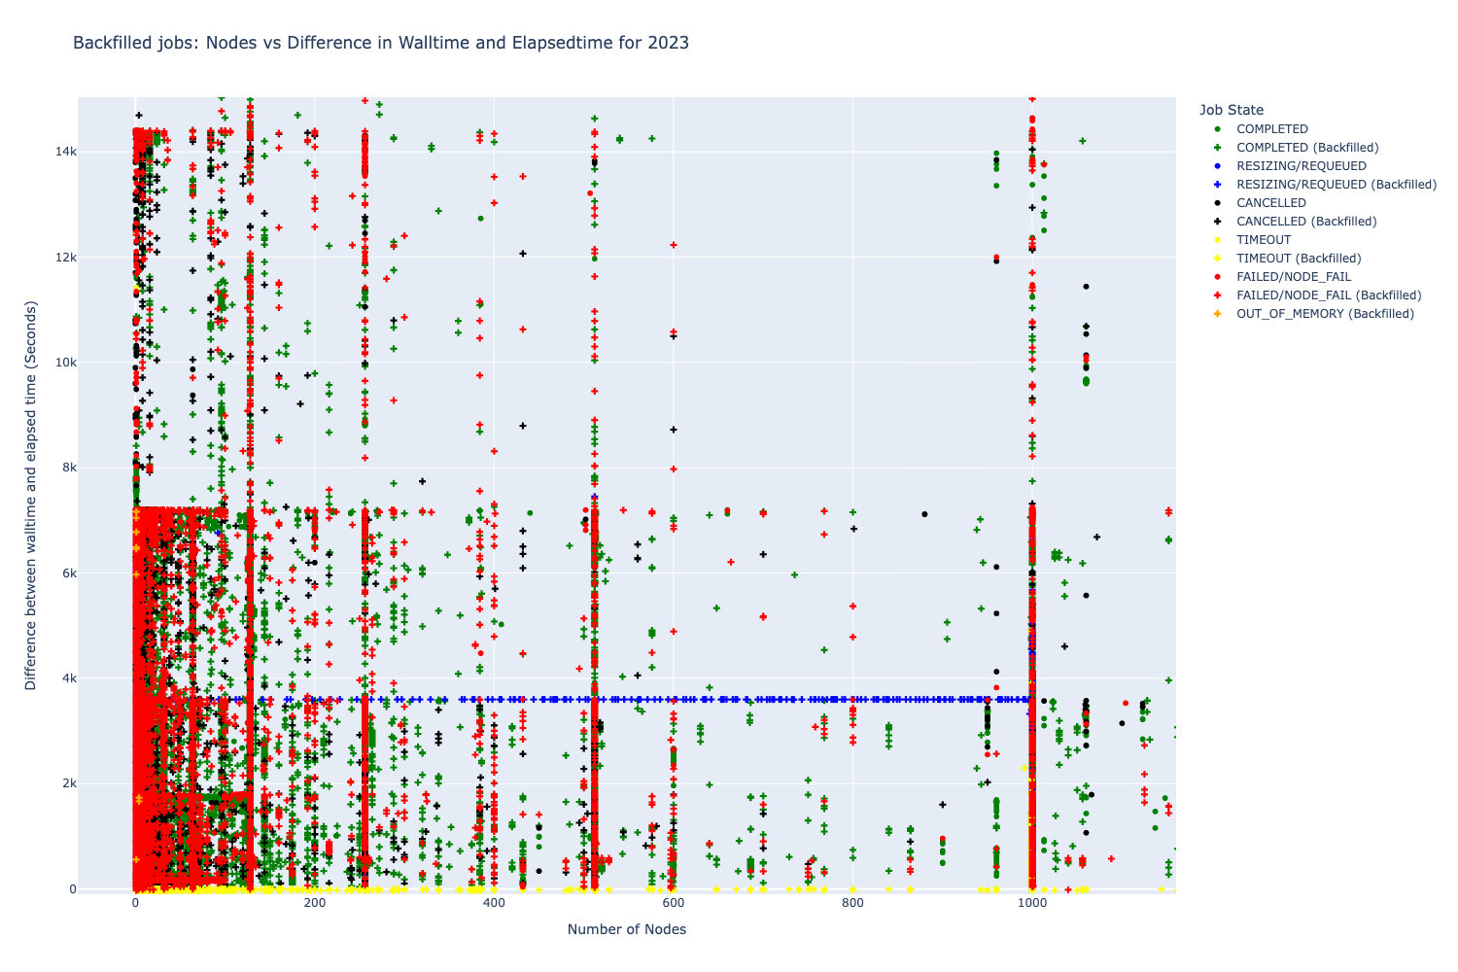
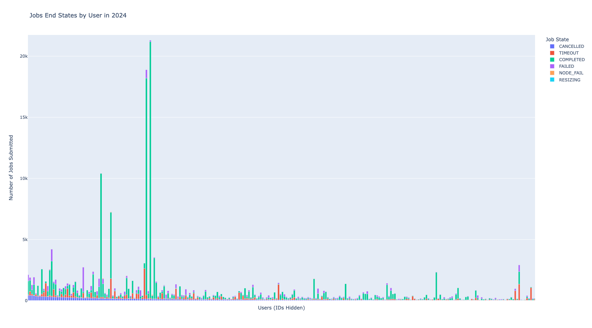
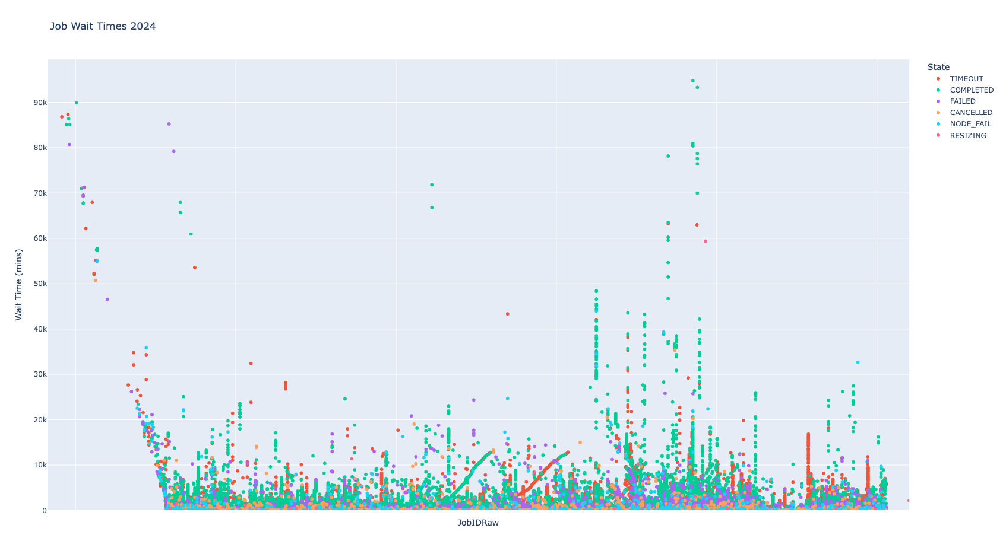
A glimpse of Results - Visualization

Slide 10
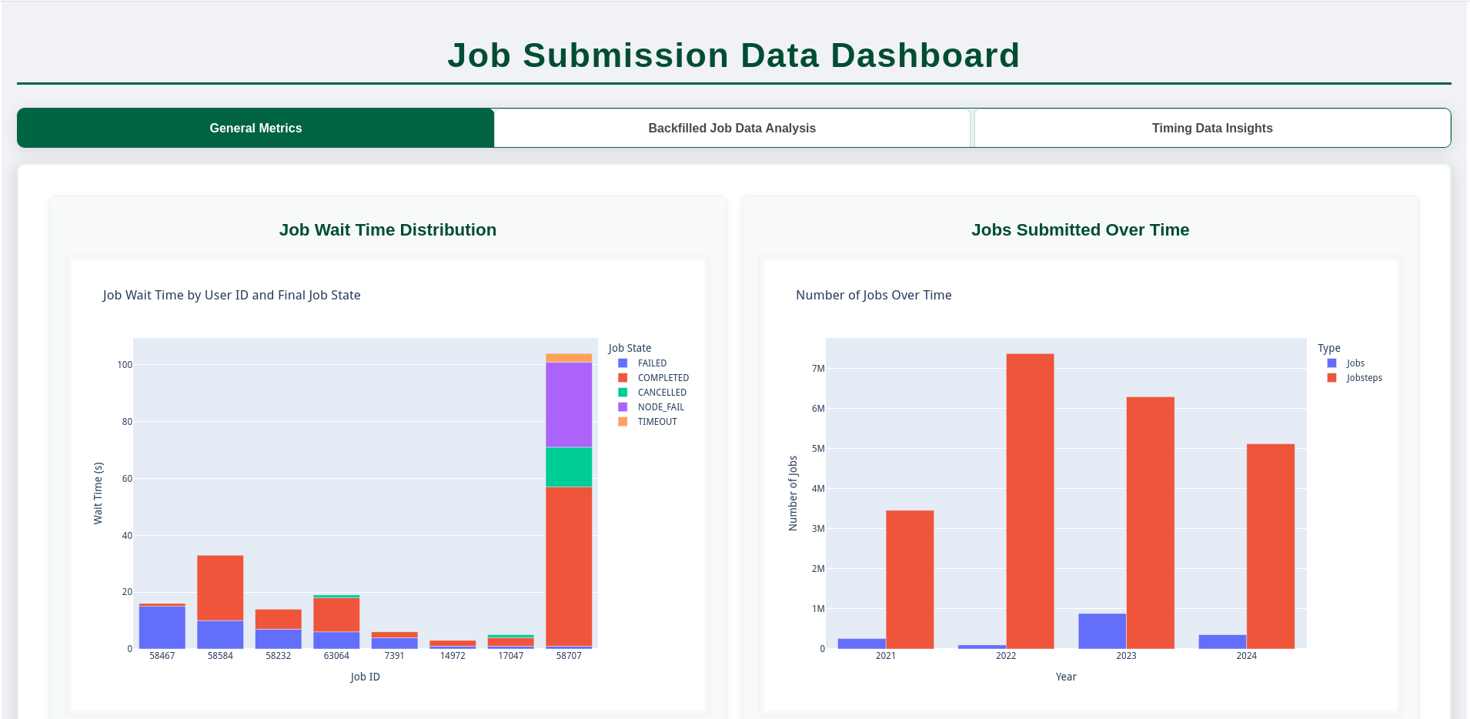
A Glimpse of Results - Dashboard

Slide 11
Summary
A portable, ready-to-use workflow to evaluate HPC job scheduling patterns
A novel use of LLMs embedded in workflow in “batch mode”
A customized and adjusted version may be readily deployed at other HPC centers

Slide 12
Thank You for your time! Questions?
maheshwarikc@ornl.gov | https://github.com/Andy-Borch/ORNL-Work

