Slide 1
Phishing Awareness

Slide 2

Phishing Awareness Training
Welcome to our essential training on phishing awareness. This session will equip you with the knowledge and tools to identify and avoid sophisticated cyber threats.

Slide 3
Recognizing Phishing Emails and Websites
Email Red Flags
Website Red Flags
Generic greetings.
Mismatching URLs.
Urgent or threatening language.
Poor grammar or spelling.
Suspicious sender addresses.
Lack of padlock icon (HTTPS).
Attachments from unknown sources.
Requests for excessive personal data.
Learn to spot the subtle clues in emails and websites that signal a phishing attempt. Vigilance is your first line of defense.

Slide 4




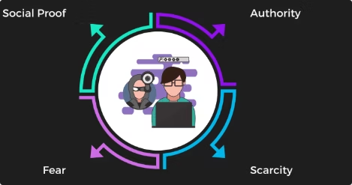

Social Engineering Tactics Used by Attackers
Pretexting
Baiting
Quid Pro Quo
Creating a fake scenario to gain trust.
Offering something enticing to lure victims.
Promising a benefit for information.
Tailgating
Following authorized personnel into restricted areas.
Attackers exploit human psychology. Understanding these tactics helps you resist manipulation.

Slide 5





Best Practices and Tips to Avoid Falling Victim
Verify Sender
Hover Over Links
Strong Passwords
Enable 2FA
Always confirm email authenticity.
Add an extra layer of security.
Check the actual URL before clicking.
Use complex, unique passwords.
Proactive measures are key to personal and organizational security. Implement these tips daily.

Slide 6

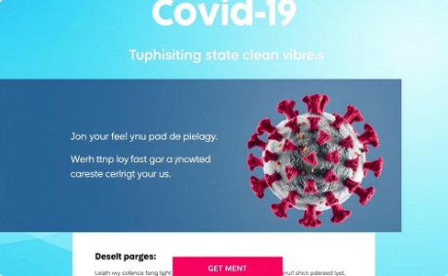

Real-World Examples and Interactive Quizzes
2017 Google Docs phishing attack
COVID-19 phishing campaigns
Nigerian Prince Scams (419 Fraud)
Attackers exploited the pandemic by sending emails impersonating health organizations, government agencies, or even vaccine providers. These scams often aimed to steal personal information, financial details, or distribute malware under the guise of urgent health updates or relief packages.
A highly sophisticated campaign impersonated Google to trick users into granting access to their accounts via a fake Google Docs application. Users clicked what appeared to be a legitimate link, giving malicious apps permission to access their data.
One of the oldest and most enduring phishing schemes, these scams involve unsolicited emails from individuals claiming to be Nigerian royalty or officials, promising a large sum of money in exchange for upfront fees. They rely on social engineering and victims' greed to extract funds.

Slide 7
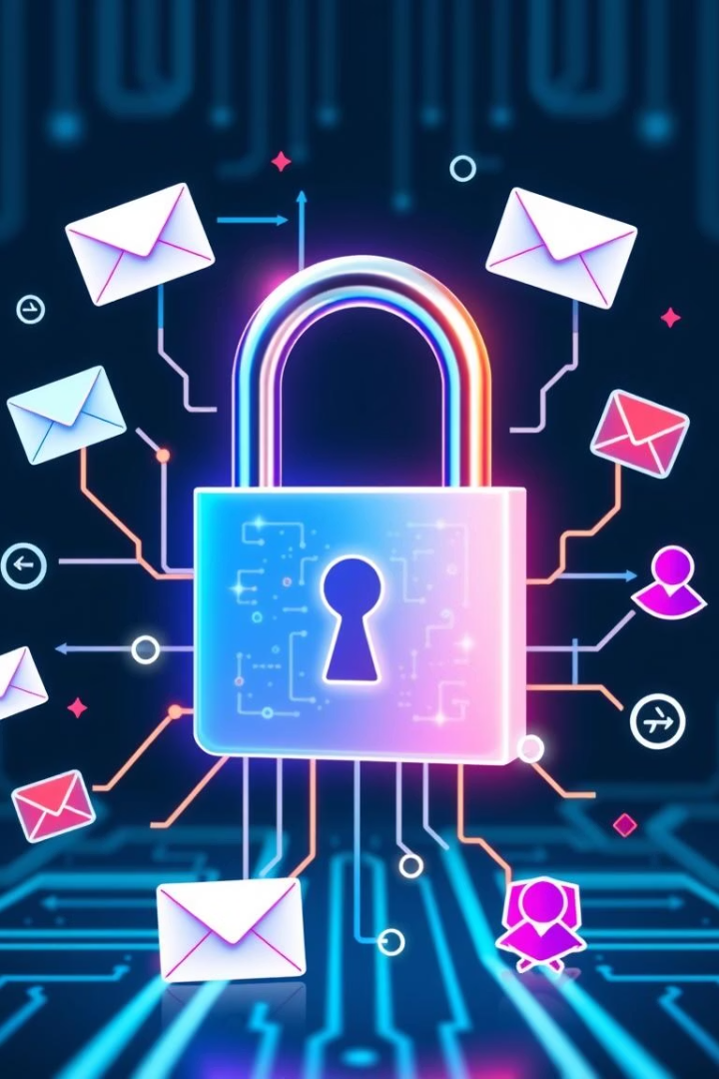
Continued Awareness Against Phishing
Phishing threats constantly evolve. Continuous learning is vital for staying secure.
Stay Updated
Follow the latest cybersecurity news.
Report Suspicious Activity
Inform IT of any dubious emails.
Share Knowledge
Educate colleagues and friends.

Slide 8
Phishing Quiz: Test Your Knowledge
How well can you spot the signs of a phishing attempt? For each scenario, identify the most significant red flag or the best course of action.
Scenario 1: Urgent Password Reset
Scenario 2: Unexpected Invoice
You receive an email from "your bank" asking you to click a link immediately to reset your password due to "suspicious activity." The sender's email address looks slightly misspelled (e.g., "bannk.com").
An email arrives with an attached PDF invoice for an item you didn't purchase, with a strong warning that legal action will be taken if not paid within 24 hours.
What should be your primary concern?
What is the biggest red flag?
The threat of legal action.
The email requests immediate action.
The attached PDF file.
The sender's email address is misspelled.
The item you didn't purchase.
It mentions "suspicious activity."
The 24-hour payment deadline.
It asks you to reset your password.
Scenario 3: Too Good to Be True Offer
Scenario 4: Fake Tech Support
A social media message from a friend promises you a luxury prize if you click a link and provide your full personal and banking details to cover a small "processing fee."
While browsing online, a pop-up appears, claiming your computer is infected with viruses and instructing you to call a toll-free number for immediate assistance.
What makes this suspicious?
What is the recommended action?
The message came from a friend's account.
Call the toll-free number immediately.
It promises a luxury prize.
Click on the pop-up to remove the virus.
It asks for personal and banking details for a fee.
Shut down your computer immediately.
It's a social media message.
Close the browser tab and scan your computer with trusted antivirus software.

