Slide 1
HakerRank
Ketan Goyal

Slide 2
Problem
Motivation
HakerRank
HackerRank is a skill based hiring platform
Skill is measure by solving online challenges
Can we “lead score” candidate pipeline?
Using:
Historical data about hiring outcomes
Ability of candidates to solve online challenges
Provide a good metric for heiring managers based on skills

Slide 3
Solution
Accurately “lead scores” the candidate pipeline

Slide 4
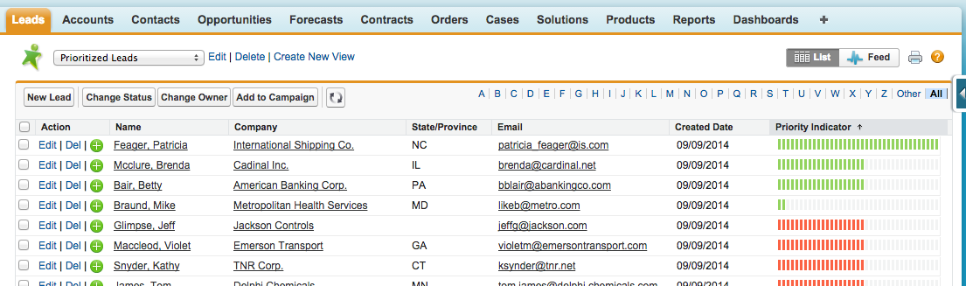
Vision
Upload list of candidates

Slide 5
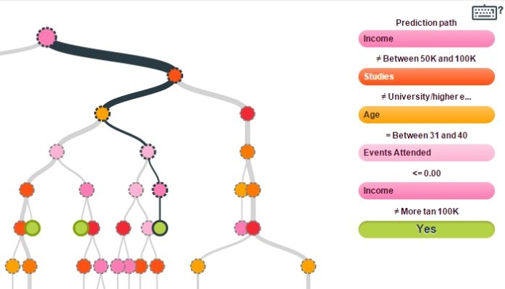
Data Sources
Model
Challenges: Challenge and it’s metadata, such as tags and activity stats.
4.1 million -- number of assessments completed on HackerRank
Data is on AWS
Decision Tree
Interpretable
Can be applied to large database

