Slide 1
HakerRank DDNA
Ketan Goyal

Slide 2
Motivation
Interview Process
Resume Review
Online Technical Screening
Phone Screening
Increase ROI of recruiters by predicting success chances of candidates
On-Site Interview

Slide 3
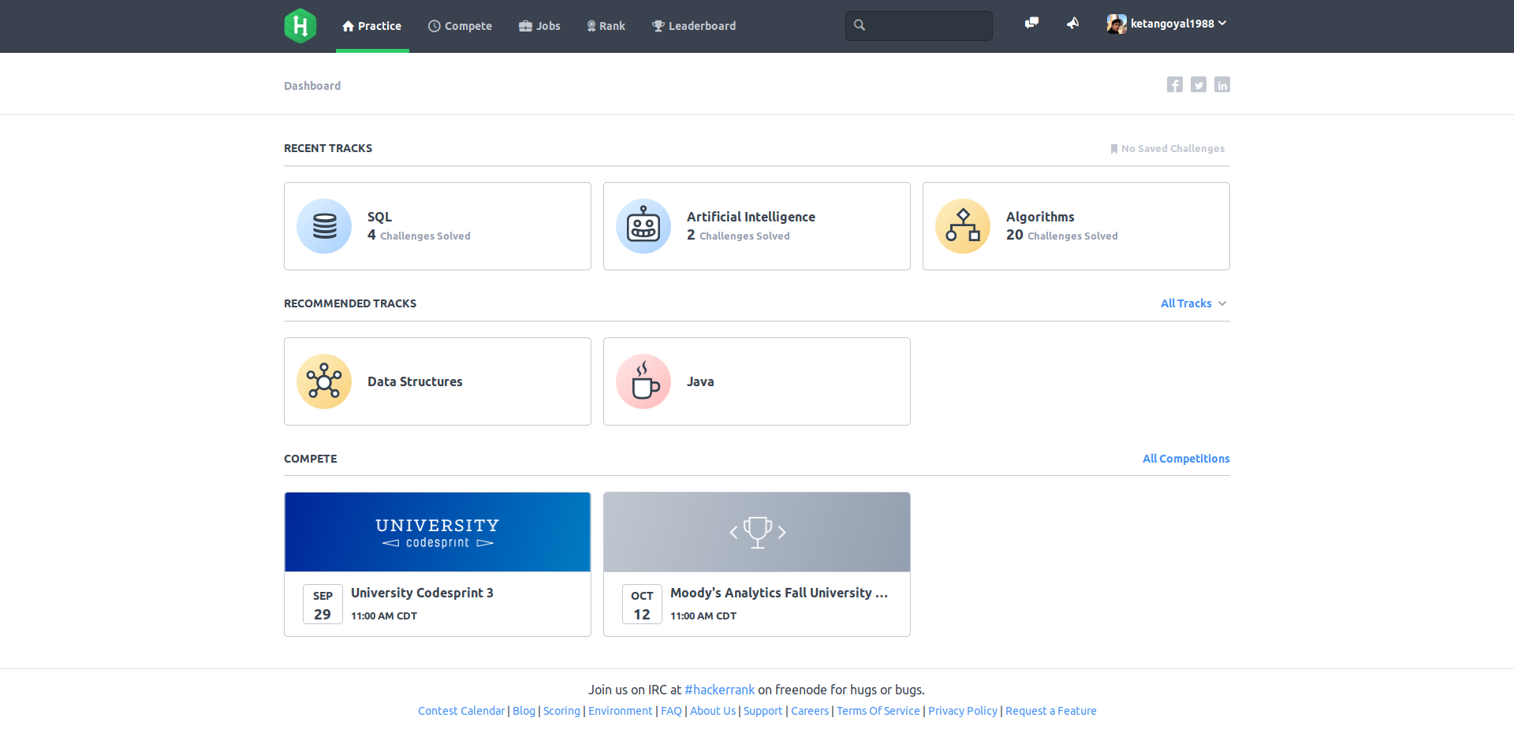
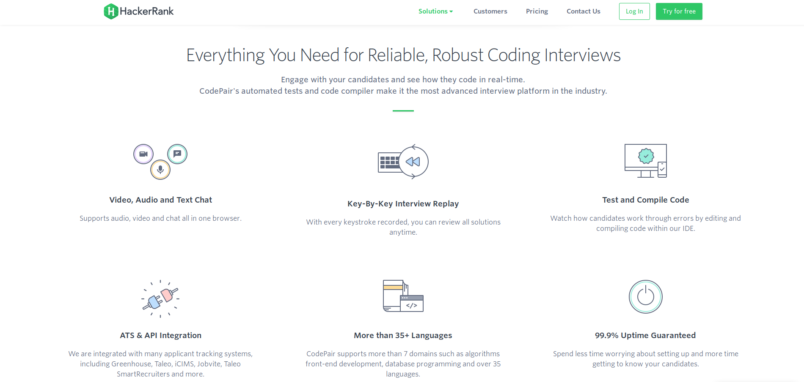
HackerRank
Community
Enterprise
Solve coding challenges for fun
Solve coding challenges for interview

Slide 4


Data Source
HakerRank
Community Database
Phone Screening Outcomes
num_challenges
min_run_time
max_run_time
avg_run_time
std_run_time
Outcomes (0,1)
Enterprise Database
test_scores
solve_duration

Slide 5
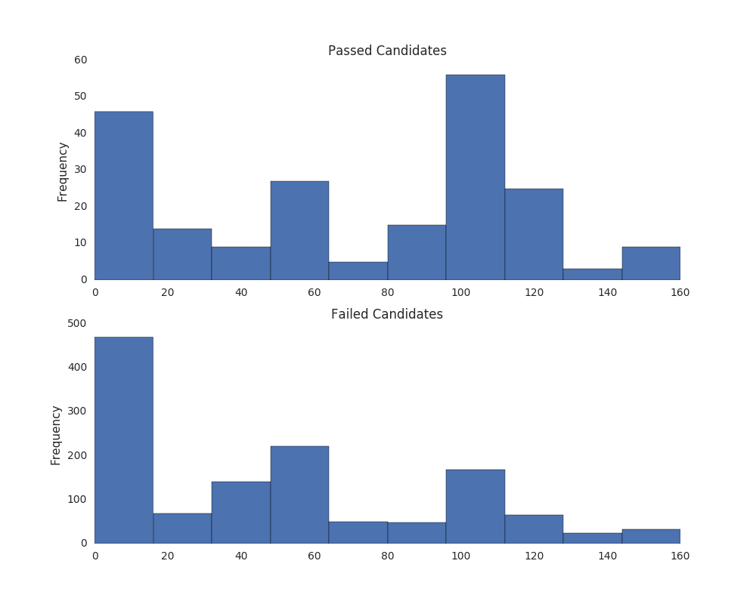
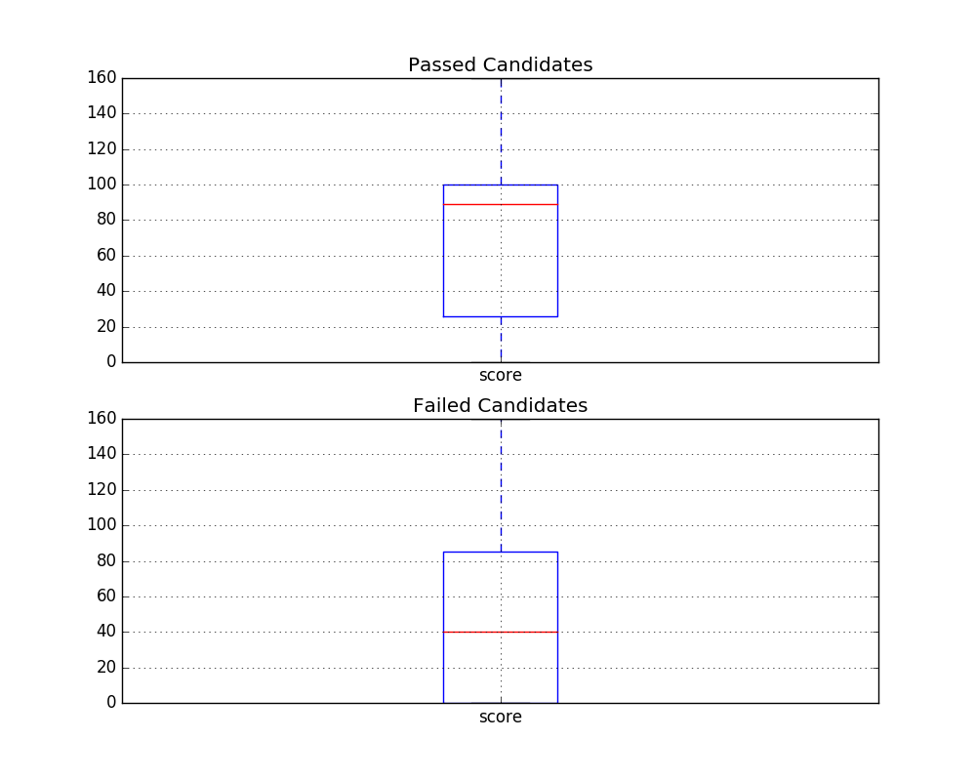
Data Exploration
Scores alone are not good indicator of phone screening outcome

Slide 6
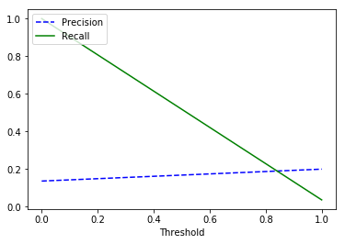
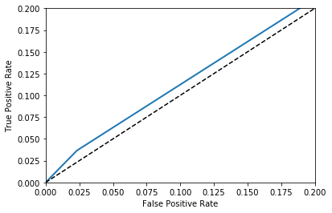
Model
Performance
Model Selection
Note: Test scores and duration not used !
Random Forest
Require no feature scaling
Implicit feature selection
Quick to train
Next Steps
Add more features:-
scores / duration
question taxonomy
code analysis
Very Low AUC!

