Slide 1
HackerRank DDNA
Ketan Goyal

Slide 2
Motivation
Interview Process
Resume Review
Online Technical Screening
Phone Screening
Increase ROI of recruiters by predicting success chances of candidates
On-Site Interview

Slide 3
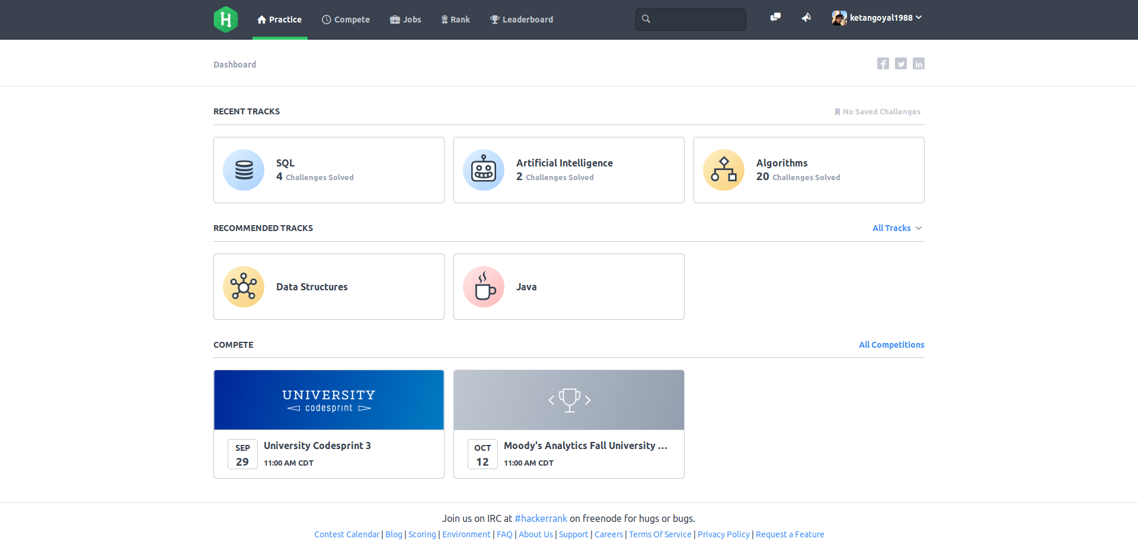
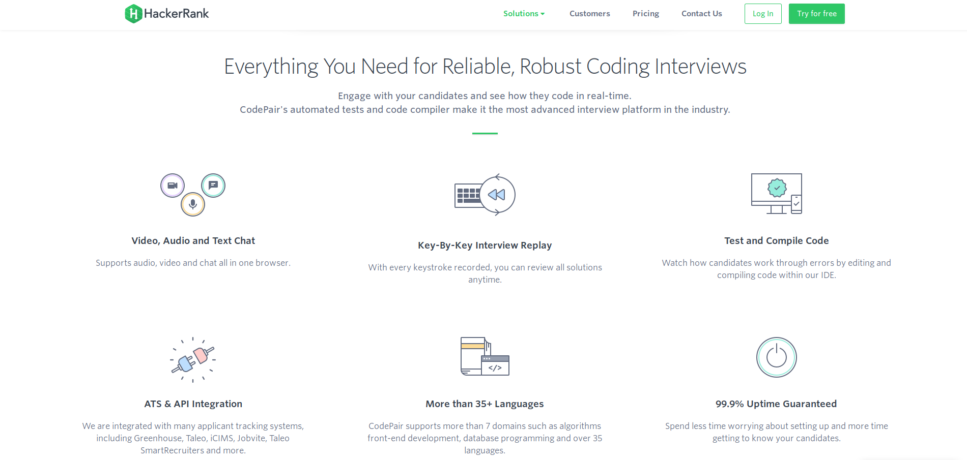
HackerRank
Community
Enterprise
Solve coding challenges for fun
Solve coding challenges for interview

Slide 4


Data Source
HackerRank
Community Database
Phone Screening Outcomes
num_challenges
min_run_time
max_run_time
avg_run_time
std_run_time
Outcomes (0,1)
Enterprise Database
test_scores
solve_duration
Divide Tests based on Difficulty
Introduced:
test-cases_cleared
run_count
solve_time

Slide 5
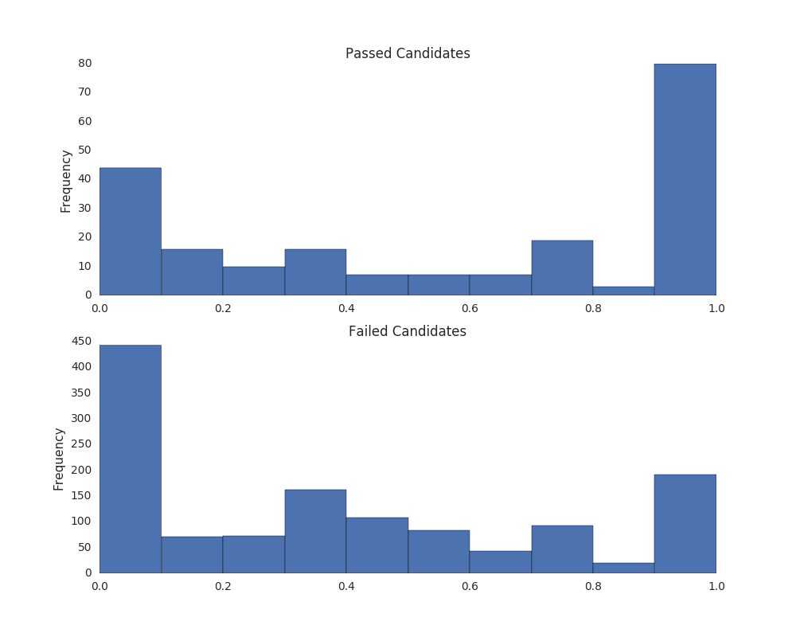
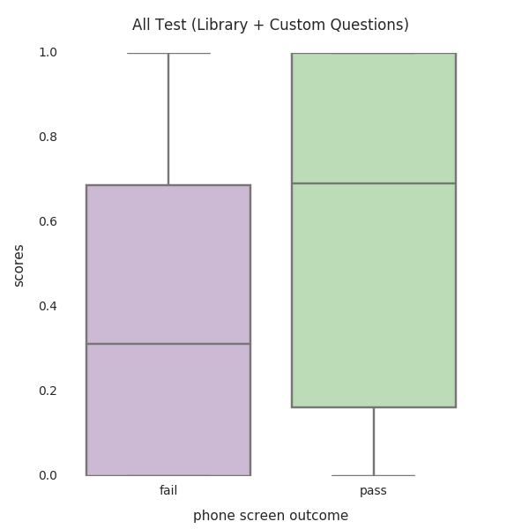
Data Exploration
Scores alone are not good indicator of phone screening outcome

Slide 6
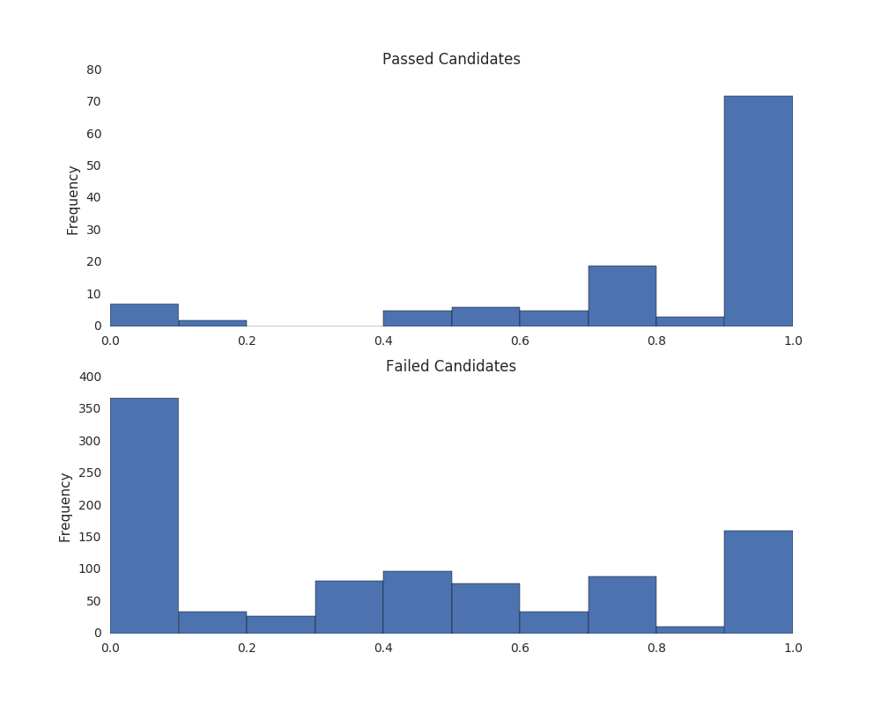
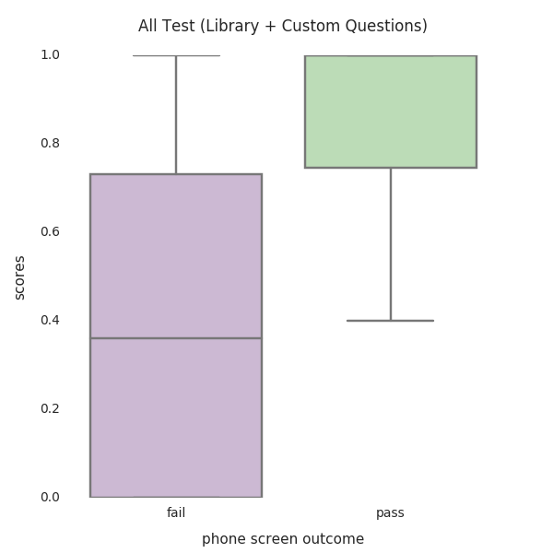
Data Exploration
Removing Tests with Custom Questions
Looks better!

Slide 7
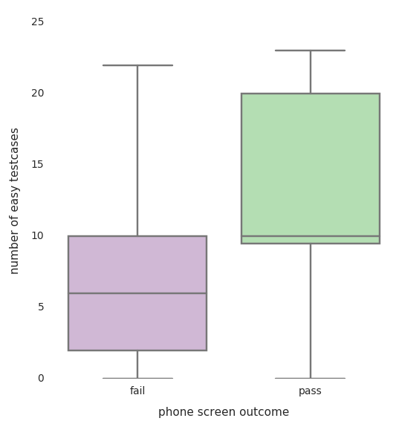
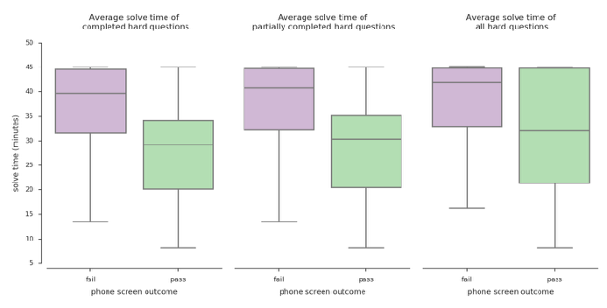
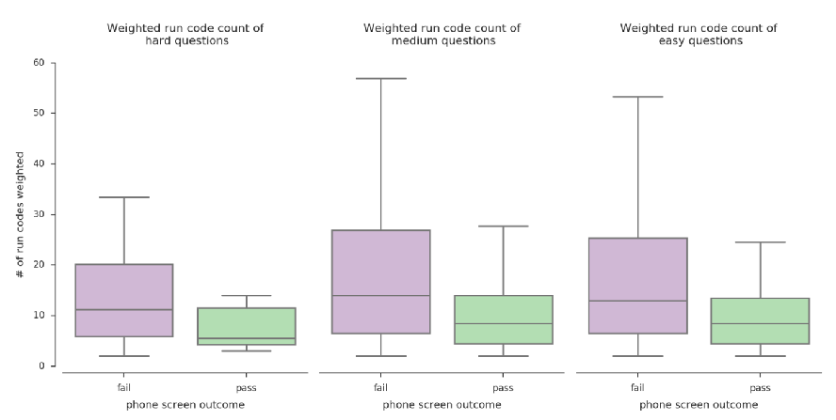
Feature Engineering
Test Cases
Solve Time
Number of Runs

Slide 8
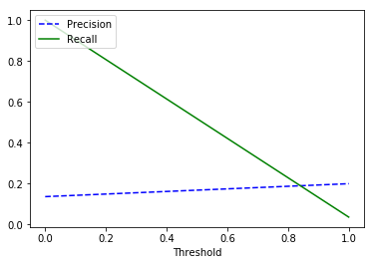
Model
Performance
Model Selection
Random Forest
Require no feature scaling
Implicit feature selection
Quick to train
AUC = 0.60
Low!
CONCLUSION: Model can be used to create a list of ordered recommended candidates
For More Information Visit:

Slide 9
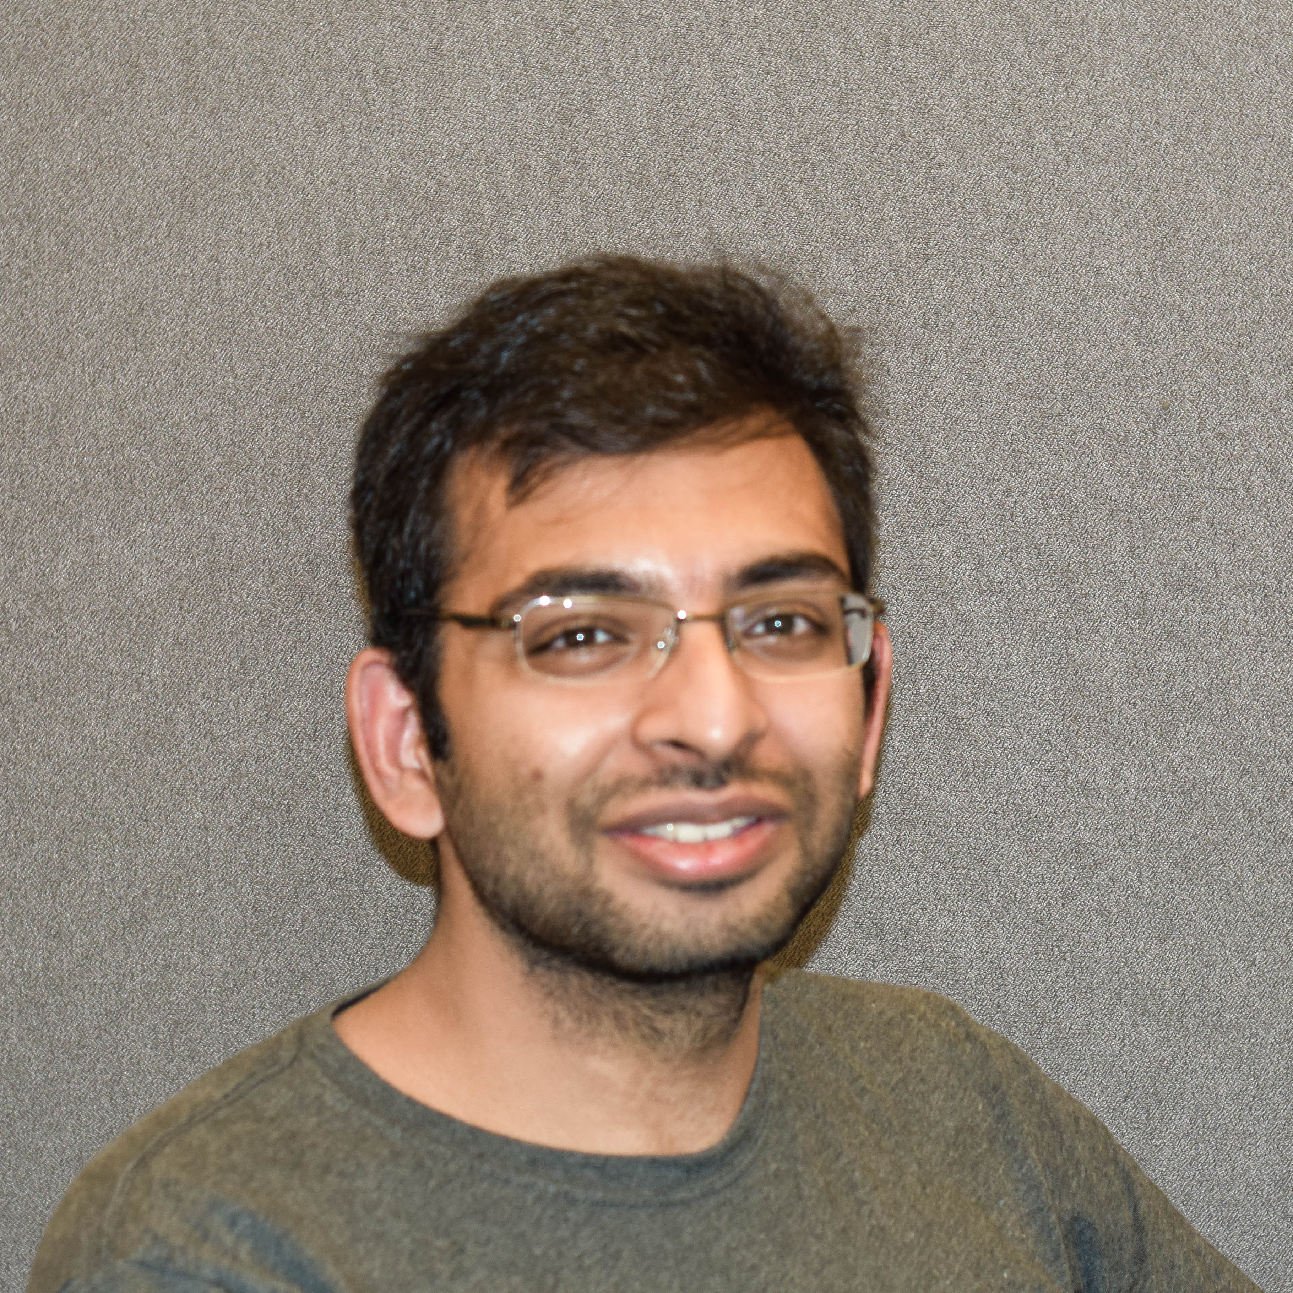
About Me
University of Alabama at Birmingham, Alabama USA
PhD – Physics
MS – Physics
Nation Institute of Technology, Jharkhand India
BTech – Civil Engineering
Email: ketangoyal1988@gmail.com
LinkdIn:
https://www.linkedin.com/in/ketan-goyal-4202351a
Github:
https://github.com/ketangoyal1988

