Slide 1
HackerRank DDNA
Ketan Goyal

Slide 2
Increase ROI of recruiters by predicting success chances of candidates
Interview Process
Resume Review
Online Technical Screening
Phone Screening
On-Site Interview

Slide 3
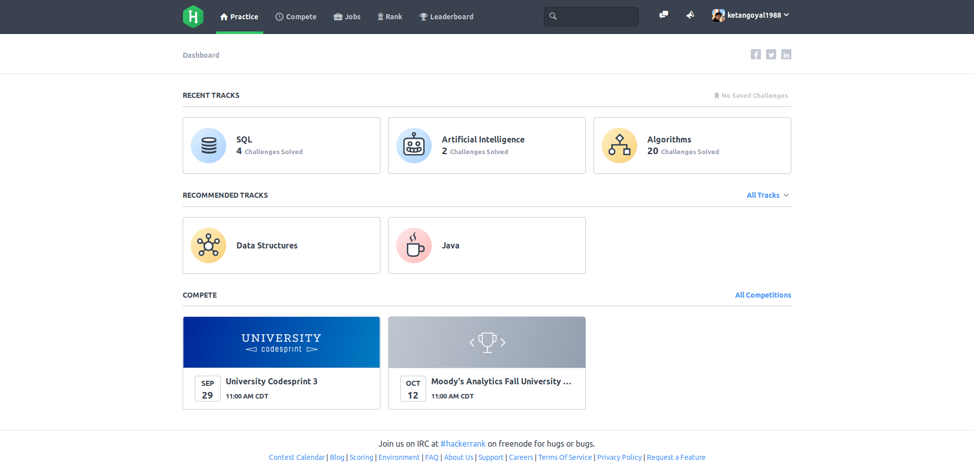
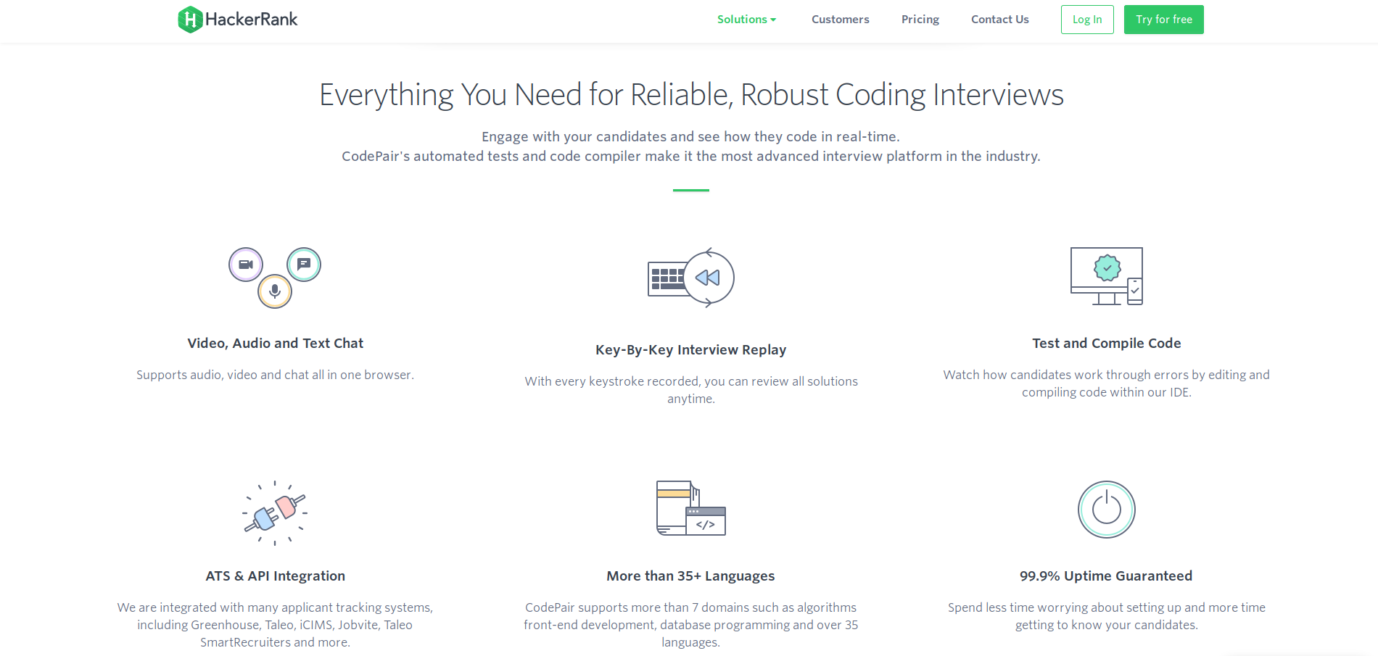
HackerRank [what they do]
Community
Enterprise
Solve coding challenges for fun
Solve coding challenges for interview

Slide 4


Data Source is...
HackerRank
Community Database
Phone Screening Outcomes
Outcomes (0,1)
Features
test_scores
test-cases_cleared
run_count
solve_time
0 – Candidate Failed
1 – Candidate Passed
Enterprise Database
Divide features based on difficulty of test questions

Slide 5
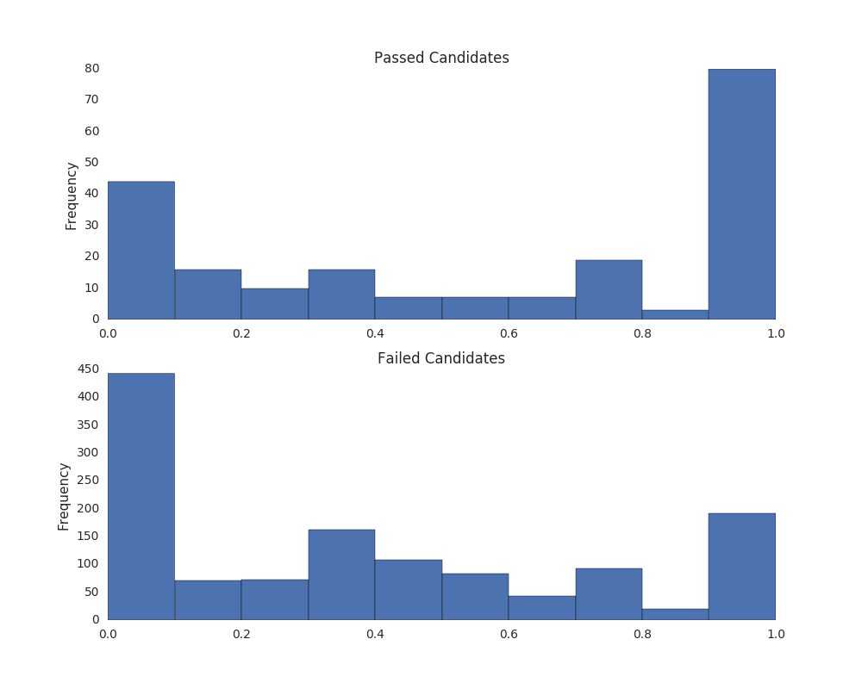
Scores seam not good indicators of phone screening outcome

Slide 6
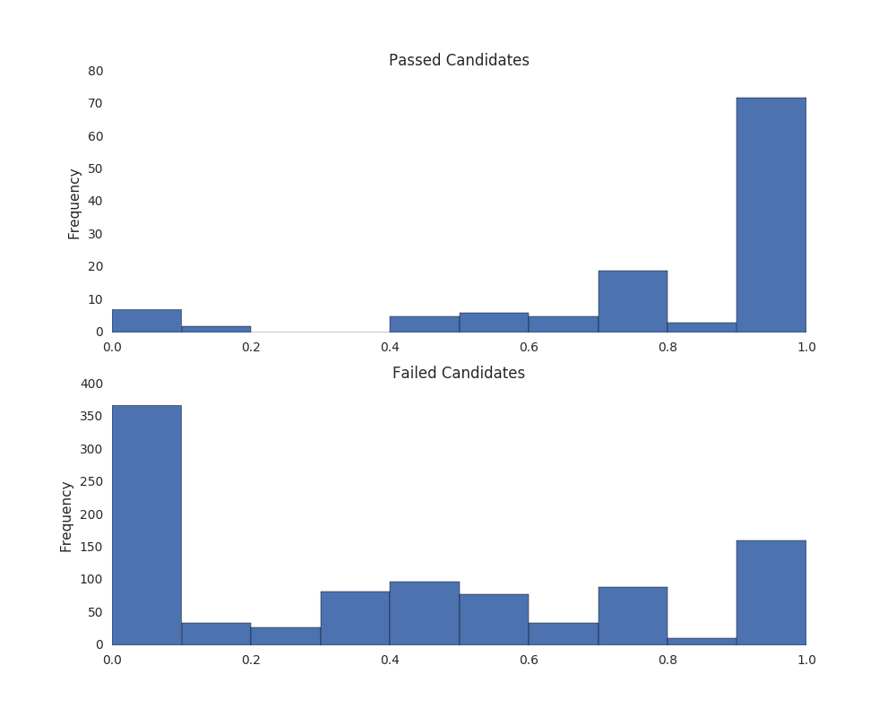
Removing Tests with Custom Questions...
Looks better!

Slide 7
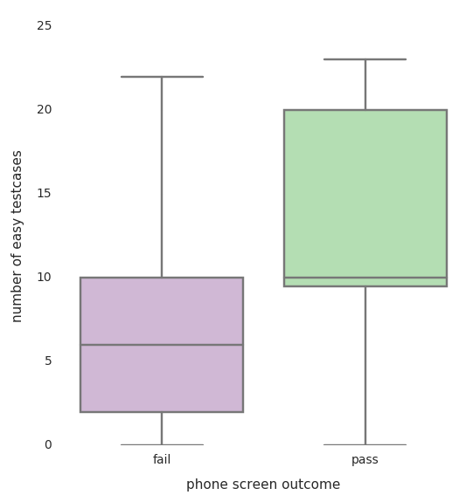
Test Cases Feature
Candidate who clear phone screens tend to
solve more easy test cases compared to
candidates who don’t clear phone screens

Slide 8
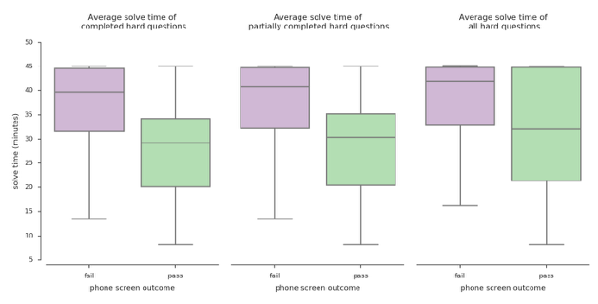
Solve Time Feature
If a candidate solves a hard question in
less than 32 mins, there is a high
possibility that they will clear the phone
screen.

Slide 9
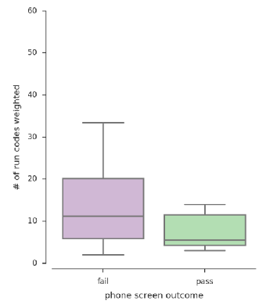
Number of Runs Feature
Candidates who clear the phone screen
tend to do less run codes compared to
candidates who don’t clear the phone
screen

Slide 10
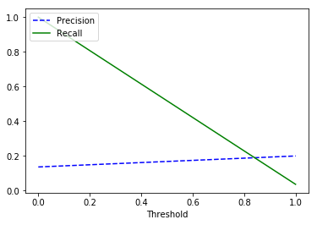
Model can be used to create a list of ordered recommended candidates
Performance
Features
test_scores
test-cases_cleared
run_count
solve_time
Model
Random Forest
AUC = 0.60
Low!
For More Information Visit:

Slide 11

About Me
University of Alabama at Birmingham, Alabama USA
PhD – Physics
MS – Physics
Nation Institute of Technology, Jharkhand India
BTech – Civil Engineering
Ketan Goyal

