Slide 1
A new data catalogue for the South African National Space Agency
http://catalogue.sansa.org.za
Notes:
Welcome to this presentation on our new data catalogue for the CSIR Satellite Applications Center (also known as 'SAC').

Slide 2



Key Features
}
Search
Earth
Observation
Data
Visualise
Order
Notes:
The aim of the new data catalogue is to allow users to search for, visualise and order earth observation data that is obtained and curated by the Satellite Applications Center.

Slide 3
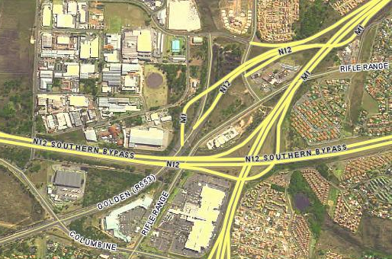
Earth Observation Data
Notes:
The Satellite Applications Center is a technology leader in South Africa, providing ground station facilities for numerous satellites.
They also provide post-processing services using cutting edge technologies such as the SARMES image processing system.
Agreements with numerous space agencies, coupled with the technological and intellectual properties they hold, place the Satellite Applications Center in a unique position to provide services and products for SADEC nations.
In this slide we can see an example of the 2008 SPOT5 national mosaic for South Africa that was produced at the Satellite Applications Center.

Slide 4

Target Audience
General Public
SAC Strategic Partners
SAC Staff
Notes:
With such a wealth of data and services on offer, the question is ”How can this resource be made easily available to the general public?”
And this is where the Data Catalogue comes into play.
The aim of the catalogue is thus to make it easy for the General Public, SAC Strategic Partners and SAC Staff to find, visualise and obtain Earth Observation data.

Slide 5

Guiding Principles
Easy To Use
Easy To Use
Easy To Use
Modern User Interface
Open Architecture and Extensible
Use Open Source and Open Standards
Notes:
With this in mind we have embarked on building a data catalogue at the Satellite Applications Center.
To realise a catalogue that provides search, visualisation and ordering facilities for the general public, SAC Strategic Partners and our internal staff, we adopted a number of guiding principles.
* The first principle is that the system should be easy to use, especially for people who may not be familiar with Earth Observation products.
* We also wanted to provide a modern interface that makes use of the very best of current available technologies.
* Under the hood, we wanted to build a system with an open architecture – where all of its components can be easily understood and where SAC always has the freedom to develop and extend the system.
* Lastly we wanted to build the system on open source and open standards. This approach, as well as adhering to the new government policies on adoption of Open Source, also leaves SAC with a system unencumbered by long term licensing fees. Being open source also makes it easy for SAC to scale the system or even redeploy it to other ground segments.Using open standards will allow the system to interoperate with other services and allow the system to be used in ways unimagined in the initial development as standard protocols continue to evolve into the future.

Slide 6


Hardware Architecture
Internet
Database Host
Application Host
15TB Online Storage
Notes:
Lets take a look at how we put the system together from a hardware perspective:
The cornerstone of the system is the catalogue database. This host stores both catalogue data and ancilliary vector data such as country boundaries, roads, cadastral boundaries and so on.
The application host provides the web server and web application hosting capabilities.
The Open Services host provides web mapping services. In particular it provides services based on the Web Mapping Service open standard.
Connected to the Open Services Host is a storage array providing 15 terrabytes of online storage. This is needed because Earth Observation data is typically voluminous and IO latency is an important consideration.
Our users will connect to the application host, which will send the applicaiton to their browser. When the application provides mapping services, the users browser will retrieve these map data from the Open Services Host in a way that is transparent to the user.

Slide 7
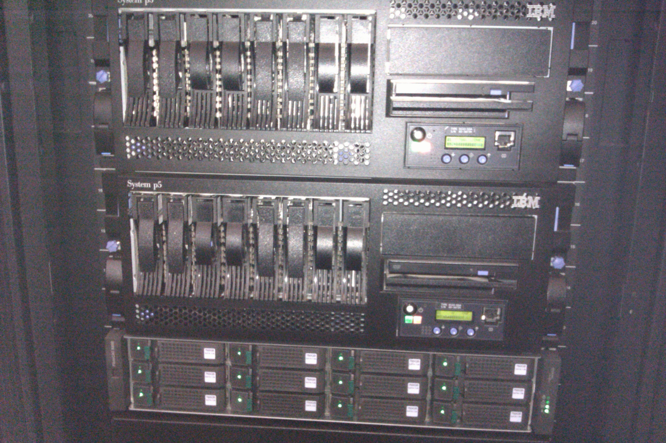

Slide 8


Software Architecture
No Flash, Java Applets, ActiveX or other 'Disabling Technologies' !
OpenLayers, JQuery, HTML & Ajax
IE8, FireFox, Safari, Chrome, Opera
GeoDjango, MapServer, TileCache
Apache, mod_python, PostgreSQL
Debian PPC64, Ubuntu Server 64
Notes:
From the software perspective, our foundation is Gnu/Linux. Linux provides an industrial strength basis on which to host the catalogue in an efficient and reliable manner.
We chose debian based distributions (Ubuntu is based on debian) because of their ease of package management and the fact that they are cost free to deploy and require minimal administrator intervention to maintain.
At the next level in our software stack, we implemented basic services using the extremely well regarded Apache web server. A large part of the World Wide Web is hosted on Apache servers and the software is reliable while using few system resources.
Mod_python is an extension to apache that allows us to deploy web applications written in the python programming language.
For our data store we are using the PostgreSQL database. Postgres is a robust, modern, enterprise-ready relational database management system. Via the PostGIS extension, Postgres is able to store spatial data as geometry features and perform spatial predicate queries such as searching for the intersection between two or more geometries.
Our application is built using GeoDjango. GeoDjango is a web application framework based on the Model View Controller paradigm. GeoDjango is programmed using Python and provides a high level development environment for building spatially enabled applications.
Our Web Mapping Services are implemented using MapServer and TileCache. MapServer runs as a cgi module on the apache WebServer and responds to client requests for map data. TileCache sits in front of MapServer and acts as an accellerator, caching and optionally pre-rendering maps in anticipation of client requests.
On the client side, the user can interact with the system using any modern web browser. We have taken a lot of care to build the catalogue using open web standards and as such it works well on FireFox, Safari, Chrome etc. The site works on Internet Explorer too albeit with some small issues which we are actively working on to resolve.
The application has been built using a modern approach to web site development – often referred to as 'Web 2.0'. In order to achieve this, we use AJAX – asynchronous javascript and XML - to provide a rich interactive experience with minimal page reloads. For example the OpenLayers mapping component provides a 'slippy' map environment, allowing the user to seamlessly pan and zoom with minimal wait times and high interactivity. We will point out some of these AJAX features as we move into our demo.
An important decision we made early on was to avoid all 'disabling' technologies. Disabling technologies are technologies that require the user to install additional proprietary software on their computers in order to be able to use the catalogue. Disabling technologies also often limit the audience – for example ActiveX controls only work under Internet Explorer in Windows, effectively disenfranchising users of different operating systems or those who have chose to use Open Source software in accordance with personal preferences or government advisories.

Slide 9
Data Flow
Informix
}
Database
SACC
Open Services
CBERS
Storage
More...!
Notes:
How does data make its way into the catalogue? We use a harvesting technique to retrieve data from data sources such as the legacy ACS Informix catalogue, or from flat files as provided for SACC and CBERS. The system is extensible, allowing us to add additional data sources into the future.
A large part of the work that went into the version of the Catalogue we are demonstrating today, involved reverse engineering and building data harvesting routines for these legacy data sources. It is from this platform that we will build out additional functionality into the future.
When data is harvested, it is copied into the Catalogue Postgres database (in the case of metadata) or synchronised onto our online storage (in the case of imagery data).

Slide 10
Best Practices
All code is version controlled
All code is hosted at and available to SAC (no vendor lock in)
Comprehensive system documentation
Notes:
Its worth pointing out, that as well as building an open architecture, we are also following Best Practices for software development as far as possible. This means that among other things, all the code we have produced is version controlled. Version controlled code means that its backed up and that its possible to roll the code back incrementally to any previous state. This versioning also provides a detailed provenance for the development effort.
Also, as part of the agreement between SAC and Linfiniti Consulting all code is hosted within SAC's computing infrastructure and SAC is a first class citizen with regards to intellectual property rights and avoidance of vendor lock in.
As part of the auditing and system build up, we have produced comprehensive documentation for procedures and processes relating to setting up the catalogue hardware and software infrastructure.
In the year that comes we will be augmenting these best practices by implementing a comprehensive unit testing suite for the catalogue software. This will further add to the levels of quality assurance as the codebase and functionality grows.

Slide 11

System Status (06/2011)
Sensor Count
Active Microwave Instrument ERS-1 20896
Advanced Very High Resolution Radiometer NOAA 3162
Enhanced Thematic Mapper Plus Landsat 7 16624
Haute Resolution Visible Spot2 145506
High Resolution CCD Camera CBERS2-B 2187
High Resolution Geometric Spot 5 549763
High-Resolution Visible and Infrared sensor Spot 4 151753
Moderate-Resolution Imaging Spectroradiometer Aqua 1000
Multispectral Imager ZA-002 857
Multispectral Medium Resolution Scanner SAC-C 285
Multi-Spectral-Scanner Landsat 2 35
Multi-Spectral-Scanner Landsat 3 20
Multi-Spectral-Scanner Landsat 4 67
Multi-Spectral-Scanner Landsat 5 17021
RapidEye Earth Imaging System RapidEye-2 1692
RapidEye Earth Imaging System RapidEye-3 1604
RapidEye Earth Imaging System RapidEye-4 1463
RapidEye Earth Imaging System RapidEye-5 1347
Spot 1,2,3 HRV Xs 1239054
Thematic Mapper Landsat 5 120975
TSX-SAR TSX-1 11146
Total 2286457
Notes:
At the time of preparing this presentation, the catalogue hosts over 1 million scene metadata records and over 150 thousand segment metadata records. Many of these records have thumbnail data associated with them which we are working actively to bring online in the coming months.
We have put a first version of our catalogue online and are busy trialling it with users and performing in-house testing before advertising it to a wider audience.

Slide 12

Demo
Lets take a look at the system in action!
Notes:
Lets take a look at the system in action!

Slide 13
Its a platform
WMS Services allow innovation and uses not planned in the original system
Clean architecture provides ability to easily add extention points e.g. Communications with DIMS
Loosely coupled architecture allows improvements to be rolled out incrementally
Easy to redeploy at other institutions e.g. International partnerships

Slide 14
Demo WMS Desktop Client

Slide 15
Recent developments
Tasking interface
Sumbandilasat coverages
Common simplified data model ...

Slide 16
Architecture Diagram
Architecture diagram

Slide 17
In the pipeline
Direct access to data for free products e.g. MODIS
Subscriptions and notifications
DIMS integration
More varied search options

Slide 18
Thank you
Tim Sutton
tim@linfiniti.com
Linfiniti Consulting CC.
http://linfiniti.com
Wolfgang Lück
wluck@csir.co.za
SANSA-EO – Project Manager
Notes:
Thank you for taking the time to watch our presentation. Please feel free to contact us using the contact details we have provided here if you have any questions.

