Slide 1
MapReduce Suneesh Moolayi

Slide 2
1.MapReduce
2.Mapper/Reducer
3.InputFormat

Slide 3
What is MapReduce?
Hadoop MapReduce is a software framework for easily writing applications which process vast amounts of data (multi-terabyte data-sets) in-parallel on large clusters (thousands of nodes) of commodity hardware in a reliable, fault-tolerant manner.
A MapReduce job usually splits the input data-set into independent chunks which are processed by the map tasks in a completely parallel manner. The framework sorts the outputs of the maps, which are then input to the reduce tasks.

Slide 4
MapReduce
A mapper takes input in a form of key/value pairs (k₁, v₁) and transforms them into another key/value pair (k₂, v₂).
MapReduce framework sorts mapper’s output key/value pairs and combines each unique key with all its values (k₂, {v_{2,} v₂,…}) and deliver these key/value combinations to reducers
Reducer takes (k₂, {v_{2,} v₂,…}) key/value combinations and translates them into yet another key/value pair (k₃, v₃).

Slide 5
Execution

Slide 6
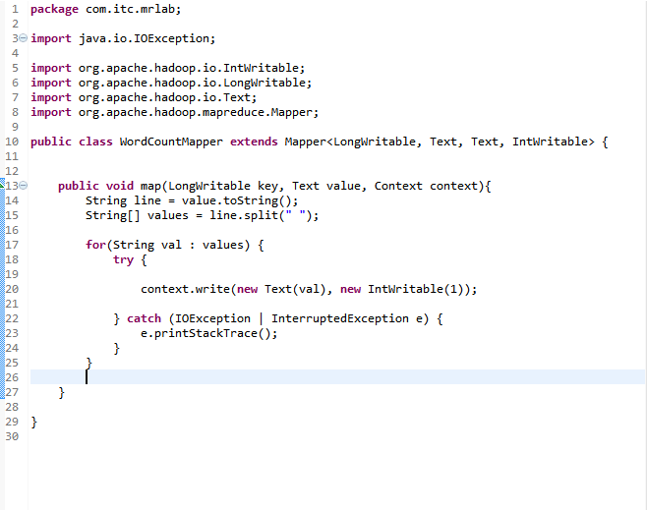
Sample Program - Mapper

Slide 7
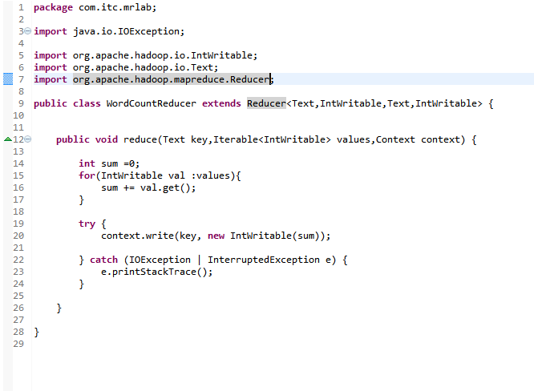
Sample Program - Reducer

Slide 8
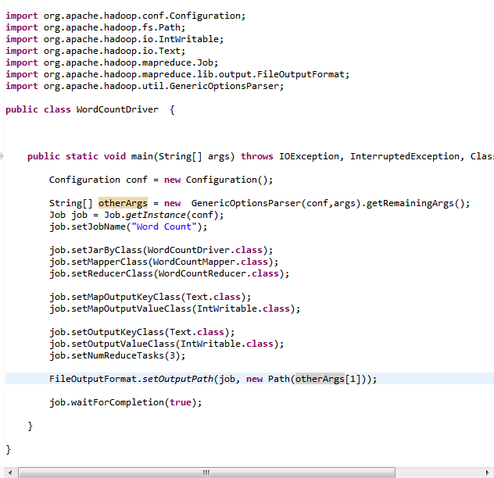
Sample Program - Driver

Slide 9
Sample Program - Jars
commons-cli-1.2.jar - hadoop-2.3.0\share\hadoop\common\lib
hadoop-common-2.3.0.jar - hadoop-2.3.0\share\hadoop\common
hadoop-mapreduce-client-core-2.3.0.jar - hadoop-2.3.0\share\hadoop\mapreduce

Slide 10
Mapper
Mapper<KEYIN, VALUEIN, KEYOUT, VALUEOUT>
protected void setup(Context context)
protected void map(KEYIN key, VALUEIN value, Context context)
protected void cleanup(Context context)
public void run(Context context)

Slide 11
Reducer
Reducer<KEYIN,VALUEIN,KEYOUT,VALUEOUT>
protected void setup(Context context)
protected void map(KEYIN key, VALUEIN value, Context context)
protected void cleanup(Context context)
public void run(Context context)

Slide 12
How MapReduce Works

Slide 13
Input/Output Format
TextInputFormat
TextInputFormat is the default InputFormat. Each record is a line of input. The key, a
LongWritable, is the byte offset within the file of the beginning of the line. The value is
the contents of the line, excluding any line terminators (e.g., newline or carriage return)

Slide 14
Input/Output Format
KeyValueTextInputFormat
Split the line into key and value using tab character as default separator
First token before the separator as key and the rest as value
Set the different separator by setting following property
mapreduce.input.keyvaluelinerecordreader.key.value.separator

Slide 15
Input/Output Format
Multiple Inputs
This class supports MapReduce jobs that have multiple input paths with a different InputFormat and Mapper for each path
MultipleInputs.addInputPath(job, ncdcInputPath,TextInputFormat.class, MaxTemperatureMapper.class);
MultipleInputs.addInputPath(job, metOfficeInputPath,TextInputFormat.class, MetOfficeMaxTemperatureMapper.class);

Slide 16
Advanced Map Reduce Topic
Combiner
Local aggregation of data after map function.
Reduce the number and size of key-value pairs to be shuffled.
. Reduce data transfer over the network
. Reduce disk I/O as intermediate result are written to disk
To implement the combiner use same interface as Reducer
Set combiner in driver as following
Job.setCombinerClass()

Slide 17
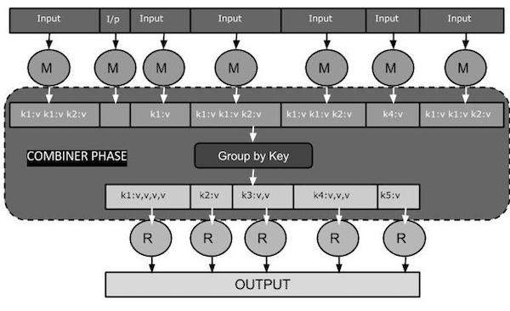

Slide 18
Advanced Map Reduce Topic
Partitioning
Deciding which reducer will receive which intermediate keys and values.
Mapper output with same keys belongs to same partition and is processed by same reducer
HashPartitioner is the default Partitioner
Data distributed by depending on number of reducer configured

Slide 19
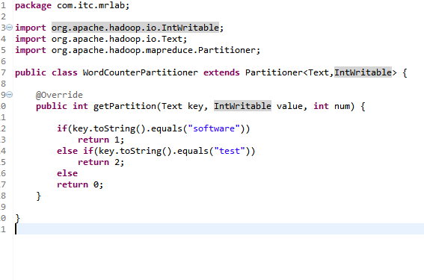
Advanced Map Reduce Topic

Slide 20
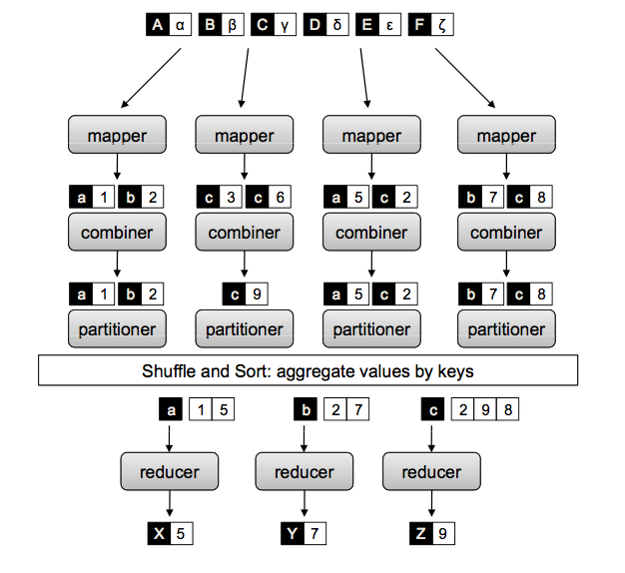

Slide 21
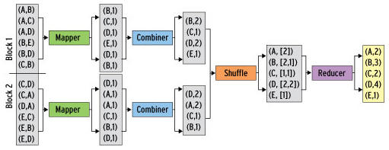

Slide 22
Shuffling-Shuffling is the process of transfering data from the mappers to the reducers. It can start even before the map phase has finished
Sorting-Sort phase in MapReduce covers the merging and sorting of map outputs.
If number of reducers are zero, no shuffling and sorting will happen

Slide 23
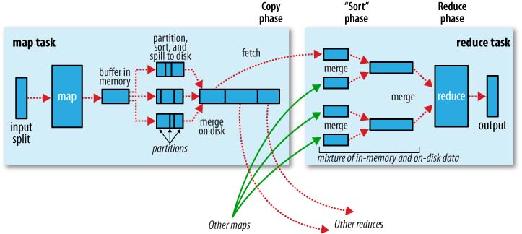

Slide 24
Advanced Map Reduce Topic
Passing Parameters using Configuration
Passing some parameter to mappr or reducer environment
Configuration details can be passed using this technique
Set Parameter in driver code as follow
Configuration conf = new Configuration();
conf.set(“ProductID”,”0003rr568”);
conf.set(“Amount”,”$673”);
Retrieve the parameter in mapper or reducer code as follow
Configuration conf = context.getConfiguration();
String productID = conf.get(“ProductID”);

Slide 25
Advanced Map Reduce Topic
Job Chaining
Running multiple map and reduce function in sequence
Output of one map reduce function to be fed to another map reduce function

Slide 26
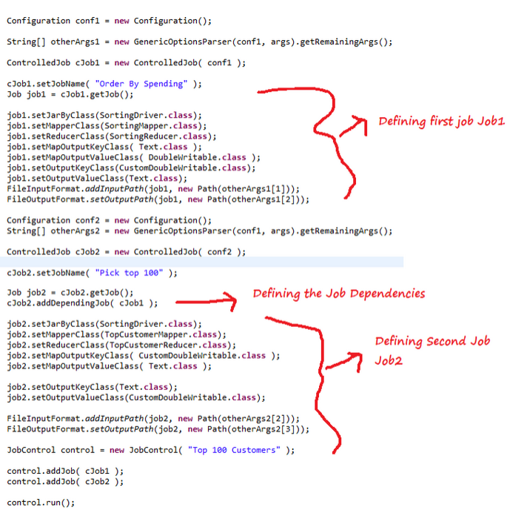
Advanced Map Reduce Topic

Slide 27
Advanced Map Reduce Topic
Distributed Cache
This provides a service for copying files and archives to the task nodes in time for the tasks to use them when they run. To save network bandwidth, files are normally copied to any particular node once per job.
job.addCacheFile(new URI("hdfs:///lab/programs/sal.txt"));

Slide 28
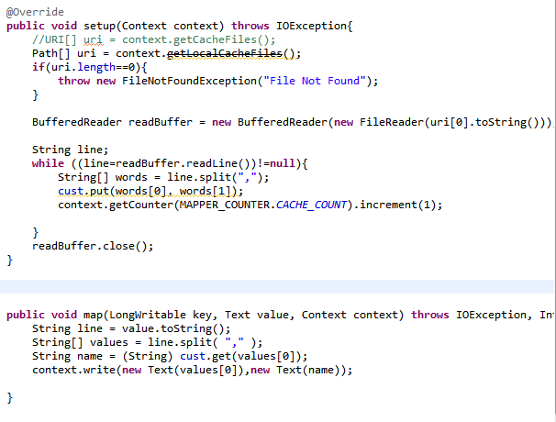
Advanced Map Reduce Topic

Slide 29
Advanced Map Reduce Topic
Counters
Counters are a useful channel for gathering statistics about the job: for quality control or for application-level statistics.
They are also useful for problem diagnosis

Slide 30
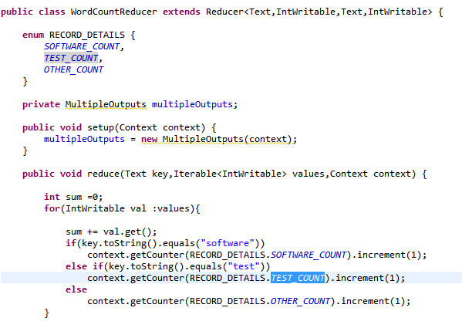
Advanced Map Reduce Topic

Slide 31
Uber Mode
Uber jobs are jobs that are executed within the MapReduce ApplicationMaster.
AM runs the map and reduce tasks within its own process.
Avoides the overhead of launching and communicating with remote containers.
For small datset running in uber mode will save time.
Map only jobs and job with one reducer are supported.

Slide 32
Counters
Counters are similar to putting log message in the code for map or reduce.

Slide 33
Thank You

