Slide 2
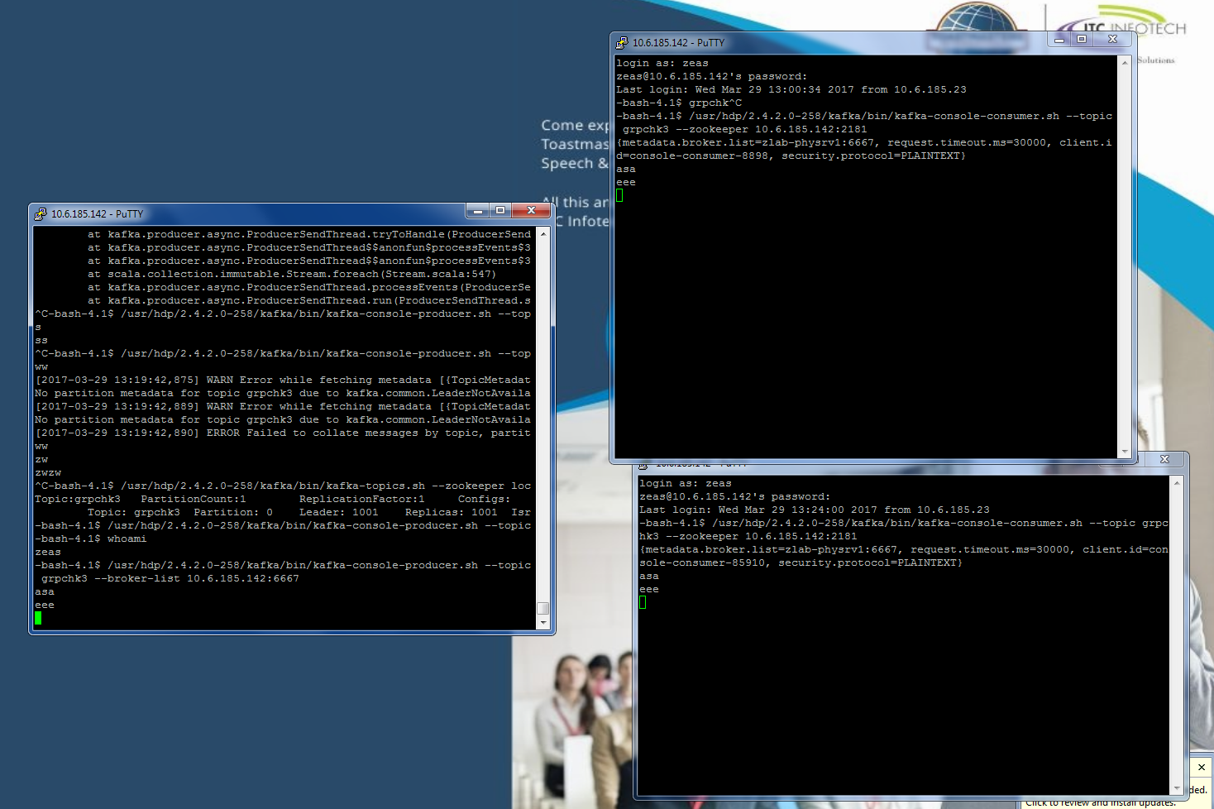

Slide 3
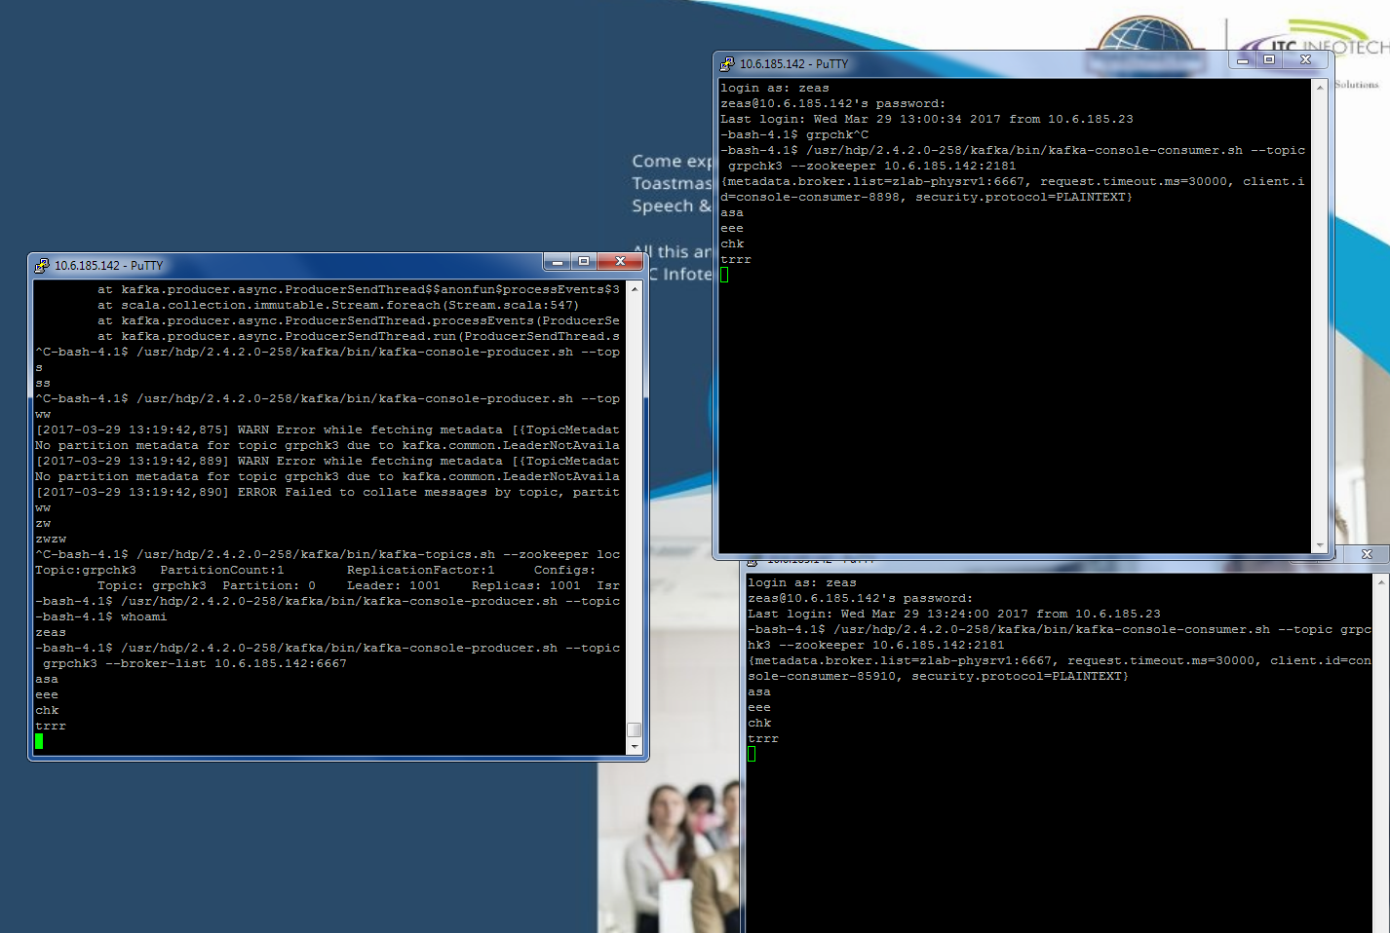

Slide 4
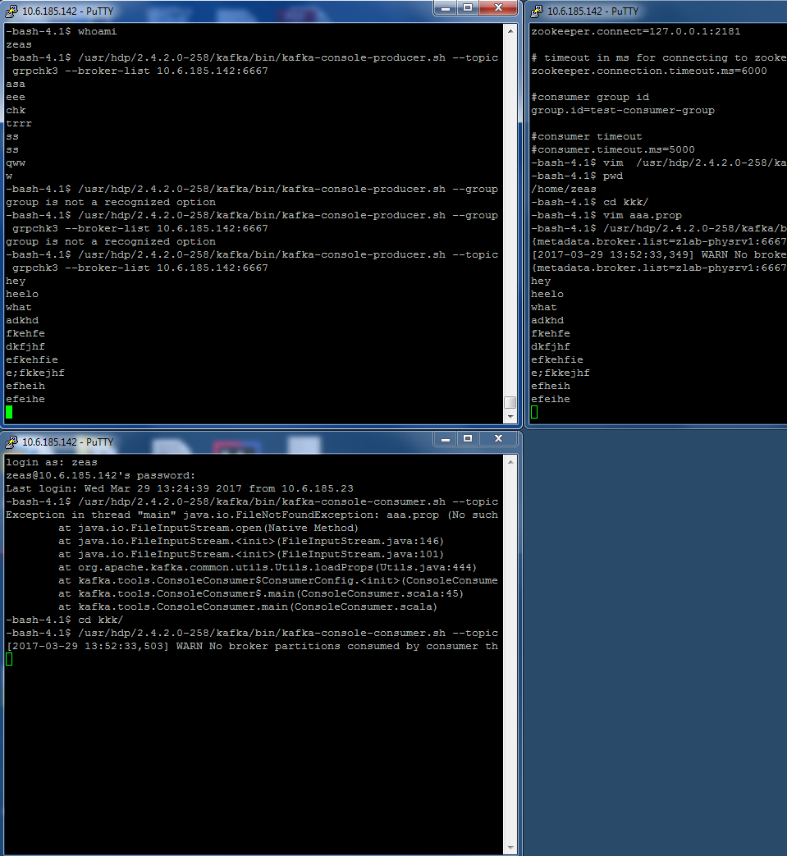

Slide 5
props.put("partitioner.class","com.howtoprogram.kafka.custompartitioner.KafkaUserCustomPatitioner");
/usr/hdp/2.4.2.0-258/kafka_2.10-0.10.2.0/bin/zookeeper-shell.sh localhost:2181

