Slide 1
Spark

Slide 2
What is spark
Spark is a improved version of MapReduce
It uses in-memory computation.

Slide 3
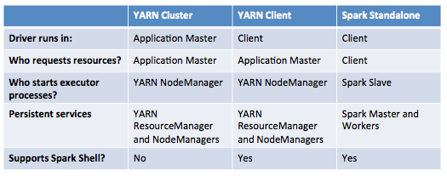
--master
Resource optimization won't be efficient in standalone mode.
In standalone mode, driver program launch an executor in every node of a cluster irrespective of data locality.

Slide 4
If –master is yarn-cluster then check history on 8088
If its local[n] then check on 18080

Slide 5
If ouput folder is already present then it will throw exception
Deployment to YARN is not supported directly by SparkContext. Please use spark-submit

Slide 6
Client mode
Want to get a job result (dynamic analysis)
Easier for developing/debugging
Control where your Driver Program is running
Always up application: expose your Spark job launcher as REST service or a Web UI
Cluster mode
Easier for resource allocation (let the master decide): Fire and forget
Monitor your Driver Program from Master Web UI like other workers
Stop at the end: one job is finished, allocated resources are freed

Slide 7
cache is merely persist with the default storage level MEMORY_ONLY
default persist() will
store the data in the JVM heap as unserialized objects.

