Slide 1
HADOOP `

Slide 2
1.What is Hadoop?
2.HDFS
3.NameNode/DataNode
4.Racks,Replicas
5.MR1 vs MR2
6.Yarn
7.Ambari
8.Zookeeper

Slide 3
What is Hadoop?
A framework used for Big data.
It has 2 components
1. Storage-HDFS(Hadoop Distributed file system)
2.Computation MapReduce.

Slide 4
More about HDFS.
HDFS is highly fault-tolerant and is designed to be deployed on low-cost hardware.
Block size- Files are stored in blocks, 128mb size in Hadoop 2.x.
Replication factor-3(by default).
Detection of faults and quick, automatic recovery from them is a core architectural goal of HDFS.
HDFS applications need a write-once-read-many access model for files.
It is often better to migrate the computation closer to where the data is located rather than moving the data to where the application is running.

Slide 5
NameNode
HDFS has a master/slave architecture.
Manages the file system namespace.
Regulates client’s access to files.
It also executes file system operations such as renaming, closing, and opening files and directories.
Determines the mapping of blocks to DataNodes,makes all decisions regarding replication of blocks.
It periodically receives a Heartbeat and a Blockreport from each of the DataNodes in the cluster. Receipt of a Heartbeat implies that the DataNode is functioning properly.
A Blockreport contains a list of all blocks on a DataNode.
Replication of data blocks does not occur when the NameNode is in the Safemode state.(when it starts, it starts in safemode).

Slide 6
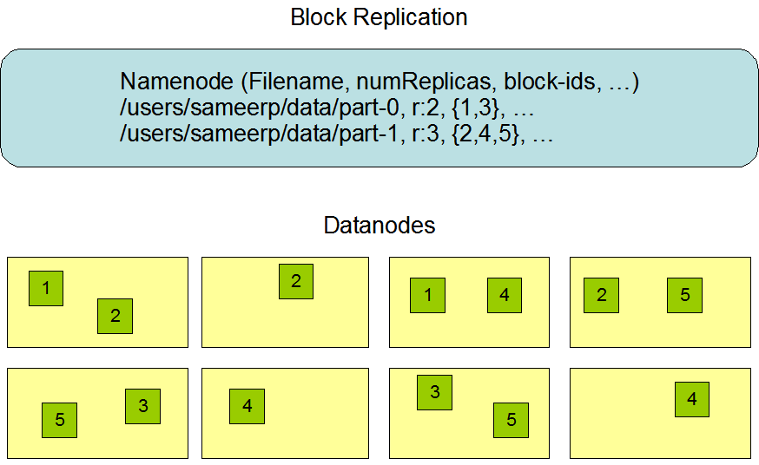

Slide 7
DataNode
Internally, a file is split into one or more blocks and these blocks are stored in a set of DataNodes.
Datanodes perform read-write operations on the file systems, as per client request.
They also perform operations such as block creation, deletion, and replication according to the instructions of the namenode.

Slide 8
Secondary Namenode
Main function is to take checkpoints namenode’s file system namespace.
Copy of FsImage(snapshot of HDFS metadata at certain point of time) file and edit log file(a transaction log which contains records for every change that occur to the file system metadata).

Slide 9


Slide 10
Checkpoint Node-The Checkpoint node periodically creates checkpoints of the namespace.
Backup node -Backup node maintains a copy of the namespace in memory.

Slide 11
High Availability
In Hadoop 2.0, to overcome SPOF multiple NameNode can be used.
Earlier there was one Hadoop NameNode for maintaining the tree hierarchy of the HDFS files and tracking the data storage in the cluster.

Slide 12
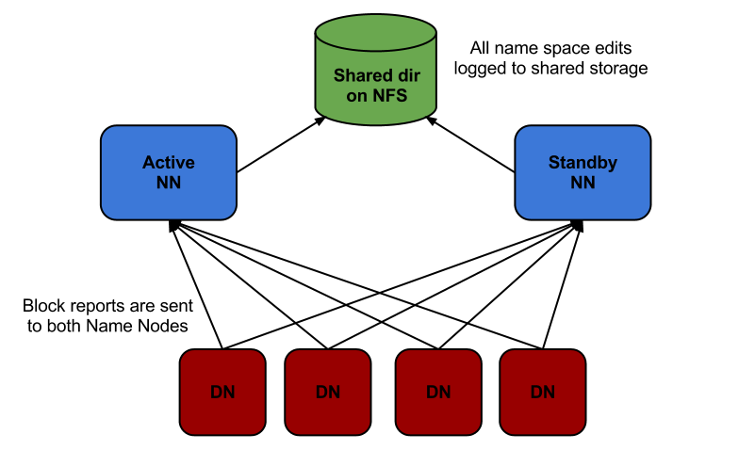

Slide 13
Racks
A rack is a collection of 30 or 40 nodes that are physically stored close together and are all connected to the same network switch. Network bandwidth between any two nodes in rack is greater than bandwidth between two nodes on different racks. A Hadoop Cluster is a collection of racks.
Large HDFS instances run on a cluster of computers that commonly spread across many racks. Communication between two nodes in different racks has to go through switches. In most cases, network bandwidth between machines in the same rack is greater than network bandwidth between machines in different racks.
The NameNode determines the rack id each DataNode belongs to via the process outlined in Hadoop Rack Awareness.

Slide 14
Replica
A simple but non-optimal policy is to place replicas on unique racks. Prevents losing data when an entire rack fails Evenly distributes replicas in the cluster which makes it easy to balance load on component failure. Increases the cost of writes because a write needs to transfer blocks to multiple racks.
For 3, one on local rack, 2nd on next rack and 3rd on same next rack. Cuts the inter-rack write traffic.

Slide 15
Hadoop Commands
hadoop fs –ls
hadoop fs –cat <file_location>
hadoop fs –put <local location> <hdfs location>
hadoop fs –get <hdfs location> <local location>
hadoop fs –rmr <location>
hadoop fs –ls –R <directory>

Slide 16
MR1
2 components of MR1 is Job Tracker and Task Tracker.
Job Tracker is the master and is in charge of allocating tasks to task trackers and scheduling these tasks globally.
Task Tracker is in charge of running the Map and Reduce tasks themselves. It runs on each node.

Slide 17
Yarn
Apache Hadoop YARN (Yet Another Resource Negotiator) is a cluster management technology.
It is a software rewrite that decouples MapReduce's resource management and scheduling capabilities from the data processing component.
It allows multiple access engines (either open-source or proprietary) to use Hadoop as the common standard for batch, interactive and real-time engines that can simultaneously access the same data set.
FIFO, Capacity, and Fair Schedulers.

Slide 18
FIFO Scheduler
The FIFO Scheduler places applications in a queue and runs them in the order of submission (first in, first out). Requests for the first application in the queue are allocated first; once its requests have been satisfied, the next application in the queue is served, and so on.
Large applications will use all the resources in a cluster, so each application has to wait its turn.
the small job is blocked until the large job completes.

Slide 19
Capacity Scheduler or the Fair Scheduler.
Both of these allow long-running jobs to complete in a timely manner, while still allowing users who are running concurrent smaller ad hoc queries to get results back in a reasonable time.
A separate dedicated queue allows the small job to start as soon as it is submitted, although this is at the cost of overall cluster utilization since the queue capacity is reserved for jobs in that queue.

Slide 20
Ambari
The Apache Ambari project is aimed at making Hadoop management simpler by developing software for provisioning, managing, and monitoring Apache Hadoop clusters. Ambari provides an intuitive, easy-to-use Hadoop management web UI backed by its RESTful APIs.

Slide 21
ZooKeeper
ZooKeeper is a centralized service for maintaining configuration information, naming, providing distributed synchronization, and providing group services.
Eg. Kafka, Hbase uses Zookeeper

