Slide 1

Spark
1
Notes:
1

Slide 2
Apache Spark
Open Source framework.
Cluster computing framework for large-scale data processing.
Important abstractions in spark
a) RDD
b) Shared Variables

Slide 3
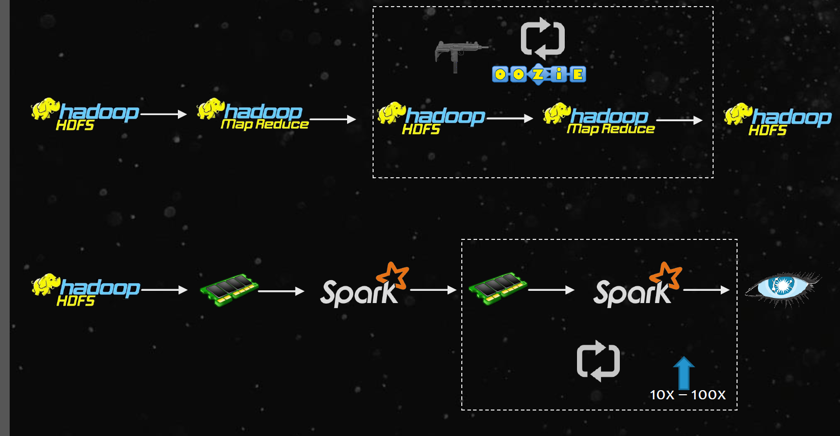

Slide 4
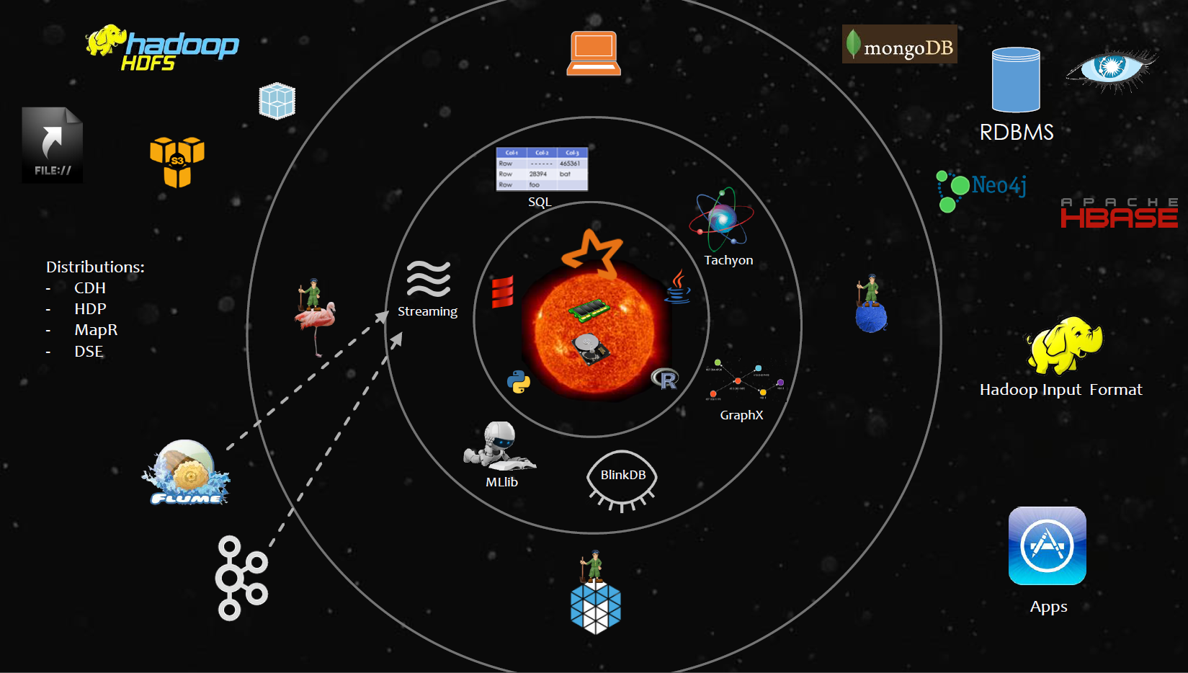
Spark Core

Slide 5
spark core
Benefits of spark
speed:
Spark core used both disk and memory while processing the data
-- >Run programs up to 100x faster than Hadoop MapReduce in memory, or 10x faster on disk.
-- > Spark has an advanced DAG (Directed Acyclic Graph) execution engine
Easy of use:
-- > Write the code in Java, Scala, python,sql etc..
-- > Support traditional APIs java, scala, python, experimental R and DataFrames

Slide 6
spark core
A Unified Engine:
-- > Spark comes packaged with higher-level libraries
spark SQL – structured data
spark streaming – way to analyze the real time data
Mlib – machine learning
GraphX

Slide 7
Initializing Spark
Create SparkContext object to connect the cluster.
Create SparkConf object to add properties.
Java:
SparkConf conf= new SparkConf().setAppName(“wordcount”).setMaster(master);
JavaSparkContext sc = new JavaSparkContext(conf);
Scala:
val conf= new SparkConf().setAppName(“wordcount”).setMaster(master);
new SparkContext(conf);

Slide 8
Using the shell
Scala :
1 ./bin/spark-shell -master local[3]
2 ./bin/spark-shell -master local[3] –-jars sample.jar
Python:
1 ./bin/pyspark -master local[3]
2 ./bin/pyspark -master local[3] --py-files sample.py
note: SparkContext already created, in the variable called sc. Own SparkContext will not work.

Slide 9
spark core
Resource Managers
Coordinators running in the execution of spark
-- > Local mode
-- > Standalone mode
-- > YARN mode
-- > Mesos
File systems:
Almost it can read the data from any file system like
local ext3, ext4, amazon s3 , HDFS
Supports NoSQL databases:
like Apache HBASE , mongo DB, RDBMS
Distributions:
CDH,HDP,MapR,IBM BigInsight etc.….

Slide 10
Resilient Distributed Dataset (RDD)
Represents a read-only collection of elements partitioned across a set of machines.
Ways to create RDDs:
1. parallelizing an existing collection in your driver program
ex: List<Integer> data=Arrays.asList(1,2,3,4);
JavaRDD<Integer> distData=sc.parallelize(data);
2 . Referencing a dataset in an external storage system
ex:
JavaRDD<Integer> file=sc.textFile(“data.txt”);

Slide 11
Resilient Distributed Dataset (RDD)
Users can explicitly cache an RDD in memory across machines and reuse using rdd.cache().
a) Cached RDDs can be retrieved only by jobs in the same application.
b) Spark automatically monitors cache usage on each node and drops out old data partitions in a least-recently-used (LRU) fashion
c) Manually remove using RDD.unpersist() method
RDDs achieve fault tolerance through a notion of lineage.

Slide 12
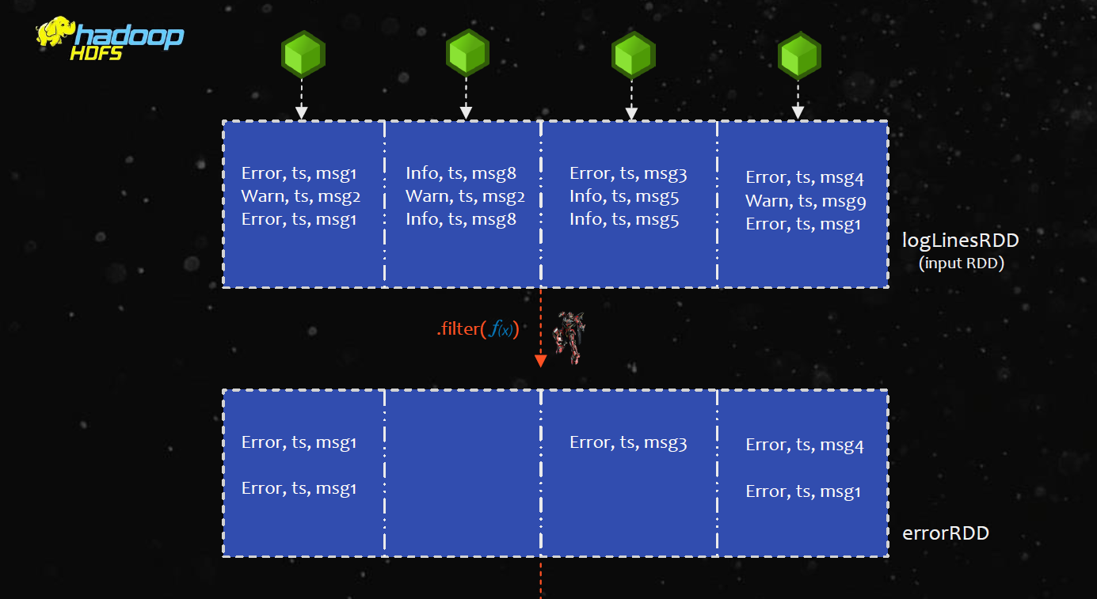

Slide 13
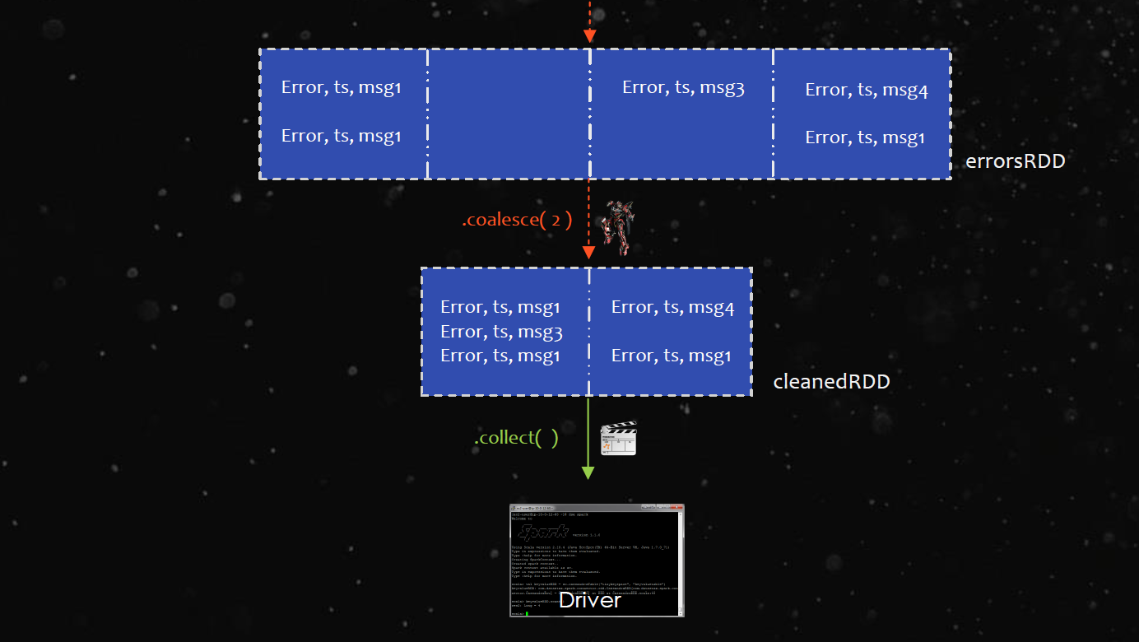

Slide 14
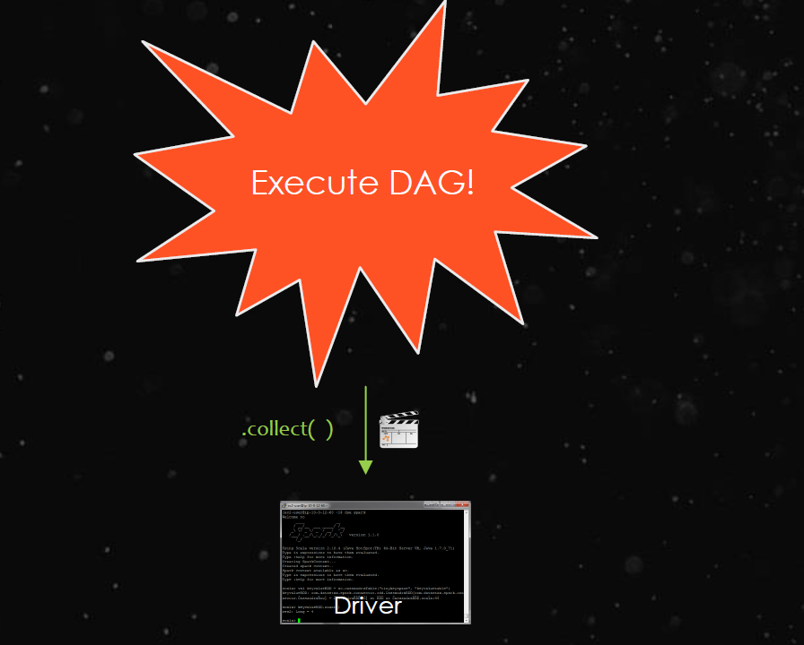

Slide 15
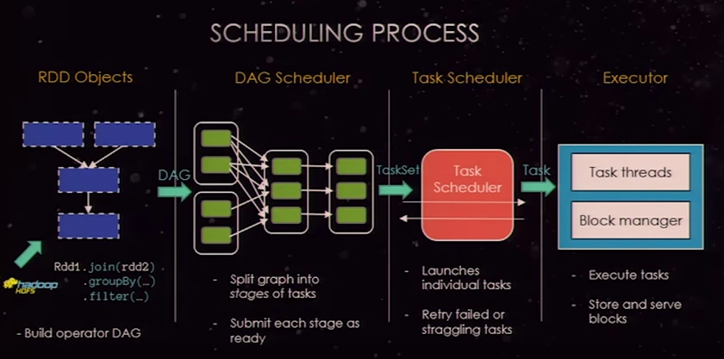
Scheduling Process

Slide 16
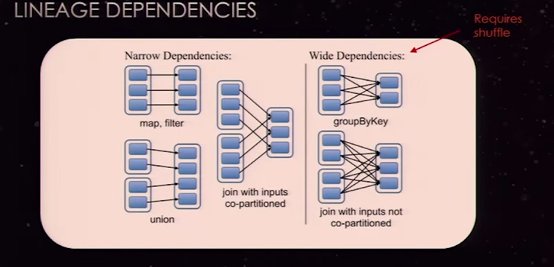
Lineage Dependencies

Slide 17
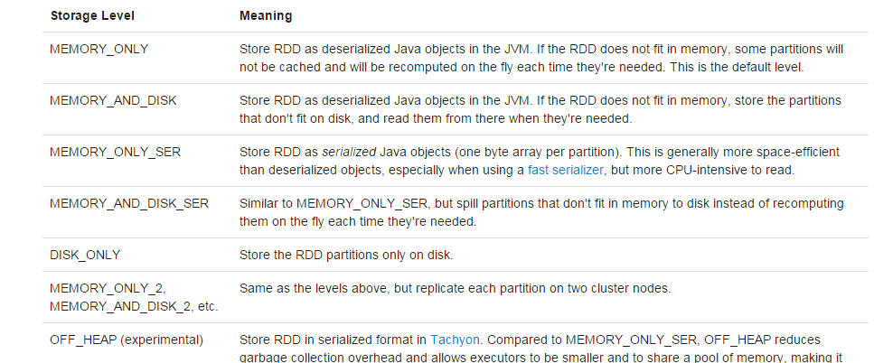
Memory and Persistance

Slide 18
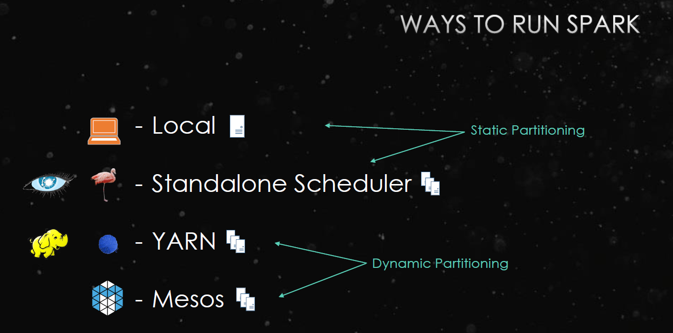
Spark execution in diff modes

Slide 19
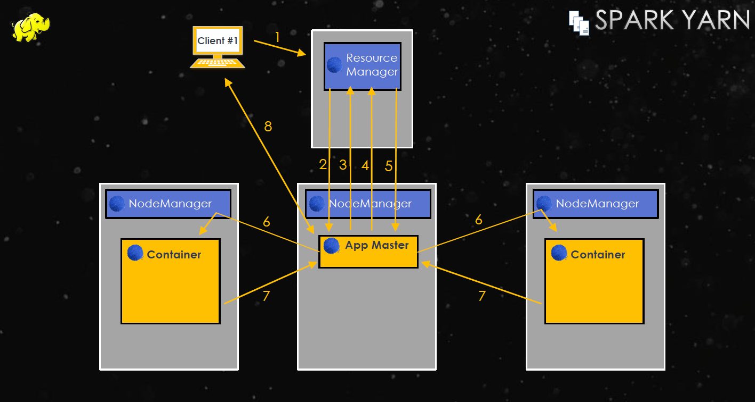
Spark YARN mode

Slide 20
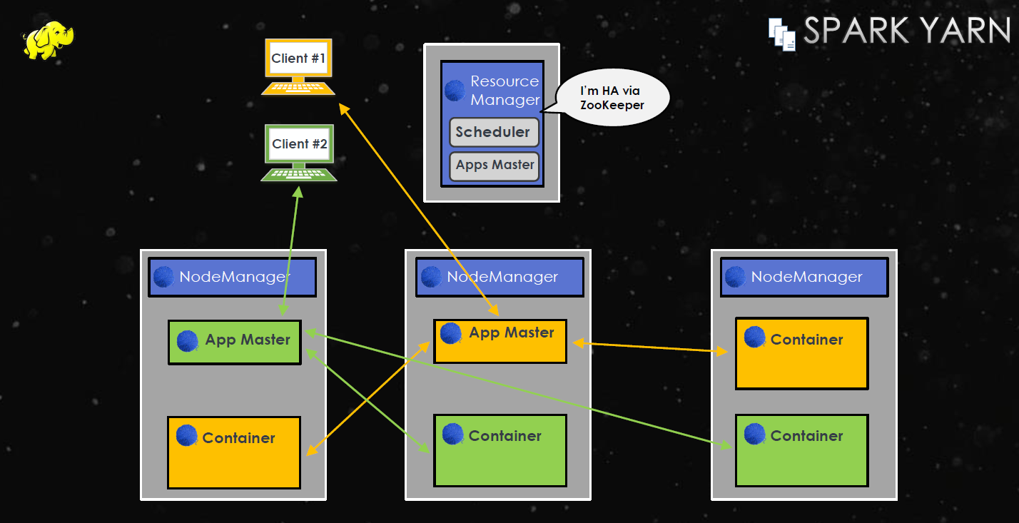
Spark YARN mode

Slide 21
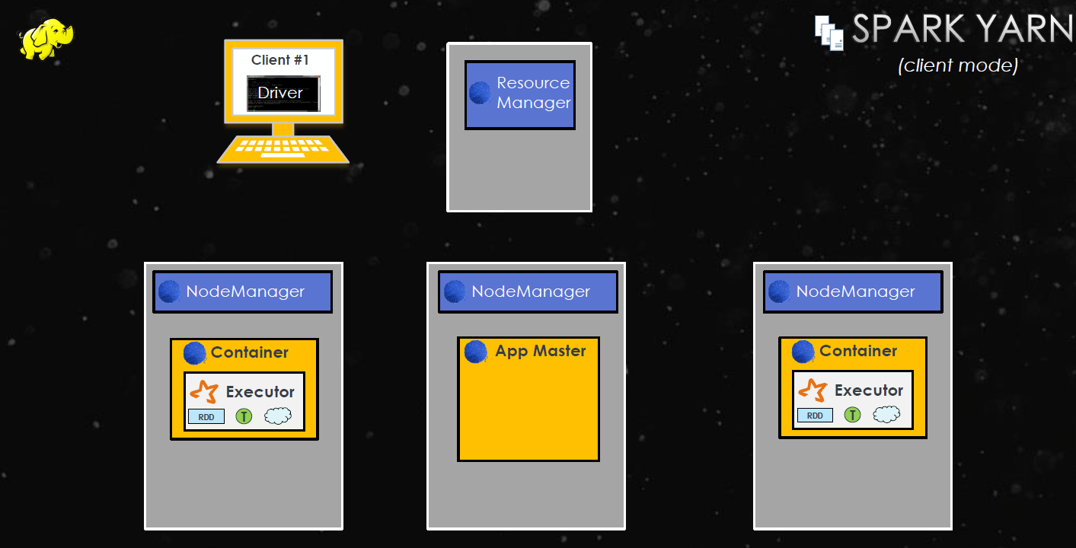
Spark YARN (client mode)

Slide 22
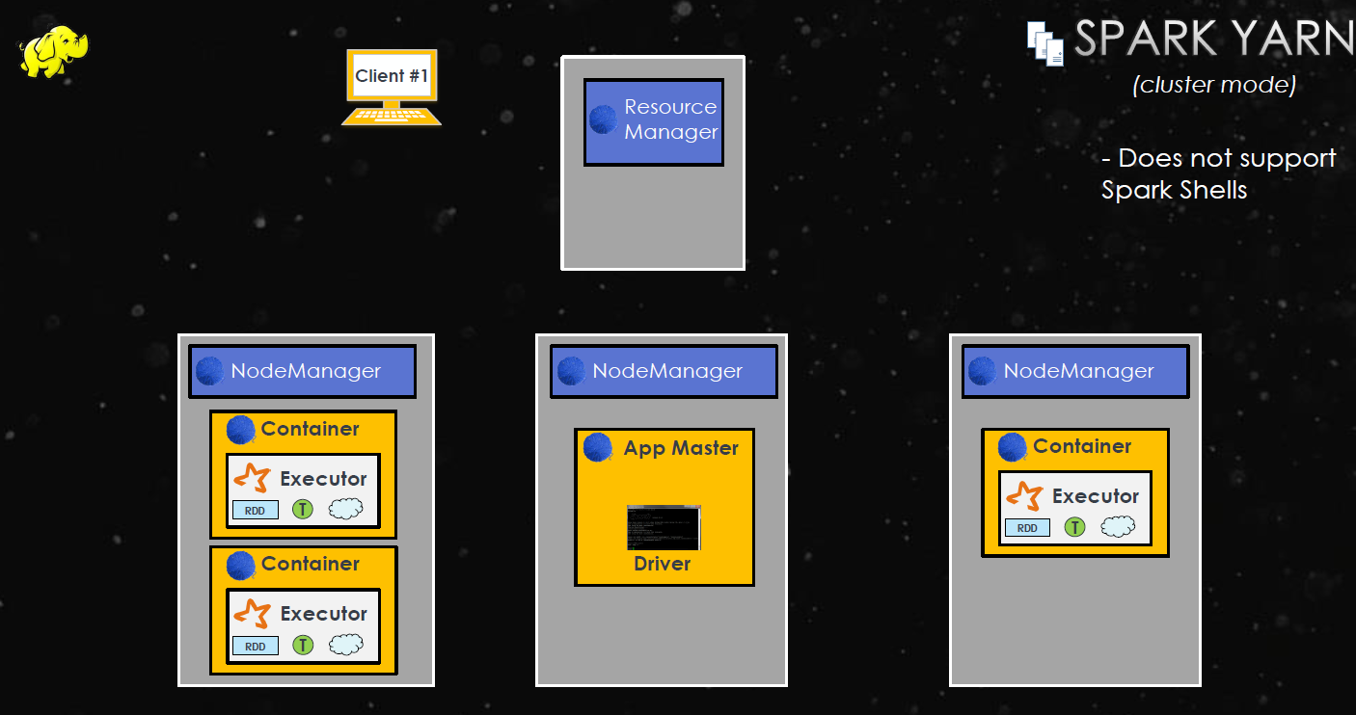
Spark YARN (client mode)

Slide 23
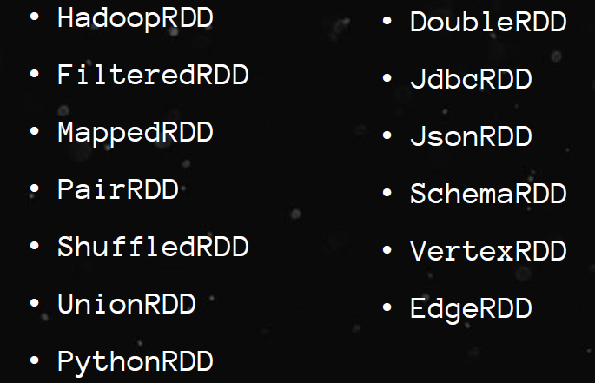
Types of RDDs

Slide 24
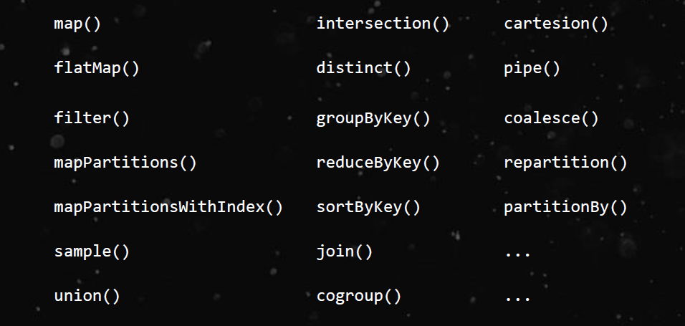
Transformations(lazy)

Slide 25
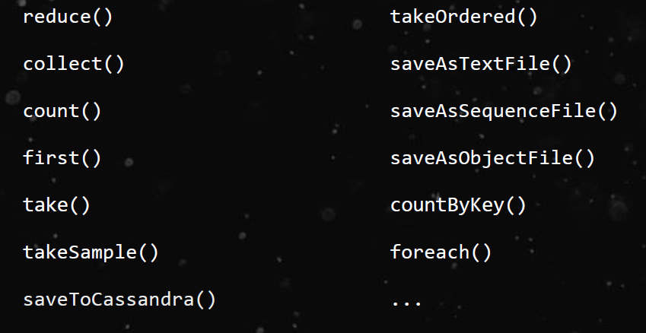
Actions

Slide 26
Shared Variables
Broadcast Variable
-- > to reduce communication cost,allow the programmer to keep a read-only variable cached on each machine rather than shipping a copy of it with tasks.
ex: Broadcast <int[]> broadcastVar = sc.broadcast(new int[]{1,2,3});
broadcastVar.value();
Accumulators:
Can be used to count the # of errors seen in an RDD of lines spread across 100s of nodes.
-- > final Accumulator<Integer> count = sc.accumulator(0);
count.add();

Slide 27
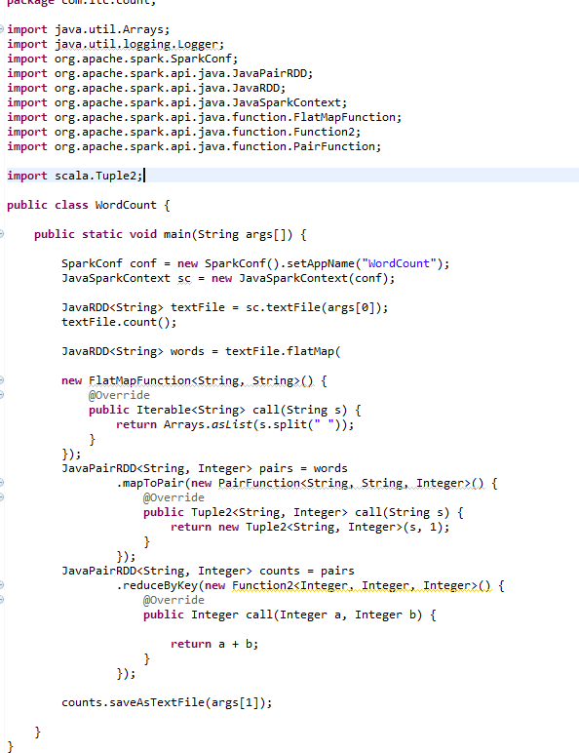
Word count example

Slide 28
Word count example
Required Jars
hadoop-common-2.3.0.jar
hadoop-mapreduce-client-core-2.3.0.jar
scala-library-2.10.3.jar
spark-catalyst_2.10-1.5.2.jar
scala-reflect-2.10.1.jar
spark-core_2.10-1.3.1.jar
Execution:
spark-submit --class <class name> --master yarn-cluster <application jar > <input path> <output path>

Slide 29
Thank You !

