Slide 1
Spark

Slide 2
What is spark
Spark is a improved version of MapReduce
It uses in-memory computation.

Slide 3
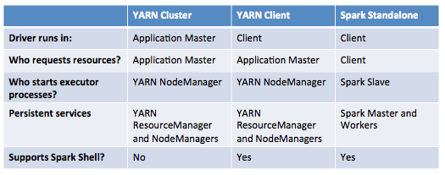
--master
Resource optimization won't be efficient in standalone mode.
In standalone mode, driver program launch an executor in every node of a cluster irrespective of data locality.

