Slide 1
Kafka

Slide 2
What is Kafka?
Kafka is a distributed message broker.
It has producer and consumer.
Producers writes data to topic in kafka and consumer consumes data from it based on topic.
Kafka, messages are written to a topic, write change event logs are maintained by topic
Kafka don't have any message ID, messages are simply addressed by their offset in the log.
Kafka doesn't maintain any indexes of messages.
consumers just specify offsets and Kafka delivers the messages in order, starting with the offset

Slide 3
More kafka features
no deletes,Kafka keeps all parts of the log for specified time,
It uses kernel level IO to stream message to consumer and not buffering message in user space
It leverages OS for file page caches and efficient writeback/writethrough disk

Slide 4
Create topics in kafka
./kafka-topics.sh --create --topic zeastest1 --zookeeper 10.6.185.142:2181 --partitions 1 --replication-factor 1
All arguments are required for creating topic
While creating topic, partition and replication factor must be defined
Replication factor is for each partition in the topic being created…it can’t be more then no. of broker.

Slide 5
List topics in kafka
./kafka-topics.sh --list --zookeeper 10.6.185.142:2181

Slide 6
List groups in kafka
/usr/hdp/2.4.2.0-258/kafka/bin/kafka-consumer-groups.sh --list --zookeeper localhost:2181
Details of group
bin/kafka-run-class.sh kafka.tools.ConsumerOffsetChecker --zookeeper localhost:2181 --group test
Every topic partition in Kafka is replicated n times, where n is the replication factor of the topic

Slide 7
Produce message using console
./kafka-console-producer.sh --topic zeastest1 --broker-list 10.6.185.142:6667
If you are getting java.nio.channels.ClosedChannelException
Change localhost to ip-address in broker-list

Slide 8
Consume message using console
./kafka-console-consumer.sh --topic zeastest1 --zookeeper 10.6.185.142:2181

Slide 9
Error faced
If some properties are not defined by default, set it using Properties(talking of java api)

Slide 10
Features
Kafka is run as a cluster on one or more servers.
The Kafka cluster stores streams of records in categories called topics.
Each record consists of a key, a value, and a timestamp.

Slide 11
--from-beginning-gets all messages on that topic from beginning, used when offset is not there in consumer

Slide 12
Distribution
Each partition has one server which acts as the "leader" and zero or more servers which act as "followers".
The leader handles all read and write requests for the partition while the followers passively replicate the leader.
If the leader fails, one of the followers will automatically become the new leader.
Each server acts as a leader for some of its partitions and a follower for others so load is well balanced within the cluster.

Slide 13
Producers
Producers publish data to the topics of their choice.
The producer is responsible for choosing which record to assign to which partition within the topic.

Slide 14
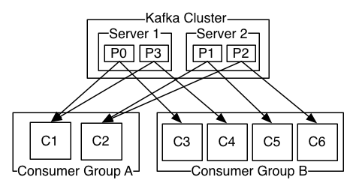
Consumers
Consumers label themselves with a consumer group name, and each record published to a topic is delivered to one consumer instance within each subscribing consumer group.
Consumer instances can be in separate processes or on separate machines.
If all the consumer instances have the same consumer group, then the records will effectively be load balanced over the consumer instances.

Slide 15
Guarantees
Messages sent by a producer to a particular topic partition will be appended in the order they are sent. -That is, if a record M1 is sent by the same producer as a record M2, and M1 is sent first, then M1 will have a lower offset than M2 and appear earlier in the log.
A consumer instance sees records in the order they are stored in the log.
For a topic with replication factor N, we will tolerate up to N-1 server failures without losing any records committed to the log.

Slide 16
Kafka as a Messaging System
Messaging traditionally has two models: queuing and publish-subscribe.
In a queue, a pool of consumers may read from a server and each record goes to one of them.
In publish-subscribe the record is broadcast to all consumers.
The consumer group concept in Kafka generalizes these two concepts
As with a queue the consumer group allows you to divide up processing over a collection of processes
As with publish-subscribe, Kafka allows you to broadcast messages to multiple consumer groups.
Kafka has stronger ordering guarantees than a traditional messaging system, too.

Slide 17
Kafka as a Storage System
Data written to Kafka is written to disk and replicated for fault-tolerance.
Kafka allows producers to wait on acknowledgement so that a write isn't considered complete until it is fully replicated and guaranteed to persist even if the server written to fails.
The disk structures Kafka uses scale well—Kafka will perform the same whether you have 50 KB or 50 TB of persistent data on the server.
you can think of Kafka as a kind of special purpose distributed filesystem dedicated to high-performance, low-latency commit log storage, replication, and propagation., As a result of taking storage seriously and allowing the clients to control their read position

Slide 18
Kafka for Stream Processing
stream processor is anything that takes continual streams of data from input topics, performs some processing on this input, and produces continual streams of data to output topics.
it uses the producer and consumer APIs for input, uses Kafka for stateful storage, and uses the same group mechanism for fault tolerance among the stream processor instances.

Slide 19
Queuing in messaging system
In a queue, a pool of consumers may read from a server and each record goes to one of them.
it allows you to divide up the processing of data over multiple consumer instances, which lets you scale your processing.
queues aren't multi-subscriber—once one process reads the data it's gone.
queue retains records in-order on the server, and if multiple consumers consume from the queue then the server hands out records in the order they are stored.
server hands out records in order, the records are delivered asynchronously to consumers, so they may arrive out of order on different consumers.
ordering of the records is lost in the presence of parallel consumption
Messaging systems often work around this by having a notion of "exclusive consumer" that allows only one process to consume from a queue, but of course this means that there is no parallelism in processing.

Slide 20
Pub-sub messaging system
In publish-subscribe the record is broadcast to all consumers.
allows you broadcast data to multiple processes, but has no way of scaling processing since every message goes to every subscriber.

Slide 21
Write file to kafka
kafka-console-producer.sh --broker-list localhost:9092 --topic my_topic < my_file.txt
This one is for 0.9 and above

Slide 22
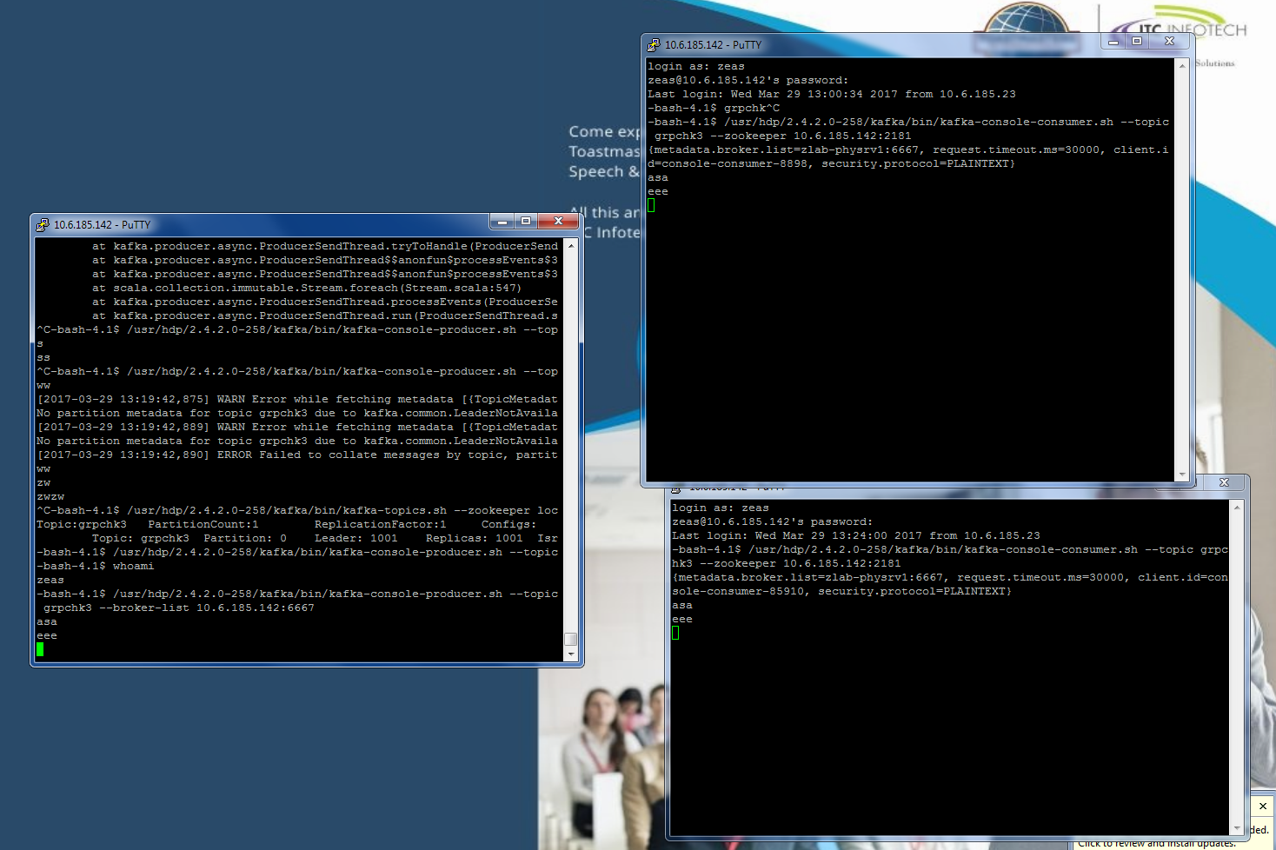

Slide 23
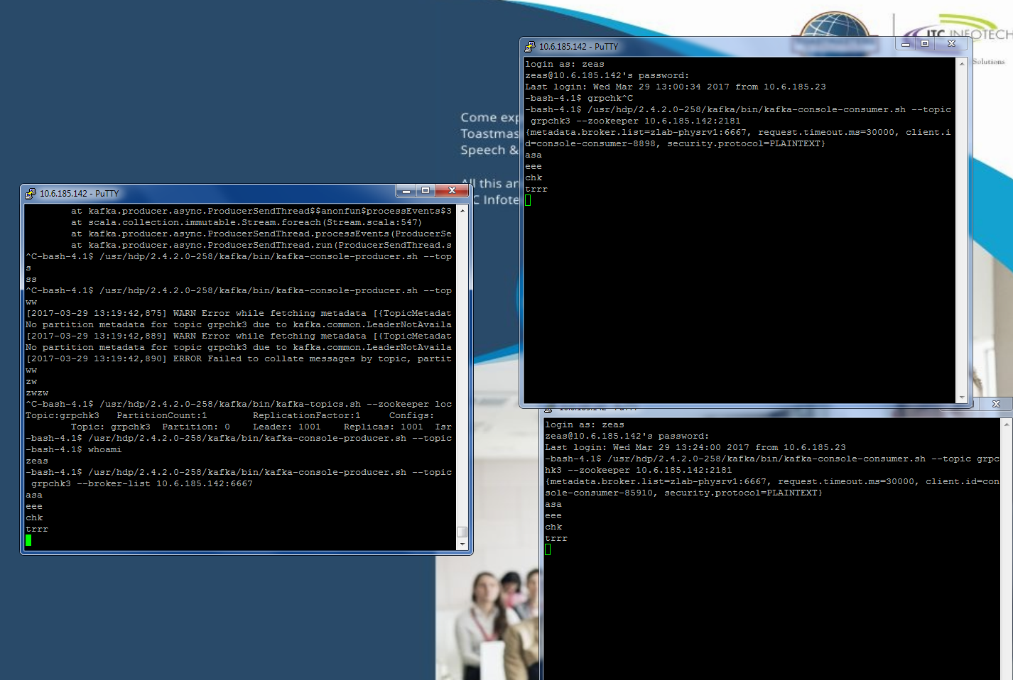

Slide 24
