Slide 1

Human Gait Analysis
Exploratory Project of
Second Year IDD.
by
Utsav Krishnan
Under the guidance of
Dr. Hari Prabhat Gupta
Department of Computer Science and Engineering
INDIAN INSTITUTE OF TECHNOLOGY (BHU) VARANASI
Varanasi 221005, India
May 2017

Slide 2
Procedure
Accelerometer is started and subject walks with phone in his/her pocket.
Subject stops and presses the button. Recorded accelerometer readings is then saved in Internal/External storage.
Subject presses button.
Recorded data is read from the storage.
Data is the then passed to the low-pass filter.
Moving average algorithm is then used to smooth time series data and remove sudden spikes.
Start
Stop
Compare

Slide 3
Procedure (Cont.)
Data is then normalized.
Local maximal points are found out in the time series data.
Points(maximal) which are less than a threshold value is discarded.
Gait cycle template is extracted.
The gait cycle template of both legs is calculate and the resemblance score is reported.

Slide 4
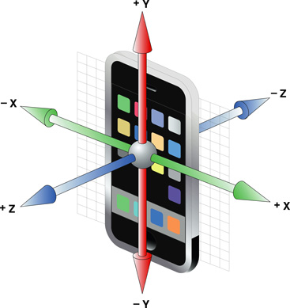
Recording Accelerometer Data
Smartphone is kept in trouser in proper orientation. As shown in the figure.
With +z axis pointing forward and -z axis passing through the legs.
-X and +X axis pointing right
and left respectively.
+Y and -Y axis pointing top and
down respectively.
Image Source:http://stackoverflow.com/questions/11175599/how-to-measure-the-tilt-of-the-phone-in-xy-plane-using-accelerometer-in-android

Slide 5
Cont..
In this orientation both Y-axis and Z-axis reading can be used for effective time series analysis.
Z-axis is used here for further analysis.
Z & Y axis give reading of same orientation where as X axis reading are mirror image of each other.

Slide 6
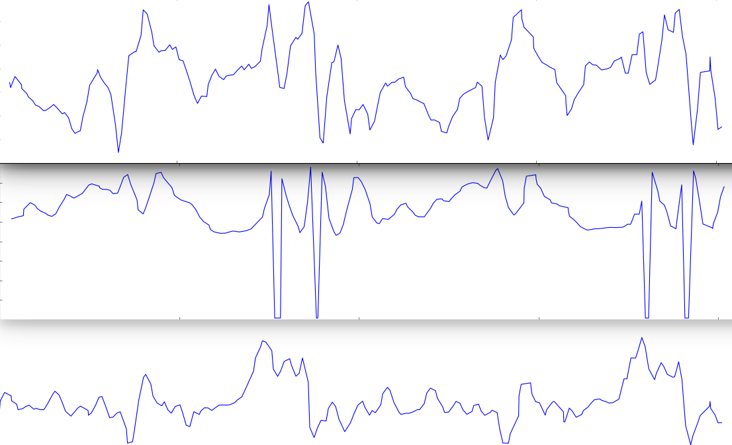
X Y Z axis raw readings
Figure image here…….
X-axis
Y-axis
Z-axis

Slide 7
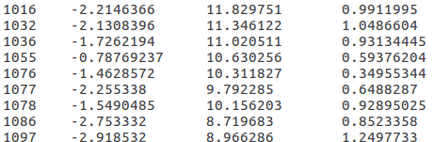
Data Logging
Either internal or external storage option can be used for logging accelerometer data.
Recorded data is saved in txt format.
This app can also be used as standalone accelerometer data logger.
First column: “time” in milli’s.
2nd,3rd,4th column are X,Y,Z axis reading respectively.
SENSOR_DELAY_FASTEST is used for recording accelerometer data.
Storage Location:
sdcard/AcceleroData/*

Slide 8

Low-pass filter
Holt exponential smoother is used^{[1].}
This filter removes the high frequency element from the time series data and its extent is set by the value of alpha i.e., the weight given to the previous data point.
1.http://folk.uib.no/ngbnk/kurs/notes/node107.html
ImageSource:https://en.wikipedia.org/wiki/Low-pass_filter

Slide 9
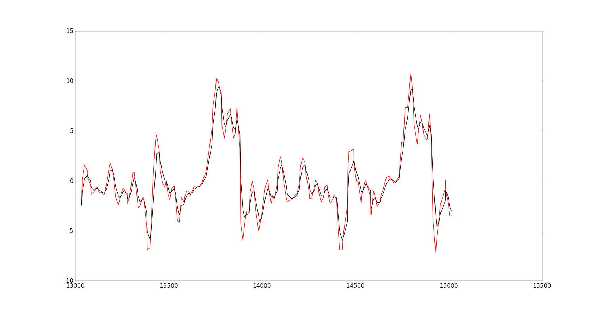
Low-pass filtered data.
Red: raw data
Black: LP filtered
`
Fig: Low-pass filtered Z-axis data with alpha=0.5

Slide 10

Moving Average
A smoothing technique used for time series analysis.
The average over q data is set as the value of the median element.
Here equal weight is given to every element over summation.
ImageSource:http://folk.uib.no/ngbnk/kurs/notes/img342.gif

Slide 11
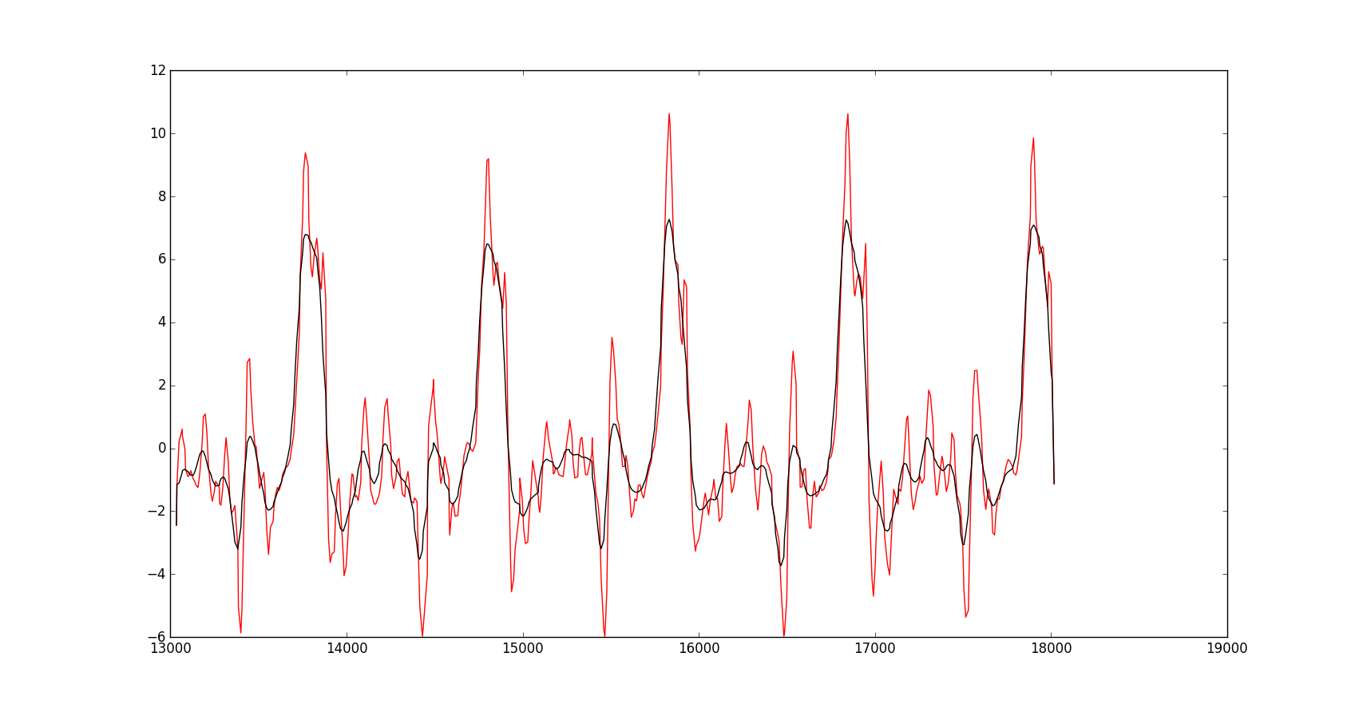
Moving Averaged data
Red:LP filtered data
Black:Moving Averaged
Fig: Moving average applied on LP filtered data. Window size=5, with moving average applied three times.

Slide 12
Normalization
y[i] = (x[i] - min) / (max – min)^{[1].}
Where y’s are the normalized data and x’s are the data to be normalized.
Helps in calculating Average Gait Cycle effectively.
1.http://machinelearningmastery.com/normalize-standardize-time-series-data-python/

Slide 13
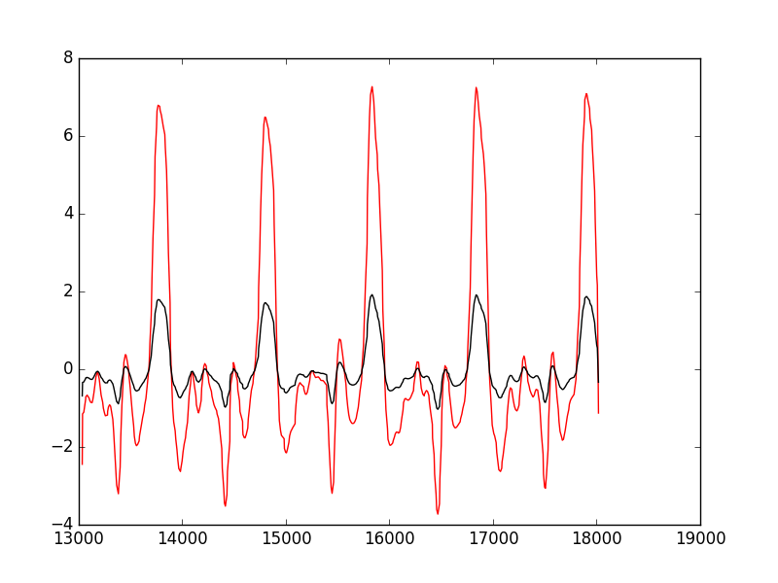
Normalized Data
Fig: Normalized data after being passed through moving average filter.

Slide 14
Maximal Points
First local maximal points are extracted. Points which are greater than its previous and next value.
Among these, points which has value[i] < threshold is discarded.
The threshold is calculated with th=mean+sd*k; the value of k is tuned according to the data set.

Slide 15
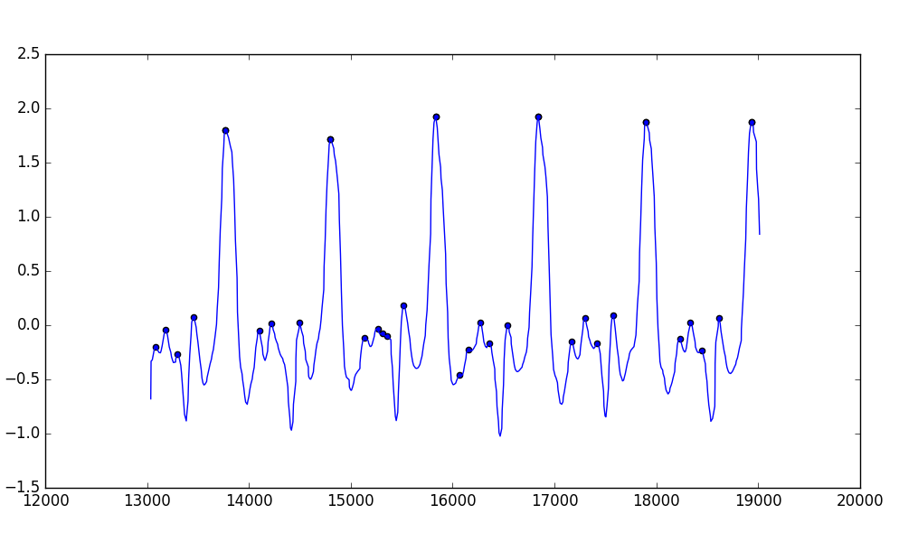
Local Maximal Points
Fig: Extracted local maximal points

Slide 16
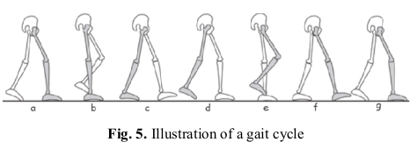
Gait Cycle
The picture clearly explains the gait cycle.
As walking is a periodic motion, each period/cycle is called gait cycle.
ImageSource:http://web.engr.oregonstate.edu/~hoangmin/pub/c/2012_ICCAIS.pdf

Slide 17
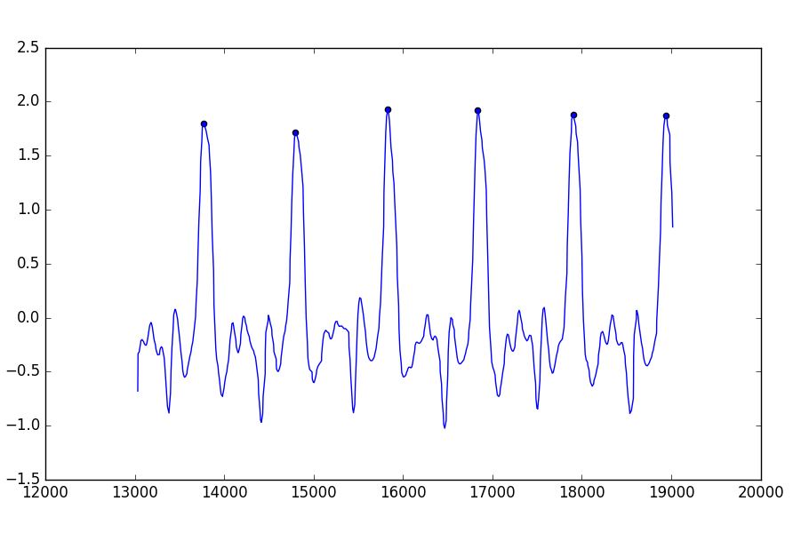
Gait Cycle Points
One Complete gait cycle
Figure: These consecutive points represent the start and end of single gait cycle.

Slide 18

Average Gait Cycle
AGC ^{[1]}.
Gait cycle which has maximum resemblance to other gait cycle of same time series data is called average gait cycle.
This resemblance is calculated using Dynamic Time Wrapping(DWT).
[1].http://web.engr.oregonstate.edu/~hoangmin/pub/c/2012_ICCAIS.pdf

Slide 19
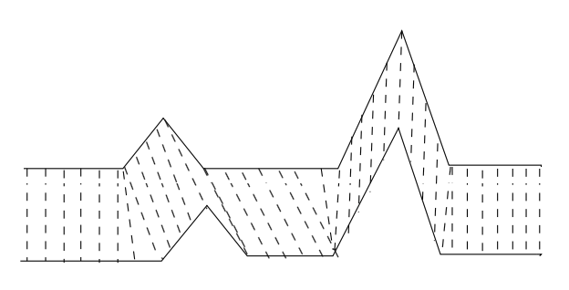
Dynamic Time Wrapping
Used for measuring similarity between two time series data.
Advantage, we don’t have to normalize the length of each gait cycle.
We use this to calculate AGC.
ImageSource:https://en.wikipedia.org/wiki/Dynamic_time_warping#/
media/File:Dynamic_time_warping.png

Slide 20
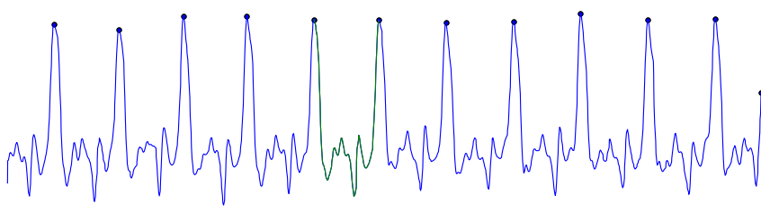
Average Gait Cycle^{[1]}
LEFT
Fig: Average gait cycle calculated for the LEFT leg as shown enclosed
in dash-dotted rectangular box.
[1http://web.engr.oregonstate.edu/~hoangmin/pub/c/2012_ICCAIS.pdf]

Slide 21
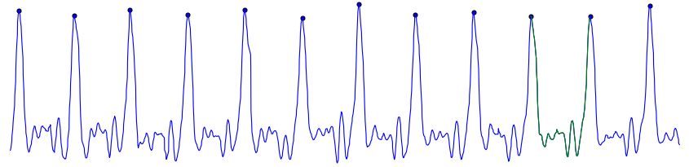
Average Gait Cycle
RIGHT
Fig: Average gait cycle calculated for the RIGHT leg as shown enclosed
in dash-dotted rectangular box.

Slide 22
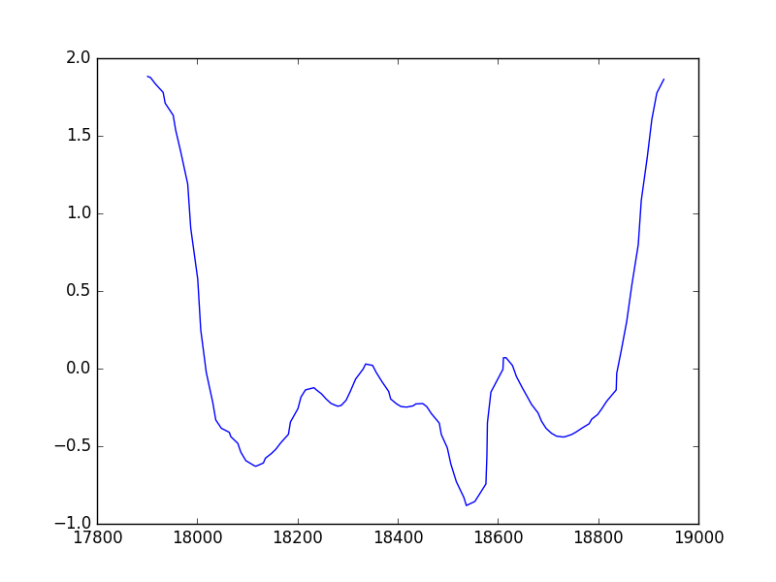
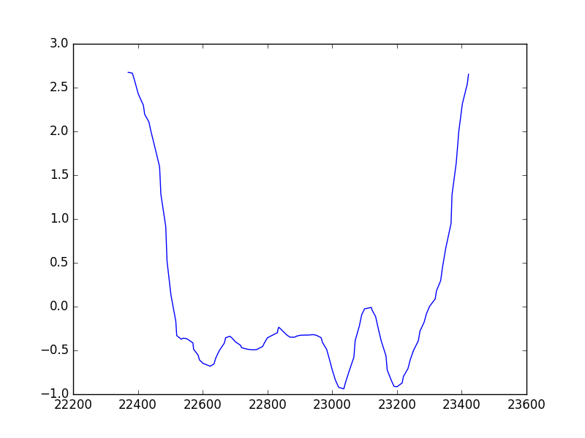
Extracted Gait Template
Left Leg
Right Leg

Slide 23
Result
The distance(dtw) for each gait cycle template is reported which shows the inverse magnitude of similarity between walking pattern between of each legs.

Slide 24
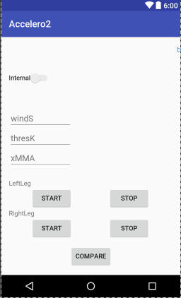
Android App
Android app for portable gait analysis.
Internal for storage if external storage is not supported, data log directory.
WindS → window_size(moving average).
ThresK → threshold for extracting gait cycle points.
xMMA → No. of times to run moving average.
Compare → Final button to get resemblance score.

Slide 25
Note...
The image consisting of time series data was recorded by me using android phone.
The method was first tested on computer in python, then it was implemented on android-app.
Python’s Matplotlib library was used to plot time series data used in this presentation.
Link to android app: Github link

Slide 26
Thank You!
End of slide

