Slide 1


𝐌𝐨𝐦 & 𝐏𝐨𝐩 𝐂𝐚𝐟é
Suggesting ElastiCache & Elastic Load Balancer
Ketan Narayan Kshirsagar
AWS Cloud Solutions Architect

Slide 2

Agenda
Introduction
ElastiCache
Benefits of Caching Data
Impact of Load on Web Applications
Elastic Load Balancer
Features & Benefits of Load Balancing
Importance of Multiple Availability Zones
Importance of Application Load Balancer
Monitoring Load Balancer Effectiveness
Load Balancing Vs Automatic Scaling
Cost and Potential Savings
Conclusion

Slide 3



Introduction
Mom & Pop Café is local coffee chain specializes in fresh roasted coffee beans.
Expanding business and making it available online.
Benefits of two AWS services to achieve Business Motto
1. ElastiCache
2. Elastic Load Balancing

Slide 4

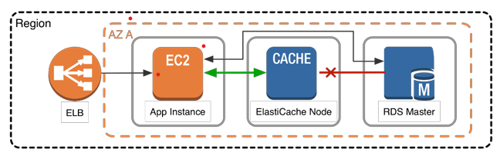

ElastiCache
ElastiCache is a web service that makes it easy to deploy and operate an in-memory cache in the cloud.

Slide 5




Benefits of Caching Data
Faster response time for users
Reduced load on the backend systems
Cost savings by reducing the number of database requests
Increased scalability

Slide 6
Impact of Load on Performance of Web Application
Load of websites increases with number of users accessing website increases
Slower in response
Increased downtime
Excessive Network Traffic

Slide 7
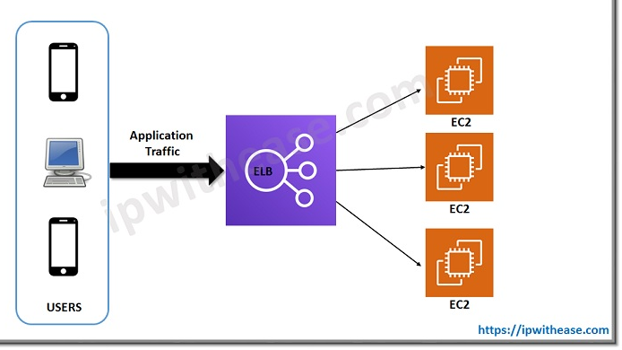
Elastic Load Balancer
Elastic Load Balancing distributes incoming traffic across multiple targets, such as EC2 instances, containers, and IP addresses.

Slide 8

Features & Benefits of Load Balancing
High Availability
Improved Scalability
Fault tolerant
Reduced response time
Increased security

Slide 9
Importance of Multiple Availability Zones
Ensuring of Traffic Distribution across multiple data centers
Improves availability and performance across region
Fault tolerant

Slide 10
Importance of Application Load Balancer
Routes traffic of website based on content
Better control over traffic flow
More flexibility in traffic routing i.e., path, host and containerized applications

Slide 11
Monitoring Load Balancer Effectiveness
Services used for monitoring load balancer effectiveness of Load Balancer
1. CloudWatch – Real-time monitoring
2. ELB Metrics – Health of the load balancer and troubleshooting issues

Slide 12


Load Balancing
Automatic
Scaling
Working together to improve the performance and availability of web applications.
Load balancing distributes traffic across multiple targets, while automatic scaling modifies targets based on demand.
Load balancing ensures that traffic is distributed evenly, while automatic scaling ensures that the application can handle the additional load.

Slide 13

Cost and Potential Savings
Cost depends on the size and usage of the application.
Result in cost saving by reducing load on the database
Benefits Café by increasing revenue, scaling services globally, and improving customer experience

Slide 14



Conclusion
• ElastiCache and ELB are cost-effective ways to improve the reliability & availability of Mom & Pop Café's web application during holiday seasons.
• ElastiCache caches frequently accessed data, reducing the load on the database & improving the performance of the application.
• ELB distributes traffic across multiple targets & automatically scales to meet the demand, improving the availability & reliability of the application.
• By using these services, Mom & Pop Café can scale their services globally, improve customer experience, and increase revenue.

Slide 15

Thank You

