Slide 1
Final Project – Boston Day Care
Ketan Malik NUID - 001378783

Slide 2
Description
Add, View, Update and Delete students enrolled in daycare
Add, View, Update and Delete teachers enrolled in daycare
View Immunization and Administrative due dates
Ability to send reminders for particular due dates

Slide 3
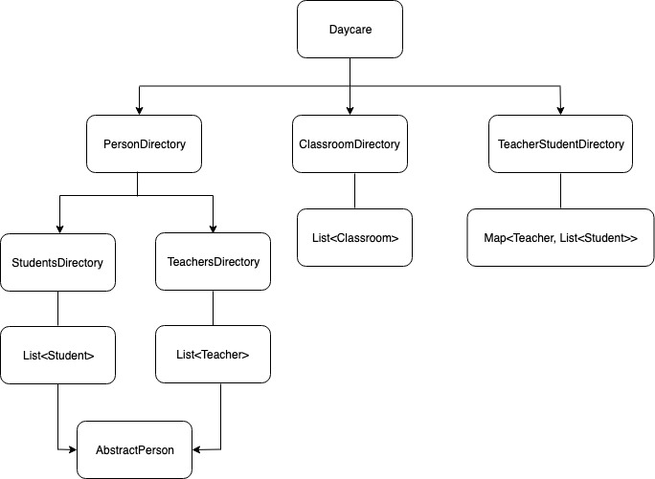
Structure

Slide 4
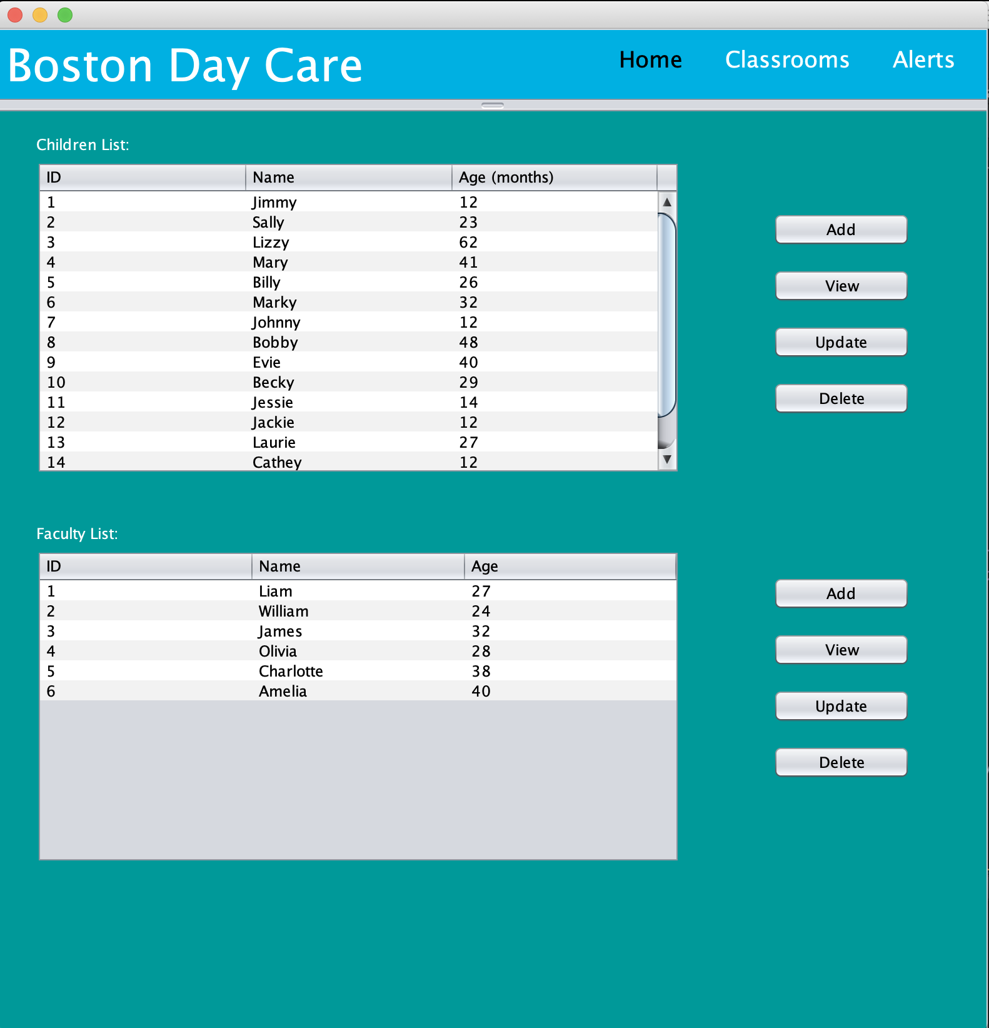
Home Page

Slide 5
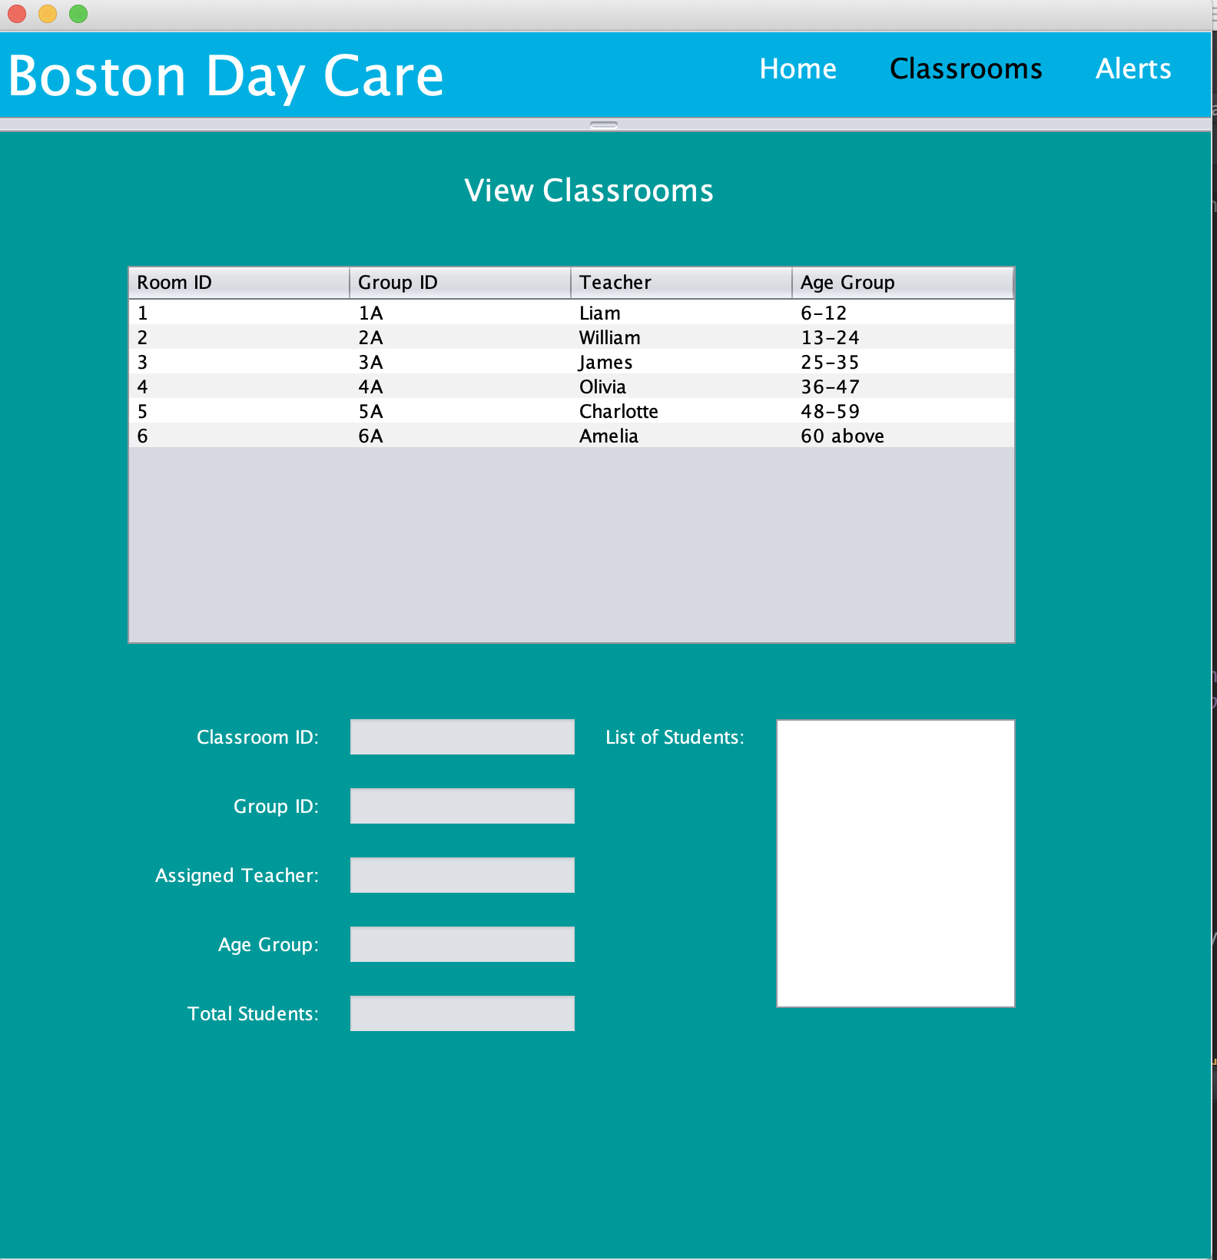
Classroom

Slide 6
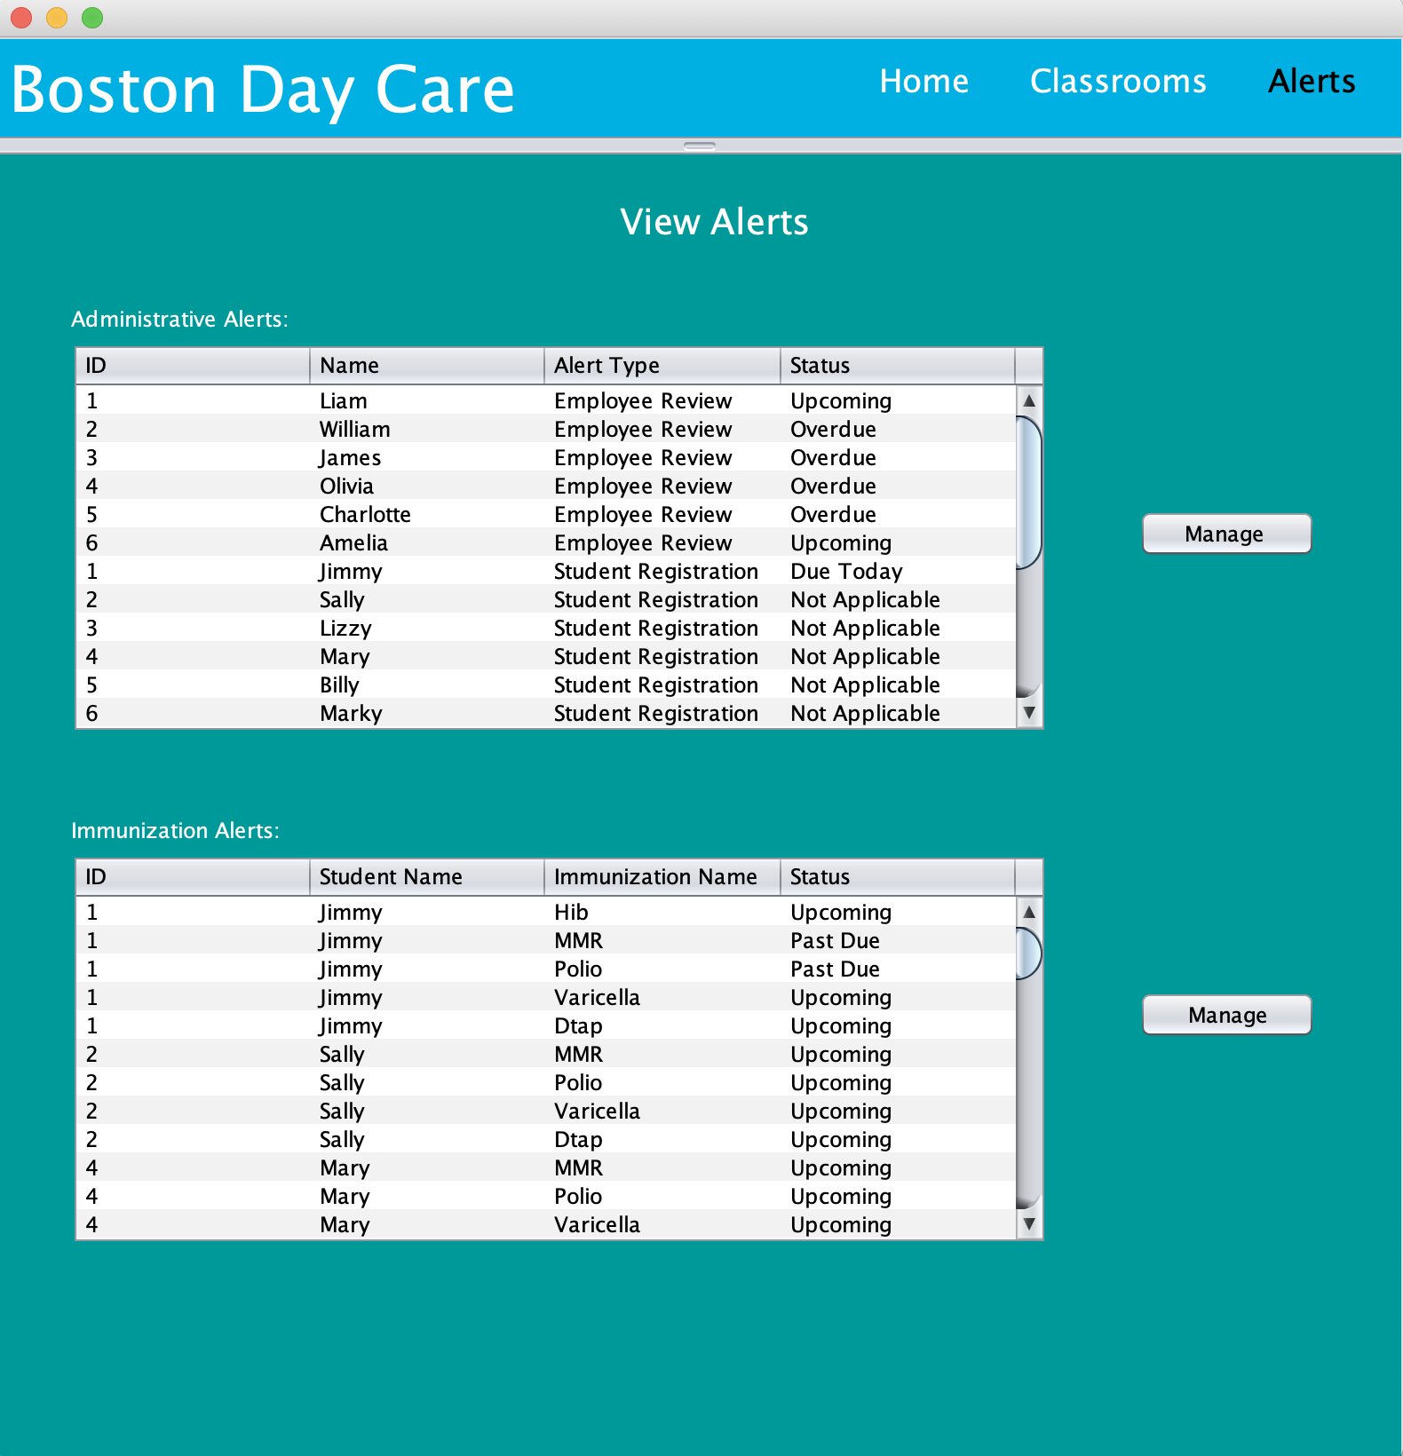
Alerts

Slide 7
Thank You

