Slide 1
Microsoft Bot Framework V4 Assignment

Slide 2
Agenda
Microsoft Bot framework V4 concept
Architecture
Services involved
Usecase
Chat screenshots

Slide 3
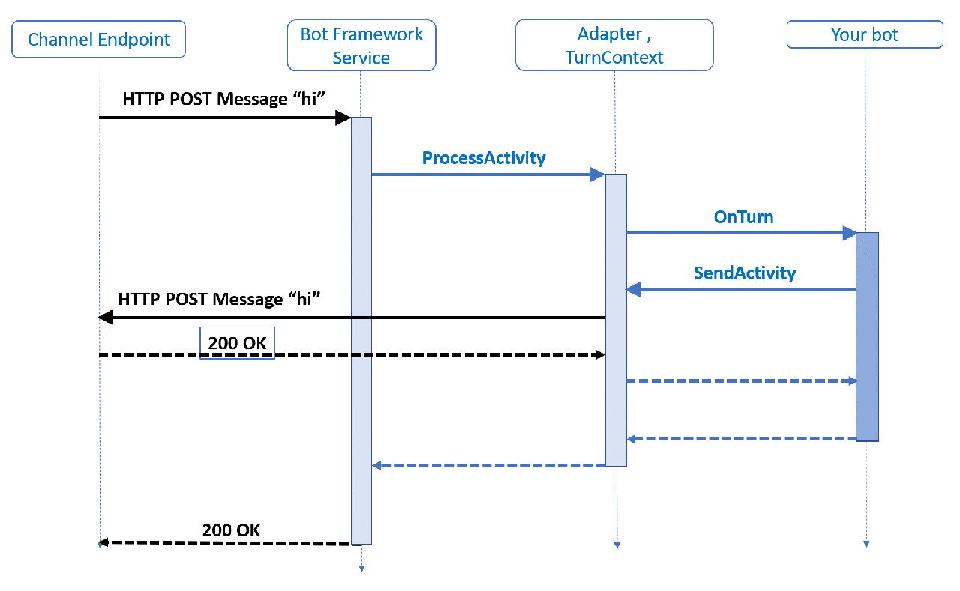
Microsoft Bot framework V4 concept

Slide 4
Architecture
LUIS
Bing Spell Check
Spell correction
Intent recognition
Microsoft Bot Framework
User interface
utterances
CosmosDB
Logging data
Analytics
Application Insight

Slide 5
Services Involved
Microsoft Bot Framework
Microsoft LUIS
Microsoft Bing Spell Check
Microsoft Application Insight

Slide 6
Usecase
Users can use bot to book cab. This bot can be used either by providing the utterances or clicking on the “Book a cab” button.
User can type following utterance to invoke the bot “Book a cab”

Slide 7
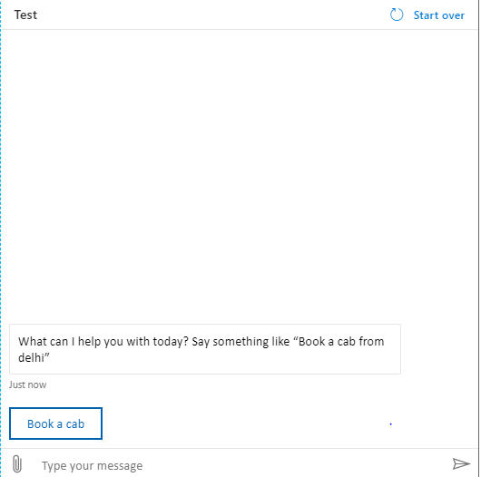
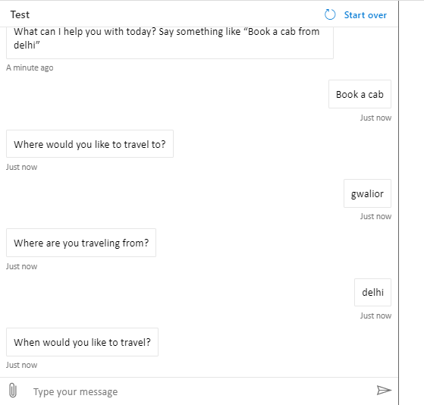
Screenshots
Screen:-2
Screen:-1

Slide 8
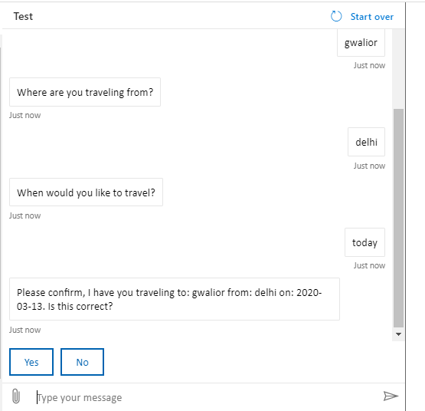
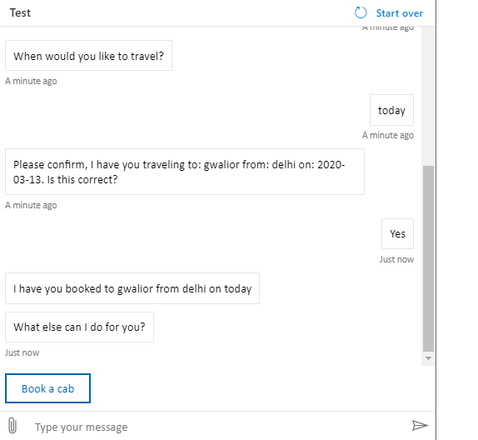
Screenshots
Screen:-3
Screen:-4

Slide 9
THANK YOU

