Slide 1
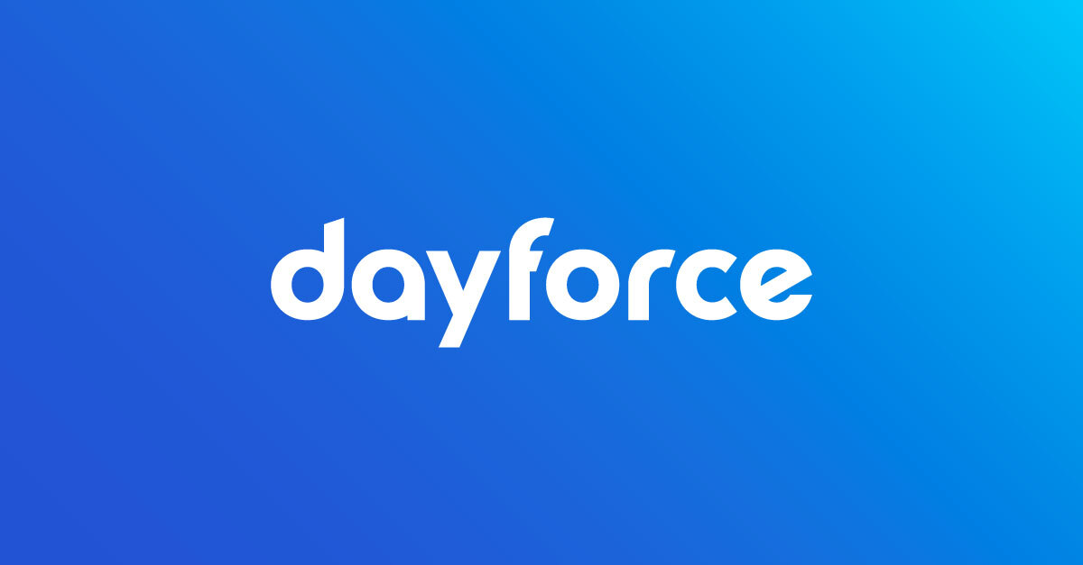




Dayflow
DAYFORCE AI INNOVATION CHALLENGE | TIME AND ATTENDANCE
A timecard exception resolution agent
The LLM proposes. The engine verifies. A human approves.
THE PROBLEM
Every pay period, timecards break: missed punches, overtime nobody saw coming, schedule clashes. Managers fix them by hand, and one miss means wrong pay.
USER VALUE
Managers review a sorted queue, not 155 alerts.
TEAM
Praveen Raj S
Reddymasi Manasa
Harshitha S
Mohammed Raqheebuddin
Ketan Ram Amara
Employees confirm a fix in one tap.
Payroll gets fixes proven by the pay engine.
Figures are from synthetic data. Simplified mock policy, not legal advice.
Notes:
Dayflow is a timecard exception resolution agent for the Time and Attendance track. Every pay period, timecards break in the same few ways: missed punches, overtime nobody saw coming, and schedule clashes. Managers fix them by hand, and one miss means wrong pay. Dayflow gives managers a sorted queue, lets employees confirm a fix in one tap, and gives payroll fixes that the pay engine has already proven. The whole project rests on one sentence: the LLM proposes, the engine verifies, and a human approves. All figures come from synthetic data and a simplified mock policy, not legal advice.

Slide 2



From messy timecard to approved fix
1
Code
2
AI
3
Engine
4
Employee
5
Manager
Detect
Propose
Prove
Confirm
Approve
Rules find missed punches, overtime risk, schedule clashes and policy breaches.
The AI reads the employee's note and quotes the exact sentence it used.
The pay engine re-computes pay with the fix before anyone sees it.
The employee answers in one tap: yes, no, or the right time.
A manager approves; every action goes into a hash-chained audit log.
WHERE EACH CARD GOES
30 employees | 2 pay periods | 60 timecards | 155 planted problems | 3 roles
Ready
Waiting on employee
Needs judgment
Engine-checked fix; nobody's hours change (duplicates removed, meal premium paid, approved extra shift paid).
The fix changes worked time, so the employee confirms the exact proposal, or gives the right time, in one tap.
Outside what a timecard edit can fix (sick leave to record in HR), or the note looked like an instruction to the system.
Live demo: Run agent > Alex confirms 17:50 > Taylor approves > Audit Ledger
Synthetic data. Simplified mock policy, not legal advice.
Notes:
This is the path every exception takes. Code detects the problem, the AI reads the employee's note and quotes the exact sentence it used, and the pay engine re-computes pay with the fix before anyone sees it. The employee confirms in one tap, then a manager approves, and every action lands in a hash-chained audit log. Each card then lands in one of three lanes: ready when the engine-checked fix changes nobody's hours, waiting on the employee when the fix changes worked time, and needs judgment when it is outside what a timecard edit can fix or the note looked like an instruction. The dataset is 30 synthetic employees over two pay periods, with 60 timecards and 155 planted problems. The same backend also covers GeoPulse (geofenced attendance), ZenBreak (breaks), SyncShield (offline sync), RotaFlow (shifts and swaps), LeaveSync (leave), TaskForge (tasks), Overtime forecast and Policy Studio. The recorded demo shows: run the agent, Alex confirms 17:50, Taylor approves, then the Audit Ledger.

Slide 3









AI proposes, code verifies, people decide
Web app
API
Agent harness
Pay engine
React, role-based screens for manager, approver and employee.
FastAPI, cookie session, CSRF, same-origin checks.
Plan, simulate, repair; open-weight Qwen3 through Ollama.
Deterministic, cites a policy clause for every pay line.
SQLite: immutable records, hash-chained audit ledger, recorded model answers for repeatable demos
HARNESS DESIGN
Signed rules
Grounded output
Verify, then repair
Untrusted notes
Twelve executable rules map to policy clauses; AI drafts need a verbatim quote, and a human signs the exact hash.
The AI must quote the note sentence that contains the time; ids and fix kinds are whitelisted in code.
The engine simulates every fix; a failure goes back to the model once, then deterministic rules take over.
Notes that give instructions never reach the model; every number in an AI answer must match the engine trace.
Notes:
The AI never computes money and never writes to the database. Reading free-text notes and drafting policy rules are its only jobs. Everything else is code: the pay engine is deterministic and cites a policy clause for every pay line, the API enforces session, CSRF and same-origin checks, and the web app only displays engine output. The model is open-weight Qwen3 under Apache-2.0, runs locally through Ollama, and the same code also works with any OpenAI-compatible endpoint. A reviewer can switch the AI on or off at runtime, and that switch is audited. The four harness rules are signed rules, grounded output, verify then repair, and treating notes as untrusted input.

Slide 4


Measured against known answers, not claimed
155 / 155
0
planted problems found, no false alarms
invented or wrong times committed
2 / 2
240
hostile notes routed to a manager
automated tests (215 backend, 25 web)
Refused, not shown: when the model got a time wrong, code refused it. 5 fallbacks to the rules plan, 0 bad answers shown.
Other languages: rules cannot read Spanish, French or Portuguese notes; the small model gets 7 of 10 right (ES 2/3, FR 3/5, PT 2/2).
Gates passed: self-approval blocked 10/10, unsafe fix rejected 1/1, injection patterns blocked 13/13, benign notes accepted 8/8
Synthetic data, seed 42 plus a held-out seed. Scores come from the committed run with open-weight qwen3:1.7b. Simplified mock policy, not legal advice.
Notes:
Every score here is measured against labelled answers, not claimed. On 60 timecards with 155 planted problems, the agent found all 155 with no false alarms and committed zero invented or wrong times. The chart compares rules only with rules plus AI; the biggest gain is on note-dependent items, which go from 32.1 to 89.3 percent. When the small model got a time wrong, code refused the answer and fell back to the rules plan: 5 fallbacks, 0 bad answers shown. Many notes are in Spanish, French or Portuguese, which rules cannot read; the small model gets 7 of 10 right, and the time must still appear word for word in the note. The data is synthetic, and scores come from the committed run with the small open-weight qwen3:1.7b model, so larger models are future work.

Slide 5
Expected impact, and what comes next
EXPECTED BUSINESS IMPACT
FUTURE IMPROVEMENTS
96%
less manager review time (620 min by hand, 25 min with the agent*)
1
Pilot on real Dayforce data
Through the Dayforce API
2
Time zones and multi-site rules
$177
overtime avoided for one person in one week, found before it happened
For global workforces
3
Rest-between-shifts rules
And a compliance rule pack
4
Geofenced punches as evidence
100%
of committed fixes proven by the pay engine and written to the audit log
For missing-punch fixes
5
Larger-model evaluation
And per-customer signed policy
*Estimate: 4 minutes per exception by hand, 0.5 minutes per agent plan; synthetic data. Simplified mock policy, not legal advice.
ALREADY BUILT ON THE SAME BACKEND
GeoPulse
geofenced check-in
ZenBreak
breaks and net time
SyncShield
offline sync
RotaFlow
shifts and swaps
LeaveSync
leave with checks
TaskForge
tasks
Overtime forecast
live week, engine-priced
Policy what-if
plain English to dollars
Notes:
The business case rests on three numbers. Manager review time drops 96 percent, from an estimated 620 minutes by hand to 25 with the agent, and that is an estimate on synthetic data based on 4 minutes per exception by hand and 0.5 minutes per agent plan. One person's overtime of $177 was avoided in one week because it was found before it happened. Every committed fix is proven by the pay engine and written to the audit log. The bottom row shows what already runs on the same backend, including geofenced check-in, breaks, offline sync, shifts and swaps, leave, tasks, a live-week overtime forecast and a what-if policy assistant. Next steps are a pilot on real Dayforce data, time zones and multi-site rules, rest-between-shifts rules, geofenced punches as evidence, and larger-model evaluation with per-customer signed policy. Employees record their day, the agent fixes what is wrong, an engine proves it, and a person approves.

