Slide 1
Emerging Trends in Software Security Assurance (SSA)
CSI-SIGSE
WORKSHOP ON SOFTWARE ENGINEERING
Presenter: Ketan Vyas
The views and opinions expressed during this workshop are those of the speaker alone and do not necessarily reflect the positions or opinions of employer or employer affiliates.
Notes:
My association with

Slide 2
Agenda
Generic Trends & Security
SSA Trends
Q & A

Slide 3
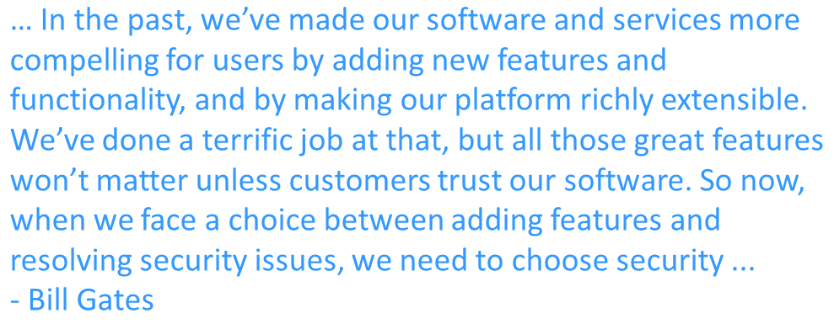
Generic Trends & Security

Slide 4




Business Trends & Security
Seven Times Less Expensive To Keep A Customer Than To Acquire One
90% of unhappy customers will not do business with company again
Consumers connect with brands in new ways, through channels that are beyond provider’s control
Average global cost of a data breach is $136 a record in 2012
Security is a trust building factor in business,
are your applications and services secure?
Notes:
http://www.forbes.com/sites/tjmccue/2013/02/04/warning-is-your-new-customer-coming-back-4-steps-you-should-take-now/
http://www.peopleclaim.com/Default_AB.aspx#the-review-of-reviews
http://blogs.hbr.org/cs/2012/08/marketing_is_dead.html

Slide 5

Technology Trends & Security
Processing speed
Connectivity
Storage
Peripherals
Interfaces
Technologies enabling Cloud model
Internet of things (IoT)
Data and Functionality access - anytime, anywhere with any device,
Is it secure?
Notes:
Talk about attack surface

Slide 6
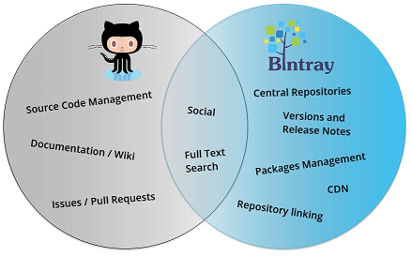




Development Trends & Security
API driven development
Client (mobile) - Server (cloud) model is back
Distributed development
Intuitive User Interfaces
“Do It Yourself” libraries
Niche Social Networks
Open source
Agile
It is App World, are development, testing and production environments and applications secure?

Slide 7
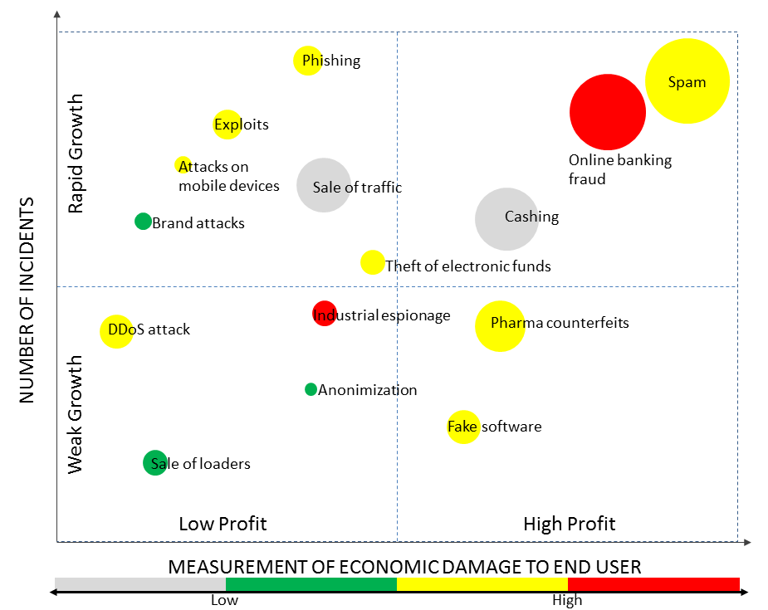
Security Incidents
Website defacement
Denial of service
Data breach
Malware distribution
Financial fraud
Privilege misuse
Privacy Breach
Intellectual property theft
…
Majority Incidents happen due to security defects in software
Image Source: http://www.infosecisland.com/blogview/21113-Russian-Cybercrime-Not-Just-a-Localized-Threat.html

Slide 8
Why Incidents Occur?
Original URL
www.example.com/HealthRecord.php/201303/user1
Predicted URL
www.example.com/HealthRecord.php/201304/user2
Root Cause: Bad Access Control & URL Formation Design
Intended
Cookie: lang=en-us; ADMIN=no; y=1 ; time=10:30GMT ;
Attacker
Cookie: lang=en-us; ADMIN=yes; y=1 ; time=10:30GMT ;
Root Cause: Bad Session Management

Slide 9
Demo

Slide 10
Section Summary
Trends demand better security
Security incidents happen due to defects in software (Note: Incidents also happen due to process failure or human errors)
Next section will show how you can prevent defects in software

Slide 11
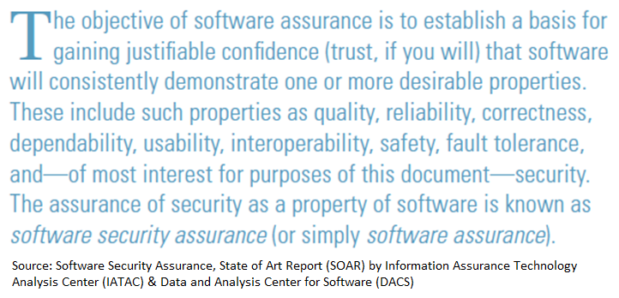
SSA Trends

Slide 12
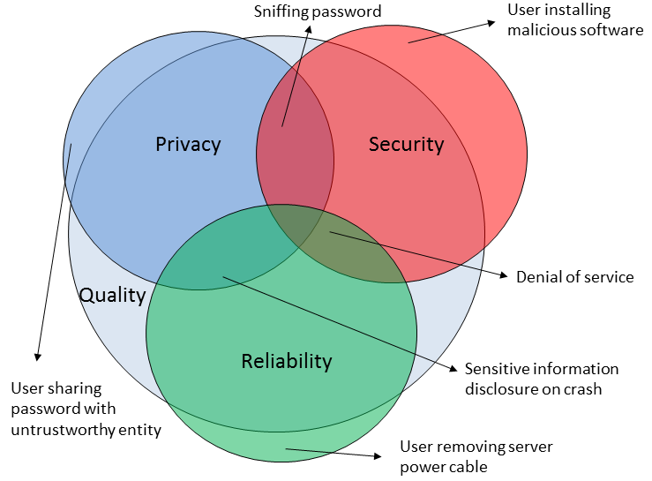
Software Security Assurance
It is a proactive way of designing, developing and operating application software to reduce/prevent security incidents and minimize risks to an organization
Risks may include legal/regulatory non compliance, financial loss, data breach, impact on customer trust and brand reputation and so on.
SSA is implemented by integrating security, privacy and reliability throughout delivery life cycle

Slide 13
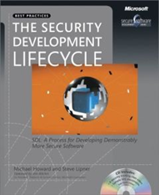

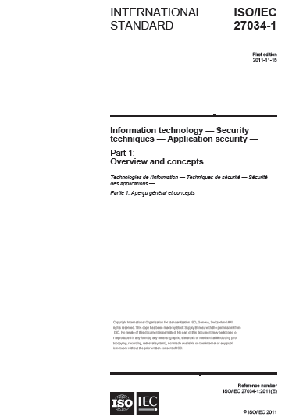
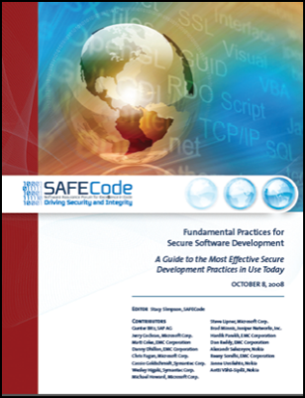
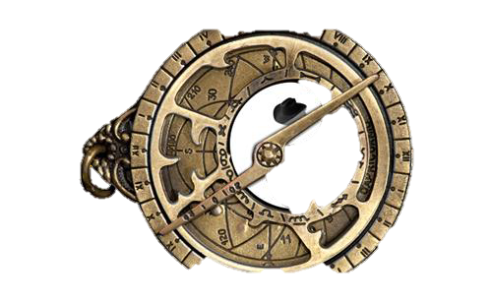
Security Development Lifecycle
Current Trends
Emerging Trends
Integrating Security in SDLC
Security Maturity Model
Microsoft SDL
Optimization Model
OWASP
SAMM
BSIMM

Slide 14

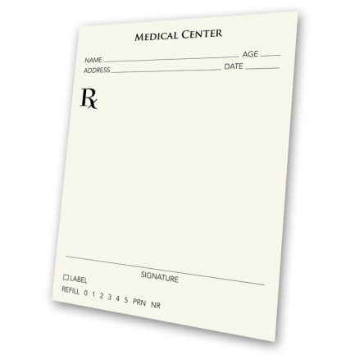
Developer Guidance
Current Trends
Emerging Trends
Descriptive
Prescriptive
Compile code using suitable flags for security
Use /GS compiler flag in Visual Studio
All changes to firewall configuration shall be logged
Timestamp and user who did the last modification to the configuration must be logged and verification shall be done using ‘show version’ command

Slide 15



Tools & Professional Services
Current Trends
Emerging Trends
Static Application Security Testing (SAST)
Interactive Application Security Testing (IAST)
Dynamic Application Security Testing (DAST)
Username
********

Slide 16



Benchmarks
Current Trends
Emerging Trends
Top n Practices
Certification
OWASP
ASVS
ISO
27034
Series
(WIP)
OWASP Top 10
CWE Top 25

Slide 17
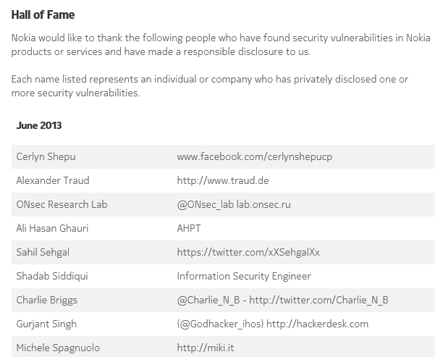
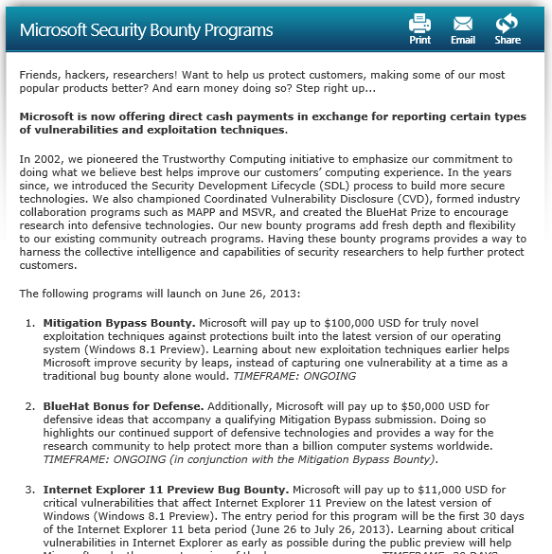
Incentives & Reward Programs
Current Trends
Emerging Trends
Appreciation
Appreciation + Money

Slide 18
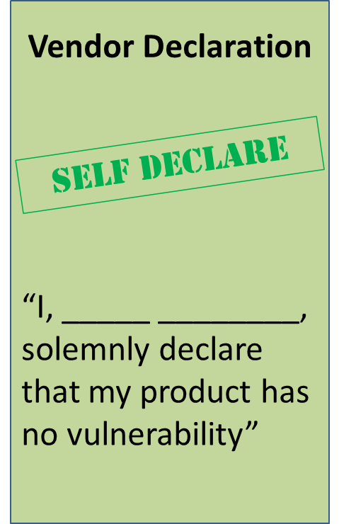
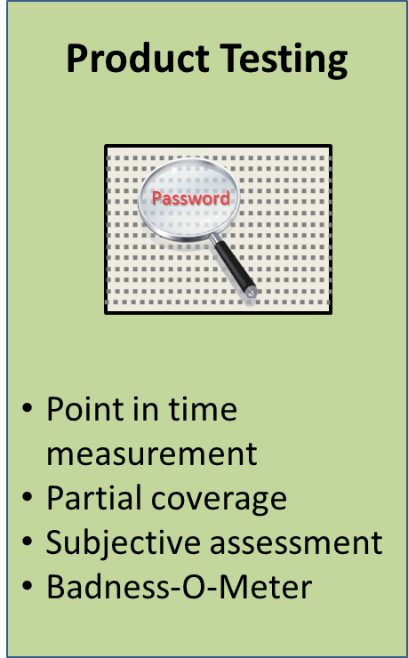
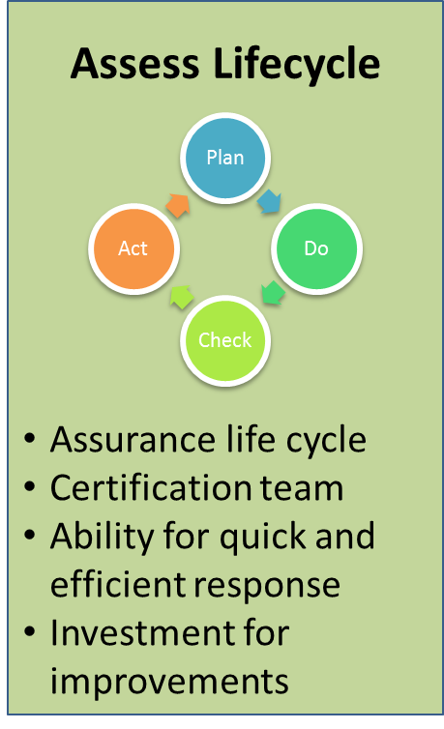
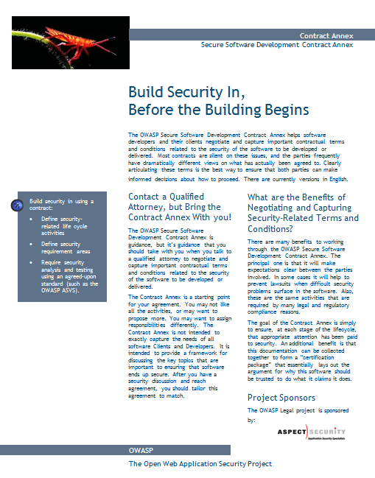
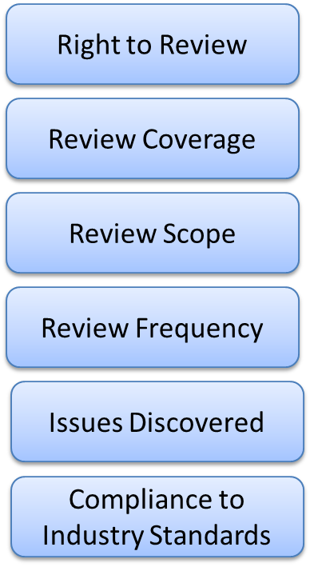
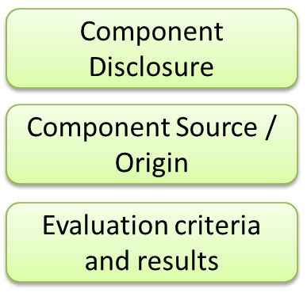
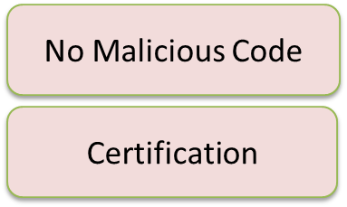
Outsourcing
Current Trends
Emerging Trends
Due Diligence
SSA in Contracts

Slide 19
Role based Education
Free
Online webinars
Tool training from vendors
Expert lectures
Paid
Conferences like CSI, blackhat, HITB
Workshops (Corporate, Professional services
Free Training Material
OWASP Tutorial Videos
Microsoft SDL videos and presentations
SecurityTube.net
Webgoat type applications
Security conference presentations / video
OWASP Podcast, Cigital silver-bullet podcast

Slide 20






Open Source / Freeware Tool Usage

Slide 21
Good Balance
Fault Removal
Fault Prevention
Source Code Security Analysis
Security Testing
VA/PT
Auditing Host
ACL & Configurations Review
Periodic Assessment
Education
Security Requirements
Threat Model
Code Generation
Reuse
Periodic Audits & Reconciliation

Slide 22
Section Summary
SSA is a proactive security management; implemented by integrating security, privacy and reliability throughout delivery life cycle
Emerging trend is to allocate more budget on application security than infrastructure security
IAST is a promising technology over SAST and DAST. Cost, accuracy and license models are major driving factors for buying decision
Bug Bounty programs are emerging as a win-win model for researchers and vendors
Outsourcing decision makers are mandating SSA into Contracts

Slide 23
Q & A

Slide 24
Thank you

