Slide 1

Data Privacy & Data Protection
Ketan Vyas
DSCI Ahmedabad Chapter
Feb 11, 2012
AMA

Slide 2
Privacy & Data Privacy
Privacy is the ability of an individual or group to seclude themselves or information about themselves and thereby reveal themselves selectively
Data privacy is the relationship between collection and dissemination of data, technology, the public expectation of privacy, and the legal and political issues surrounding them
Source: Wikipedia

Slide 3
Data Privacy Day
An annual (28th January) international celebration designed to promote awareness about privacy and education about best privacy practices
Promotes awareness around how personal information is collected, stored, used, and shared
Educates individuals to protect their personal information through privacy best practices
Players: Consumers, Citizens, Private & Public Sector Companies, Governments, Privacy Promoting Bodies like DSCI, you and me

Slide 4
Data Privacy & Data Protection
Speakers
Mr. Nitin Bawsay, General Manager & Executive Vice President, Sales-Priya Softweb Solutions
Ms. Rakhi Jindal, Associate at Nishith Desai Associates
Mr. Pankaj Patel, Deputy General Manager – IT, Vodafone India Services
Mr. Vishal Vasu, Director- Dev Information Technology Pvt. Ltd

Slide 5
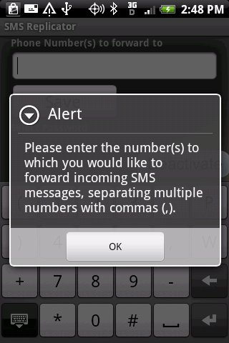
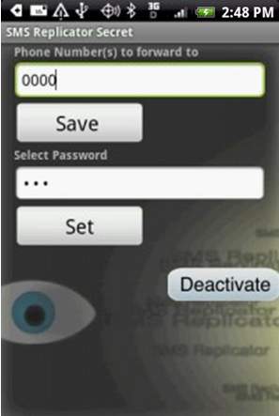
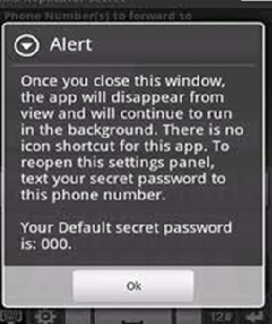
Data Protection in the Mobile World
Secret SMS Replicator (http://www.dlpmobile.com/)

Slide 6
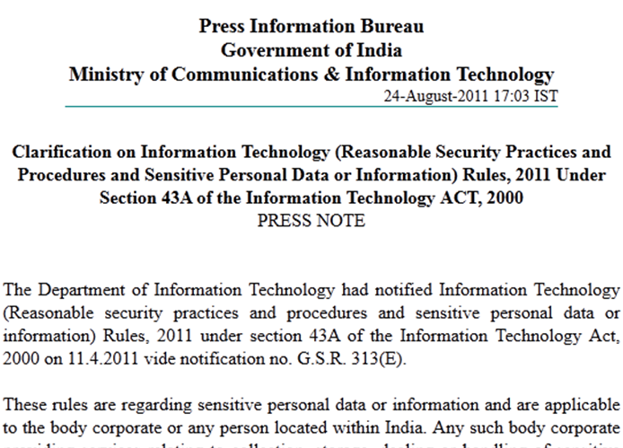
Data Privacy & Protection – The Law and Practical Issues
Source: http://pib.nic.in/newsite/erelease.aspx?relid=74990
Laws applicable to individuals, corporate, government
Laws applicable to personal information collection, reception, processing, storage, handling etc.

Slide 7

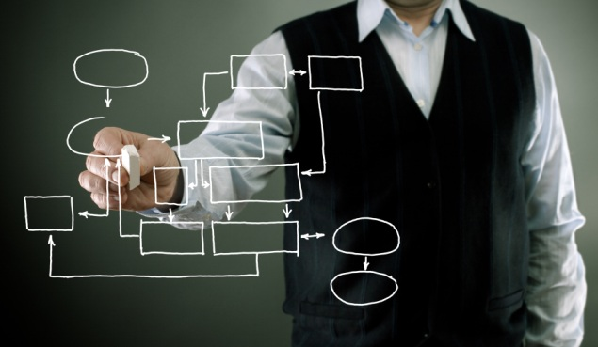
Integrating Technology, Process and People for Data Security
Employee Data Privacy
Government Demand for Data
Outsourcing
Incident Investigations and Forensics
Monitoring & Surveillance
Data Stored on Cloud
…

Slide 8
Data Privacy and Security – Why & How
Fundamental Rights
Policy Enforcement

Slide 9
Q & A

Slide 10
Thank You
Ketan.Vyas@tcs.com

