Slide 1

OWASP Top10 2013 Risks and Use cases for AST Technologies
Presenter: Ketan Vyas
The views and opinions expressed during this workshop are those of the speaker alone and do not necessarily reflect the positions or opinions of employer or employer affiliates.

Slide 2
Agenda
OWASP Top10 Risks
Security Defect Patterns and Root causes
Security Defect Detection Techniques
Use cases for AST Technologies

Slide 3
OWASP Top10 Risks

Slide 4
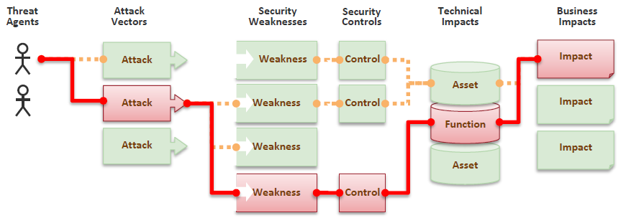
Business is all about managing Risk
OWASP Top10 Risks
Tell me and I forget.
Teach me and I remember.
Involve me and I learn.
- Chinese Proverb
Image Source: OWASP Top10 2013 document

Slide 5
A1 – Injection
OWASP Top10 Risks
Manipulate data sent to interpreters such as SQL, OS Shell, LDAP, XPath, Hibernate etc.
Interpreters take strings and interpret them as commands
SQL

Slide 6

A2 – Broken Authentication and Session Management
OWASP Top10 Risks
Authentication secret or session is compromised
Along with user sessions, it is also applicable to services, state and keys
Authentica tion

Slide 7

A3 – Cross-site Scripting (XSS)
OWASP Top10 Risks
User supplied data displayed in browser without proper validation or escaping
Attacker scripts are executed into victim’s browser
My bank account
X
www.
<script>alert(document.cookie)</script>

Slide 8
A4 – Insecure Direct Object References
OWASP Top10 Risks
Attacker gains unauthorised access to resources by predicting hidden value, secret or bypassing restrictions
Presentation layer controls are easy to bypass
Resource could be data, file or service
Personal Records
Enter your birthdate to access your data
MM / DD / YYYY
Submit

Slide 9

A5 – Security Misconfiguration
OWASP Top10 Risks
DevOps issue
Poor configuration with insecure values in production environment technology stack
Inadequate controls in configuration, change and release management activity
Host = localhost
Username = (default)
Password = (default)
Troubleshooting with
Backdoor account

Slide 10

A6 – Sensitive Data Exposure
OWASP Top10 Risks
Sensitive Data Vault
Failed to classify data
Unencrypted sensitive data stolen from storage, transit or client
Admin having access to encrypted data and keys
insecure key management, Weak algorithm selection or poor implementation using good algorithm
Unecrypted Data
Encrypted Data
Unencrypted
channel

Slide 11



A7 – Missing Function Level Access Control
OWASP Top10 Risks
Bob’s Data
Application fails to protect application functions
Horizontal and vertical privilege escalation
Lack of clarity about who has what level of access to which resources, when and how
Allowed
Allowed
$$f\left(x\right)$$
$$f\left(y\right)$$
Check ACL
Redirect to given URL
Allowed
Denied
Bob

Slide 12
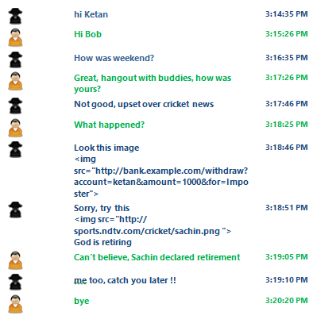
A8 – Cross-Site Request Forgery
OWASP Top10 Risks
Attacker tricks victim’s browser to send valid request using user’s access token without user’s consent
Exploiting state change, transactions, functionality access etc. due to absence of anti-automation control

Slide 13
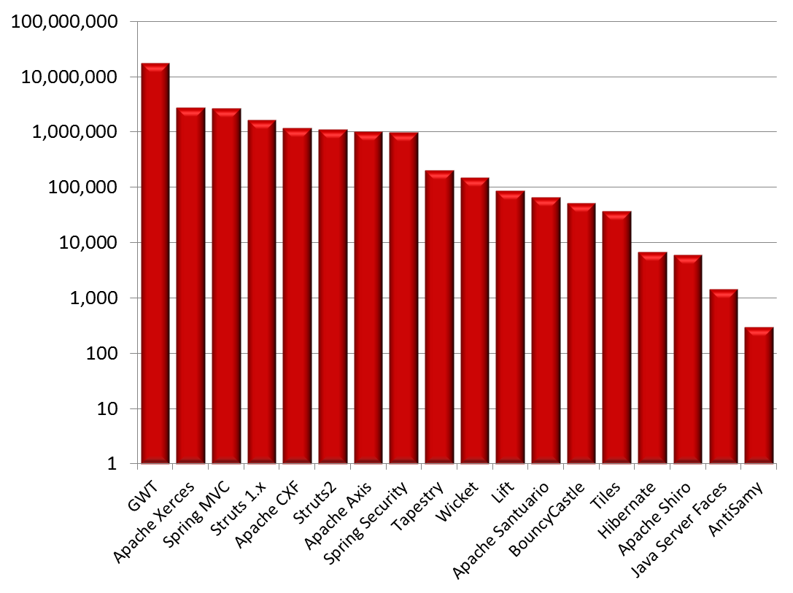
A9 – Using Known Vulnerable Components
OWASP Top10 Risks
Nobody wants to change running system
Vulnerable components in technology stack can be identified and exploited using automated tools
Out of date versions or unpatched software or dependent components evenif new versions are released
Libraries | 31
Library Versions | 1,261
Organizations | 61,807
Downloads | 113,939,358
Source: https://www.aspectsecurity.com/news/press/the-unfortunate-reality-of-insecure-libraries

Slide 14
A10 – Unvalidated Redirects and Forwards
OWASP Top10 Risks
Application redirect users to destination based on attacker supplied parameters
Attacker can also change internal forwards
Check for 3xx codes (especially 302 for browser based redirects)
bad.com
http://example.com/redirect.jsp?url=bad.com
Bad
Good

Slide 15
Security Defect Patterns and Root Causes

Slide 16
Tainted Data
Security Defect Patterns and Root Causes
User supplied data is interpreted as instruction
A1 – Injection
A3 – XSS
Mostly code level issue

Slide 17
Tainted Flow
Security Defect Patterns and Root Causes
Few flows are bypassed
A2 – Broken Authentication and Session Management
A7 – Missing Function Level Access Control
A10 – Unvalidated Redirects and Forwards
Mostly design level issue
A
B
C
D

Slide 18
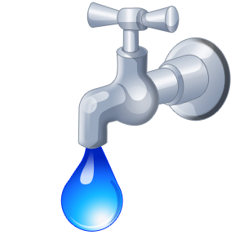
Hidden Secrets
Security Defect Patterns and Root Causes
Secrets are stored as part of program files and accessible to users having knowledge about their locations or access methods
A4 – Direct Object Reference
A6 – Sensitive Data Exposure
A7 – Missing Function Level Access Control
Design flaws & code level issues

Slide 19
Ignorance
Security Defect Patterns and Root Causes
Security is not part of priority list
A5 – Security Misconfiguration
A9 – Using Known Vulnerable Components
Configuration issues

Slide 20
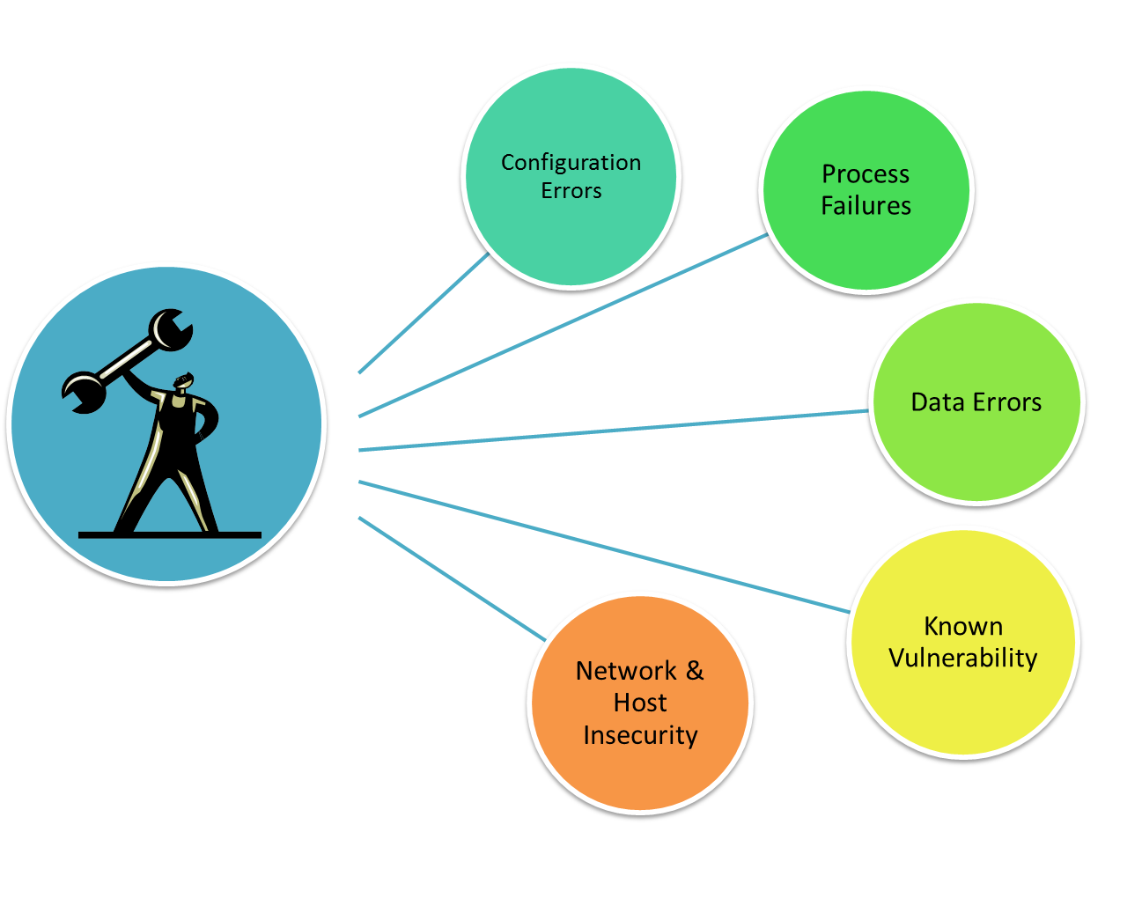
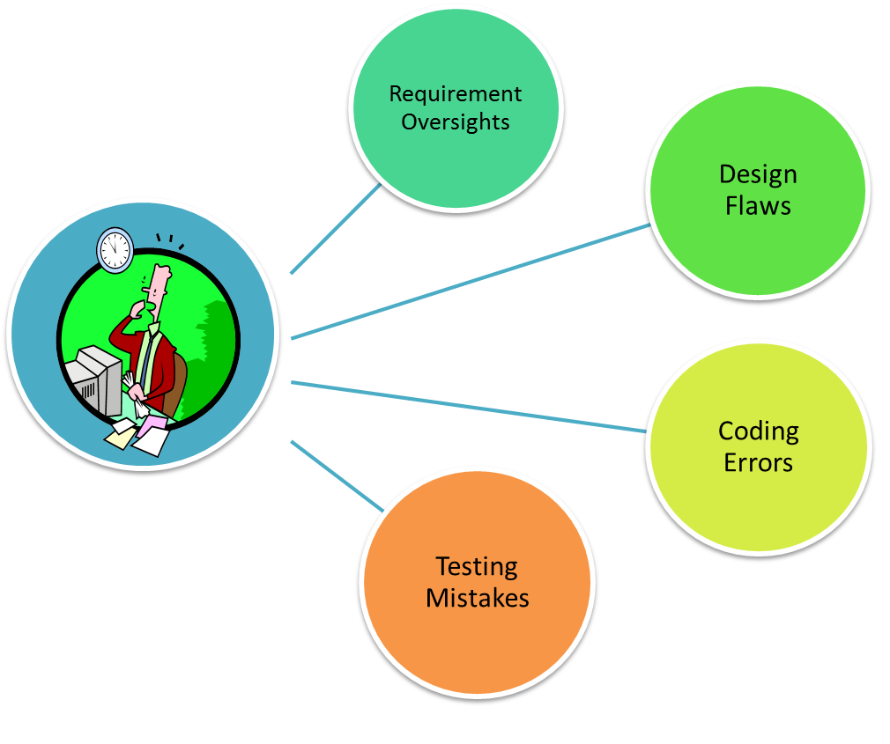
Security Defects Examples
Security Defect Patterns and Root Causes
Development
Maintenance

Slide 21
Security Defect Detection Techniques

Slide 22
Security Assurance during SDLC
Security Defect Detection Techniques
Security Requirements Review
Security Review for Architecture
Code Review
Security Testing
Configuration Review
Reviewing Operations
Matters only if you have
in-house mature practices

Slide 23
Techniques
Security Defect Detection Techniques
Information Gathering
Tampering – changing url, parameter, property, permission, injection, fuzzing etc.
Bruteforce – Predicting, permutation & combination
Pattern Analysis – Request, response
Protocol Analysis
Matters only if you have
in-house security experts

Slide 24
AST Technology Convergence
Security Defect Detection Techniques
Automated assessment
Manual assessment
Prevention techniques
Claim v/s reality

Slide 25
Use cases for AST Technologies

Slide 26
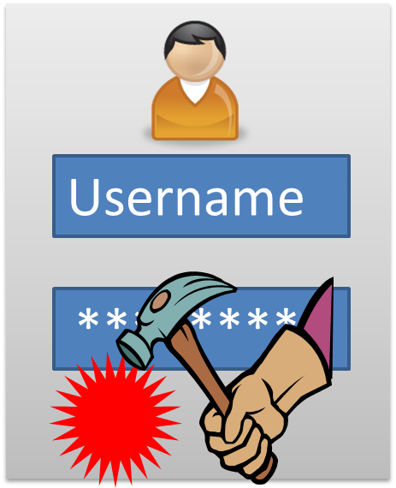
Dynamic Application Security Testing
Use cases for AST Technologies
Blackbox testing
Analysing running application and changing it’s state in unexpected ways through trial and error, behavior analysis etc.
Outside in approach to detect and exploit security defect
Independent of language / platform
Good for QA/Production phases
Mature and widely accepted
Password
Dynamic Application Security Testing (DAST)

Slide 27
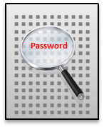
Static Application Security Testing
Use cases for AST Technologies
Whitebox testing
Analysing source code, bytecode or native binary
Inside out approach to find conditions indicative of a security defect
Does not require application execution
Language / platform dependent
Analysing third party library
Good for Dev/QA phases
Static Application Security Testing (SAST)

Slide 28
AST Technologies Evolution
Use cases for AST Technologies
Accuracy and
Coverage
IAST
DAST
SAST
DAST
SAST
Convergence
Silo
Collaborative
DAST
SAST
Timeline
2000 - 2005
2006 - 2010
2011 - 2015

Slide 29

Interactive Application Security Testing
Use cases for AST Technologies
Blackbox + Whitebox testing
Combining source code and application runtime behavior analysis
Inside out + Outside in approach to accurately identify security defect
Uses instrumentation agent on server
Language / platform dependent
Good for Dev/QA phases and not suitable for production phase
Password
Interactive Application Security Testing
(IAST)

Slide 30

Application Protection
Use cases for AST Technologies
Web Application Firewall (WAF)
Runtime Application Self-Protection (RASP)
In-built Intrusion Detection & Prevention
Application Protection

Slide 31
Application Security Testing Market
Use cases for AST Technologies
Products
Hosted Services
Professional Consulting Services
Open Source Software & Freeware

Slide 32

Usage Decision
Use cases for AST Technologies
Requirements
Application criticality
Team skillset
Technology
Delivery duration
Compliance
Offerings
Track record
License & pricing
Product or SAS
Support
Integration API

Slide 33

Decision Challenges
Use cases for AST Technologies
Which option is good for me Open Source / Freeware OR Commercial OR Outsourcing?
At what cost is it worth?
Is it sufficient or false sense of security?
What are dependencies and what type of skillset required?
Where will it fit into my DevOpsSec cycle?
Can I be 100% secure?

Slide 34
Section Summary
Some type of Security testing is better than nothing
OWASP Top10 help translate technology risks into business risks
Security is a program state problem and cannot be solved automatically (without manual intervention)
SAST+DAST produces far better results than SAST or DAST alone and IAST is way forward for Assurance
Vulnerability detection techniques vary depending on technology stack, complexity of the application functionality, size of the application, expertise with assessment team, tools availability and more…
Context aware testing gives better results

Slide 35
Thank you

