Slide 1

FiddlerScript
Presenter: Ketan Vyas
The views and opinions expressed during this workshop are those of the speaker alone and do not necessarily reflect the positions or opinions of employer or employer affiliates.

Slide 2
Agenda
FiddlerScript Basics
FiddlerScript for Security Testing
Creating Security Tools with FiddlerScript
Usage Limitations

Slide 3
FiddlerScript Basics

Slide 4
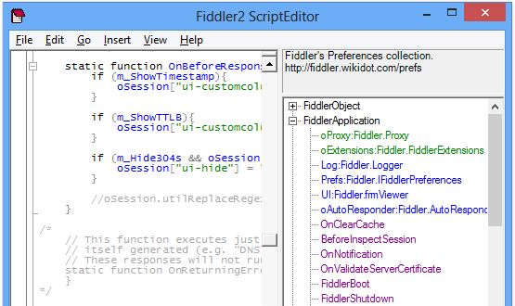
About FiddlerScript
FiddlerScript Basics
FiddlerScript
Based on JScript.NET
C# style class declaration
Class can have fields, properties, methods
(Optional) variable types
Allow custom rules in Custom.js
Can use APIs from user created .NET Dlls
Web Session Functions
General Functions
FiddlerScript Editor Download: http://fiddler2.com/fiddlerscript-editor

Slide 5
General Functions
FiddlerScript Basics
Main – Runs immediately after script is successfully compiled
OnRetire – Runs immediately before script is unloaded, either because fiddler is closing or new script is loaded
OnBoot – Runs only when Fiddler first boots
OnShutdown – Runs when Fiddler is shutting down
OnAttach – Runs after Fiddler registers as system proxy
OnDetach – Runs after Fiddler is unregistered as system proxy and default proxy is restored
OnExecAction – Runs when user enters command in the QuickExec box or send command through ExecAction.exe
Loading…

Slide 6
Fiddler Object Functions
FiddlerScript Basics
ReloadScript() – Reload script from disk, recompile and reset all variables to default value
StatusText – Set text on Fiddler’s status bar
log(sMessage) – Log sMessage to Fiddler’s event log
playSound(sWavFileName) – Load and play sWavFileName
flashWindow – Flash fiddler window in taskbar
Alert(sMessage) – Displays message with title “FiddlerScript”
Prompt(sMessage) – Prompt user for input
createDictionary() – Allow creation of dictionary for Import and Export functions
WatchPreference(sPrefBranch, oFunc) – Notifies when any change occurs within specified branch of preferences

Slide 7
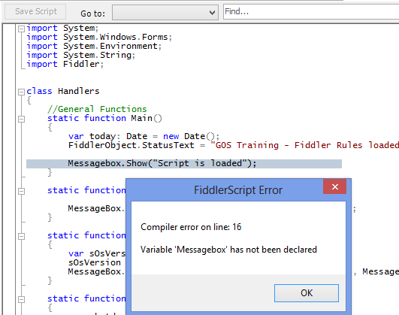
Error Handling
FiddlerScript Basics
Replace “Messagebox” with correct function “MessageBox”

Slide 8
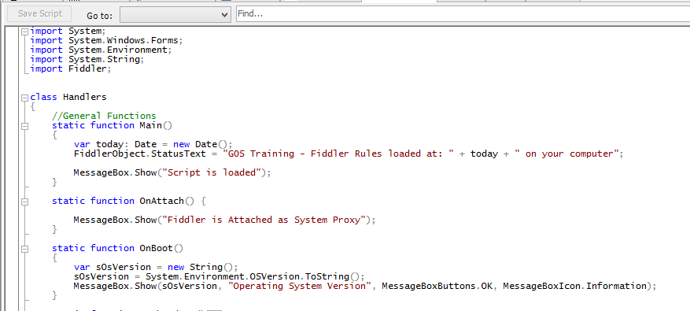
Calling .Net classes
FiddlerScript Basics

Slide 9
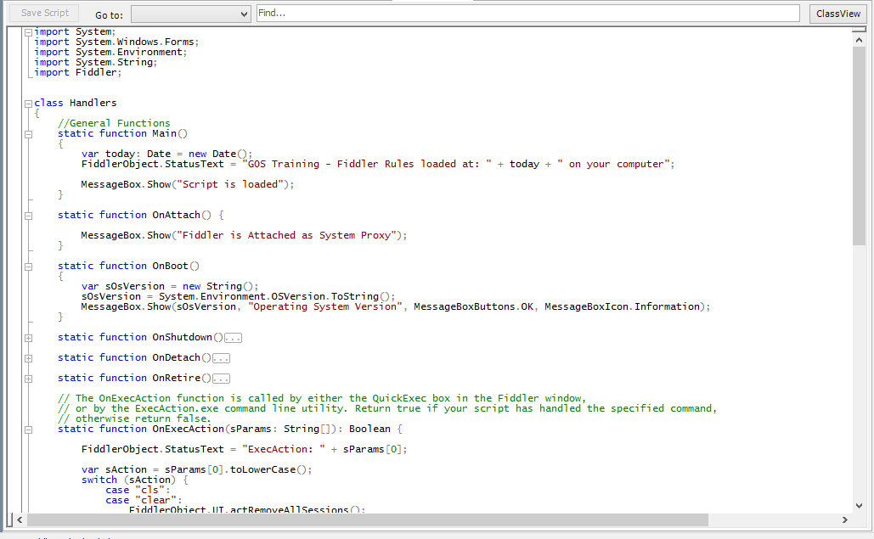
Exercise: General Functions
FiddlerScript Basics
http://fiddler2.com/documentation/KnowledgeBase/FiddlerScript/CustomizeSessionsList

Slide 10
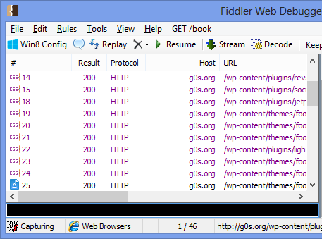
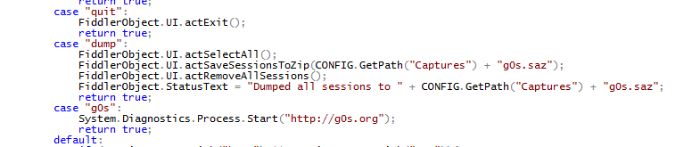
OnExecAction
FiddlerScript Basics
Launch script commands quickly
Search keyword
Shortlist sessions based on condition
Set breakpoints
http://fiddler2.com/documentation/KnowledgeBase/QuickExec

Slide 11

Web Session Handling Functions
FiddlerScript Basics
Send
OnPeekAtRequestHeaders – executed as soon as request headers read from client
OnBeforeRequest – executed after client’s complete request is read and before the request sent to server
OnPeekAtResponseHeaders – executed as soon as response headers read from server
OnBeforeResponse – executed after server’s complete response is read and before response it sent to client
OnReturningError – executes when Fiddler generated error message (i.e. DNS lookup failed) is returned to client. Show more customized message
Receive

Slide 12
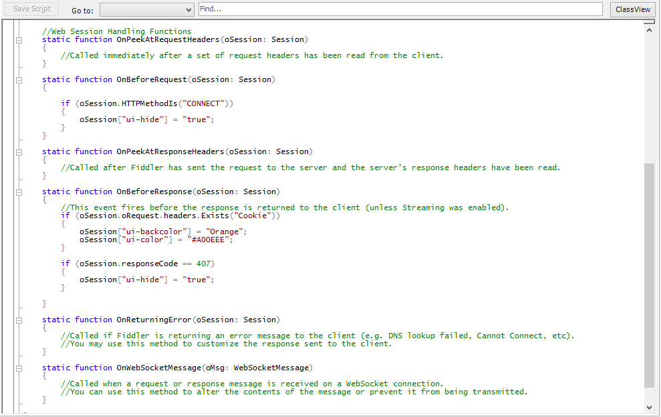
Exercise: Session Handling Functions
FiddlerScript Basics
Visit http://www.google.com

Slide 13
FiddlerScript for Security Testing

Slide 14
Security Testing Activities
FiddlerScript for Security Testing
Host based detection
Header analysis
Content analysis
Cookie analysis
Tampering requests having specific parameters
Creating new requests

Slide 15
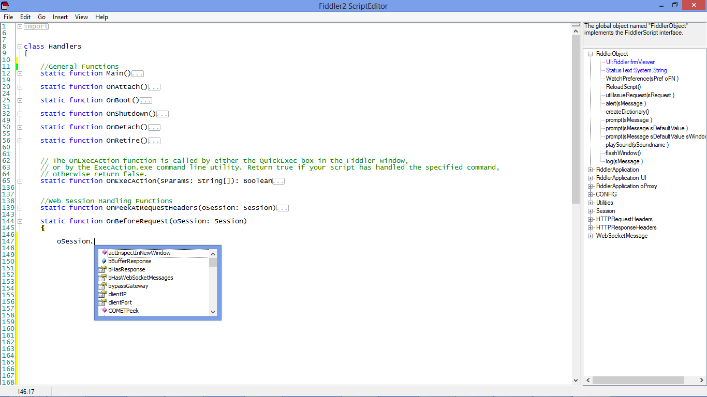
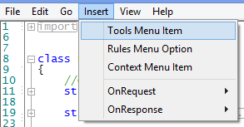
FiddlerScript Editor
FiddlerScript for Security Testing

Slide 16
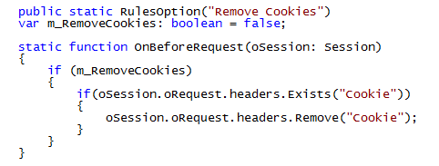
Exercise: Remove Cookies from Request
FiddlerScript for Security Testing
Visit http://www.google.com before and after enabling this rule

Slide 17
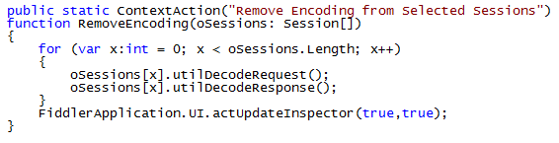
Exercise: Remove Encoding
FiddlerScript for Security Testing
Update Request Inspector
Update Response Inspector

Slide 18
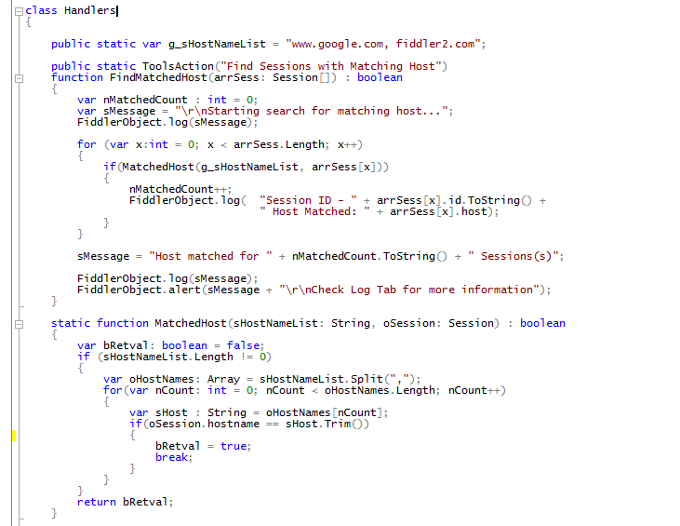
Exercise: Find Matching Sessions
FiddlerScript for Security Testing
Add Req Header to Result
FiddlerObject.log( "Req Headers" + arrSess[x].oRequest.headers.ToString());
Add Check for specific file type
if(oSession.url.EndsWith(".png"))

Slide 19
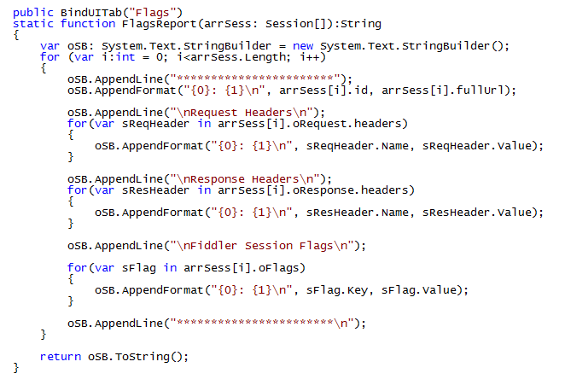
Exercise: List Headers & Fiddler Session Flags
FiddlerScript for Security Testing
http://fiddler2.com/documentation/KnowledgeBase/SessionFlags

Slide 20
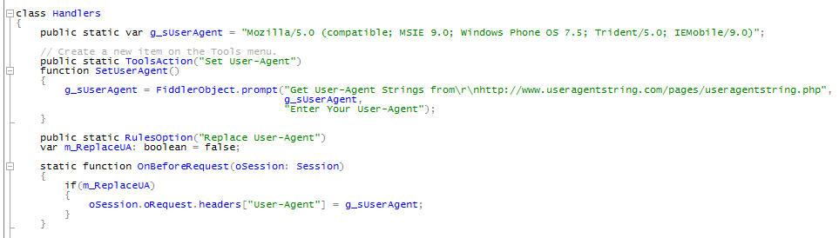
Exercise: Modifying User-Agent
FiddlerScript for Security Testing
Visit “www.microsoft.com” with and without replacing “User-Agent”

Slide 21
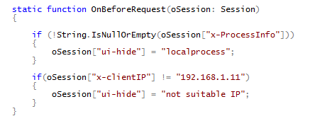
Detecting Traffic from Specific Client
FiddlerScript for Security Testing

Slide 22
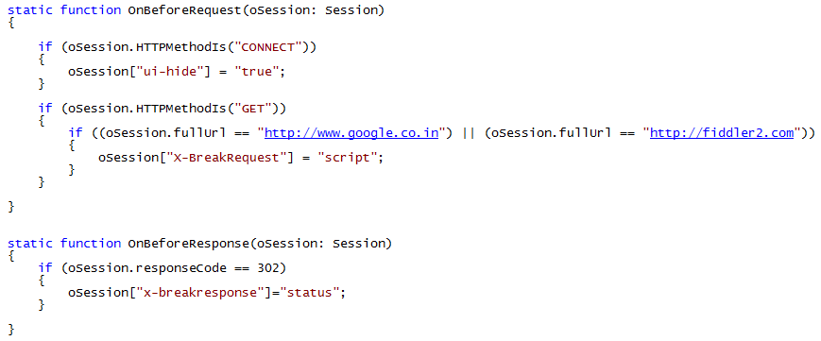
Exercise: Breakpoints on Specific Condition
FiddlerScript for Security Testing
http://fiddler2.com/blog/blog/2013/08/20/breakpoints-in-fiddler

Slide 23
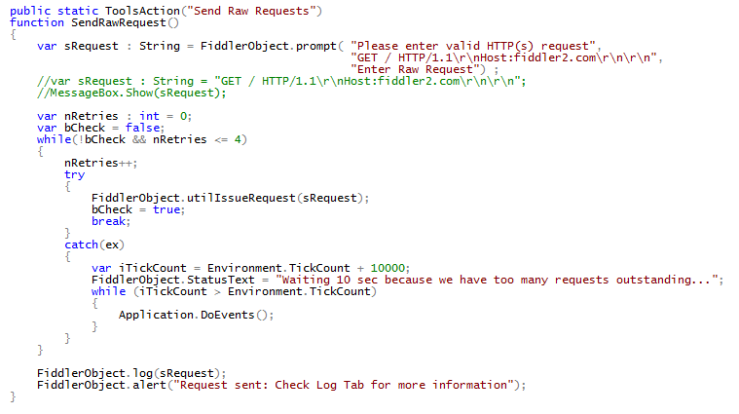
Demo: Create New Requests
FiddlerScript for Security Testing

Slide 24
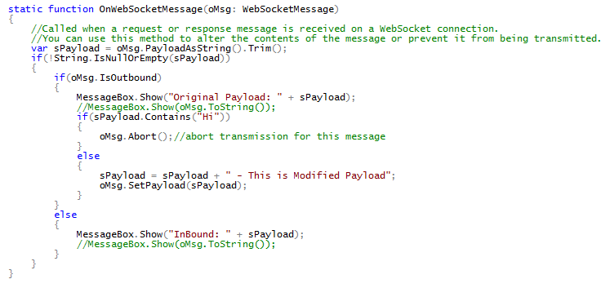
Exercise: Changing WebSocket Payload
FiddlerScript for Security Testing
Visit – http://www.websocket.org/echo.html, connect over Secure channel

Slide 25
Creating Security Tools with FiddlerScript

Slide 26
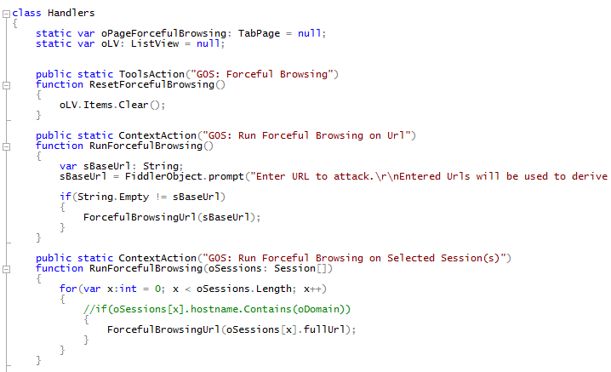
Demo: Forceful Browsing
Creating Security Tools with FiddlerScript
Directory browsing
Hidden file access
Identification of restricted access (later you can brute force)
Information disclosure

Slide 27
Compliance Checker
Creating Security Tools with FiddlerScript
Cookie Checks
Cache Checks
Http Header Checks
Cross-Domain Checks
Do It Yourself

Slide 28
Usage Limitations

Slide 29
Usage Limitations
Good for simple and light use
Lack of support for debugging
Source code distribution
Slow performance
Increases chance of failure when ported to another machine

Slide 30
Section Summary
FiddlerScript can programmatically invoke Fiddler functionalities
FiddlerScript can call .Net classes to extend functionality
FiddlerScript help perform security testing activities and repeat them

Slide 31
Thank you

