Slide 1

Developing Automated Security Tools with FiddlerCore
Presenter: Ketan Vyas
The views and opinions expressed during this workshop are those of the speaker alone and do not necessarily reflect the positions or opinions of employer or employer affiliates.
Notes:
My association with

Slide 2
Agenda
FiddlerCore Basics
Creating Tools
Selenium Integration

Slide 3
FiddlerCore Basics

Slide 4
Fiddler v/s FiddlerCore
FiddlerCore Basics
Fiddler.exe
Your App.exe
Inspector
IFiddlerExtension
FiddlerScript Engine
FiddlerCore
FiddlerCore
Xceed*.dll
Makecert.exe
DotNetZip
Makecert.exe
CertMaker.dll

Slide 5
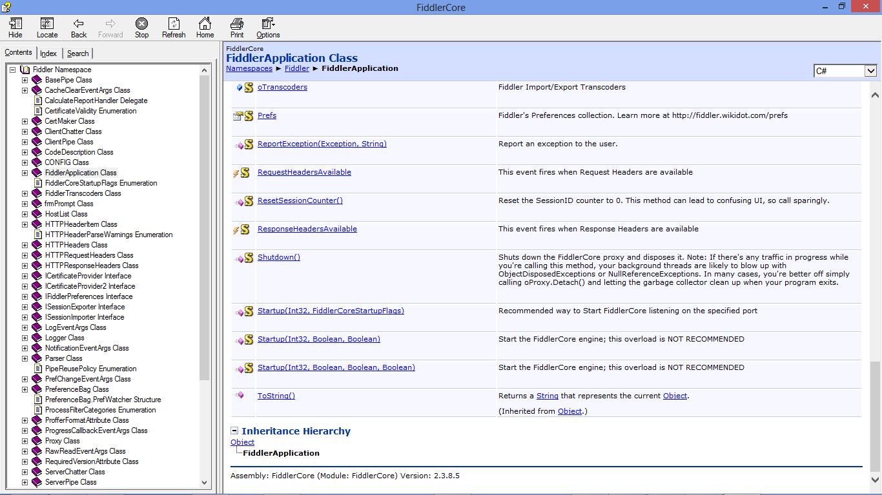
FiddlerCore API Documentation
FiddlerCore Basics

Slide 6
FiddlerCore 101
FiddlerCore Basics
Methods
Startup – Start listener and capture traffic
Shutdown – Detach listener (if attached) and dispose
Events
BeforeRequest – Fires after request is completed read from client
BeforeResponse – Fires after response is completely read from server
AfterSessionComplete – Fires when processing of session is complete
BeforeReturningError – Fires when error is generated
OnNotification – Fires error or configuration problem notifications are raised

Slide 7
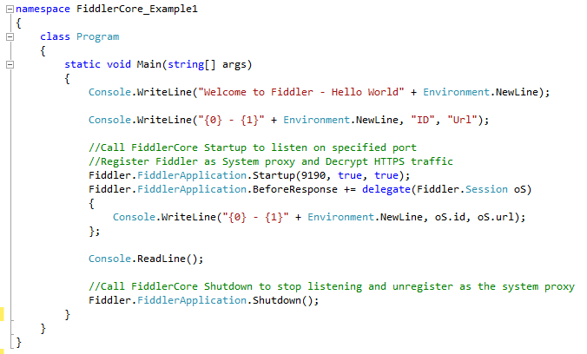
Exercise: FiddlerCore – Hello World
FiddlerCore Basics

Slide 8
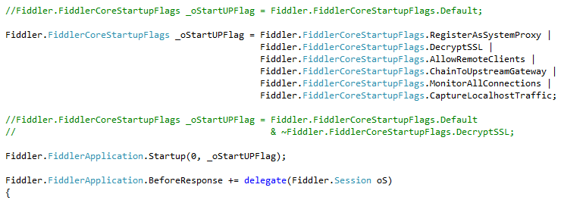
Exercise: Fiddler Startup Flags
FiddlerCore Basics

Slide 9
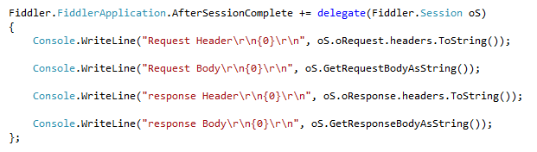
Get Request & Response Information
FiddlerCore Basics

Slide 10
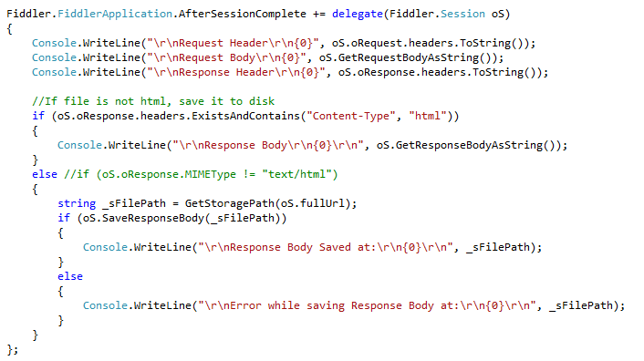
Save Response to File System
FiddlerCore Basics

Slide 11
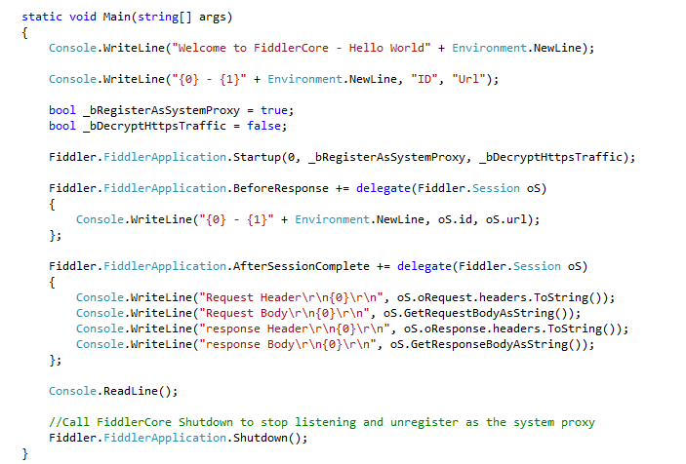
Handling HTTPS
FiddlerCore Basics
Make it true
Copy Makecert.exe where this program Exe and FiddlerCore.dll are placed

Slide 12
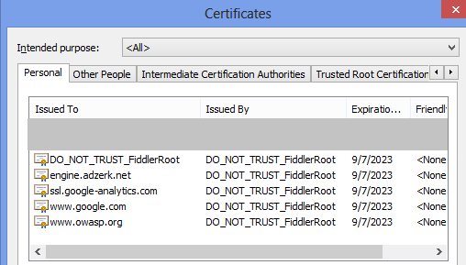
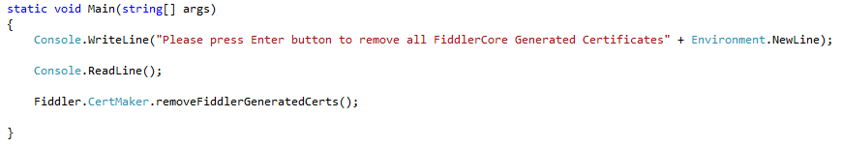
Remove Fiddler Certificates
FiddlerCore Basics

Slide 13
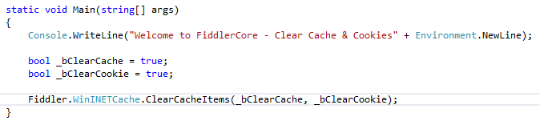
Clearing WinINET Cache and Cookies
FiddlerCore Basics

Slide 14
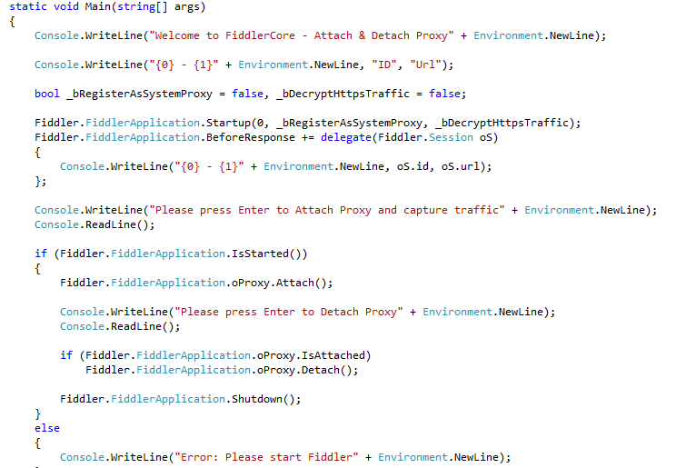
Attach & Detach Proxy
FiddlerCore Basics

Slide 15
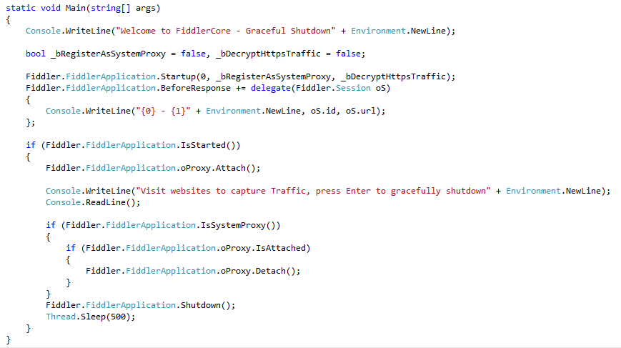
Graceful Shutdown
FiddlerCore Basics

Slide 16
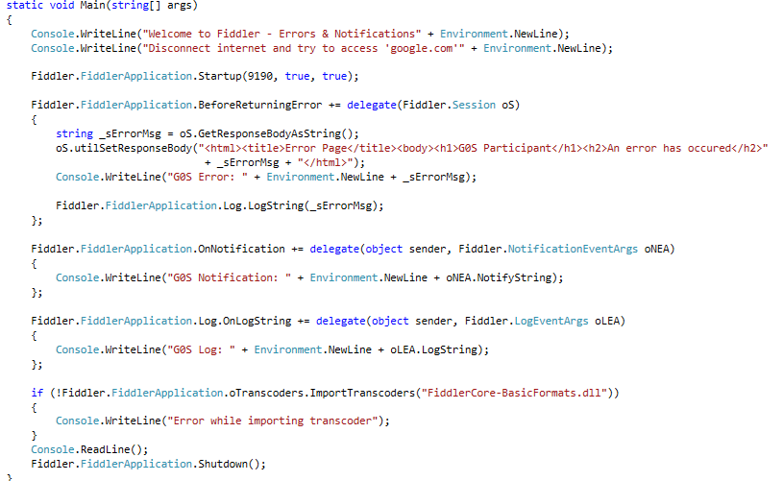
Notifications & Error Logging
FiddlerCore Basics

Slide 17
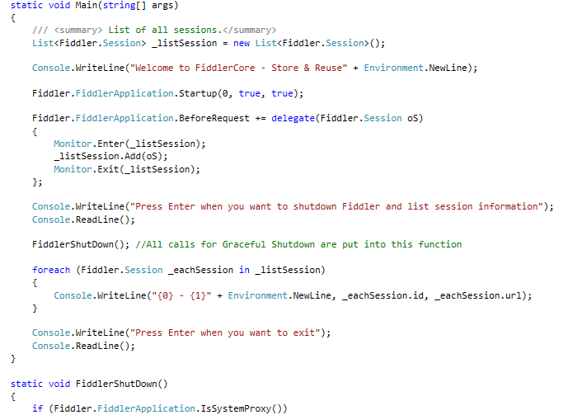
Storing & Reusing Fiddler Session
FiddlerCore Basics

Slide 18
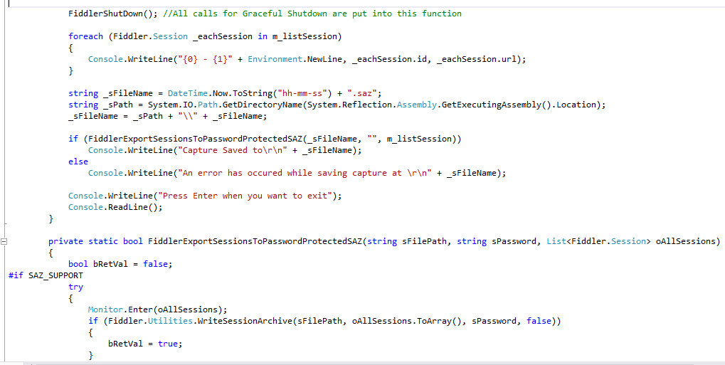
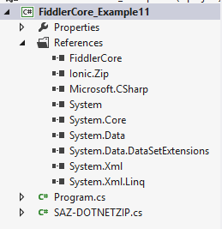
Transcoding – Import & Export
FiddlerCore Basics

Slide 19
Creating Tools

Slide 20
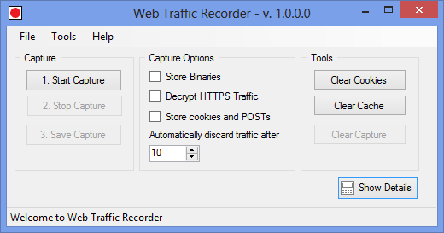
Web Traffic Recorder (WTR)
Creating Tools
WTR is a demo application to demonstrate FiddlerCore functionality.

Slide 21
Selenium Integration

Slide 22
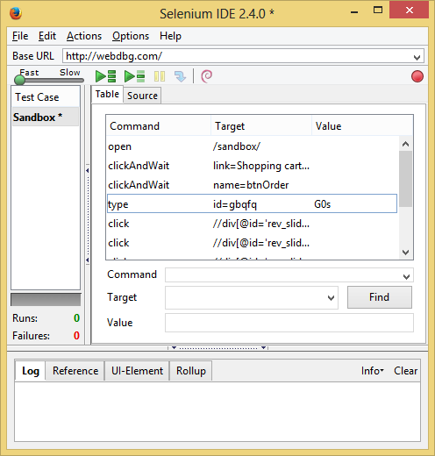
Selenium IDE
Replay Toolbar
Start / Stop Recording
Assessor Area
Log

Slide 23
Autofiddle - Architecture
Capture Activity as Selenium Testcase
Export Selenium Testcase as C# code
Generate C# DLL at runtime through CodeDOM
Report
Capture Traffic with Fiddler
Execute DLL using Nunit
Offline Checks
Online Checks

Slide 24
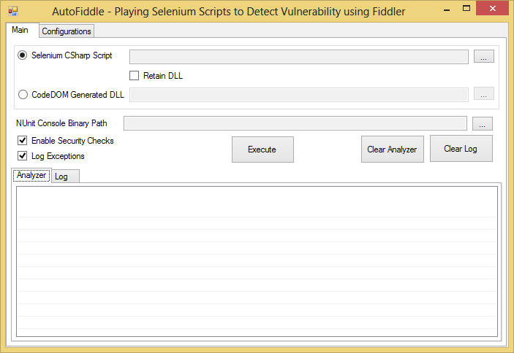
Autofiddle

Slide 25
Section Summary
You can build security tools with FiddlerCore

Slide 26
Thank you

