Slide 1

Fiddler Data Analytics
Presenter: Ketan Vyas
The views and opinions expressed during this workshop are those of the speaker alone and do not necessarily reflect the positions or opinions of employer or employer affiliates.
Notes:
My association with

Slide 2
Agenda
Data Analytics
Analysing Fiddler Data with Tools
Building your own Analyser

Slide 3
Data Analytics

Slide 4
Data Analytics
Process of inspecting, cleaning, transforming, and modeling data with an objective of deriving useful information, suggestive conclusions, and drive decision making
Understand historical patterns for performance improvement and predicting future strategy
Data generally collected from online, mobile, social, etc. channels

Slide 5
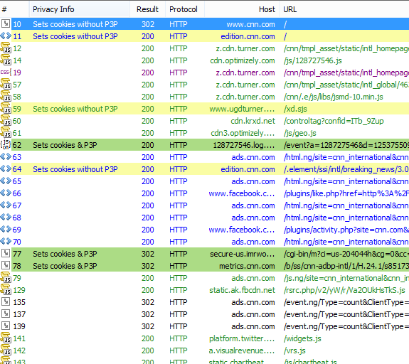
Fiddler Data Analytics
Performance Improvements
Attack surface analysis
Broken links
Entry point identification

Slide 6
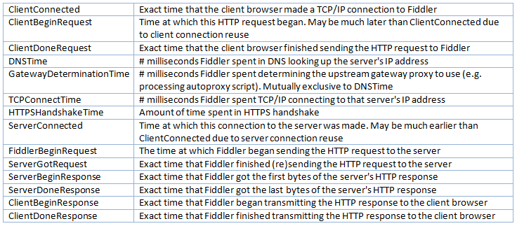
Timers

Slide 7
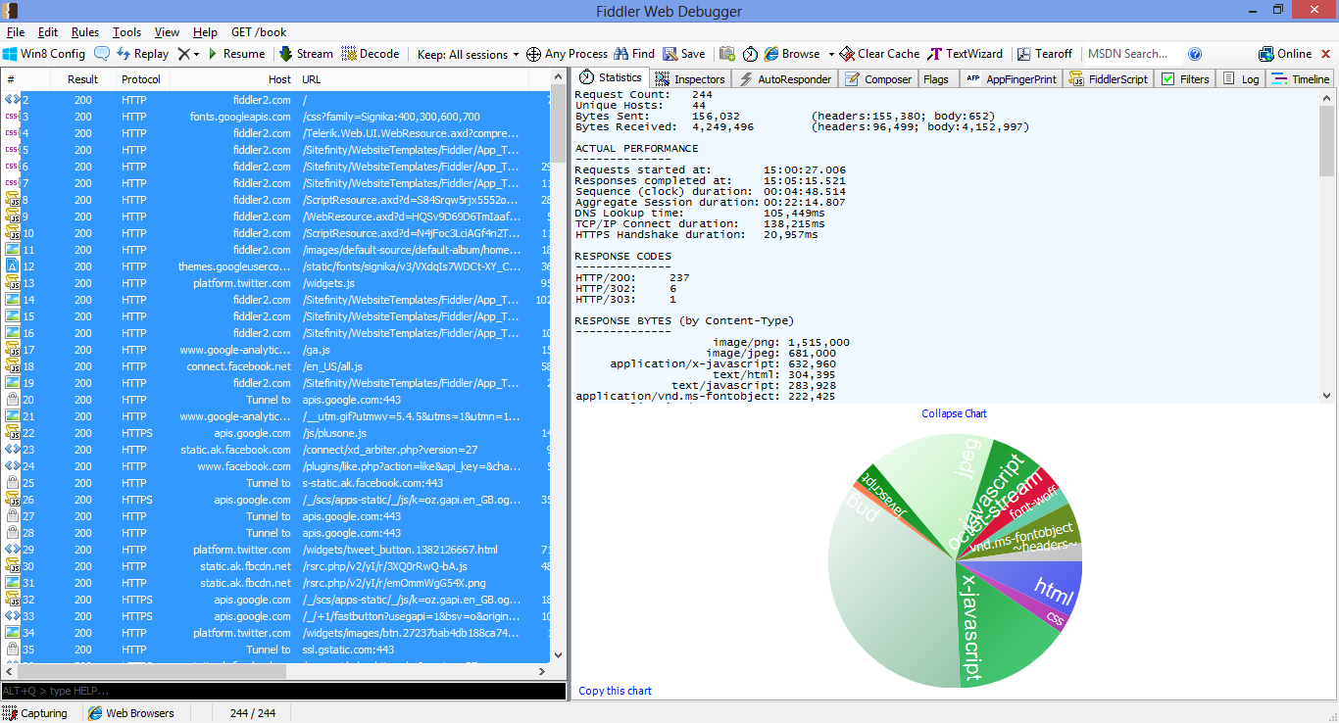
Fiddler Statistics Tab

Slide 8
Analysing Fiddler Data with Tools

Slide 9
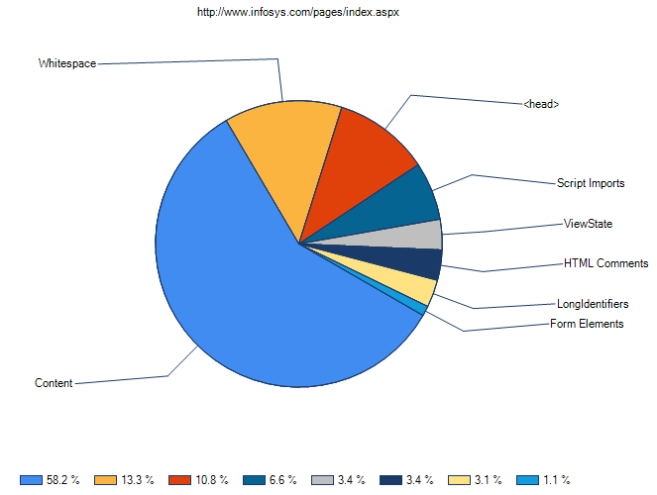
Html Inspector
Source: http://fiddlerhtmlinspector.codeplex.com/

Slide 10
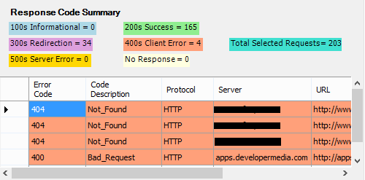
Response Code Analysis
Source: http://www.codeproject.com/Articles/94380/Fiddler-Extension-HTTP-Response-Code-Analyzer

Slide 11
Building Your Own Analyser

Slide 12
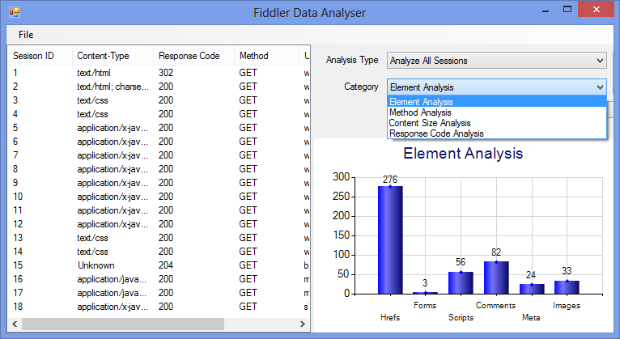
Demo: Primitive Data Analyzer
Analysis Category
Elements
Method
Content Size
Response Code
Other possibilities
Extension
Cookie
Headers
Inputs
Performance
Libraries:
FiddlerCore
DotNetZip
HtmlAgilityPack

Slide 13

Large Data Analytics
Take Fiddler sessions data into information files/tables (i.e. Apache Hadoop)
Identify interest patterns
Run query for deriving conclusions
Source: Chromogram, http://hint.fm/projects/chromogram/

Slide 14
Section Summary
Data Analytics
Technology stack detection
Urls having more exposure & entry points
Sensitive file Paths
Prioritization and limiting scope of security testing

Slide 15
Thank you

