Slide 1

Application Security Assessment with Fiddler
Presenter: Ketan Vyas
The views and opinions expressed during this workshop are those of the speaker alone and do not necessarily reflect the positions or opinions of employer or employer affiliates.

Slide 2
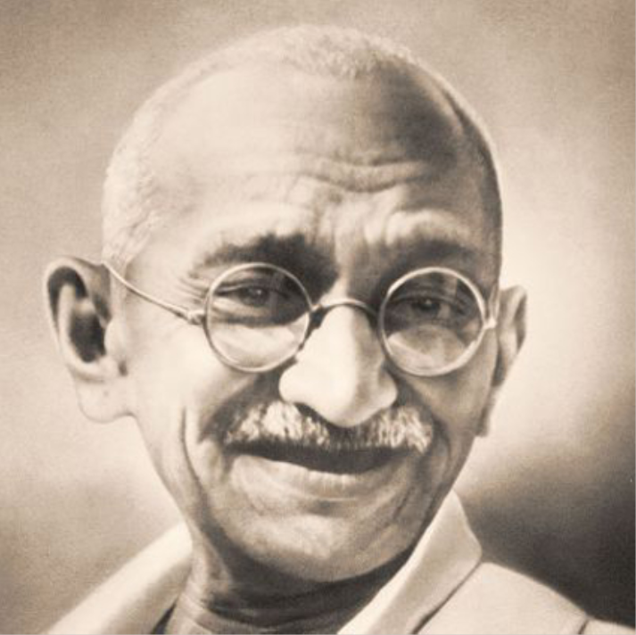
Managing Customer Expectations
A customer is the most important visitor on our premises. He is not dependent on us. We are dependent on him. He is not an interruption in our work. He is the purpose of it. He is not an outsider in our business. He is part of it. We are not doing him a favor by serving him. He is doing us a favor by giving us an opportunity to do so.
- Mahatma Gandhi

Slide 3




Business Trends & Security
Seven Times Less Expensive To Keep A Customer Than To Acquire One
90% of unhappy customers will not do business with company again
Consumers connect with brands in new ways, through channels that are beyond provider’s control
Average global cost of a data breach is $136 a record in 2012
Security is a trust building factor in business,
are your applications and services secure?

Slide 4

Technology Trends & Security
Processing speed
Connectivity
Storage
Peripherals
Interfaces
Technologies enabling Cloud model
Internet of things (IoT)
Data and Functionality access - anytime, anywhere with any device,
Is it secure?

Slide 5
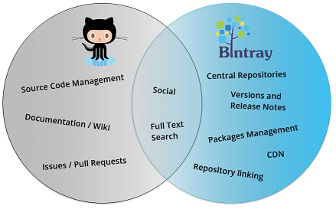




Development Trends & Security
API driven development
Client (mobile) - Server (cloud) model is back
Distributed development
Intuitive User Interfaces
“Do It Yourself” libraries
Niche Social Networks
Open source
Agile
It is App World, are development, testing and production environments and applications secure?

Slide 6
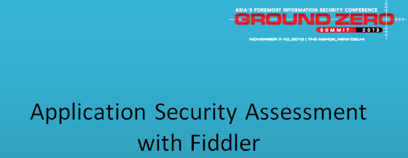

Slide 7
Schedule
Application Security Risk
Introduction
OWASPTop10 Risks & AST Technologies
Understanding Fiddler features for security testing
Fiddler Overview
FiddlerScript
Extending Fiddler to create new security tools
Fiddler Extensions
FiddlerCore
Fiddler Data Analytics

Slide 8
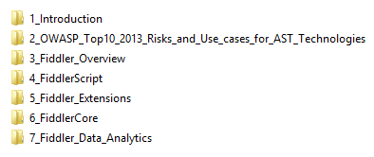

Training Material

Slide 9
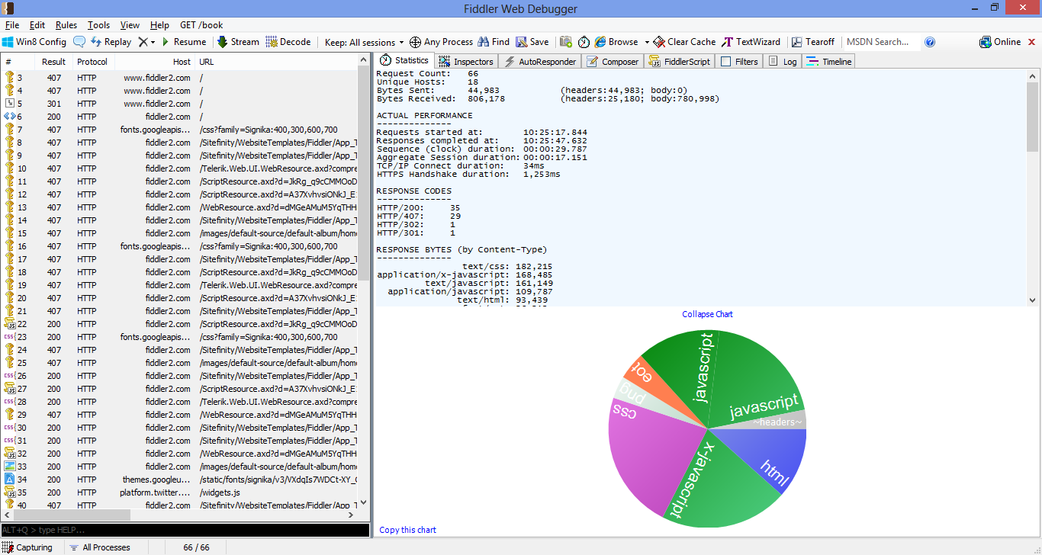
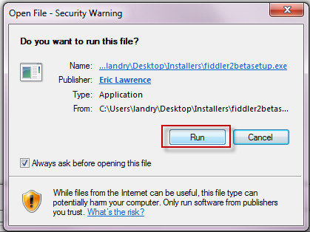
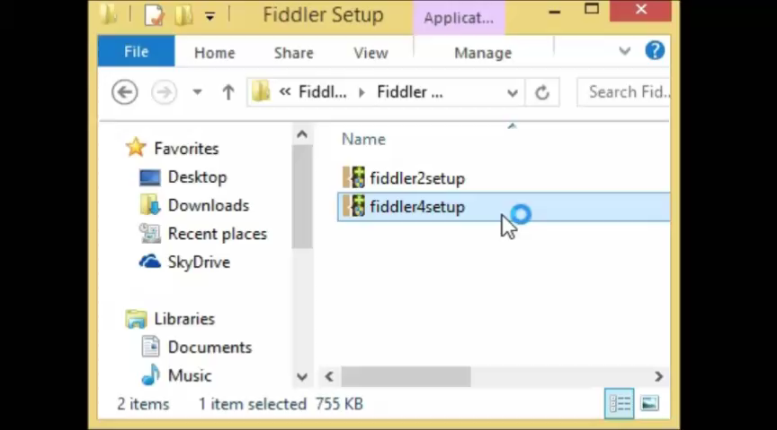
Demo: Download & Install Fiddler
About Fiddler
Fiddler is free to use
Visit http://fiddler2.com

Slide 10
Workshop Etiquettes
Mobile phone on silent mode, if you want to talk over phone, please use lobby

Slide 11
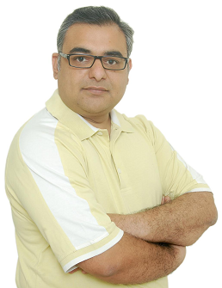
About Me
Ketan Vyas heads Application Security Initiative for Tata Consultancy Services (TCS). He is the Chief Architect of Software Security Assurance (SSA) framework and responsible for developing process, techniques, methodology and tools for embedding security throughout delivery life cycle. He also oversees security implementation in large engagements.
Ketan has 17 years of experience in security, software development and product evaluation. Prior to joining TCS, Ketan has worked for organizations like Net-square solutions, Contech Software Limited, Indian Space Research Organization (ISRO) and Maharshi Electronics Systems.

Slide 12
Disclaimer
The views and opinions expressed during this workshop are those of the trainer alone and do not necessarily reflect the positions or opinions of employer or employer affiliates. This workshop is based on trainer’s current knowledge on subject and personal experience. Please verify it independently before making decision based on it. In addition, any views or opinions expressed by audience during session are theirs and do not necessarily reflect trainer’s.
During workshop, we will be using fictitious company names with ‘Example’ prefix for illustration purpose. All organization names appearing in this workshop are fictitious. Any resemblance to real organization is purely coincidental.

Slide 13
Thank you

